Slide 1
Do Now:
Presented by Amy Freaking Diaz
Why was the Louisiana Purchase an ‘internal struggle’ for a Democratic Republican like Thomas Jefferson?
Who was John Marshall and why is he significant?

Slide 2
Jefferson, Marshall, and the struggle of Federalism
MR. winchell
APUsh
Period 4

Slide 3
Election of 1800
Thomas Jefferson & Aaron Burr both tie with 73 votes. It goes to the House and Hamilton controls the outcome and chooses Jefferson! Why?
He hates Burr more than Jefferson!
Thomas Jefferson became our 3rd president
The Democratic-Republicans took control of Congress
The Twelfth Amendment was added to the Constitution
Pres and VP run as a ticket
"We are all Republicans, we are all Federalists." (Appealing to both Parties)
Notes:
The pre-election atmosphere in 1800 was colored by the Alien and Sedition Acts controversy, which had created much ill feeling between the contending parties. The Jeffersonian Republicans triumphed. Since 1796, they had control of New York State thanks largely to Aaron Burr's political skills; he had wrested control of the legislature from Alexander Hamilton.
The bad news, however, was that the two Democratic-Republican candidates, Jefferson and Burr, garnered the same number of electoral votes; according to the Constitution, the matter was to be resolved in the House of Representatives. (See Article II, Section 1, Clause 3.)
The Election of 1800 Candidate
Party
Electoral Vote
Popular Vote
Thomas Jefferson (VA)
Democratic-Republican
73
*
Aaron Burr (NY)<
Democratic-Republican
73
John Adams (MA)
Federalist
65
C.C. Pinckney (SC)
Federalist
64
John Jay (NY)
Federalist
1
*Popular vote totals were not recorded until the Election of 1824.
Thirty-six ballots were cast over five days to reach a decision. Once again Hamilton played a pivotal role, throwing his support to Jefferson, whom he disliked, rather than Burr, whom he truly hated.
This election is sometimes referred to as the "Revolution of 1800" because it marked the transition from the Federalists, the only party to have held the presidency to that point, to the Democratic-Republicans of Jefferson. It appeared that major changes were in the offing.
The dilemma posed by two candidates receiving an equal number of electoral votes was later addressed in Amendment XII.

Slide 4
Election of 1800
Referred to as constituting “another revolution”
the party in power (Federalist) stepped down after losing the election
Changes made by Jefferson
Size of the military reduced (Why?)
Number of Federal employees increased
Amount of national debt reduced
Alien and Sedition Acts repealed (Why?)
Lowered Government Expenses, Cut Taxes
Increased the power of Agricultural in the South.
Free Trade w/o Government Control
Reduced the size of the National Bank (Why?)

Slide 5
Judiciary Act 1801
Increases the Number of Federal Judges to 16.

Slide 6
The Midnight Judges
John Adams filled all open positions with Federalist Judges!
Adams appoints one right before Jefferson takes office. (Why?) Hence the midnight judge.
This causes some problems for the Supreme Court… Stay tuned!

Slide 7
Marbury Vs. Madison (1803)
William Marbury – A Supreme court judge appointed by Adams on his last night of Office.
Jefferson ordered the Secretary of state (James Madison) not to deliver the official papers to Marbury the next day.
Marbury Sued Madison over this matter.
What does the Supreme court do? Does Marbury win?

Slide 8
Marbury Vs. Madison Continued
Supreme court rules against Marbury!
Why?
Jefferson was going to ignore the appointment & therefore ignore the supreme court.
So…The Supreme Court protects their power keeping judicial review.
Judicial Review- Gives the SC the power to decide which laws are Constitutional.

Slide 9
Hamilton Vs. Burr
Duel (1804) When two gentleman cannot settle an argument and ones honor is in question they use Pistols to settled it.
Hamilton Supported Burr’s Opponent in the New York Governors race.
Burr Challenges Hamilton and Kills him.
Hamilton Never fires a shot.
Notes:
Burr is still upset that Hamilton outwardly support Jefferson for President.
Hamilton never fires a shot because it was a tactic that is his opponent missed he would be able to take aim and get a good shot off. It didn’t work

Slide 10
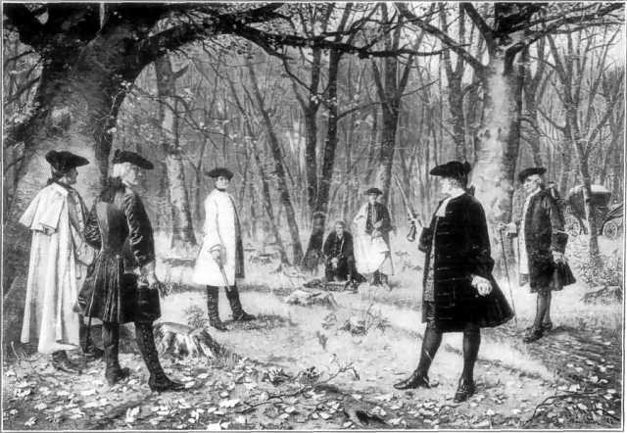
Hamilton vs. Burr

Slide 11
Louisiana Purchase
Jefferson’s purchase of Louisiana had its origins in his desire to
Give the United States control over the Mississippi River
Acquire a port to provide an outlet for western crops
Hoped to preserve an agricultural (agrarian) society by making abundant lands available to future generations
To prevent war with France over control of the Louisiana Territory and secure American commerce

Slide 12
JEFFERSON WANTS NEW ORLEANS
JEFFERSON SENDS JAMES MONROE & ROBERT LIVINGSTON TO PARIS.
THEY ARE TO BUY NEW ORLEANS- CAN PAY AS MUCH AS $10 MILLION

Slide 13
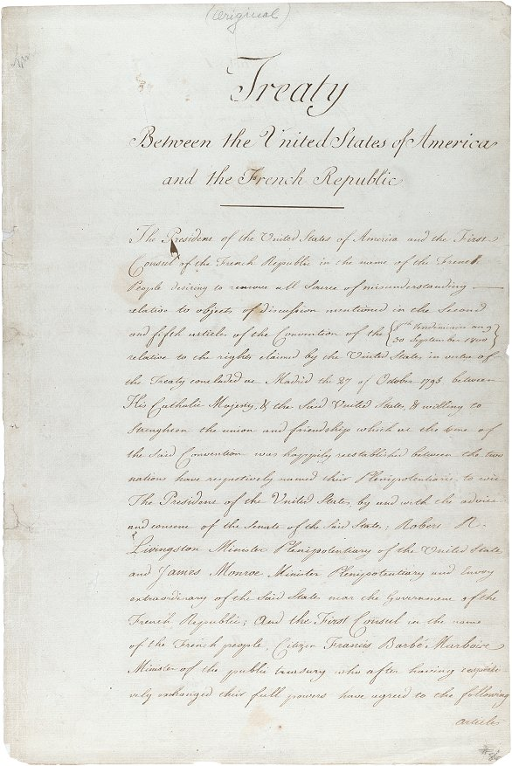
Louisiana Purchase
April 30, 1803
Robert Livingston & James Monroe signed the Louisiana Purchase Treaty in Paris
The United States paid $15 million for the land, roughly 4 cents per acre
The purchase added 828,000 square miles of land west of the Mississippi to the United States
July 4 the Louisiana Purchase is publicly announced
Original treaty can be found at: http://www.archives.gov/exhibits/american_originals_iv/sections/louisiana_purchase_treaty.html

Slide 14
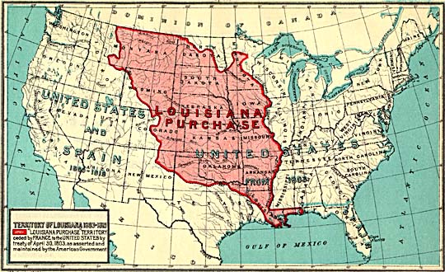
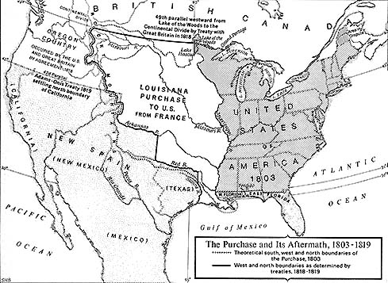
Maps of the Louisiana Purchase
The original maps can be found at: http://www.washington.edu/uwired/outreach/cspn/hstaa432/lesson_4/louisiana.html

Slide 15
JEFFERSON’S PRINCIPLES GET IN THE WAY.
JEFFERSON IS A STRICT CONSTRUCTIONIST.
MUST USE IMPLIED POWERS TO JUSTIFY THE DEAL.
FEDERALIST ATTACK JEFFERSON FOR STRETCHING THE CONSTITUTION.

Slide 16
Louisiana
Jefferson reluctantly submitted the treaties to the Senate while privately admitting the purchase as unconstitutional.
Senate promptly ratified the treaty
Land-hungry Americans jubilantly supported the purchase
Federalist opposition (typical of "loyal opposition" up to the present)
Ironically argued for strict construction: President did not have power to purchase LA.
Ironically claimed LA would cost too much especially when balancing budget was a goal
Real reason: worried that western lands would be loyal to Jefferson’s Republicans..

Slide 17
Embargo Act of 1807
Causes:
Napoleonic Wars between France and England
Impressment by both British and French
Nonimportation Acts:
Stop importing stuff from GB to teach them a lesson.
Honor

Slide 18
Embargo Act 1807
Forbade export of all goods from U.S.
Jefferson got Congress to hastily pass the act
Reasoned that a U.S. embargo would force Britain & France to respect its rights.
Loose construction of the Constitution
Congress' power to "regulate commerce" meant it could stop exports.
Undermined Jefferson’s states’ rights philosophy
Embargo Act was a disaster to the U.S. economy. Why? We need foreign business more than they do.
Non Intercourse Act (ended Embargo Act)
Formally reopened trade with all nations of the world except France and Britain
Remained U.S. policy until War of 1812.
Notes:
The Embargo Act of 1807 was an American law prohibiting all export of cargo from American ports. It was designed to force Britain to rescind its restrictions on American trade, but failed, and was repealed in early 1809. Specifically, the Embargo act prohibited American goods from being shipped to foreign ports and all foreign vessels from taking cargo at American ports. Cargo for the coastal trade had to be bonded at double value. Foreign imports were not banned, but they mostly ceased because ships would have to return empty. It represented President Thomas Jefferson's response to the United Kingdom's Orders in Council (1807) and France's Continental System, which were severely hurting America's merchant marines. Although it was designed to force the British and French to change their commercial systems, neither country did, and the Act was repealed in 1809. Moreover, the Act failed to prevent the War of 1812. Historians in 2006 ranked it #7 of the 10 worst mistakes ever made by an American President.^{[1]}
From the 1790s to 1807, American shippers enjoyed their status as the primary neutral carrier between France and Britain while both countries were engaged in the Napoleonic Wars, profiting as both Nations purchased American goods and ships. Before it passed, about $120 million in American ships and cargo were on the high seas on any one day. Jefferson thought that Britain needed the business so badly it would buckle on the impressment issue, where British warships stopped American commercial ships and seized sailors it said were British subjects. The vast British Royal Navy required a large workforce to keep a stranglehold on the oceans; a need which could not be provided for by volunteer enlistment. British warships stopped American merchant ships; inspected the papers of every crewmember, and carried off those they decided were British subjects. Over 6,000 sailors with American naturalization papers were also taken because Britain did not honor "naturalised citizenship" papers issued by American courts to men born in Britain.

Slide 19
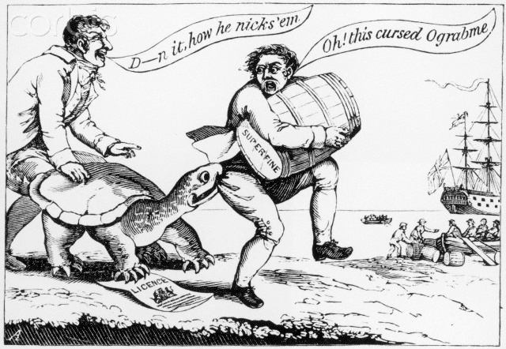

Slide 20
Evaluating Jefferson
Positives
Expands the size of the United States. “Louisiana Purchase”
Keeps US out of a costly war
Preserves neutrality
Negatives
Contradicts his own interpretation of the constitution.
~ Why? for the good of the country

Slide 21
Jefferson’s Legacy
Expansion became prime goal
Creation of a democratic non-aristocratic government
Total defeat of Federalists by 1816
Jefferson kept the country out of a damaging European war
War of 1812 not until late in Madison’s first term.

Slide 22
War of 1812
Causes:
British helping Natives with weapons and alcohol
Britain trading with the Natives
British presence
Henry Clay and John C. Calhoun ‘War Hawks’
Elections coming up…Madison needing votes
Effects:
Further split party politics
Who does the war benefit…?
Hartford Convention
Federalists MAD. Secession? 1 Term Presidency? No more 3/5ths?

Slide 23
End of War
HEY!! We didn’t lose!
England broke.
America broke.
Nobody winning war
Treaty of Ghent…Christmas Eve 1814
Ends war, changes nothing.
Battle of New Orleans…January 8, 1815
Andrew Jackson crushes British, becomes national hero, even though war over.

Slide 24
Federalist Legacy
Republicans split into two groups
Clay (National Republicans) support Federalist-like policies.
Clay’s National System
National Bank
Funding for roads and internal improvements
Tariffs
Madison vetoes.
‘government lacks the authority to fund internal improvements’
Federalist Party crumbles
Marshall maintains policies in Supreme Court however

Slide 25
Marshall’s Law
As chief justice of the Supreme Court (lifetime appointment), Marshall increased the power of the federal government at every turn.
McCulloch v. Maryland (1919)
2nd National Bank gets taxed by Maryland’s state bank.
Marshall: NOPE, nat’l gov has power to regulate currency and through Necessary and Proper Clause, create bank.
Gibbons v. Ogden (1824)
NY gave a monopoly to Ogden for steamboat service.
Marshall: NOPE, nat’l gov has power to regulate interstate commerce.
Dartmouth v. Woodward (1819)
State took over Dartmouth University (private) and turned it into public school
Marshall: NOPE, Dartmouth private university and contract rights upheld.

