Slide 1
DO NOW Presented eloquently by Sara Esquivel.
How did the Fugitive Slave Act, despite being part of a compromise, actually further the divide between North and South.
Why was Popular Sovereignty unrealistic as a concept in the existing territories of Kansas and Nebraska.
Bleeding Kansas…what was it?

Slide 2
Conflict Leads to Secession
Mr. Winchell
APUSH
College Board Period 5

Slide 3
Objective:
Students will be able to identify and analyze the key issues that escalated the conflict between North and South pre-Civil War by taking guided notes, analyzing a political cartoon, and identifying trends in statistical graphs.

Slide 4
Standards
Students will be able to determine the impact of the Kansas-Nebraska Act and relate it to the emergence of the Republican Party.
Students will be able to understand the cultural and political impact of the national career of Abraham Lincoln, the election of 1860, and secession by Southern states.

Slide 5
Calendar
Notes to Secession today.
John Brown, Election of 1860, and Quiz on secession and the compromises Monday.
Review for the benchmark Monday.
Benchmark Wednesday
Movie Friday!
BREAK!!!

Slide 6
Free and Slave States in the 1850’s
Category | Free States | Slave States | Slave States as % of Free States
Population | 18,484,922 | 9,612,979 | 52 Percent
Patents for New Inventions | 1,929 | 268 | 14 Percent
Value of Church Buildings | $67,778,581 | $21,674,581 | 32 Percent
Newspapers and Periodicals | 1,790 | 740 | 41 Percent
Bank Capital | $230,100,840 | $109,078,940 | 47 Percent
Value of Exports | $167,520,098 | $107,480,688 | 64 Percent

Slide 7
Underground Railroad
Network of ‘conductors’ and ‘stations’ with a loose network of Northern free blacks and courageous ex-slaves, with help of white abolitionists.
Helped escaped slaves reach freedom in the North or Canada.
Most famous conductor was Harriet Tubman, who made at least 19 trips into the South to help over 300 slaves escape.

Slide 8
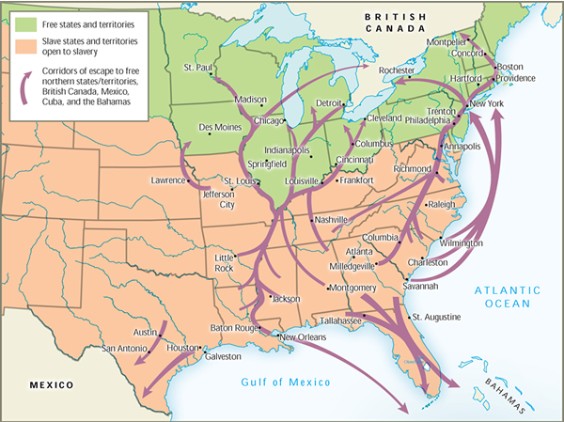

Slide 9
Uncle Tom’s Cabin
MOST influential book of this era.
Novel between an enslaved man named Tom and the brutal white slave owner Simon Legree.
Written by Harriet Beecher Stowe.
Moved a generation of Northerners as well as many Europeans to regard all slave owners as cruel monsters and inhuman.
Southerners condemned the ‘untruths’ in the novel and pointed to it as another example of the North’s prejudice against the Southern ‘way of life.’
When Lincoln later met Stowe, he told her “So you’re the little woman who wrote the book that started this great war…”

Slide 10
Impending Crisis of the South
Published in 1857 and written by Hinton R. Helper.
Attacked slavery from a statistical viewpoint, showing that slavery actually weakened the Southern economy.
Banned quickly in the South but widely distributed in the North.

Slide 11
Southern Reaction
Proslavery whites counterattacked by arguing that slavery was a positive good for the slave.
Argued that slavery was sanctioned by the Bible and was firmly grounded in philosophy and history.
Southern authors contrasted the conditions of Northern ‘wage workers’ forced to work long hours in factories and mines with the ‘familial bonds’ that could develop between slave and master.
George Fitzhugh was the best known of the proslavery authors (Sociology for the South, 1854 and Cannibals All!, 1857).
He questioned the principle of equal rights for ‘unequal men’ and attacked the capitalist wage system as worse than slavery.

Slide 12
Effect of Law and Literature
The Fugitive Slave Act, combined with the antislavery and proslavery literature polarized the nation even more.
Northerners who had earlier ignored abolition became more concerned about slavery as a moral issue.
A growing number of Southerners became convinced that the North's goal was to destroy the institution of slavery and the way of life based upon it.

Slide 13
National Parties in Crisis (1852)
Whigs, by electing Winfield Scott, tried to ignore slavery in the election of 1852, and tried to focus on improving infrastructure.
The antislavery and Southern factions (groups) within the party fell to quarreling regarding slavery.
The Democrats nominated a safe compromise candidate, Franklin Pierce. Pierce was acceptable to both sides, as a Northerner who supported the Fugitive Slave Act.
The Democrats won all but four states, suggesting the days of the Whig party were numbered.

Slide 14
Kansas-Nebraska Act
To obtain Southern approval for a transcontinental railroad through the Central US, Stephen Douglas introduced a bill to divide the Nebraska territory into 2 parts: Kansas and Nebraska.
Settlers would decide via popular sovereignty whether to allow slavery or not.
Since the territories were located north of the 36’30 line, Douglas’ bill gave Southern slave owners an opportunity to expand slavery that previously had been closed by the Missouri Compromise.
Northern Democrats condemned the bill as a surrender to the ‘slave power.’
It was passed by both houses of Congress in 1854.

Slide 15
Bleeding Kansas
Douglas expected the slavery issue in the territories to be settled peacefully by the antislavery farmers from the Midwest who had migrated to Kansas.
Unfortunately, settlers from neighboring Missouri set up homes in Kansas as a means of winning control of the territory for the South.
Northern Abolitionists and Free-Soilers responded by organizing the New England Emigrant Aid Company (1855) to pay for the transportation of antislavery settlers to Kansas.

Slide 16
Bleeding Kansas
Proslavery Missourians (or border ruffians) created a proslavery legislature in Lecompton, Kansas.
Antislavery settlers did not recognize this government, and created their own legislature in Topeka, Kansas.
In 1856, proslavery forces attacked the free-soil town of Lawrence, killing 2 and destroying homes and businesses,
Two days later, abolitionist John Brown retaliated, attacking a proslavery farm settlement at Pottawatomie Creek, killing 5 settlers.

Slide 17
Bleeding Kansas in the Senate
The violence in Kansas spilled into the US Congress.
In 1856, Massachusetts Senator Charles Sumner verbally attacked the Democratic administration’s support for slavery in a speech titled “The Crime Against Kansas.”
He personally attacked South Carolina Senator Andrew Butler.
Butler’s nephew, Congressman Preston brooks, defended his uncle’s honor by walking into the Senate and beating Sumner over the head with a cane.
Sumner never fully recovered from the attack, and this showed another sign of growing passion both sides had for their cause.

Slide 18
New Parties!
The increasing tension over slavery divided Northern and Southern Democrats and completely broke apart the Whig Party.
(AP ESSAY ALERT: “compare and contrast the disintegration of the political parties in the 1850’s with the disintegration of the Union in the next decade…or something like that”
2 new parties came into being in this time period, one temporary and one permanent.
The Know-Nothing Party grew rom ethnic tensions in the North between native-born Protestant Americans and immigrant Germans and Irish Catholics.
Nativist hostility to these newcomers led to the formation of the American party, or ‘Know-Nothing Party.’
Their core issue was opposition to Catholics and immigrants. They didn’t win any key elections, but helped weaken the Whigs.

Slide 19
New Parties!
Republican Party: founded in Wisconsin in 1854 as a DIRECT REACTION to the passage of the Kansas-Nebraska Act.
Composed of a coalition of Free-Soilers and anti-slavery Whigs and Democrats.
Its one purpose was to oppose the spread of slavery in the territories, not to end slavery itself.
First platform (1854): repeal of the Kansas-Nebraska Act and the Fugitive Slave Law.
As violence spread in Kansas, more people (including some abolitionists) joined the Republican Party, and it was soon the second largest party in the nation.

Slide 20
Dred Scott v. Sandford (1857)
The Supreme Court worsened the crisis when it infuriated many Northerners with a controversial proslavery decision in the case of a slave named Dred Scott.
Dred Scott had been held in slavery in Missouri (slave state) and then taken to the free territory of Wisconsin for 2 years before returning to Missouri.
Scott sued for his freedom (7th Amendment), arguing that living in a free territory made him free.

Slide 21
Dred Scott v. Sandford
Presiding over the Supreme Court was Southern Democrat Roger Taney. The majority of the Court decided against Scott giving these reasons.
Dred Scot had no right to sue in a federal court because African Americans weren’t US Citizens.
Congress did not have the power to deprive any person of property without due process of law. Therefore, if slaves were a form of property, then Congress could not exclude slavery from any federal territory.
The Missouri Compromise was unconstitutional because it excluded slavery from Wisconsin and other Northern territories.

Slide 22
Dred Scott v. Sandford
Court’s decision delighted Southern Democrats and infuriated Northerners.
Ruling basically said slavery is legal everywhere.
Northern Democrats, such as Senator Stephen Douglas, were left with the impossible task of supporting popular sovereignty without contrasting the Dred Scott decision.
Douglas’ hopes for a sectional compromise and his ambitions for the presidency were FINISHED!

Slide 23
Lincoln vs. Douglas Debates
1858: Douglas (Democrat) and Lincoln(Republican) were running for Senator of Illinois.
Douglas was a national name, Lincoln a great unknown.
Lincoln campaigned by attacking Douglas’ view of popular sovereignty and indifference towards slavery as a moral issue.
Douglas won the election, but Lincoln had made a name for himself as an anti-slavery proponent.

Slide 24
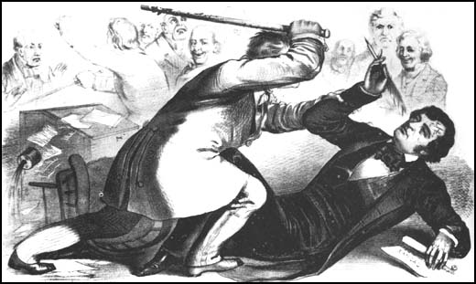
The Caning of Senator Sumner

