Slide 1
Do Now
To what extent did LBJ’s presidency offer continuity AND change for America? Be specific.
THEN: bit.ly/49signup to signup for this Saturday

Slide 2
LBJ & The
Great Society
Reforming America,
One Issue At A Time
Mr. Winchell
APUSH
Period 8

Slide 3
The LBJ Brand on the Presidency
Lyndon Johnson had been a senator in the 1940s and 50s, and his idol was Franklin D. Roosevelt, and he could manipulate Congress very well (through his in-your-face “Johnson treatment”)
As a president, LBJ went from conservative to liberal, helping pass a Civil Rights Act of 1964, which banned all racial discrimination in most private facilities open to the public, including theaters, hospitals, and restaurants.

Slide 4
The Three Keys:
Stimulation, Civil Rights, & Poverty

Slide 5
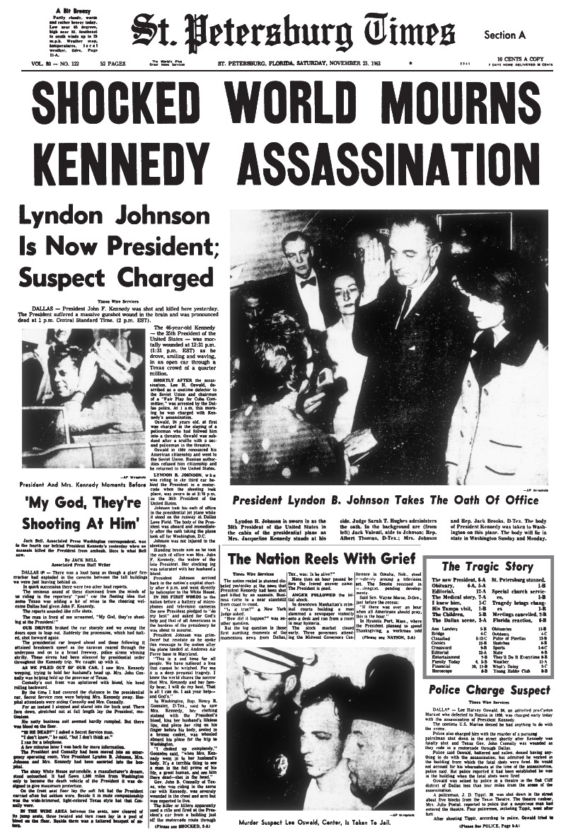
The Three Keys Origins
Following the assassination of JFK, Johnson wanted to further the domestic advances made by JFK, as well as meeting the following three major legislative goals.
Assassination Of JFK
http://www.tampabay.com/specials/2009/reports/times_125th_anniversary/images/KENNEDY-ASSASSINATION.jpg

Slide 6
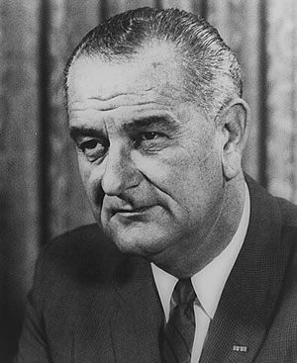
The Three Keys Stimulate the Economy
Tax Reduction Act of 1964.
Cut taxes by $11.5 billion.
Result: consumer spending rose by $45 billion in four years and unemployment fell to under 4%.
36th POTUS Lyndon B. Johnson
http://www.jlcauvin.com/wordpress/wp-content/uploads/2010/01/lbj1.jpg

Slide 7
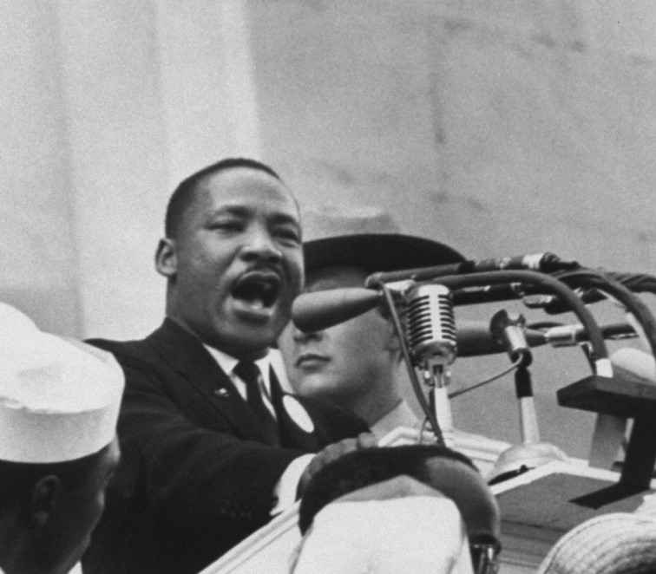
The Three Keys Enact Civil rights Legislation
Johnson’s View.
“We have talked long enough about equal rights in this country. We have talked for 100 years or more. It is time now to write the next chapter and to write it in a book of law.”
MLK At The March On
Washington 1963
http://media-3.web.britannica.com/eb-media/43/95543-050-F1A9AD13.jpg

Slide 8
The Three Keys Enact Civil rights Legislation
Civil Rights Act of 1964.
Outlawed discrimination in public facilities.
Authorized the attorney general to sue to desegregate public facilities and schools.
Stopped federal funds to states and localities that failed to integrate.
Forbade the unequal application of voter registration standards.
Forbade discrimination from employers or labor unions on the grounds of race, color, religion, sex, physical disability, or age.

Slide 9
The Three Keys Declare War On Poverty
Over 35 million Americans trapped in the poverty during the “Affluent Society” of the 1950s.
Environment of poverty is characterized by disease, helplessness, drug and alcohol abuse, increased crime, and a “hand-to-mouth” existence.
Poverty increased in urban slums and economically depressed rural areas.
Children were a product of their environment and the poverty culture would perpetuate itself.
Destroy poverty and the country can combat the other ills more effectively.
Needed new programs that were designed to meet the needs of the poor.

Slide 10
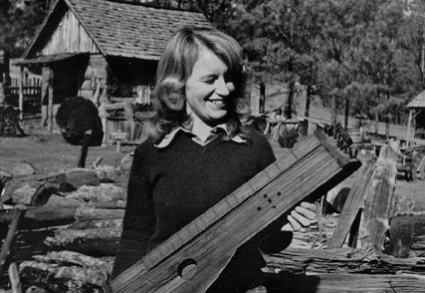
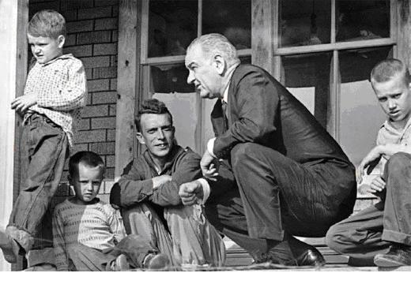
The Three Keys Declare War On Poverty
College Student Helping With The War On Poverty In The 1960s
http://3.bp.blogspot.com/_aRE25RtcVM8/S8Dy9i9WgNI/AAAAAAAACmE/-O26GKy6EXY/s1600/apa2.JPG
LBJ With An Impoverished Family In Appalachia
http://drewashton.edublogs.org/files/2009/11/lbj1.JPG

Slide 11
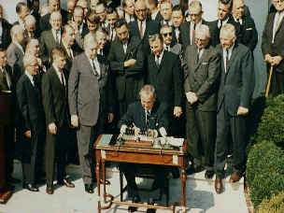
The Three Keys Declare War On Poverty
Economic Opportunity Act of 1964.
Provided $1 billion to develop a number of programs, including the ones below.
Job Corps, which provided employment for youths 16-21.
Job training for unemployed adults.
Work-study funds for college students.
LBJ Signing The Economic Opportunity Act Of 1964 http://www.capc-pensacola.org/Photos/about-1.jpg

Slide 12
The Three Keys Declare War On Poverty
Loans for employers to train low-skilled workers.
Head Start Program, intended to improve the early education of economically-challenged youngsters.
VISTA (Volunteers in Service to America).
A domestic Peace Corps, sent to depressed areas to aid in training, education, and establishing schools and other public institutions.
Head Start Program
http://sitemaker.umich.edu/tucker.356/files/sub-head-start.gif

Slide 13
The Three Keys Declare War On Poverty
Creation of HUD (Department of Housing & Urban Development).
Headed by Robert C. Weaver, the nation’s first African-American Cabinet member.
Job was to oversee housing requirements and standards for the poor, inspect urban areas, and develop programs intended to clean up cities.
Department Of Housing &
Urban Development
http://www.reinvestology.com/wp-content/uploads/2008/11/hud-logo-small.jpg

Slide 14
`

Slide 15
The Great Society
Passed bills increasing funding for education; the first major federal aid package for education in the nation’s history
LBJ created Medicare and Medicaid
Created the Department of Housing and Urban Development (HUD)
Medicare: give low-cost medical insurance to Americans age 65 years and up
Medicaid: extends health care insurance to people on welfare.

Slide 16
The Great Society Congress
Johnson’s win was also coupled by sweeping Democratic wins that enabled him to pass his Great Society programs.
Johnson also created the Department of Transportation and the Department of Housing and Urban Development (HUD), headed by Robert C. Weaver, the first Black cabinet secretary in the United States’ history.

Slide 17
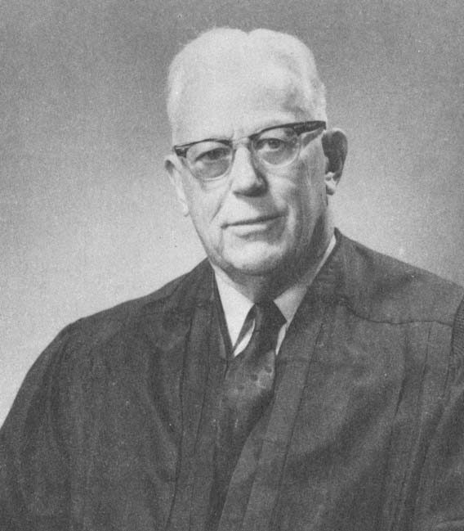
The Warren Court
The Warren Court also greatly expanded the rights of people accused of crimes. Earl Warren →
Illegally seized evidence couldn’t be used in court
Required criminal courts to provide free legal counsel
(Gideon v. Wainwright)
Right to a lawyer during questioning
People must be read their Miranda rights before questioning
(Miranda v. Arizona - 1966)
EQ: How did the Warren Court expand the individual rights of American citizens?

Slide 19
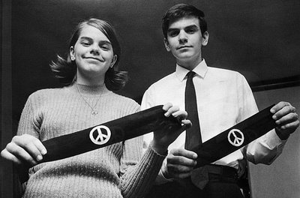
The Warren Court
The Supreme Court under Chief Justice Earl Warren encouraged the expansion of individual rights in the U.S.
This started with Brown v. B.O.E.
Limited censorship
Stated free speech included allowing students to wear black armbands to protest the war (Tinker v Des Moines)
Tinker v Des Moines - 1969

Slide 20
Impact of the Great Society
The Great Society and the Warren Court changed the United States
People disagree on whether the U.S. was better or worse afterwards
The massive tax cut spurred the economy, but funding the Great Society along with the Vietnam War led to increased deficits

Slide 21
Impact Of
The Great Society

Slide 22
Impact Of The Great Society Success Of The Great Society
Brought hope to millions of Americans.
Enabled more than 11 million students to receive loans for a college education.
Prepared more preschoolers for grade school and low-income middle years students for high school and college.
Provided some important programs for the poor, including medical aid, food stamps, welfare, and school lunches.
Over 2 million older Americans were raised above the poverty levels due to the new Medicare program.
Created 2 million government jobs, with nearly half of them filled by minorities.

Slide 23
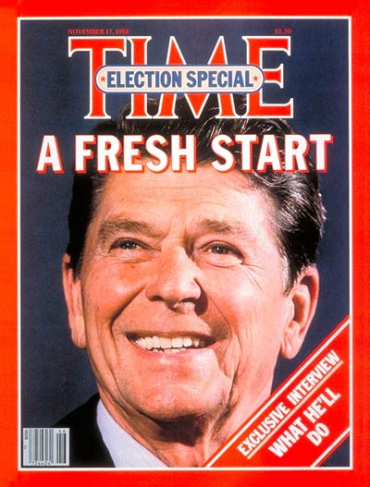
Impact Of The Great Society Failures Of The Great Society
Could not accomplish everything it set out to do.
Created concern among many whites that the social programs established in the name of the War on Poverty were draining public funds without producing visible results.
Felt that very little had been changed despite the amount of money spent.
Made Americans reconsider the commitment to expensive social programs that were putting the nation into debt.
Would lead to the Conservative Revolution in the 1970s and the 1980s.
Reagan Revolution 1980
http://img.timeinc.net/time/magazine/archive/covers/1980/1101801117_400.jpg

Slide 24
Impact Of The Great Society Failures Of The Great Society
Despite the fact that the economy was expanding again, some people prospered more than others.
Many people were still poverty-stricken and depressed.
Social dissatisfaction had led to violence and fear, as evidenced by the social unrest of the mid-1960s.
African-Americans still found it hard to get jobs or share in the affluence.
Thank You For Selling Out Corporate America!
http://www.propertyrightsresearch.org/images/MillMapSide2.jpeg

Slide 25
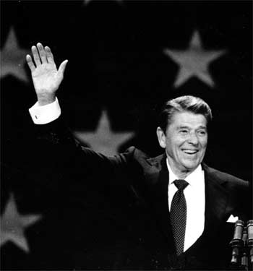
Backlash
There was a conservative backlash
Ronald Reagan swept to victory in the race for governor of California
The increase in Communist forces in Vietnam began to overshadow the Great Society
Four years after the election, Johnson, who ran on a peace ticket, would be labeled a “hawk” for supporting one of the most divisive wars in recent U.S. History

