Slide 1
Manifest Destiny and the Mexican American War
Mr. Winchell
APUSH Period 5

Slide 2
Ulysses S. Grant on the Mexican American War
“Generally, the officers of the army were indifferent whether the annexation was consummated or not; but not so all of them. For myself, I was bitterly opposed to the measure, and to this day regard the war, which resulted, as one of the most unjust ever waged by a stronger against a weaker nation. It was an instance of a republic following the bad example of European monarchies, in not considering justice in their desire to acquire additional territory”

Slide 3
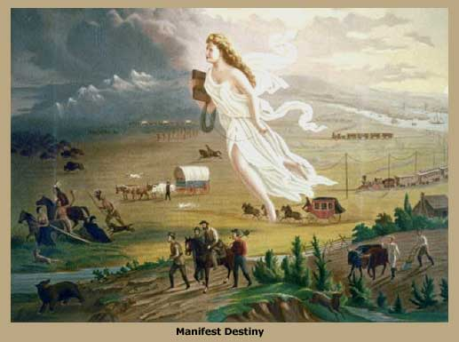
Western Expansion and Manifest Destiny
Tension with Britain
Texas Annexation
Manifest Destiny
Trails
The Mexican American War
California
The Aftermath

Slide 4
Manifest Destiny
Jefferson’s Louisiana Purchase – by 1840, large numbers of Americans moved westward.
“Manifest destiny” (being the idea that America had a God-given right to expand to the Pacific)swept America.
Arguments for manifest destiny - superiority of the American “race”.
Eventually, America will look to other places to apply manifest destiny.

Slide 5
“Manifest Destiny”
First coined by newspaper editor, John O’Sullivan in 1845.
".... the right of our manifest destiny to over spread and to possess the whole of the continent which Providence has given us for the development of the great experiment of liberty and federaltive development of self-government entrusted to us. It is right such as that of the tree to the space of air and the earth suitable for the full expansion of its principle and destiny of growth."
A myth of the West as a land of romance and adventure emerged.

Slide 6
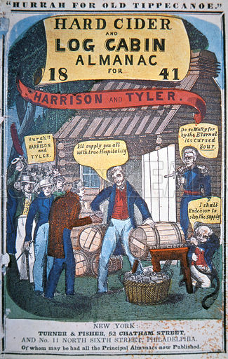
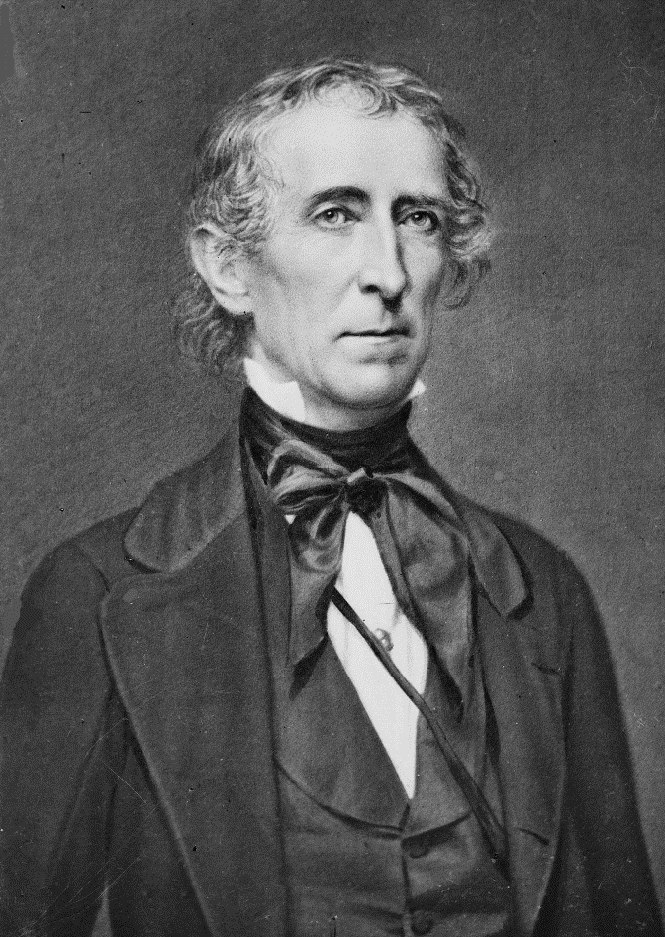
Harrison…Uh oh…I mean Tyler as President
One month after taking office - WHH died…John Tyler now president.
WHH deferred some powers and decisions to Henry Clay and Daniel Webster - Tyler would not.
Tyler - former Democrat.
Now a Whig - disagreed often with Whig leaders.
Refused to support Clay’s attempts to re-charter the BUS.
Whigs voted him out of the party - his entire Cabinet resigned.
Served the rest of his term without party loyalty.

Slide 7
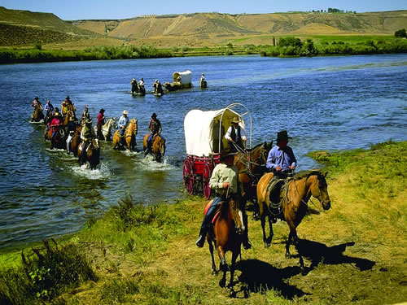
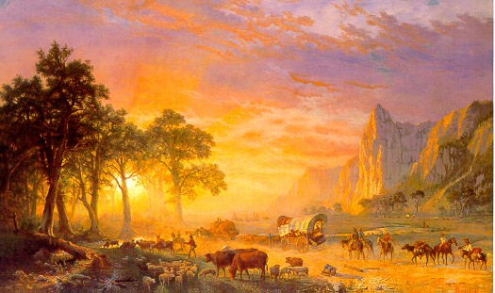
Oregon Fever
US and Britain – both claiming the territory of Oregon.
Early missionaries populated the area.
Made the territory seem popular and valuable.
Led to the “Oregon Fever” – wagon trains traveled over 2,000 miles.
Lots of disease, death, and hardships.
Remember the game…

Slide 8
The Game was fun…Reality is a little different

Slide 9
More Tension with Britain
“Oregon Country” - disputed between the US and Britain for many years.
Many Americans wanted the US to gain the territory - rallying cry “54-40 or FIGHT!”
US and British peacefully agreed in 1846 to set the permanent border at the 49th parallel.
Set the northern border with Canada and extended the US to the Pacific (NW).
Previous US-British issues, (ex: Maine-Canada border) resolved in the 1842 Webster-Ashburton Treaty.

Slide 10
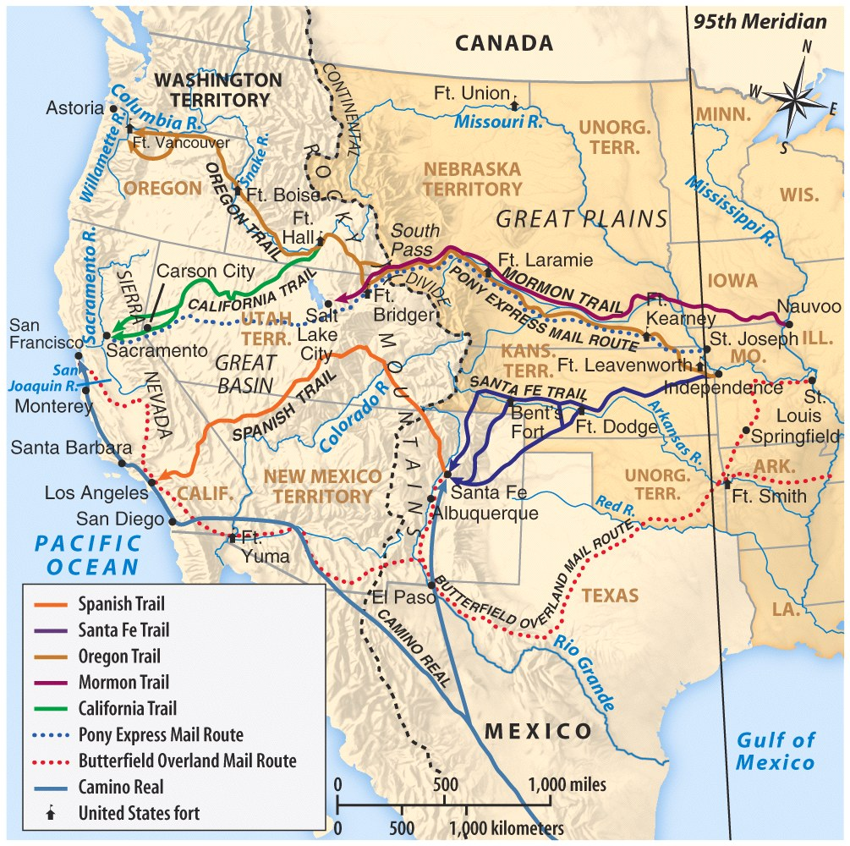
Famous Trails West
Sante Fe Trail
Independence, MO to Sante Fe, NM***
Old Spanish Trail
Sante Fe, NM*** to Los Angeles, CA***
Mormon Trail
Nauvoo, IL to Salt Lake City, UT***
Oregon Trail
Independence, MO to Portland, OR***
California Trail
Cuts off Oregon Trail to Sacramento, CA***
Butterfield Overland Trail
St. Louis, MO southwards thru TX, NM, to Los Angeles, CA***

Slide 11
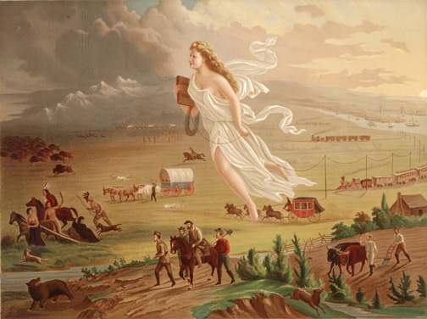

Slide 12
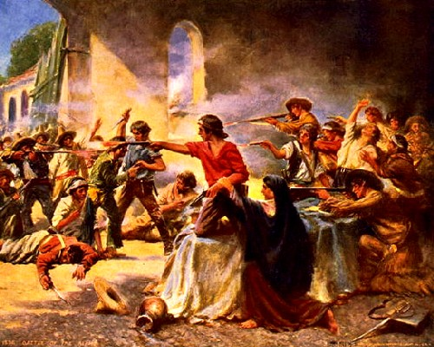
A REVIEW: Texas Independence
American population of Texas increased… cultural tensions between Texas and Mexico increased.
End result - Texas Revolution (also called the Lone Star Rebellion) in 1835-36.
A small “war” with notable battles
Ex: Battle of the Alamo (all the Texan defenders were killed).
Sam Houston’s army would capture Mexican president and general Santa Anna.
This resulted in the independence of the Republic of Texas.

Slide 13
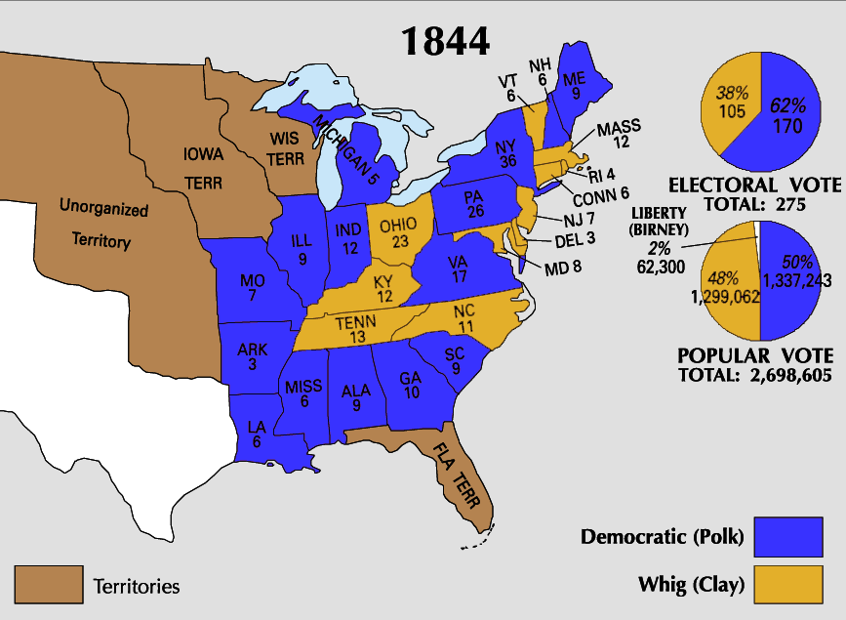
The Lone Star Republic to State
Texas had been an independent country since 1836 – but it is shaky and unstable.
Reached out to the US and European powers for aid.
Many Americans wanted Texas (Ex: Sam Houston) as a part of the United States.
Became an issue in the election of 1844.
1844 election - James K Polk (Dem) pro-expansion vs. Henry Clay (Whig) was not.
Polk wins election - Americans favored expansion.
Lame-duck President Tyler saw Polk’s victory as a mandate to annex Texas.
1845 – Tyler pushed through bill which annexed Texas.
Caused outrage in Mexico - This will lead to violence and eventually war!

Slide 14
The Republic of Texas

Slide 15
Beginning of the Dispute
“Mexicans must amalgamate and be lost, in the superior vigor of the Anglo-Saxon race, or they must perish.”
John L. O’Sullivan
Mexico refused to negotiate.
Mexico also disputed the border Texas had been claiming for the previous 10 years.

Slide 16
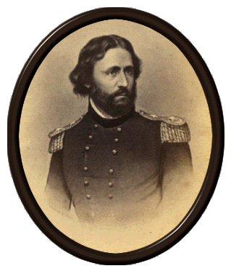
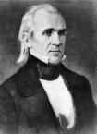
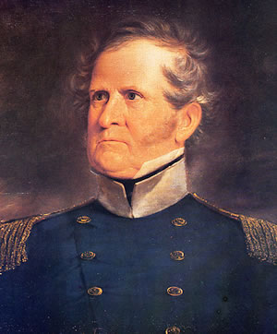
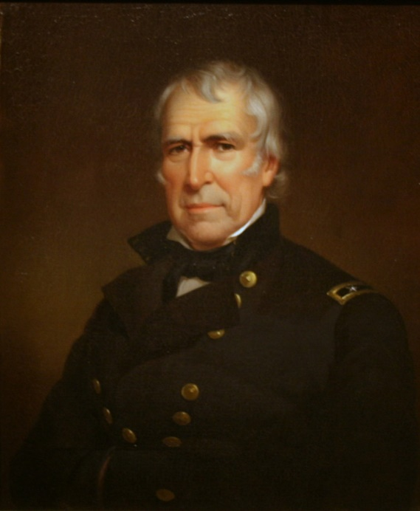
The “US Invasion” War - Causes
James K Polk – pro-expansion in the Southwest (esp. California).
Willing to pay for territory OR also willing to use force.
A growing issue was the Texas-Mexico border.
Texas claimed it was the Rio Grande River.
Mexico claimed it was the Nueces River.
Polk sent Gen Zachary Taylor (“Old Rough and Ready”) to Texas – “protect” Texas from Mexican threat.
He set up camp on the “US” side of the Rio Grande River.

Slide 17
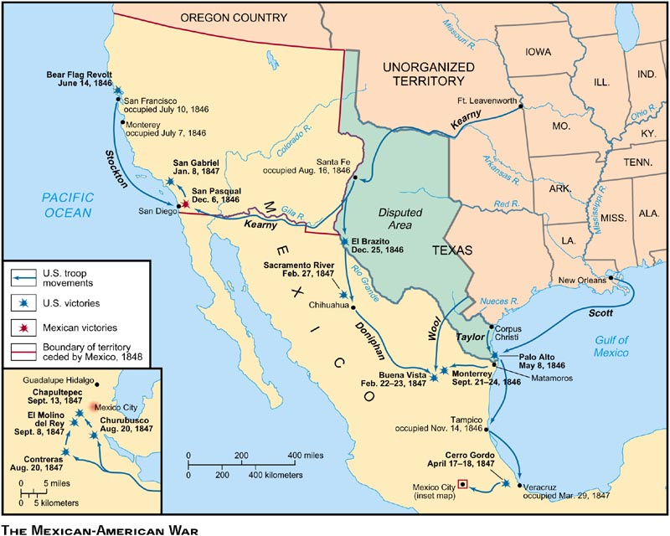

Slide 18
War of Aggression
President Polk sent General Taylor to the area that the U.S. considered it’s border.
Predictably, Taylor’s troops were attacked by the Mexican army.
Polk now had reason to go to war, and enough evidence to convince Congress to declare war, despite the objections of Northern Whigs (like Lincoln).

Slide 19
Polk’s message to Congress, 1846
“...after reiterated menaces, Mexico has passed the boundary of the United States, has invaded our territory and shed American blood upon the American soil. She has proclaimed that hostilities have commenced, and that the two nations are now at war...I invoke the prompt action of Congress to recognize the existence of the war, and to place it at the disposal of the Executive the means of prosecuting the war with vigor...”

Slide 20
America Divided
Northerners feel that the war is taking money away from improvements to the nation.
Northerners feel that Polk wants to take over all of Mexico…they’re right
Taxes increase for the war effort. Many Americans mad
Senator John C. Calhoun is against acquiring Mexico because it will ‘taint’ the US

Slide 21
Political Opposition to War
Many members of Congress opposed the war with Mexico.
Some felt that the president had forced the U.S. into the war, which was wrong because only Congress can approve war.
Others just thought it was wrong to take any territory from Mexico.
Lincoln makes his name accusing Polk of misleading Congress and starting a war for territory

Slide 22
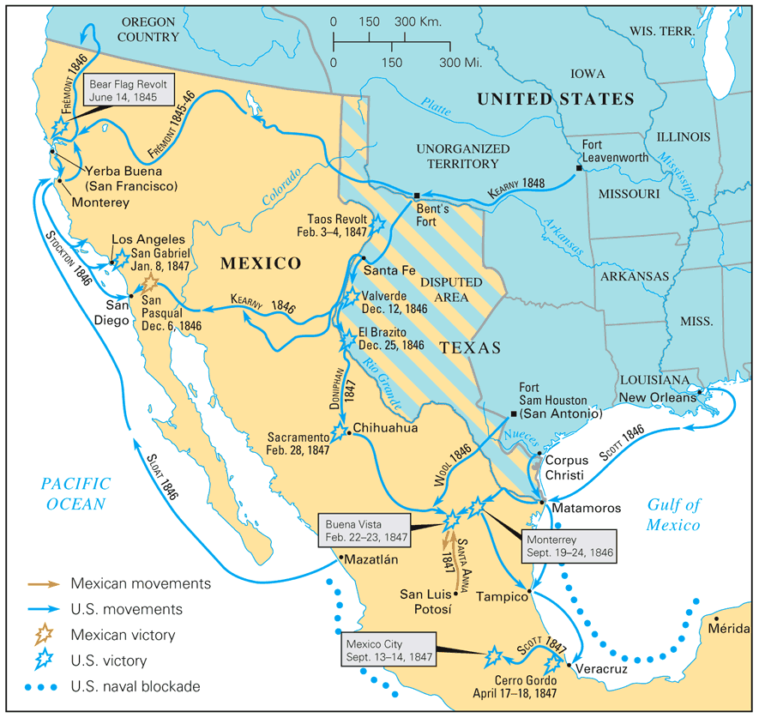

Slide 23
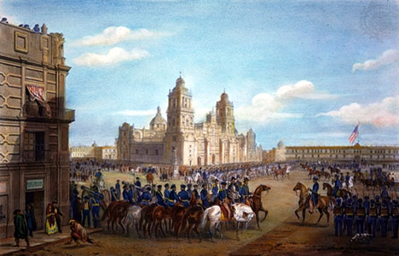
The Mexican-American War - Course
1846 – disputed reports saying Mexican troops crossed the Rio Grande/attacked US troops.
Polk asked for a declaration of war against Mexico – Congress granted it.
Opposition to the war - Whigs believed Polk had steered us towards war.
Abraham Lincoln - ‘spot resolutions’ asking for the exact spot the first shots were fired.
Victory – not as quickly or easily as expected.
Other important leaders:
John Fremont leads exploration in CA and declared independence from Mexico.
Winfield Scott (“Old Fuss and Feathers”) – went into Mexico never loosing a battle.
Several victories in NM, Cali, Mexico, (final victory by capturing Mexico City).

Slide 24
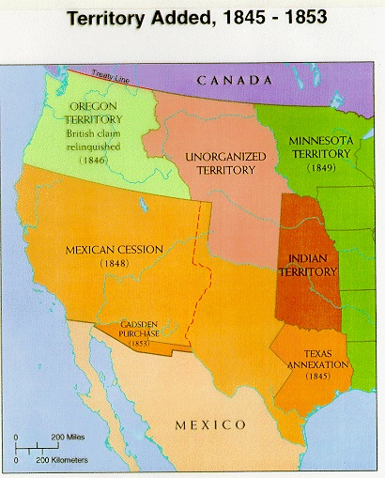
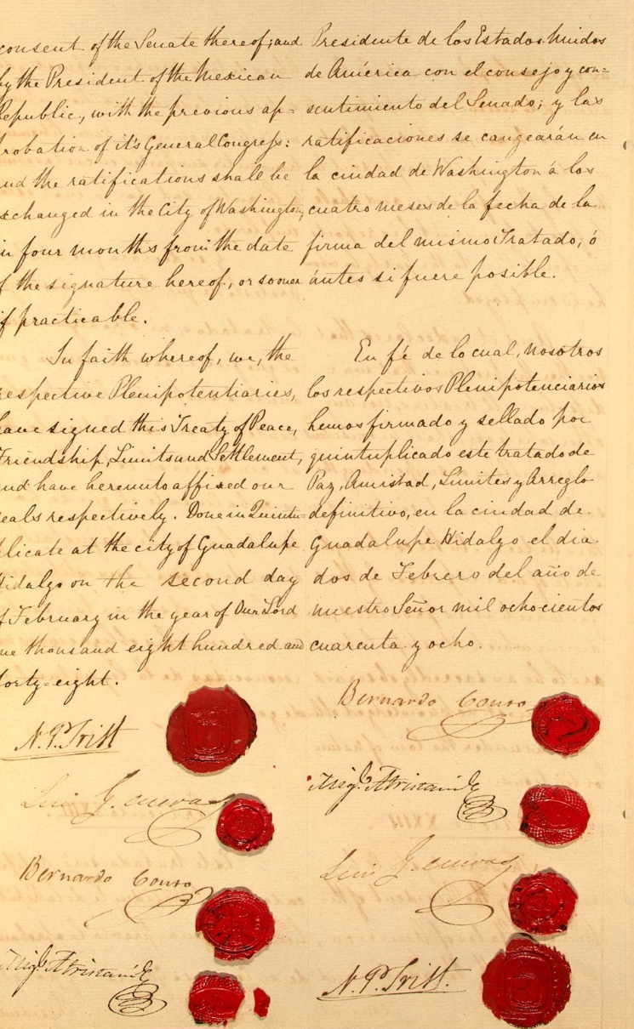
The Aftermath of the War
Mexico surrendered - agreed to the Treaty of Guadalupe Hidalgo.
Mexico would cede the remainder of the current American SW to the United States (TX, CA, NM, AZ, NV, UT, CO).
US paid Mexico $15 million.
Viewed as an insult in Mexico as the land was much more valuable.
Some view this as the US “stealing” the land.

Slide 25
Opposition
As always…not everyone agreed.
Northern Whigs opposed the treaty because they saw the war as an immoral effort to expand slavery.
A few Southern Democrats disliked the treaty for the opposite reasons. They wanted the US to take ALL of Mexico.

Slide 26
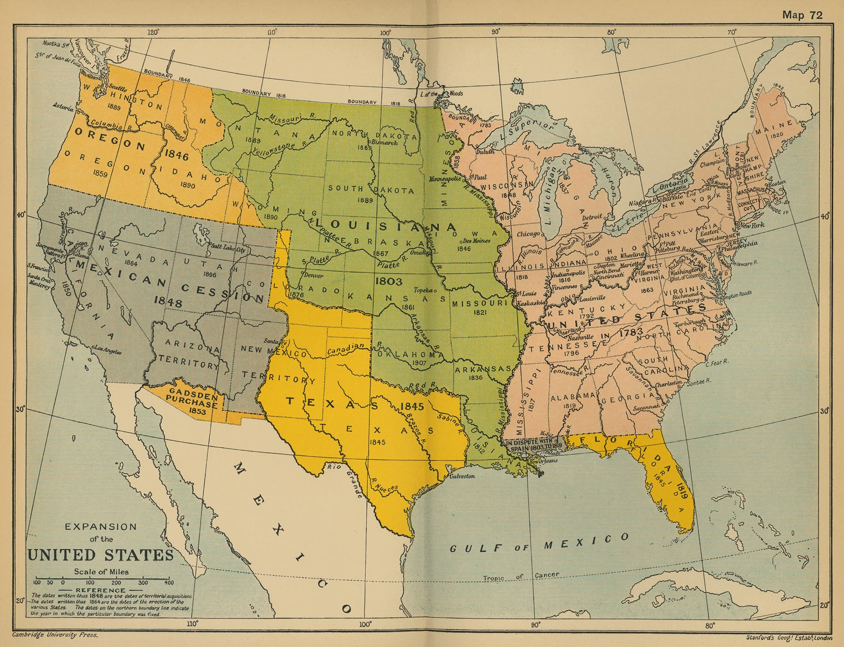
What’s to Come - New Territory = Conflict in DC!
New Territory = huge population movement out west.
Creates tension in DC! – over FREE vs SLAVE state.
Oh wait…no worries, we have the 36-30 line from the Missouri Compromise – we can extend that west…
However, there is CA…Uh oh!
Attempted Solution: The Wilmot proviso – no slavery allowed in territories from the M-A War.
Never passed – came to represent Northern anti-slavery sentiment.
Balance of power and stability of the Union is now in question!

Slide 27
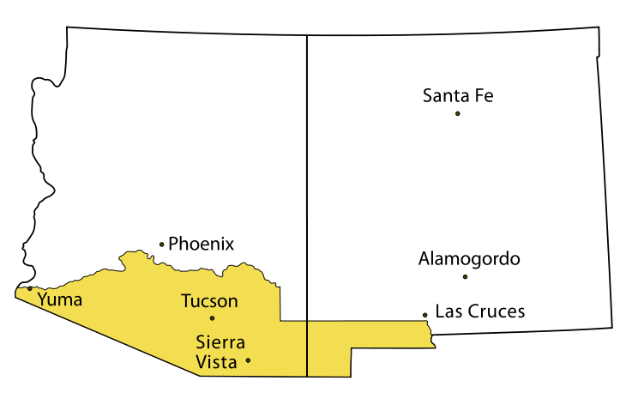
Gadsden Purchase
1853 agreement to buy a strip of land in what is now the southern United States so that a railroad line could be built to the Gulf of California. It cost $10 million.

Slide 28
https://www.youtube.com/watch?v=gn2FzuPyFlY

Slide 29
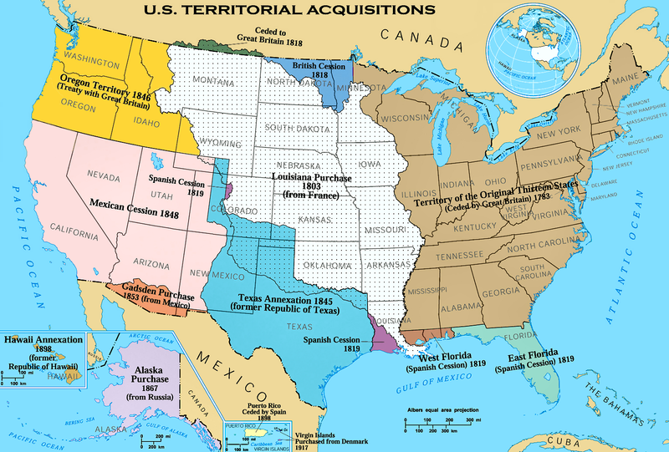
Territorial Expansion

Slide 30
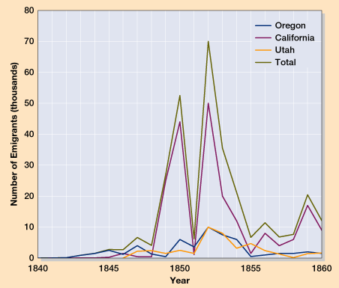
What’s to Come – Western Movement Explodes!
1848 - traces of gold in the foothills of the Sierra Nevadas.
Word spread to San Francisco, the east coast, and the rest of the world.
People worldwide flocked to CA to find gold – biggest year 1849.
1848 Cali. Pop = 14k
1852 Cali. Pop = 220k
Many “49ers” left families and jobs to head west…Mostly men - created a volatile society.
Word of gold reached China - large scale Chinese immigration to the US.
While some did, most people never found gold.
Created the “Wild West!”

