Slide 1
Period 4 Political Cartoon Analysis Review
Mr. Winchell
APUSH
Period 4

Slide 2
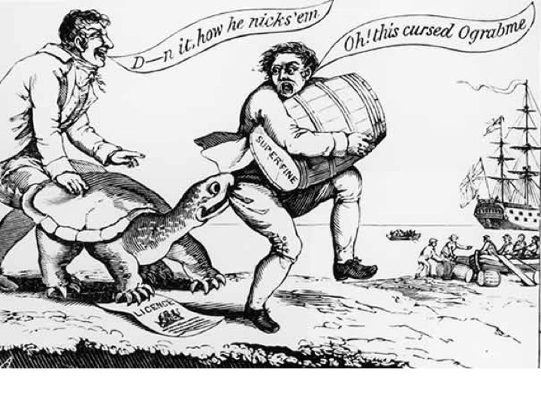
Notes:
Bit.ly/winchellcartoon1

Slide 3
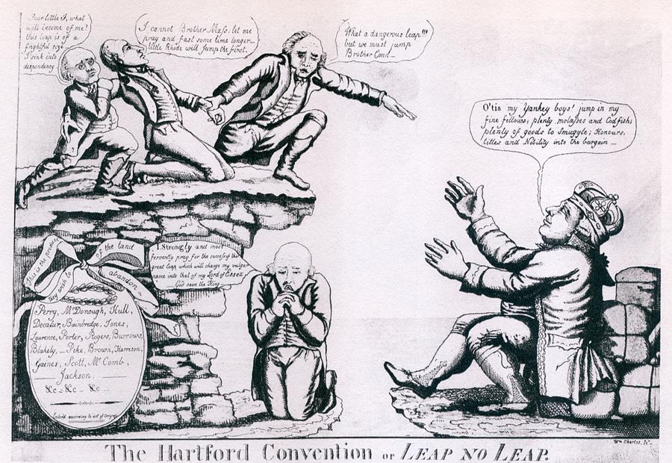
Notes:
Bit.ly/winchellcartoon2

Slide 4
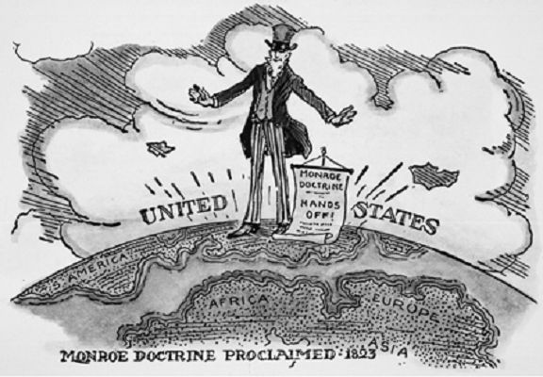
Notes:
Bit.ly/winchellcartoon3

Slide 5
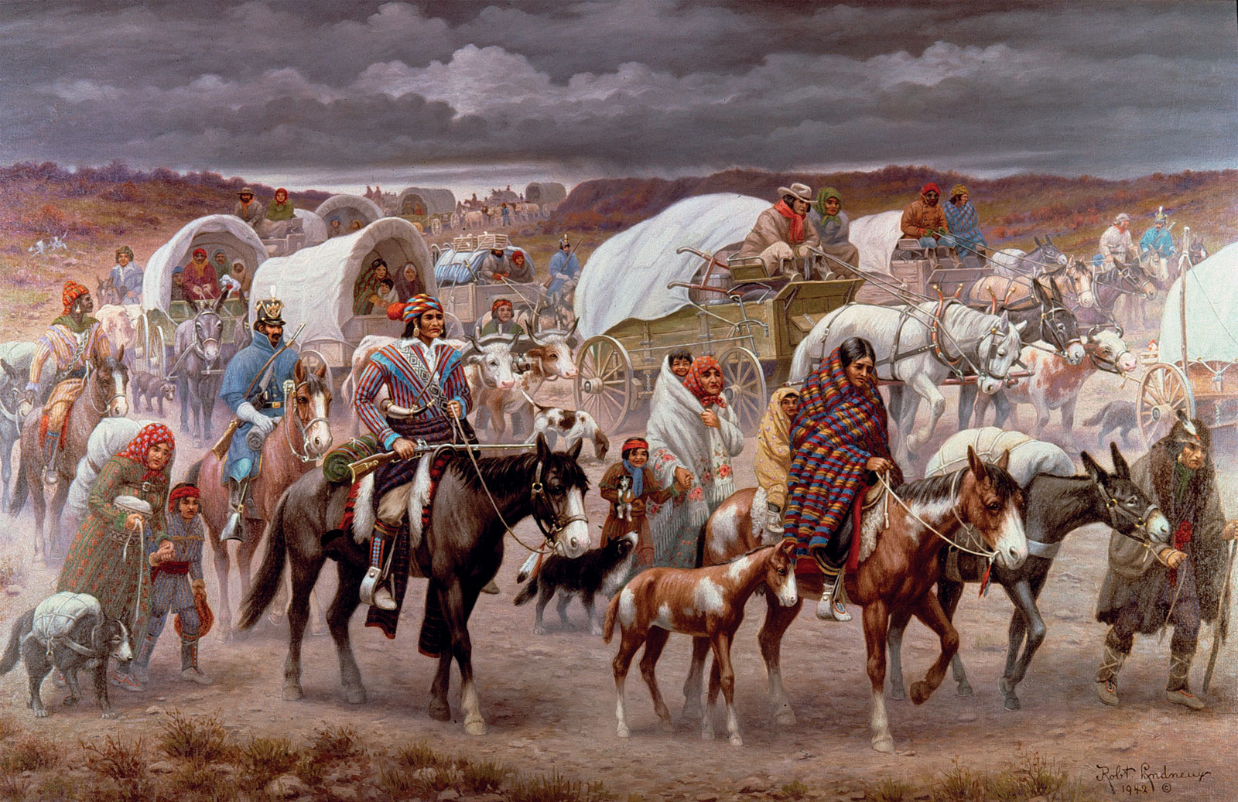
Notes:
Bit.ly/winchellcartoon4

Slide 6
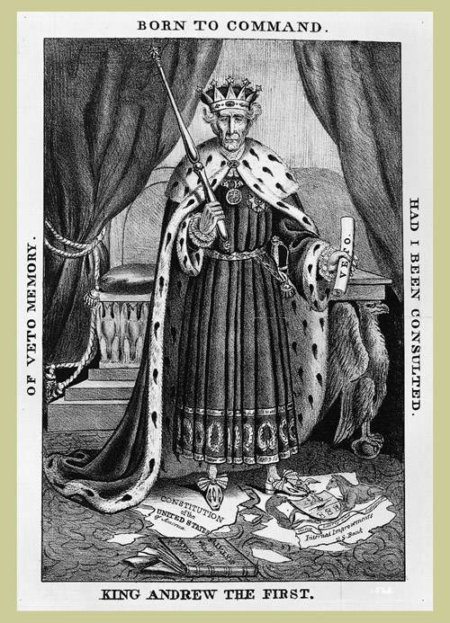
Notes:
Bit.ly/winchellcartoon5

Slide 7
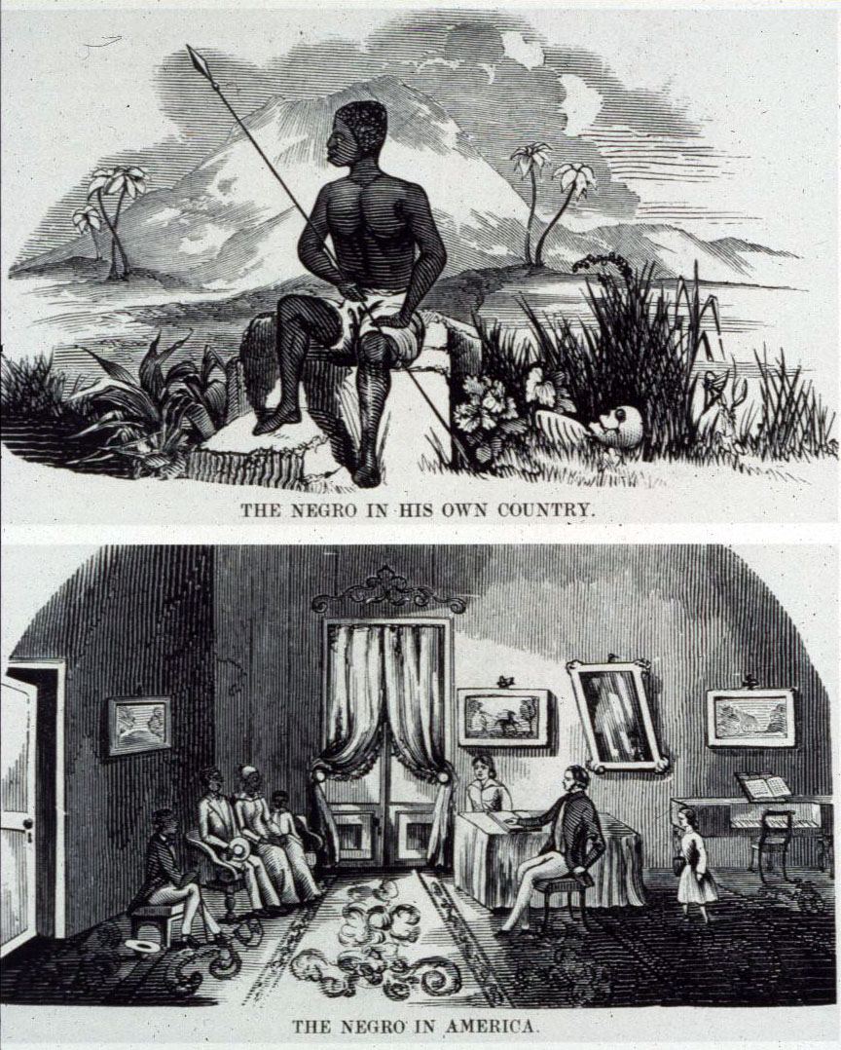
Notes:
Bit.ly/winchellcartoon6

Slide 9
Test Time!
51 multiple choice questions in 55 minutes
bit.ly/apushperiod4test

