Slide 1
Post-Jackson America and the 2nd 2-Party System
Mr. Winchell
APUSH
Period 4

Slide 2
Financial Crisis
In order to ‘kill’ the bank before its charter expired, Jackson took all the nation’s money out of the National Bank and deposited into loyal ‘Pet Banks.’
Land speculation continued to run rampant in the western states and prices for land and manufactured goods became badly inflated.
  Large amounts of money made their way into circulation because of the National Bank being no longer able to control currency…further inflation

Slide 3
Financial Crisis
Jackson attempted to fight this inflation by issuing an order that stated that all lands purchased from the government (western lands) would now have to be purchased in gold or silver (called Specie Circular)
  This only worsened the situation by making paper currency worth even less than its already decreasing value
Land sales plummeted and, as they had during the Financial Panic of 1819, land speculators failed on their bank loans and caused many banks to go bankrupt, leading to many people to lose their savings
This decrease in spending power led many industries/manufacturers to fail as well, leading to a nationwide financial crisis

Slide 4
End of Jackson’s Tenure
Since Jackson’s second term ended in 1836 and the financial crisis did not fully explode until 1837, blame for the financial downturn did not fall on his shoulders.
  The blame would fall on the next president, Jackson’s protégé Martin Van Buren
  He had served Jackson as Secretary of State and as Vice President, and had also supported him throughout all of Jackson’s controversies, the Peggy Eaton Affair, the Nullification Crisis, the Bank Veto, etc…

Slide 5
Second Two-Party System
Jackson’s severe demeanor and controversial actions led to the splitting of the Republican Party
  Jackson’s supporters became known as Democrats
  Clay’s supporters would form another political party, the Whigs
    The term Whig was a reference to both the British political party that had supported liberty during the Revolution, and also to the founding political party of the Federalists

Slide 6
The Democrats
Were very similar to the Jeffersonians
Favored limited government
  Wanted equal political and economic opportunities for all (that is, white males)
  Opposed elitist, big government policies such as the National Bank and high tariffs that protected Northern manufacturers (anything seen as supporting the wealthy)
Most strong in the South and the West, also in the working classes of the North

Slide 7
The Whigs
Were very similar to the Federalists
Pushed for policies that would lead to a powerful
and active federal government
  Supported the policies of Clay’s American System
  Opposed anything associated with “immigrants”
    Crime, immoral acts (drinking, gambling), radical government that empowered the lower classes
Were strongest in the New England region and in the upper classes of all regions, also with pious Protestants

Slide 8
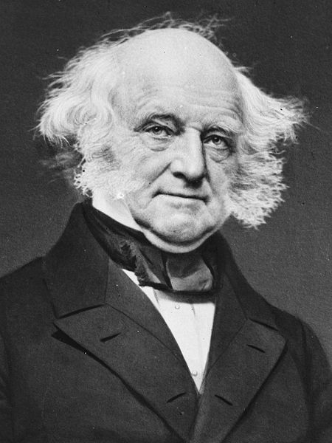
Martin Van Buren
Eighth President
(1837-1841)
DEMOCRAT
New York
The “Little Magician”
Panic of 1837
Panic of 1839
MARTIN VAN RUIN!!
Van Buren

Slide 9
Van Buren’s Presidency
Van Buren’s term as president (1836-1840) was an uneventful and unproductive term
  His presidency was mired in the Financial Crisis of 1837, which he adopted from his mentor Jackson
The Whigs tried to pass many pieces of legislation surrounding policies of the American System (higher tariffs, banking credit, internal improvements, etc.) but Van Buren continuously vetoed these bills as unnecessary

Slide 10
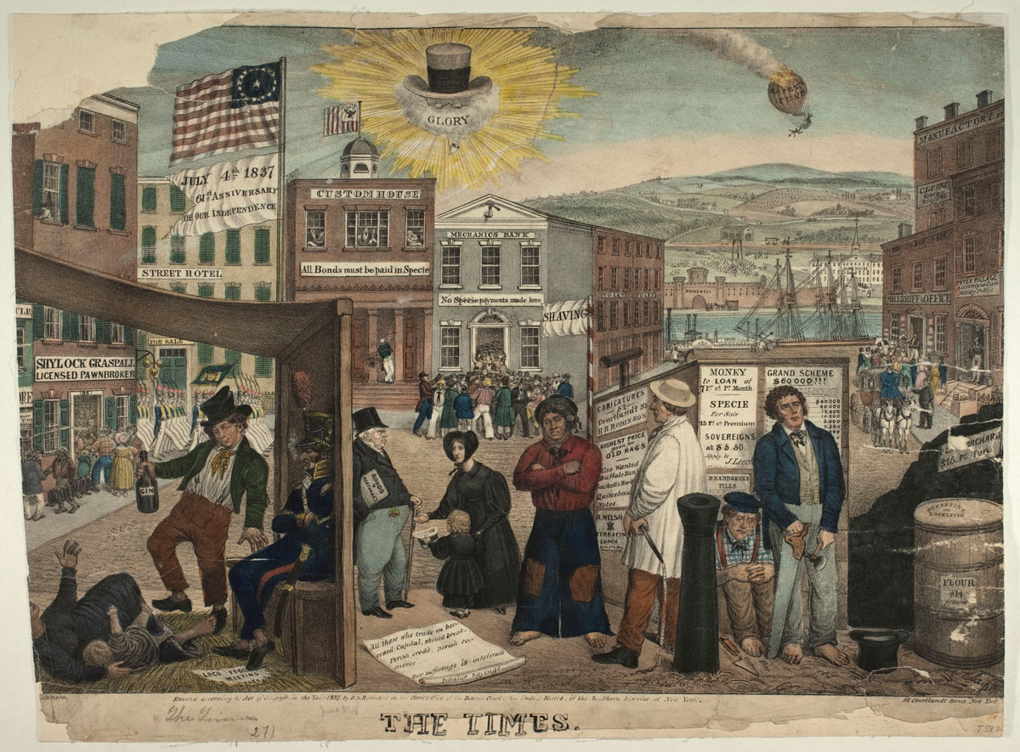

Slide 11
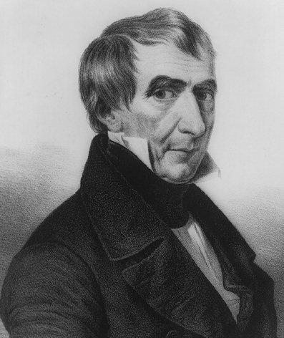
Election of 1840
Elitist Whigs Regroup
Tippecanoe and Tyler Too!
The “Log Cabin” Campaign
Whigs beat the Democrats at their own game.
William Henry
Harrison

Slide 12
Whigs Gain Power
The Election of 1840
  With his image hurt by the financial crisis that had embraced the country, Van Buren faced an uphill battle for reelection as president in 1840
  The Whigs chose as their candidate the war hero William Henry Harrison (“Ol’ Tippecanoe”)
    The Whigs stole a play from the Jackson playbook and portrayed Harrison as a common man (they played on his being born in a log cabin and being raised on hard cider)
  Harrison swept the electoral vote and the Whigs won the election, bringing and end to the age of Jackson…
    And then Harrison died. 32 DAYS LATER!

Slide 13
Post-Jackson era
Presidency of John Tyler
  Veto of Whig’s American System program
  Whig repudiation of Tyler
  Weakness of Tyler without party backing

Slide 14
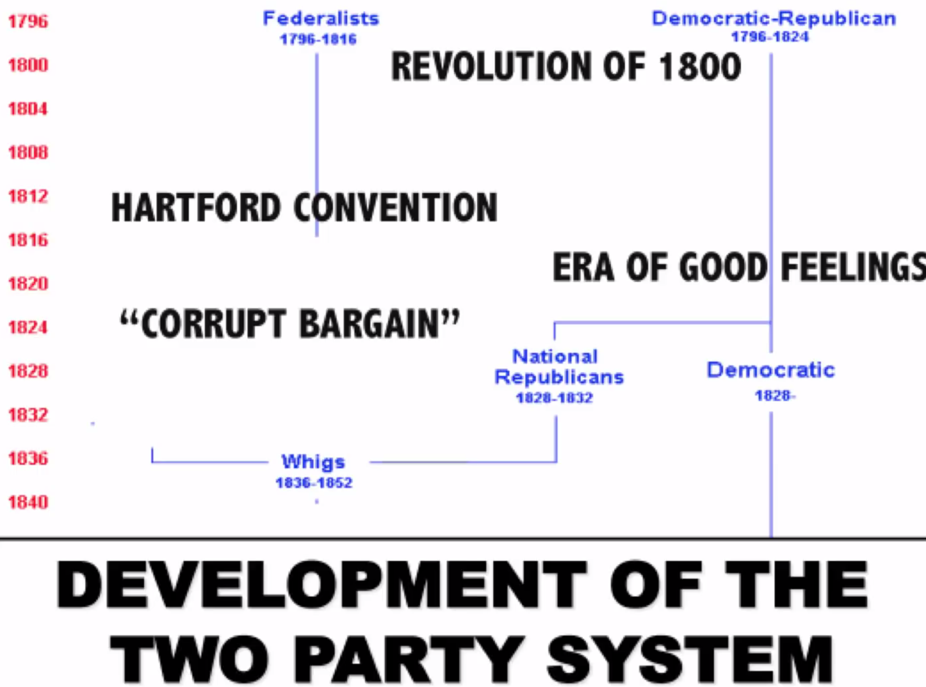

Slide 15
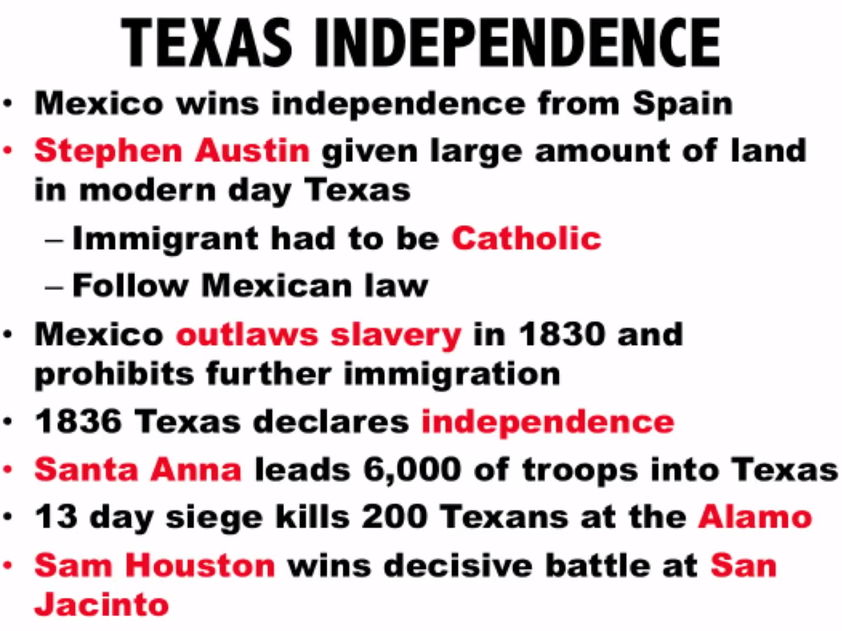

Slide 16
