Slide 1
Presidents of the Progressive Era
Mr. Winchell
APUSH
Period 6-7

Slide 2
Do Now
Why were the presidents in the early 20th century considered progressive? To what extent was this depiction accurate?

Slide 3
Roosevelt’s View of the Presidency
Roosevelt’s rise to governor of New York upset the Republican political machine.
To get rid of the progressive Roosevelt, party bosses got him elected as vice president, a position with little power at that time.
From Governor to Vice President
President William McKinley was shot and killed in 1901, leaving the office to Roosevelt.
At 42 years old he was the youngest president and an avid reformer.
Unlikely
President
Roosevelt saw the presidency as a bully pulpit, or a platform to publicize important issues and seek support for his policies on reform.
View of Office

Slide 4
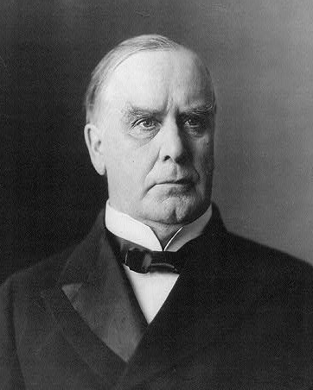
Theodore Roosevelt/Assumes Presidency After the McKinley Assassination 1901
Used Presidency as “Bully Pulpit” a means to bring attention and demand corruption
Supported the growth of industry but believed there were GOOD trusts and BAD trusts
Nicknamed the “Trustbuster” in 1902 he ordered his Attorney General to bring a lawsuit against the Northern Securities Company (J.P. Morgan)
1904 US v. Northern Securities went to the Supreme Court which ordered the trust to be broken up (it was in violation of the Sherman Anti Trust Act
Roosevelt later broke up Standard Oil and American Tobacco Company

Slide 5
Theodore Roosevelt/The Square Deal
Coal Miner Strike 1902
Coal miners in Pennsylvania went on strike for better pay and shorter day. Mine owners refused collective bargaining
Roosevelt threatened to send in troops to run the mines if owners wouldn’t agree to arbitration
Strike was settled peacefully
This was a change in gov’t policy because the government helped settle the strike without using the military against striking workers
Roosevelt ran for and won the Presidency in 1904. He promised all American a SQUARE DEAL
all people rich and poor, native born and immigrant should have an equal opportunity and be treated fairly

Slide 6
3 C’S OF SQUARE DEAL
Control Corporations
Attacked ‘irresponsible’ trusts
Consumer Protection
Unchecked business created dangers for consumers
FDA, Meat Inspection…
Conservation of Natural Resources
Expanded national parks and forests

Slide 8
Other Roosevelt Accomplishments
Elkins Act (1903) Ended Rebates
Hepburn Act (1906) Gave the ICC greater power including the authority to set railroad rates
Meat Inspection Act (Passed After TR read the Jungle) Forced Meat packing Plants to open their doors to government inspectors
Pure Food and Drug Act required food and drug companies to list all ingredients on their package and monitored untrue claims
First CONSERVATIONIST President
Created 5 Natural Wilderness areas and Convinced Congress to ban lumbering in 150 million acres of Govt. land

Slide 9
William Howard Taft/Continuation of TR Policies
Chosen by TR to run for Republican nomination
Wins the election of 1908
Busted two times as many trusts as TR
Taft lacks TR’s political skill; loses Progressive support when he backs a high tariff bill

Slide 10
Progressivism under Taft
President Roosevelt didn’t run for a third term, instead supporting William Howard Taft, a friend and advisor who, despite a more cautious view on reform, pledged loyalty to the Roosevelt program.
Upon his election, Taft worked to secure Roosevelt’s reforms rather than build upon them.
Taft worked to secure several reforms, such as creating a Labor Department to enforce labor laws and increasing national forest reserves.
Taft’s administration is also credited with the passage of the Sixteenth Amendment, which granted Congress the power to levy taxes based on individual income.
Progressives supported a nationwide income tax as a way to pay for government programs more fairly.

Slide 11
Trouble in Taft’s Presidency
President Taft lost the support of most of the Progressive Republicans, despite the reforms he helped secure.
Tariff Trouble
In April 1909, Congress passed a bill on tariffs, or taxes charged on import and export goods.
The House passed a version that lowered tariffs on imports, but the Senate added so many amendments that it became a high-tariff bill instead.
Taft nevertheless signed the Payne-Aldrich Tariff into law.
Progressives were outraged because they saw tariff reduction as a way to lower consumer goods prices.
Conservation Trouble
1910: Secretary of the Interior Richard Ballinger let business leaders illegally buy millions of acres of protected public land in Alaska.
When Gifford Pinchot, head of the U.S. Forest Service, accused Ballinger, Taft fired Pinchot, not Ballinger.
Progressives thought this showed Taft was not committed to conservation, and Roosevelt refused to support Taft from that point on.

Slide 12
The Republican Party Splits
In the 1910 congressional elections, Roosevelt campaigned for the Progressive Republican who opposed Taft.
Roosevelt proposed a program called the New Nationalism, a set of laws to protect workers, ensure public health, and regulate business.
Reformers loved the New Nationalism, but Roosevelt’s help wasn’t enough to secure a Republican victory.
Republicans lost control of the House of Representatives for the first time in 16 years.
By the presidential election of 1912, the Republican Party was split.
The Republican party nominated President Taft as its candidate, outraging Progressive Republicans.
The Progressives split to form their own party, the New Progressive (“Bull Moose”) Party, with Roosevelt as its candidate.
With the Republicans split, Democrat Woodrow Wilson easily took the election, receiving almost 350 more electoral votes than Roosevelt and over 400 more than Taft.

Slide 13
The Taft Tub

Slide 14
Woodrow Wilson/New Freedom
Lowers Tariffs
Wilson does not believe that any trusts were “good” trusts:
found it impossible to break them all up and so worked to control big corporations
Federal Trade Commission: Could investigate companies and order them to stop using unfair business practices
Clayton Anti Trust Act: Prohibited business practices that tried to destroy competition. It also protected Unions and Workers right to organize. (reinforced/clarified Sherman Anti-Trust Act)
Federal Reserve Act – regulated and centralized banking
Began Graduated Federal Income Tax

Slide 15
Woodrow Wilson: Financial Reforms
Financial Reforms
Underwood Tariff Act
lowers tariffs for the first times since the Civil War
provides for graduated income tax/progressive tax
Creates Federal Trade Commission to investigate businesses
Federal Reserve System
National Banking System (12 banks)
Provided for fair interest rates
Money no longer would depend on gold supply
Income level | Tax rate
up to $20,000 | 1%
$20,000 - $50,000 | 2%
$50,000 - $75,000 | 3%
$75,000 - $100,000 | 4%
$100,000 - $250,000 | 5%
$250,000 - $500,000 | 6%
over $500,000 | 7%

Slide 16
Progressivism and African Americans
Though the Progressive movement achieved much, African American rights were still extremely limited, as even Progressive presidents were shaky on supporting civil rights laws.
President Roosevelt
1901: Invited Booker T. Washington to the White House
Appointed an African American collector of tariffs in South Carolina
Discharged African American soldiers accused of going on a shooting spree in the Brownsville Incident, though it turned out later that they were wrongly accused
Woodrow Wilson
Opposed federal anti-lynching laws, saying the states should deal with it
Allowed cabinet members to segregate offices, which had been desegregated since Reconstruction
Let Congress pass a law making it a felony for black and whites to marry in Washington, D.C.
The outbreak of World War I in Europe helped end the Progressive movement, as people were more interested in war than in reform.

Slide 17
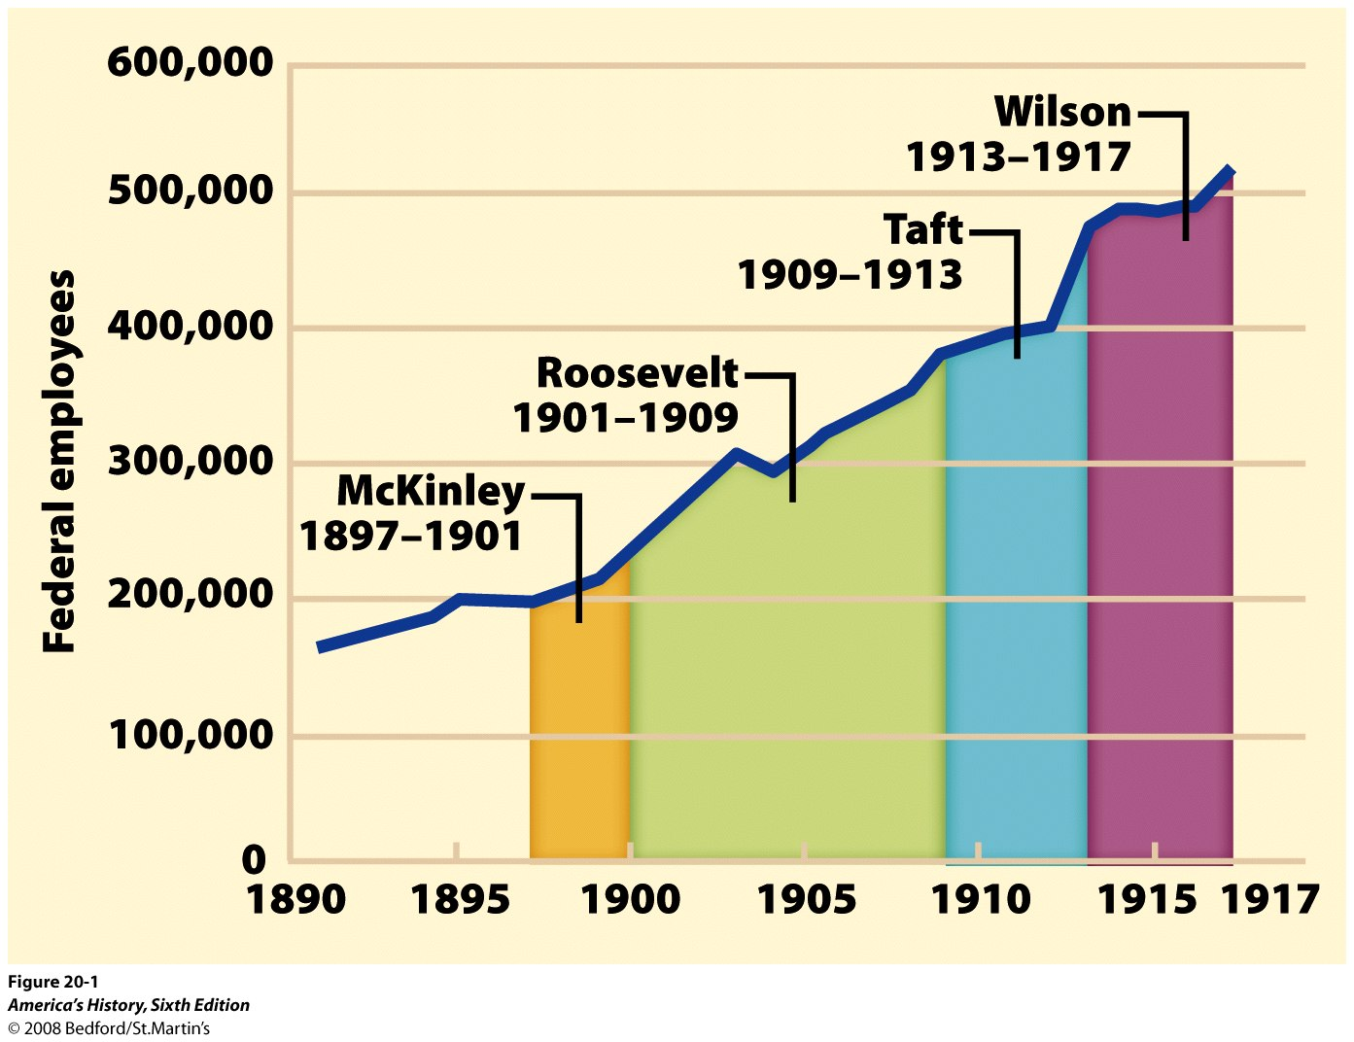
Look over the chart. How are these Presidents’ progressive reforms changing the federal government?

Slide 18
CONCLUSION:
How did the “PROGRESSIVE PRESIDENTS” influence Government?
Used the government as a means to reform & regulate big business/broke up unfair trusts
Government regulation/protection for consumers (pure food & drug act)
Regulated the money supply/attempted to add fairness to the tax system
Protected the environment/created the national parks system

Slide 19
Bye-Bye Progressives
End of the Progressive Era
World War I causes US to focus on war effort and not social change

Slide 21
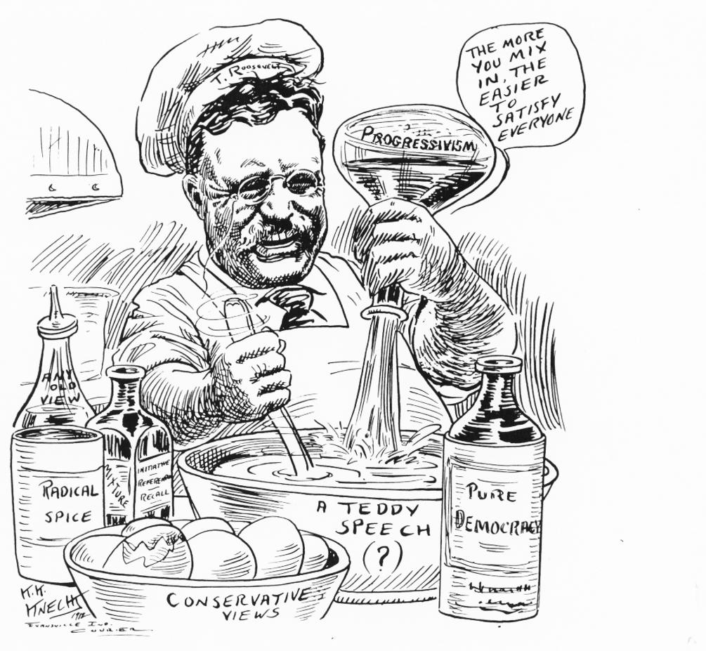
1005 × 927 - boundless.com

