Slide 1
Do Now
Please define the following:
Reform
Temperance
Abolition
Suffrage
“The spirit of reform is in every place…”
What aspects of society in the 1800’s do you think needed reforming? Why?

Slide 2
Antebellum Culture and Reform
Mr. Winchell
APUSH
Westward Expansion Era

Slide 3
Objectives
Students will be able to identify specific reform movements in the pre-Civil War Era and explain how they impacted America by utilizing guided notes, a review and recall worksheet, and reflection questions
Students will be able to continue to identify how society reflected growing tension between North and South towards a Civil War.

Slide 4
Essential Question
To what extent did individualism, new religious sects, abolitionism, and women’s rights (as the movement was called in the nineteenth century) change American culture between 1820 and 1860?
How did the economic and democratic revolution in the early 1800’s impact reform movements?

Slide 5
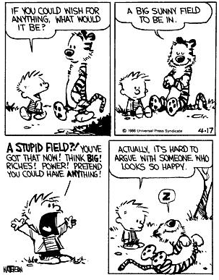
The Transcendentalists
“Nothing is at last sacred but the integrity of your own mind.”
-Ralph Waldo Emerson
“I went to the woods because I wished to live deliberately, to front only the essential facts of life and see if I could not learn what it had to teach, and not, when I came to die, discover that I had not lived.”
-Henry David Thoreau

Slide 6
The Transcendentalists
Intellectual movement rooted in religion.
Questioned the constraint of the church.
Embraced human passion and sought deeper insight into the mysteries of existence.
Rejected organized religion.
Wanted to rediscover relations with nature.
Emerson worried that the new market society was destroying Americans’ spiritual lives.

Slide 7
The Mormons
Joseph Smith: young, energetic, economically unsuccessful (or poor…).
Religious utopians with a conservative social agenda: to pursue close-knit communities and patriarchal power.
Provoked a lot of animosity.
Smith believed God had chosen him to be a prophet of the Book of Mormon, which he published in 1830.
Harassed by anti-Mormons, Smith moved his people from New York, all the way to Utah, with a few stops.

Slide 8
Mormons

Slide 9
Urban Popular Culture
As Utopian movements fled the city, rural migrants and foreign immigrants created a new urban culture.
In 1800, American cities were overgrown towns with rising death rates.
Jobs were hard to come by and didn’t pay well.
Much of population was between 15-20
Many turned to sex for income.
In 1855, NYC had 500 brothels
Notes:
NYC 60,000
PHI had 41,000 and life expectancy was 25 years.
By 1840, NYC 312,000
PHI 150,000

Slide 10
Urban Popular Culture
Minstrel shows became popular.
White actors in blackface presenting comic routines that combined racist ideas with social criticism.
By the 1840’s, there were hundreds of minstrel troupes.
Ridiculed the drunkenness of Irish immigrants, the halting English of German immigrants, denounced women’s demands for political rights and mocked the arrogance of upper-class men.

Slide 11
Immigrants and Nativism
By 1850, immigrants played a huge role in the Northeast.
200,000 Irish men and women in NYC.
110,000 German men and women in NYC.
The American Catholic Church became Irish dominated and the Democratic Party gave them a foothold in the political process.
Native-born New Yorkers were alarmed at the new minorities and established the nativist movement.
Called for a halt to immigration.
In 1844, the American Republican Party swept the city elections by focusing on temperance, anti-Catholicism, and nativism.

Slide 12
Abolitionism and the Crusade Against Slavery
In 1831, William Lloyd Garrison started a weekly Abolitionist newspaper called the ‘Liberator.’
Garrison’s point of view was simple, but revolutionary.
‘Opponents of slavery should view the institution from the point of view of the black man, not the white slave-owner.’
Garrison attracted a large group of followers in the North and founded the New England Antislavery Society in 1832 and the American Antislavery Society the following year.

Slide 13
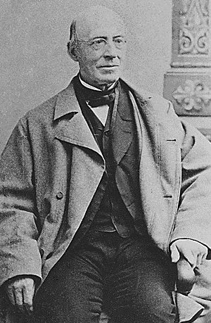
Abolitionism and the Crusade Against Slavery
By 1835, there were more than 400 chapters of the two societies.
By 1838, there were 1,350 chapters with over 250,000 members.
Garrison stressed that to truly end slavery, America must extend to African Americans all the rights of American citizenship.

Slide 14
Abolitionism and the Crusade Against Slavery
Abolition was obviously very appealing to free African Americans in the North.
In 1850, 250,000 free African Americans lived in the North, mostly concentrated in cities in areas of extreme poverty.
Northern blacks had little access to education, could rarely vote, and weren’t able to get good jobs.
They were often victimized by mob violence.
Despite these conditions, they were very aware of and very proud of their freedom.

Slide 15
Abolitionism and the Crusade Against Slavery
Frederick Douglass, an escaped slave, became a very popular and vocal crusader against slavery.
He was a fantastic speaker and spent two years lecturing in England to prominent British anti-slavery groups.
He founded the antislavery newspaper, ‘The North Star’ in 1847.
He demanded not only freedom, but full social and economic equality as well.
With Douglass’ leadership, black and white abolitionists became more organized and influential.

Slide 16
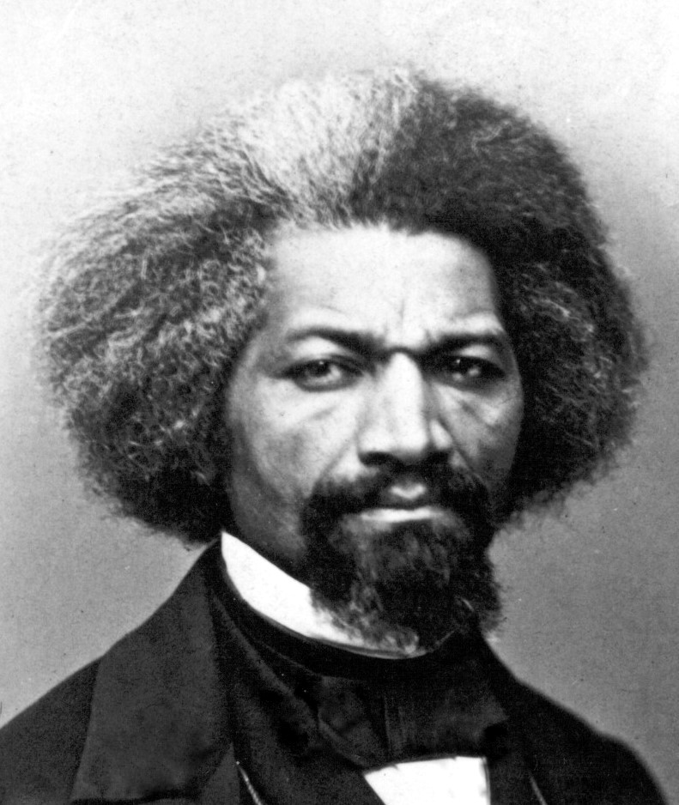
Abolitionism and the Crusade Against Slavery

Slide 17
Opposition to Abolition

Slide 18
Underground Railroad

Slide 19
Redefining Gender Roles
Feminism begins taking a role in society.
Women began fighting for abolition and realized they were also limited with their rights in society
As some aspects of society (Like the Transcendentalists) questioned the traditional role of women in society.
Women taking a role in the workplace helped change society’s perception of them and their perception of themselves.
Seneca Falls Convention, 1848
Grew out of the Abolition Movement.
Created a ‘Declaration of Sentiments’ similar to the Declaration of Independence.

Slide 20
Temperance
One of the most influential reform movements of this time was against alcohol.
Many argued that no social vice was more responsible for crime, disorder, and poverty than the excessive use of alcohol.
Women played a prominent role in this movement.
‘Men are spending money on alcohol that their families needed for necessities and drunken husbands often abused their families.’

Slide 21
Temperance
Supply of alcohol increased greatly.
Farmers in the west grew more grain than they sold, so much of it was made into whiskey.
Drinking became much more of a social pastime.
The average male in the 1830’s drank almost 3 times as much alcohol as today.
1826: The American Society for the Promotion of Temperance emerged as an agency to push for limiting of alcohol in society.

Slide 22
Reforming Education
In 1830, no states had a system in place for universal education.
Education was emphasized as a way to encourage social stability.
‘The only way to protect democracy is to create an educated electorate’ –Horace Mann, Massachusetts Board of Education.
Schools were somewhat created in response to industrialization: order, discipline, punctuality, respect for authority, but also tended to emphasize democracy and individual opportunity.

Slide 23
Reflection
To what extent did individualism, new religious sects, abolitionism, and women’s rights change American culture between 1820 and 1860?
How did these changes reflect changes in other aspects of society during this time period?

