Slide 1
Do Now:
Presented by: Andy Sazo
Identify key strengths and weaknesses for the British entering the conflict.
Identify key strengths and weaknesses for the Colonists entering the conflict

Slide 2
The Revolutionary War
Mr. Winchell APUSH
Period 3

Slide 3
Questions to Consider
Politics and Power: What accounted for the colonial victory over the British?

Slide 4
The Outbreak of Revolution
The British entered the war confident of a complete victory:
Their army was 400% larger; well-trained solders, experienced officers, & Hessian mercenaries
Strong manufacturing base
The world’s most dominant navy
Believed the 1776 battles were a “police action” & the show of force would force rebels to submit
Notes:
21

Slide 5
The Outbreak of Revolution
In reality, England faced an impossible task:
Their long supply lines across the Atlantic would not be able to provide timely provisions
The American terrain was large
To win, the English had to find & defeat the Continental Army
Underestimated the colonial commitment to independence

Slide 6
The American Revolution, 1775-1781
Where was the American Revolution fought?

Slide 7
Early Battles
General William Howe captured NYC.
Goal: Seize Hudson River and isolate New England.
August 1776, Howe defeats the Americans in the Battle of Long Island.
War almost ended on Manhattan Island with the Continental Army almost trapped.
Winter came just in time for Patriots.

Slide 8
Wartime Economy
Inflation.
Blockades.
Lack of Taxable Income
Smaller than promised military force.
Scarcity
Basically life sucks…
Taxes?

Slide 9
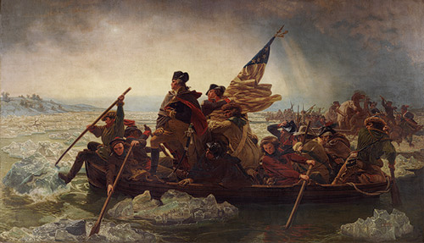
Washington! America!

Slide 10
Strategy
British: Convince the Colonists they have no chance and they should just give up.
Colonists: Play Defense. String the British Out. Counter Attack.

Slide 11
Saratoga: Turning Point
Attack by British.
Goal: Isolate New England by attacking Albany, NY with 3 groups.
Howe takes Philadelphia.
Doesn’t mean surrender.
Continental Congress fled to countryside.
Other group, led by Burgoyne, gets stuck and isolated, surrounded by Colonists.
Patriots captures more than 5,000 British troops

Slide 13
Why Saratoga?
…was a great turning point of the war, because it won for Americans the foreign assistance which was the last element needed for victory.
France wanted to help the Patriots.
Worried Patriots had no shot to win.
Saratoga convinced France there was a chance.
King Louis XVI wanted revenge on Britain, saw this as a change, sent aid, military support, supplies, etc. and forced Britain to divert resources.
Franklin and other diplomats pledged that neither would sign a separate peace.
Notes:
War also becomes much less popular in England.

Slide 14
Valley Forge
Winter of 1777
“The army now begins to grow sickly.”
Terrible location
Army lost over 4,000 soldiers in one winter.
Baron Von Steuben saved the day.
Smaller army, but better

Slide 15
Yorktown
Washington’s troops marched towards the coast of Virginia.
French fleet took control of the Chesapeake.
Cornwallis surrendered in October, 1781.
“Isolated diplomatically in Europe, stymied diplomatically in America, and lacking public support at home…”

Slide 16
The Treaty of Paris (1783)
The Treaty of Paris in 1783 was negotiated with England by Franklin, John Adams, John Jay
The terms included:
Full American independence
All territory east of Mississippi River, between Canada & FL
The removal of the British army from U.S. claims in America
Fishing rights in the Atlantic
Florida back to Spain (T. of Versailles)
Notes:
28

Slide 17
North America after the Treaty of Paris, 1763

Slide 18
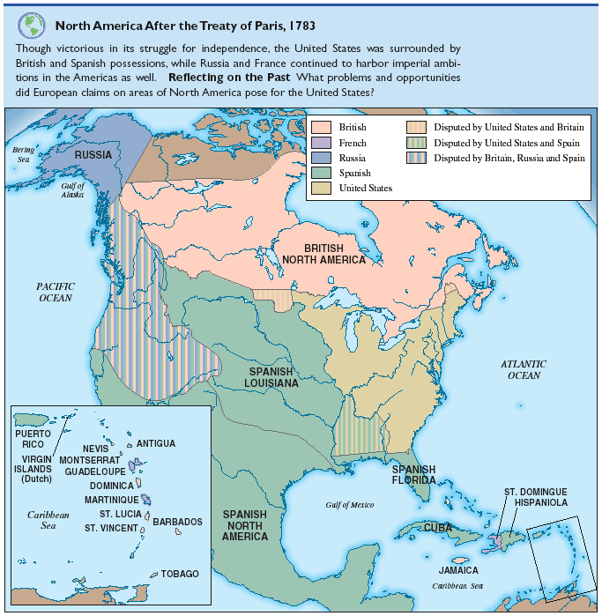
After the TOP 1783

Slide 19
Preserving Independence
After 176 years of British rule, the American Revolution began the construction of a new form of government
But...will the new United States be a government of the elite or a government of the people?
Next: To what degree did 1776 bring about a social revolution?
Notes:
29

Slide 20
Articles of Confederation
Each state retains its “sovereignty, freedom, and independence”
Unicameral legislature and weak national government
No executive or judicial system
Could not regulate interstate commerce
Limited taxation
Voting and Ratification
Each state received one vote
No new tax or amendments without unanimous consent

Slide 21
Articles of Confederation

