Slide 1
The Rise of Colonial Assemblies
Mr. Winchell
APUSH Period 2 Day 4

Slide 2
Do Now
Presented by:
What was the South Atlantic System and how did it impact economic development in the Northern Colonies?
What was salutary neglect and how did it impact colonial society?

Slide 3
Questions to Consider…
IDENTITY: To what extend did British American colonists develop a sense of identity separate from that of English men and women?
IDENTITY: What factors encouraged and what factors impeded the development of an ‘American’ identity?
POLITICS AND POWER: In what ways did British American colonists model their political institutions on England? How did these colonists adapt these institutions in a way that seemed uniquely ‘American’?

Slide 4
AP Concepts

Slide 5
SOUTH ATLANTIC SYSTEM
New England Farmers: Bread, Lumber, Fish, Meat, Wheat, Corn to the West Indies.
1750’s: 2/3 of New England’s Exports and ½ of Middle Colonies Exports went to the West Indies.
Sugar from the Indies to England.
Slaves to the West Indies.
Manufactured Goods, textiles, iron goods to the US.
Notes:
The Northern Maritime Economy
A. The Urban Economy
1. American merchants – West Indian trade created American merchant fortunes and urban industries among sugar producers, distillers, fishermen, and export businesses.
2. American cities – Transatlantic commerce spurred the growth of port cities; by 1750, major cities included Newport and Charleston with 10,000 people each; Boston had 15,000 residents; and New York had nearly 18,000. The largest port was Philadelphia, whose population reached 30,000 by 1776.
3. American shippers and teamsters – American shippers traversed Atlantic but also the Hudson and Delaware rivers; teamsters transported wheat, corn and flour to urban markets; transportation spurred new businesses such as taverns, horse stables, and barrel-making shops.
.

Slide 6
Urban Economy
1. Upper classes
Upper classes – Wealthy merchants dominated American cities; imitated British upper classes through architecture, consumption, and genteel culture.
2. Middle ranks
Middle ranks – Artisans and shopkeepers made up nearly half the population. Innkeepers, butchers, seamstresses, shoemakers, weavers, bakers, carpenters, masons and other skilled workers lived in modest comfort, but most artisans were not well-to-do.
3. Lower classes
Lower classes – Laboring men and women made up 30 percent of urban population; they were dockworkers and unskilled wageworkers, washerwomen, wool-spinners, servants, or prostitutes.
Notes:
6

Slide 7
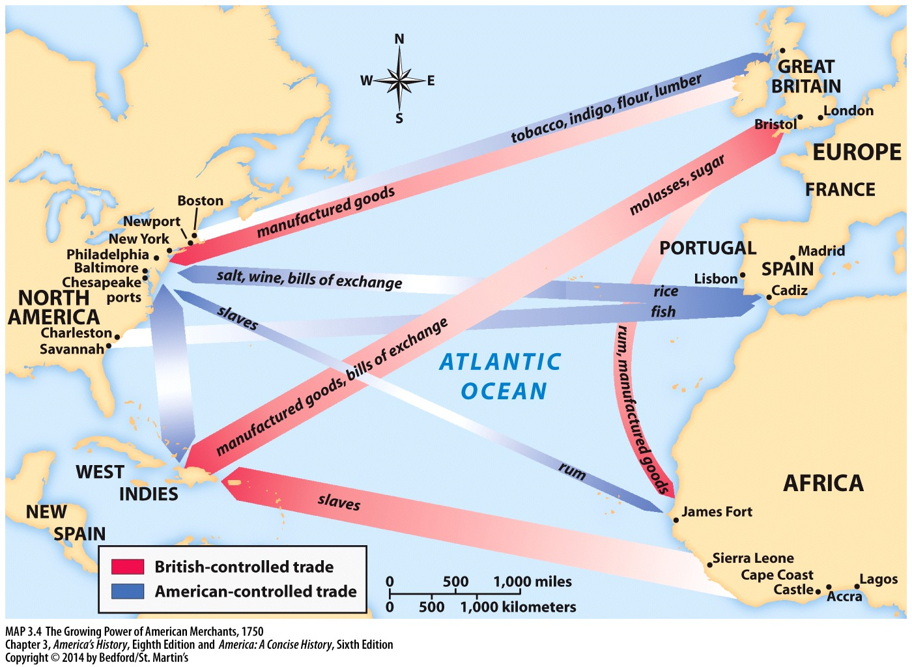

Slide 8
The New Politics of Empire, 1713–1750
The Rise of Colonial Assemblies
– Post-Glorious Revolution, assemblies in the colonies sought to limit the power of the crown; colonial elite led assemblies; men of wealth could be elected, but all men who owned property could vote.
MA, NC, NJ, PA: Assembly ignored king’s requirement to pay the royal governor.
Took control of taxation
Assemblies were ruled by the colonial elite, but common people had input.
Notes:
V. The New Politics of Empire, 1713–1750
B. Salutary Neglect
1. Salutary Neglect – Bureaucrats in England relaxed control over colonies when they were happy with the relationship (pleased by financial benefits); colonists took advantage of this relationship by increasing the power of their representative assemblies.

Slide 9
Salutary Neglect
Bureaucrats in England relaxed control over colonies when they were happy with the relationship (pleased by financial benefits); colonists took advantage of this relationship by increasing the power of their representative assemblies.
Sir Robert Walpole (Leader of the House of Commons post Glorious Revolution) practice a policy of patronage.
Patronage: giving offices and salaries to political friends.
Walpole: “Let sleeping dogs lie.”
These policies accidentally created a developing American identity.

Slide 10
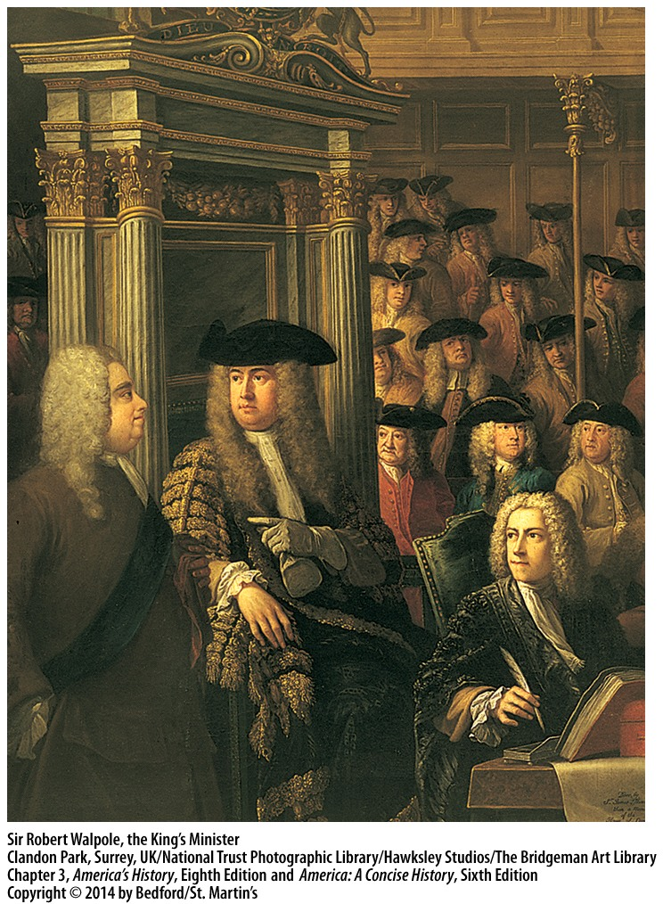

Slide 11
Mercantilism and the American Colonies
Britain allowed Americans to own ships and transport goods
Colonists made significant gains in control of exports during 18th century
Increased trade relationship with the French sugar islands.
Lack of currency in colonies further complicated financial relationships
In 1751, Parliament passed the Currency Act, which barred New Englanders from establishing new banks and prohibited the use of publicly issued paper money to pay for private debts
The English attempted to regain control of colonial economic pursuits. In the late 1740s, British officials vowed to reassert their power in America—an initiative that proved to have disastrous results.

