Slide 1
Road to Revolution
Mr. Winchell
APUSH
Period 3 Day 3

Slide 2
Do Now
Presented by:
What was the first Continental Congress’ purpose? What was the result of their discussions?
Why were many individuals (Loyalists) still loyal to England before the Revolutionary War began?

Slide 3
Quote to Consider…

Slide 4
Committees of Correspondence
In Boston (of course), Patriots warned Americans of imperial domination and began a committee to communicate grievances to England and with each other.
Soon, Virginia and other assemblies followed.

Slide 5
Tea Act
May 1773
Financial relief for the East India Company, deeply in dept.
Kept American shopkeepers out of the tea game and ‘forced’ Americans to buy their tea from this British company.
Monopoly

Slide 6
Boston Tea Party
Sons of Liberty
Disguised as Native Americans, went aboard 3 ships and destroyed $900,000 (today’s money) in tea.
“This destruction of the tea must have so important consequences, that I cannot but consider it as an epoch in history.”
John Adams.
King is pissed. “Concessions have made matters worse.”

Slide 7
Coercive Acts (Intolerable Acts)
Response to Boston Tea Party.
Massachusetts:
Pay for the tea.
Submit to imperial authority.
Boston Harbor closed to shipping.
Prohibited town hall meetings
New Quartering Acts
Trials now in Britain, not colonies for capital crimes.
“The cause of Boston now is and ever will be considered as the cause of America.”
George Freakin’ Washington

Slide 8
First Continental Congress
In response to the Coercive Acts.
12 colonies sent reps.
Philadelphia, September 1774.
Differing Agendas!
Southern colonies wanted an economic boycott
New England wanted political union and independence
Middle colonies wanted compromise
Demanded a repeal of the Coercive Acts and removal of British regulations on all buy trade.
Threat of all out commercial warfare

Slide 9
Loyalists
Despite movements towards independence, many colonists were hesitant.
Many poor colonists thought the Patriots were only advocating independence for their own self interest.
Many were worried about anarchy/lack of government.
As Patriots took over local governments, Loyalists were persecuted and driven from homes/businesses.

Slide 10
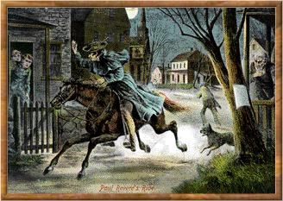
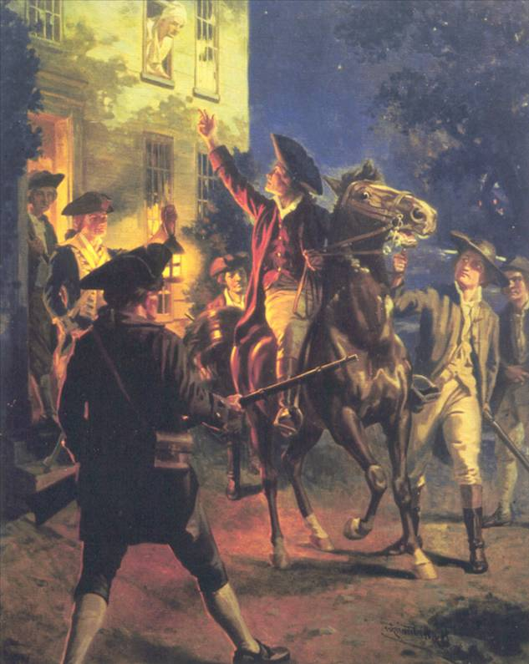
Here come the Brits!
Early on April 19, 1775, 700 British soldiers were secretly sent to destroy the military supplies the colonists had collected at Concord
After learning the soldiers’ destination, the Sons of Liberty sent Paul Revere & William Dawes to warn the Minutemen of approaching British soldiers.
Fighting between the Americans and the British broke out near Boston – a city occupied in 1774 by the British army under General Thomas Gage

Slide 11
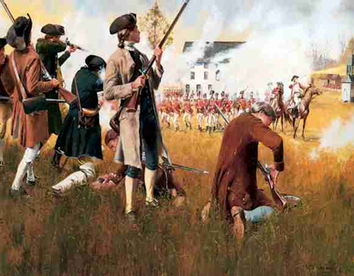
Lexington and Concord
When the British soldiers reached Lexington, Captain Jonas Parker and 75 armed Minutemen were there to meet them.
The Minutemen were greatly outnumbered. The British soldiers fired, killing 8 Minutemen and injuring 10 others.
While the British soldiers continued on their way to Concord, the men and women of Concord were busy moving the arms and ammunition to new hiding places in surrounding towns.

Slide 12
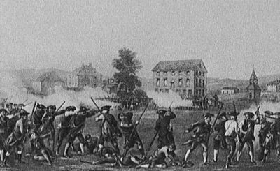
The British Retreat to Boston
A large force of patriots gathered in response to the British troops.
As the British soldiers headed back to Boston, they were attacked by the Minutemen.
All along the route, Minutemen, local farmers and townspeople continued the attack against the British.
By the time the soldiers reached Boston, 73 British solders were dead and 174 more were wounded.

Slide 13
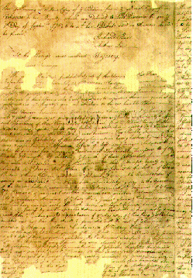
Second Continental Congress
The Second Continental Congress was a body of representatives appointed by the legislatures of several British North American colonies which met from May 10, 1775, to March 1, 1781
By the time the Second Continental Congress met, the American Revolutionary War had already started with the Battles of Lexington and Concord on April 19, 1775.
Thus, the Second Continental Congress found itself in the unenviable position of being the decision-making body of a military alliance at war with a far more powerful enemy.

Slide 14
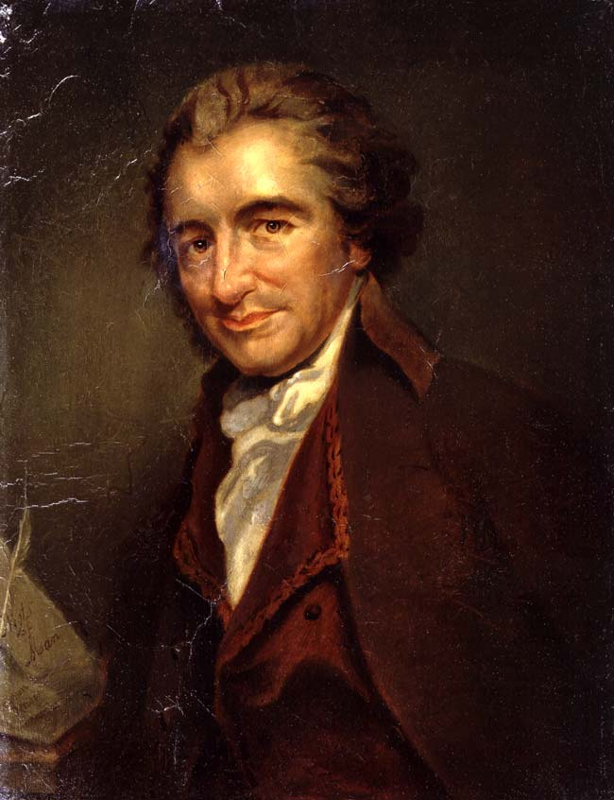
Thomas Paine and Common Sense
In January 1776, Thomas Paine published Common Sense
He attacked the strongest bond tying tying America to Britain – the King
He pointed out the advantages of freedom from British rule and commercial restrictions
The book divided Americans into either Patriots or Loyalists

Slide 15
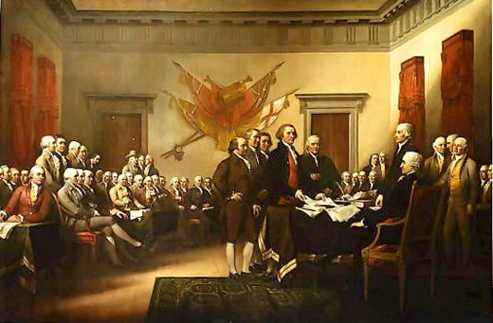
Independence!
Beginning in April of 1776, the colonies advised their delegates to vote for independence
On June 7th, Richard Henry Lee introduced a brief “Resolution of Independence”
On July 2nd, 1776, the Continental Congress adopted Lee’s resolution “that these united colonies are, and of right ought to be free and independent states.”

Slide 16
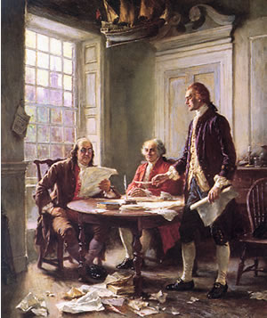
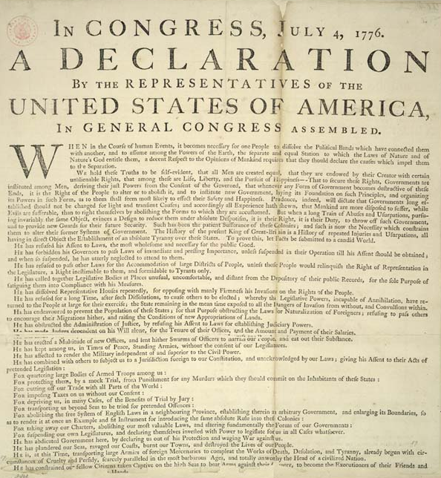
The Declaration of Independence
The Official Declaration of Independence was agreed upon on July 4th, 1776
Its purpose was to justify the Revolution, state that the colonies were independent and to express the nation’s principles
The rest is history!

