Slide 1
Do Now Presented by: Kevin Morales
What did the Supreme Court decide in the Dred Scott v. Sandford case? Why was it significant?
Why was the Republican party founded? Why was it able to grow so quickly?

Slide 2
John Brown & Secession!
Mr. Winchell
APUSH
Period 5

Slide 3
Standards
10.2 Students will be able to analyze all cultural, economic, and political pro and antislavery arguments and conflicts.
Students will be able to understand the rationale behind the compromise of 1850 and popular sovereignty.
Students will be able to determine the impact of the Kansas Nebraska Act and relate it to the emergence of the Republican Party
Students will be able to understand the cultural and political impact of the national career of Abraham Lincoln, the election of 1860, and secession by southern states.

Slide 4
Objective
Students will be able to identify the last steps to secession, including John Brown’s raid at Harpers Ferry and the election of Lincoln, by viewing a video clip, taking guided notes, & filling in a timeline.

Slide 5
Southern Democrats’ Concerns
Republican Party: gaining momentum and strongly anti-slavery.
Republican Party: pushed an economic platform that favored the interests of northern industrialists at the expense of Southern farmers.
High tariffs
Southern Democrats feared that a Republican victory in the election of 1860 would spell disaster for their economic interests and also threaten their ‘constitutional right,’ as affirmed by the Supreme Court, to hold slaves as property.

Slide 6
John Brown: Delusional Murderer or Martyr?
The South feared that radical abolitionism would attempt to alter their way of life.
Their fears came true with the actions of John Brown.
The same John Brown responsible for killing 5 proslavery settlers in ‘Bleeding Kansas.’
What is the definition of terrorist?
What is the definition of hero?

Slide 7
John Brown at Harpers Ferry
In October 1859, John Brown led a small group of followers, including his four sons and some former slaves, in an attack on the federal arsenal at Harpers Ferry.
His ‘plan’ was to use guns from the arsenal to arm Virginia’s slaves, who he expected to rise up and join his revolt…
It…didn’t work. Believe it or not.

Slide 8
John Brown at Harpers Ferry
Federal troops responded under the command of Robert E. Lee and captured Brown and his group after a 2 day siege.
Brown and 6 of his followers were tried for treason, convicted, and hanged by the state of Virginia.

Slide 9
John Brown Aftermath
Moderates in the North, including Republican leaders, condemned Brown’s use of violence.
Southerners were not convinced by their words.
Southern whites saw the raid as ‘final proof’ of the North’s true intentions—to use slave revolts to destroy the South.

Slide 10
John Brown Aftermath
John Brown spoke very simply at his trial of his humanitarian motives in wanting to free the slaves, making him a martyr to many antislavery Northerners.
After John Brown’s failed raid, more and more Americans understood that their country was moving to the brink of disintegration.
The election of 1860 would be a test if the union could survive.

Slide 11
The Election of 1860
As 1860 began, the Democratic party was the last hope for compromise.
At the national nominating convention in Charleston, SC, Stephen Douglas was the party’s leading candidate and the person most capable of winning the presidency.
His nomination was blocked by angry Southerners who thought Douglas was too moderate.

Slide 12
The Election of 1860
Northern and Southern Democrats split, with the North nominating Stephen Douglas and the South nominating John C. Breckinridge of Kentucky.
Northern Democrats and Douglas would run on a platform of popular sovereignty and enforcement of the Fugitive Slave Act.
Southern Democrats and Breckinridge would run on a platform of unrestricted extension of slavery in the territories and the annexation of Cuba

Slide 13
The Election of 1860
The Republicans met to nominate their candidate with the strong possibility of defeating a divided Democratic Party.
They created a platform that appealed to the economic self-interest of Northerners and Westerners.
Exclusion of slavery in the territories, a protective tariff for industry, free land for settlers, internal improvements to encourage western settlement, and a railroad to the Pacific.

Slide 14
The Election of 1860
To help ensure victory, the Republicans nominated a more moderate Abraham Lincoln instead of Senator William H. Seward, a well-known leader who was more radical on slavery.
In the South, secessionists warned that if Lincoln was elected, their states would leave the Union.

Slide 15
The Election of 1860
Fearing the consequences of a Republican victory, a fourth political party was created of former Whigs, Know-Nothings, and moderate Democrats, called the Constitutional Union Party.
They nominated John Bell of Tennessee, pledging enforcement of the law and the Constitution, and above all, preserving the Union.

Slide 16
The Election of 1860
The election results were predictable.
Lincoln won every free state in the North, which represented 59% of the electoral votes.
He only won 39.8% of the popular votes however, meaning there would be a minority president.
Breckinridge, the Southern Democrat, carried the Deep South.
Douglas and Bell got a few electoral votes from the border states.
Together, the 2 Democrats (Douglas and Breckinridge) received many more votes than Lincoln, but the populous free states had enough electoral votes to elect a president without the need for a single vote in the South.

Slide 17
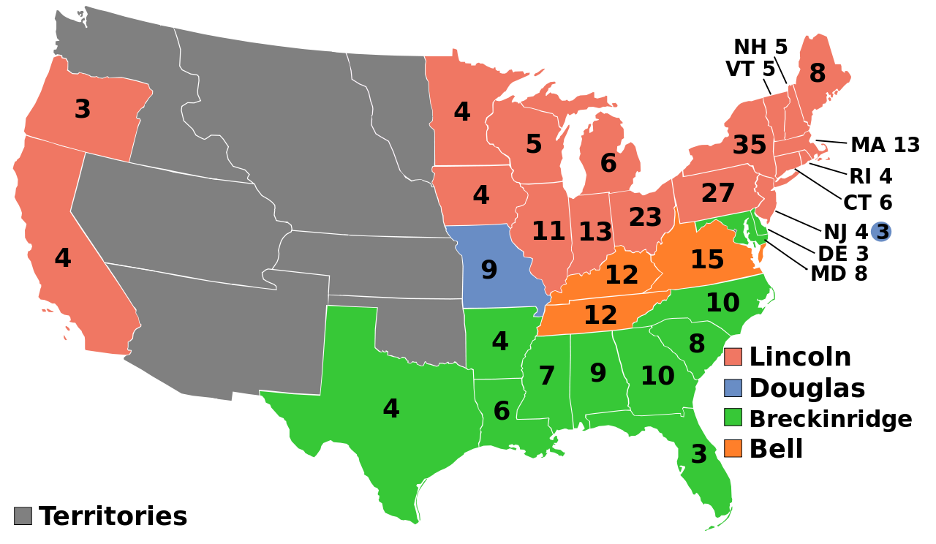

Slide 18
Secession of the Deep South
Despite the fact that Republicans controlled neither Congress nor the Supreme Court, the election of Lincoln was all that Southern secessionists needed to call for immediate disunion.
In December 1860 (before Lincoln even took office), a special convention in South Carolina voted unanimously to secede. Within the next 6 weeks, Georgia, Florida, Alabama, Mississippi, Louisiana, and Texas did the same.

Slide 19
Secession of the Deep South
In February 1861, representatives of the 7 states of the Deep South met in Montgomery, Alabama and created the Confederate States of America.
The constitution of this would-be Southern nation was similar to the US Constitution, except that the Confederacy placed limits on the government’s power to impose tariffs and restrict slavery.
Elected president and VP of the Confederacy were Senator Jefferson Davis of Mississippi and Alexander Stephens of Georgia.

Slide 20
Crittenden Compromise
A lame-duck president (a leader completing a term after someone else has been elected to his or her office), Buchanan had 5 months in office before Lincoln was scheduled to take over.
Buchanan did nothing to prevent the secession of the 7 states.
Congress was more active. Senator John Crittenden of Kentucky proposed a constitutional amendment that would guarantee the right to hold slaves in all territories south of the 36’30 line.
Lincoln said he could not accept this compromise because it violated the Republican position against extension of slavery into the territories.

Slide 21
Secession Complete
Southern whites who voted for secession believed they were acting in the tradition of the Revolution of 1776. They argued that they had a right and a responsibility to national independence and to dissolve a constitutional compact that no longer protected them from ‘tyranny.’
The tyranny of Northern rule in this case.
Many of them thought that Lincoln, like Buchanan had, might permit secession without a fight. They were badly mistaken.

Slide 22
