Slide 1
The South Expands: Slavery and Society 1800-1860
Mr. Winchell
APUSH
Period 4
Overlapping Revolutions

Slide 2
“Cotton is King”
“To sell cotton in order to buy negroes—to make more cotton to buy more negroes, ‘ad infinitum,’ is the aim of the thorough-going cotton planter. His whole body is wrapped up in the pursuit.”

Slide 5
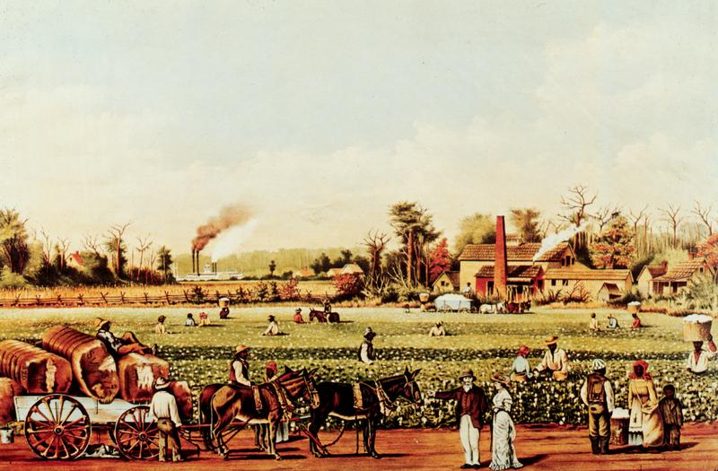
The South and Slavery
Plantation System
Cotton is King
“Planters”
Free Blacks
The Slave Experience
Abolitionist Activity
Southern Response

Slide 6
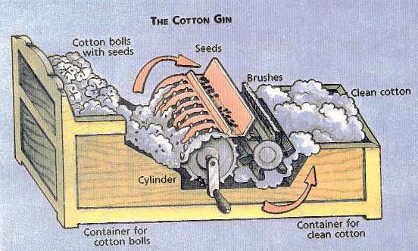
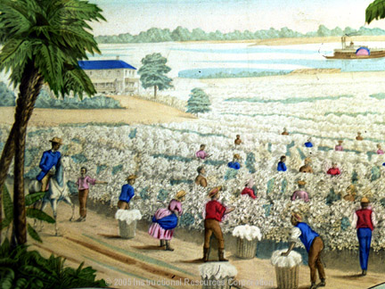
“Cotton is King”
Post Revolution - slavery faced an uncertain future.
Many southern leaders spoke of freeing their slaves.
Then…Eli Whitney’s cotton gin (1793) invented - made possible the wide scale cultivation of the crop.
Prior to this, cotton had to be cleaned by hand – labor intensive and expensive.
Allowed the crop to be cleaned quickly and cheaply lowering the cost of cotton.

Slide 7
The Domestic Slave Trade
The cotton boom shifted the African American population to the South and West. By 1830, hundreds of thousands of slaves labored on the cotton and sugar lands of the Lower Mississippi Valley and on cotton plantations in Georgia and Northern Florida
3 decades later, the majority of blacks lived and worked along the Mississippi River and in an arc of fertile cotton lands-the ‘black belt’, sweeping from Mississippi through South Carolina.

Slide 8
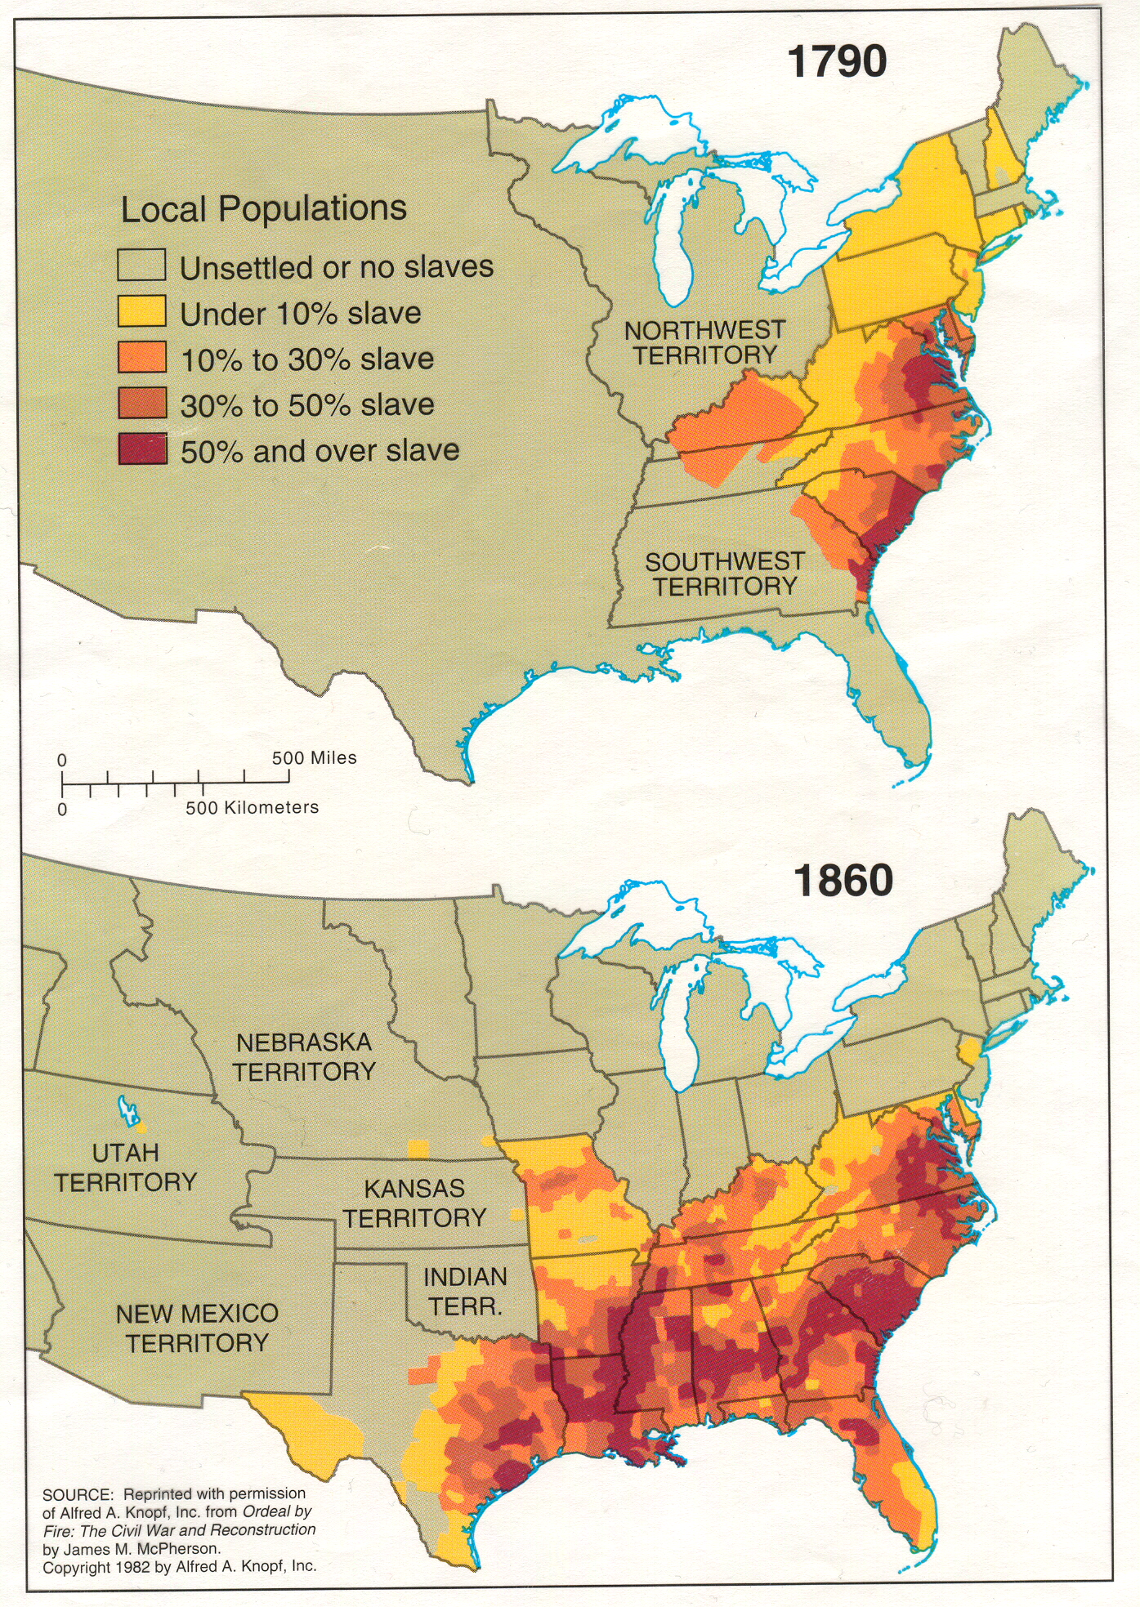

Slide 10
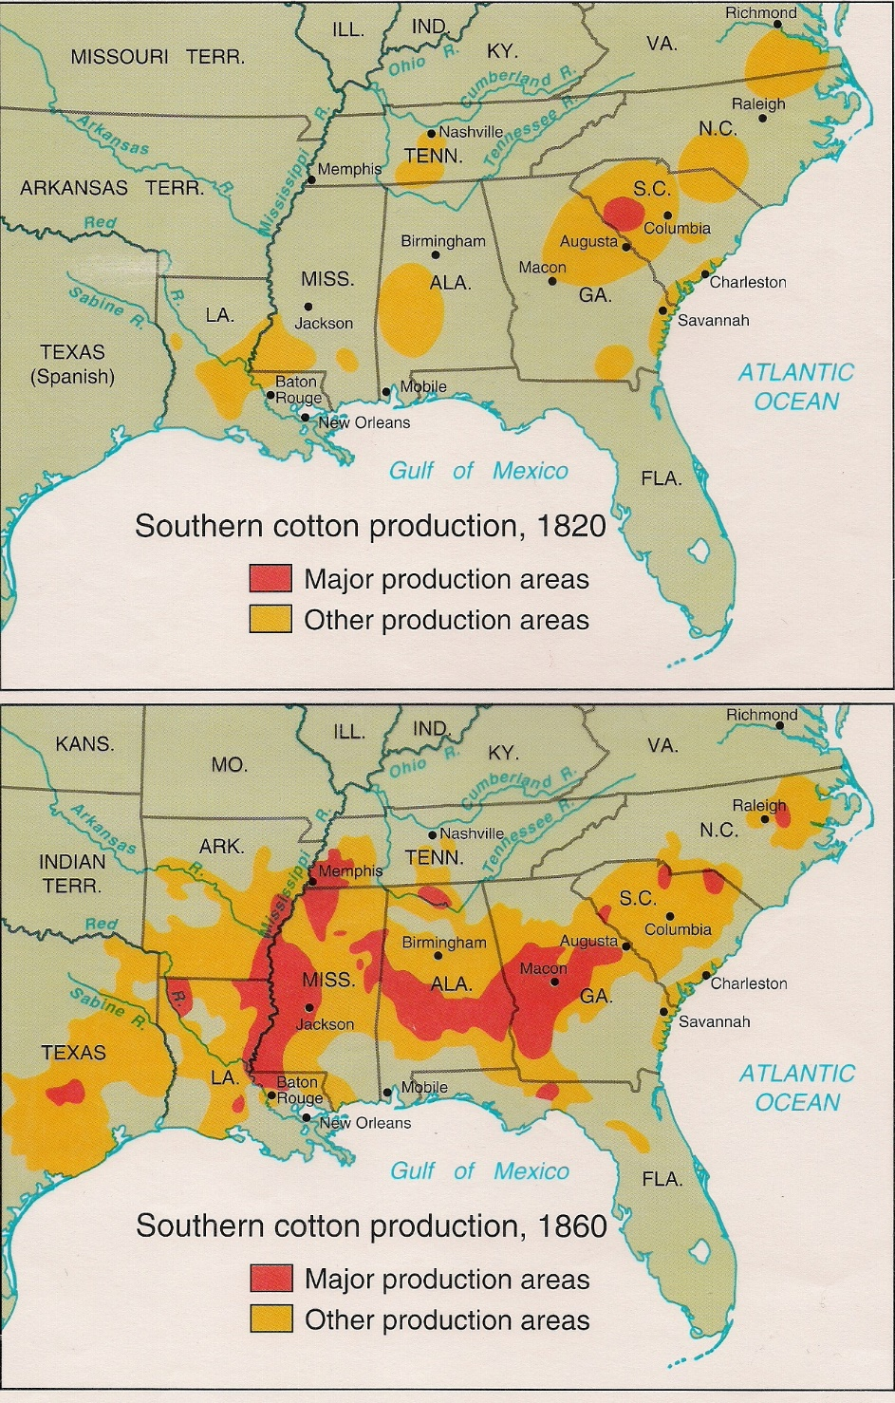
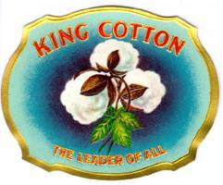
“Cotton is King”
Cheap cotton = the textile boom of both the North and Great Britain.
Southerners raced to grow more - created a HUGE demand for slave labor.
“King Cotton” -> economic growth in both the North and South (S. planters and N. shippers/manufacturers made huge profits).
Cotton production skyrocketed.
1840-60 - South produced over half of the world’s supply of cotton.
Cotton accounted for over half of all US exports.
75% of the cotton used in British textile mills came from the US South.

Slide 11
The Effect of the Cotton Gin

Slide 12
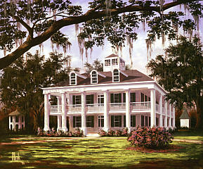
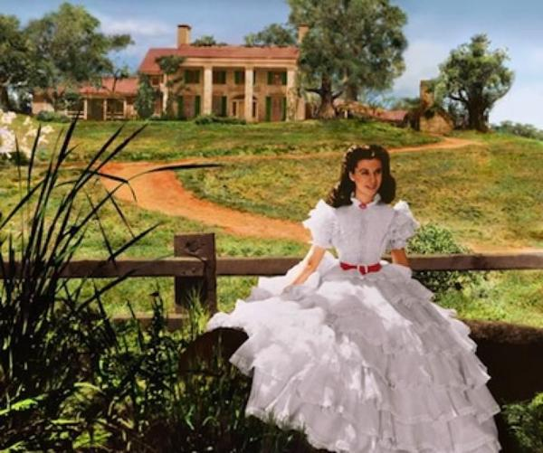
The Planters
Antebellum South image - nothing but wealthy plantations.
Reality - most southerners were still poorer farmers, very small merchant class in the few Southern “cities”.
25% of southern families owned slaves.
Most of these owned 1 to 4.
2% owned plantations with more than 50 slaves.
The wealthy plantation owners - dominant group.
Southern politics worked more like an oligarchy (rich planters controlling most southern governments).
Poorer white farmers - “hillbillies” or “poor white trash” supported the slave system (one day they could buy a slave and their supposed racial superiority).
Appalachian white groups - despise the plantation system and slavery itself.

Slide 13
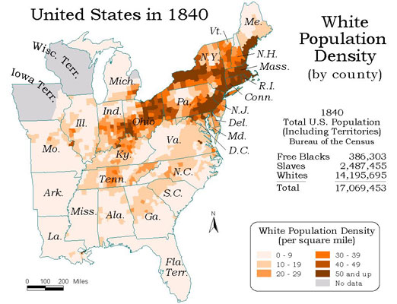
The Plantation System
Very unstable and unsustainable!
Relying on one crop was dangerous economically…if it goes under, the economy tanks.
A very small group of southerners controlled the money and power in the South – never good…
Led smaller farmers to sell land to huge plantations – land is finite…therefore your earnings are too.
The North make exponential profits off cotton production – the system is set up for the North to economically grow…the south is not.
Led to a mostly Anglo-Saxon (British descendants) , white population – immigrants were not used on plantations as laborers.

Slide 14
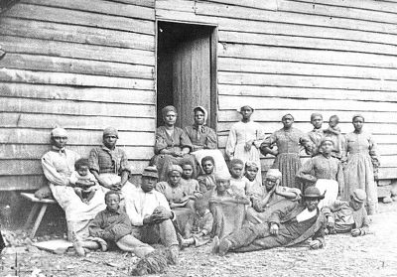
Free Blacks
Free blacks lived in both the north and the south.
South - worked in agriculture as day laborers, some were artisans or owned property (including slaves).
North – worked in lowest level jobs available.
How did one become a “free black”?
Emancipation in the revolutionary age.
Freed mulattoes (white master and black mistress).
Slaves purchased freedom from extra labor after hours.
1860 population - 4M slaves (250k southern free blacks and 250k northern free blacks).

Slide 15
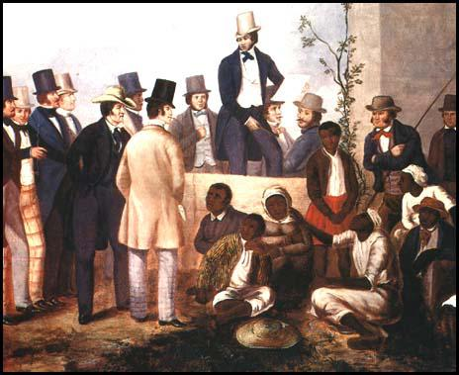
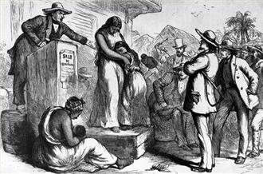
Life as a Slave
Slave trade ended in 1808, GB ended slavery trade in 1807 – West African Squadron – freed slave ships in the high seas.
Increased activity of internal slave markets – slaves were seen as economic investments (slaves were primary source of wealth in South).
Slaves weren’t given work that was overly dangerous (RR tunneling given to the Irish and Chinese immigrants) – needed them alive.
How do we get more slaves…births and children! – sexual exploitation is common.
Children (around adolescence) were sold – families divided all across the South.

Slide 16
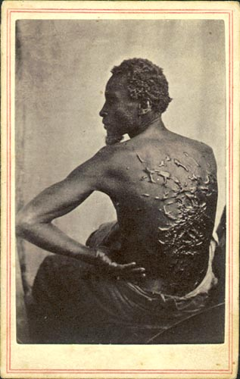
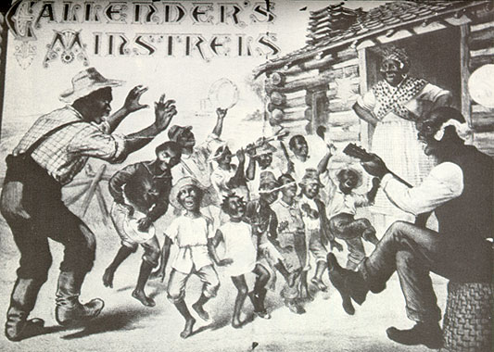
Live as a Slave
Most slaves worked on farms, some worked in cities as skilled laborers.
Southern plantation slaves:
Image: South attempted to portray the image of the “happy slave.”
The Reality: Harsh working conditions, very long hours, no rights, no access to education, cruel punishment for rule breakers (whipping or flogging).
Strong willed slaves – sent to “Breakers.”

Slide 17
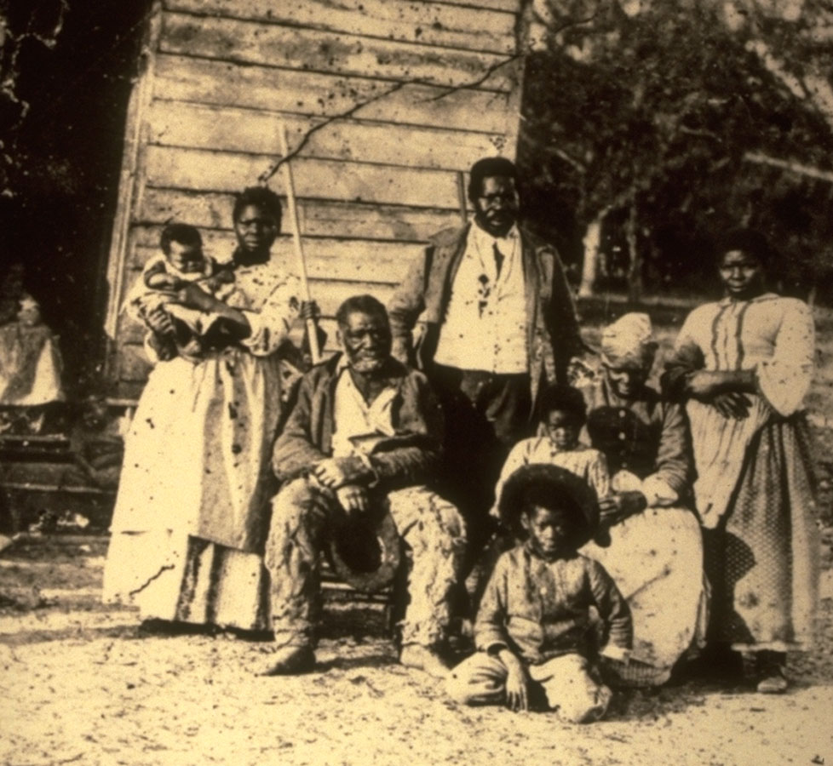
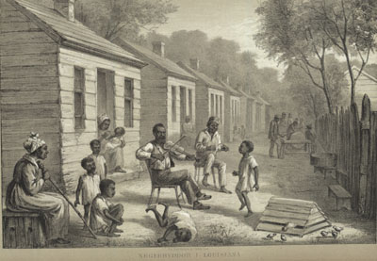
Live as a Slave
Most densely populated areas – deep south (Cotton Kingdom – SC, GA, MS, AL, LA).
Larger plantations – 20+ slaves created stable communities and less family divisions.
Despite hardships – slaves promoted their own culture (a mix of African and Christian cultures).
Central “gathering” place (free or slave) of the black community – church (led to the creation of AME church).
It was a source of opportunity, support, and education.

Slide 18
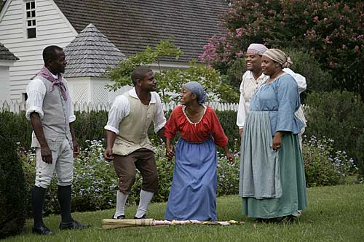
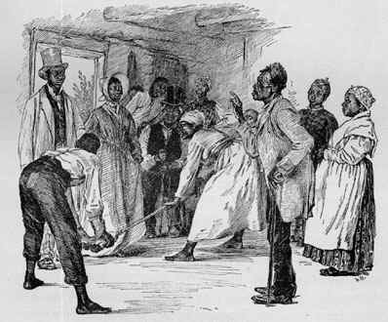
Jumping the Broom

Slide 19
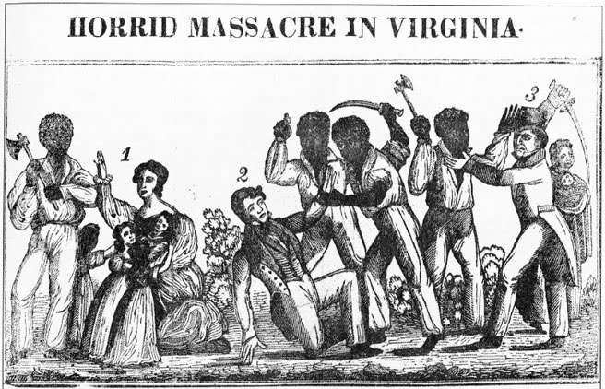
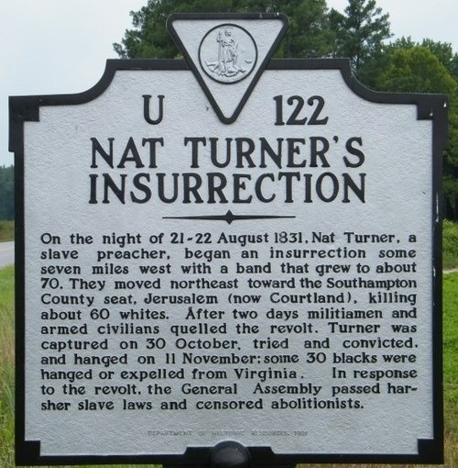
Slave Rebellion
Found ways to subvert the Plantation System.
Work slowly to slow production – gave the stereotype that Blacks are lazy.
Stole food from the owner’s home.
Sabotaged equipment.
Nat Turner’s rebellion (1831 in Virginia) - attacked several plantations and killed many white inhabitants.
A failure - he and his men captured and executed.
Had opposite effect - strengthened the resolve of southerners to control their slaves (made conditions worse for slaves).

Slide 20
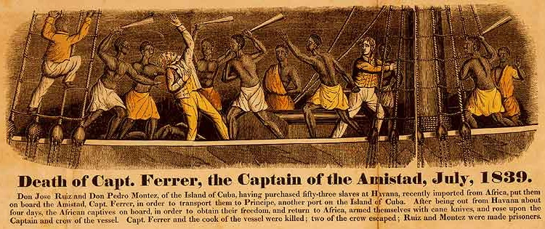
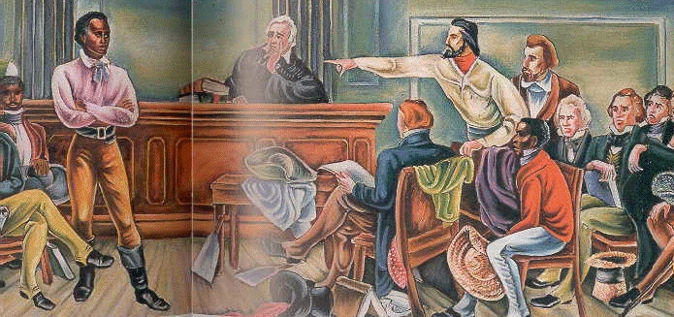
Slave Rebellion
Amistad rebellion – slave mutinied ship ended up on American shores.
Eventually were liberated and sent to Africa.
Rebellions scared southern planters!
Southern states moved towards controlling slaves more strictly.
Rescinded rights of free blacks to vote.
Can’t purchase guns.
Can’t testify in court.

Slide 21
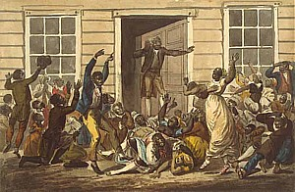
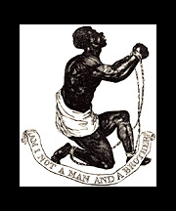
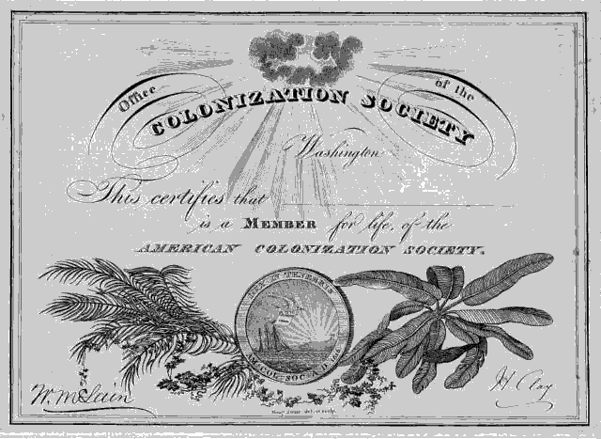
Early Abolitionist Activity
Abolitionism active since Revolutionary War - gained support in the early 1800’s (1833 - British freed their slaves).
American Colonization Society and African country of Liberia founded - set up to return slaves to Africa.
Movement picked up pace - 2nd Great Awakening pushed against the “sin” of slavery.
Connected being a good Christian to anti-slavery!

Slide 22
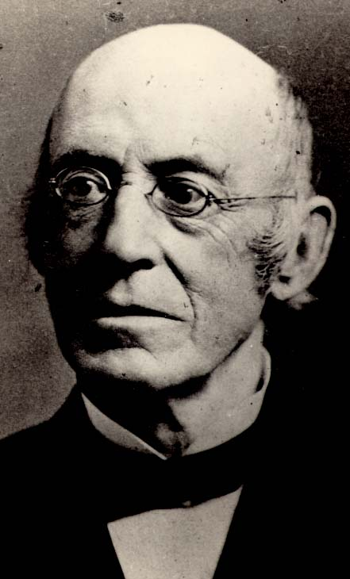
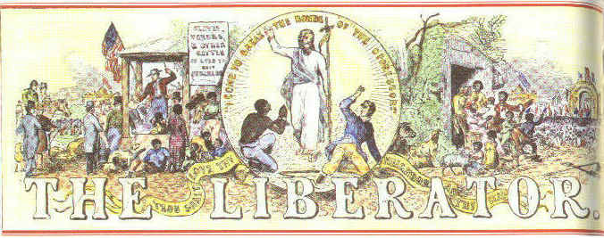
The Abolition Movement Grows
Harriet Beecher Stowe’s “Uncle Tom’s Cabin” – novel about a slave who sold to a plantation and a mother running to stop the selling of her son.
HUGE public response and outcry - making slavery a moral conversation (humanized slaves).
William Lloyd Garrison “The Liberator” – newspaper calling for the immediate emancipation of slaves.
Militant and uncompromising language intensifies the issue.
American Anti-Slavery Society founded – promoted mobility and growth of the movement.

Slide 23
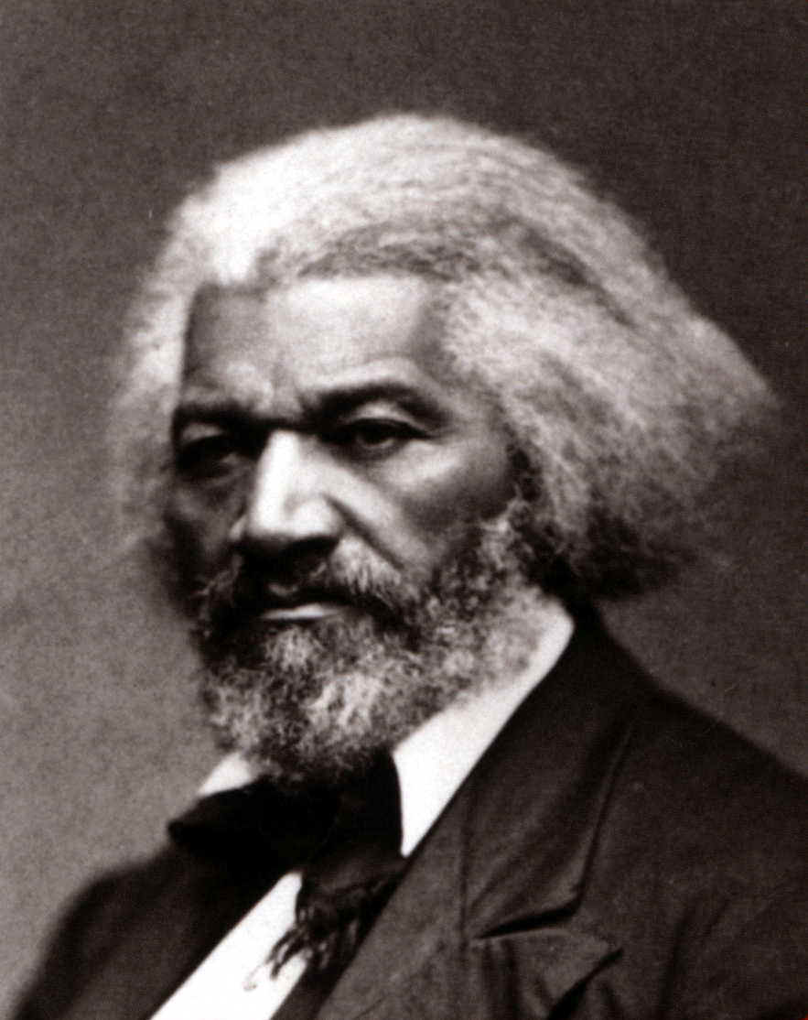
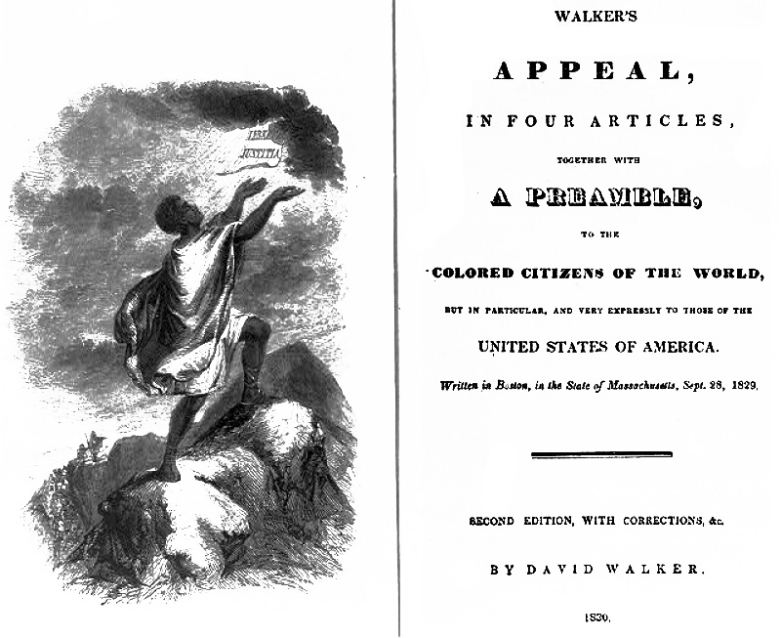
The Abolition Movement Grows
David Walker’s “Appeal to the Colored Citizens of the World” – called for violent uprising of slaves to overthrow white supremacy.
Fredrick Douglass’s “Narrative of the Life of a Slave” – self-educated to read and escaped slavery.
Used politics and more reasoned/practical – became the face of the movement.
Pro Abolition Political Parties - Liberty Party in 1840, the Free Soil Party in 1848, and eventually with the Republican Party during the 1850’s.

Slide 24
The Response to Abolition – In the South
In the South
Until 1830’s – Abolition was unknown…then Nat Turner’s Rebellion and Nullification Crisis.
The South is terrified! - Tightened slave codes
Promoted religious activity – to combat the view that Slavery was un-Christian.
Contrasted the image of the Happy slave to the sweatshop working immigrant of the North.
Passed the Gag Resolution – tried to stop any debate over slavery in congress.
Mobs broke in Charleston – burned anti-slavery propaganda.
In the North
Manufacturing needed plantations to succeed – cotton production for textiles.
Bankers loaned money to plantation owners – needed them to repay!
Therefore…most people were anti-abolitionist efforts.
However…some northern citizens start to change their minds
See the south as immoral and hateful.
Leads to ideas about “Free Soil” in the Western territories.

Slide 26
19
Period 4 Summary
- New intellectual and religious movements – Transcendentalism, Second Great Awakening, etc.
- Social reforms – Temperance, Suffrage, Abolition, Prison Reform, etc.
- Beginnings of the Industrial Revolution in America – Factory system, Transportation Revolution, Market Revolution, etc.
- Re-emergence of a second party system and more political democratization – Whigs, Rise of mass democracy!, etc.
- Increase in federal power → Marshall Ct. decisions, American System, etc.
- Increase in American nationalism…and elements of sectionalism – American System, Era of Good Feelings, Nullification Crisis, etc.
- Further westward expansion – Louisiana Purchase, Manifest Destiny, War with Mexico, etc.

