Slide 1
The Bill of Rights and the Federalist Period
Mr. Winchell
APUSH
Period 3

Slide 2
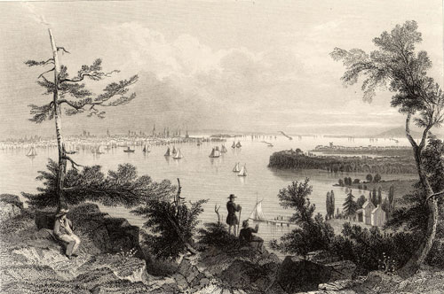
The Federalist Period, 1789-1800
“We are in a wilderness without a single footstep to guide us.”

Slide 3
Major Principles of the Bill of Rights
* Ratified in December 1791 by three-fourths of the states.
They are the first ten amendments to the U.S. Constitution.
* The first eight amendments spell out the personal liberties the states requested in order to ratify the Constitution.

Slide 4
Major Principles of the Bill of Rights (cont.)
1st Amendment guarantees citizens’ rights to freedom of religion, speech, the press, and political activity.
2nd and 3rd Amendments protect citizens from the threat of standing armies because the government cannot deny citizens the right to bear arms as members of a militia of citizen-soldiers, nor can the government house troops in private homes in peace-time.
4th Amendment prevents the search of citizens’ homes without proper warrants.
5th through the 8th Amendments guarantee fair treatment for individuals accused of crimes.

Slide 5
Major Principles of the Bill of Rights (cont.)
The 9th Amendment makes it clear that peoples’ rights are not restricted to just those specifically mentioned in the Constitution. Others may exist; it doesn’t mean they can be violated. (i.e. right to privacy)
The 10th Amendment clarifies that people and the states have all the powers that the Constitution does not specifically give to the national government or deny to the states.
*** The protection of rights and freedoms did not apply to all Americans at the time the Bill of Rights was adopted. Native Americans and slaves were excluded. Women were not mentioned. Free blacks were not fully protected.

Slide 6
Ideology of Factions
Federalists | Anti-Federalists
Supported removing some powers from the states and giving more power to the national government.
Wanted important political powers to remain with the states.
Favored dividing powers among different branches of government.
Wanted the legislative branch to have more power than an executive.
Proposed a single person to lead the executive branch.
Feared that a strong executive might become a king or tyrant.
Believed Constitution did not need a Bill of Rights
Wanted a Bill of Rights added to the Constitution
Notes:
1SS-E17. Describe the aspirations, ideals, and events that served as the foundation for the creation of a new national government, with emphasis on:
PO 4. Struggles over ratification of the Constitution and the creation of the Bill of Rights

Slide 7
Constitutional Interpretation
Strict Interpretation?
“Only do what the Constitution says the President can do.”
Limits the power of government
Loose Interpretation?
Elastic Clause
The Congress shall have power …To make all laws which shall be necessary and proper for carrying into execution the foregoing powers, and all other powers vested by this Constitution in the government of the United States, or in any department or officer thereof.
Strengthens the power of government

Slide 8
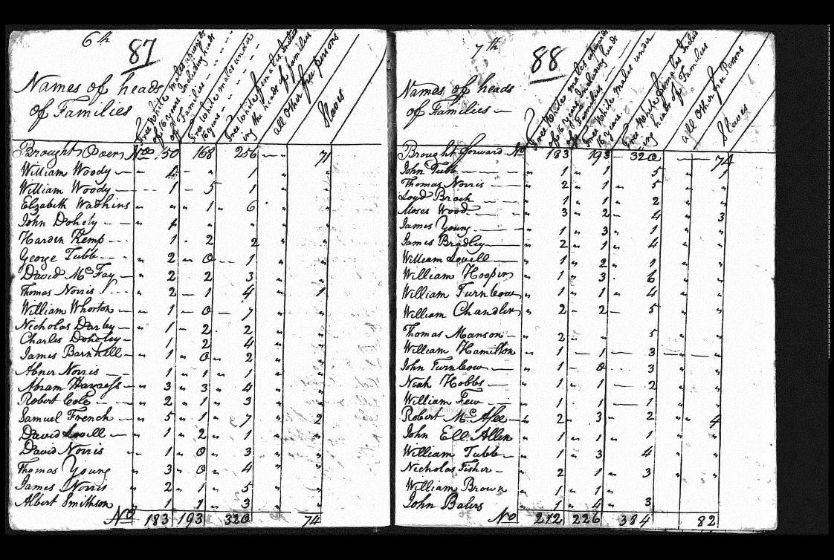
A. America in 1790
Population nearly 4 million
doubling every 25 years
90% of Americans lived on farms
Public debt large ($52 million) – revenue low.
Threats from GB and Spain threatened fragile unity of US

Slide 9
Washington’s Presidency
Established:
State Department (Foreign Affairs)
Thomas Jefferson-ANTI-FEDERALIST IDEALS
Treasury (Finance)
Alexander Hamilton-SUPER FEDERALIST
War
Henry Knox
Presidential Cabinet-Beginning of Presidential Bureaucracy

Slide 10
Judiciary Act of 1789
Established federal and state court systems with Supreme Court overseeing all.
Established judicial chain of command.
Federalists wanted strong national institutions.
Ensured federal judges (not state) would have final say on interpreting the Constitution.
Favoring Federalists or Anti-Federalists?

Slide 11
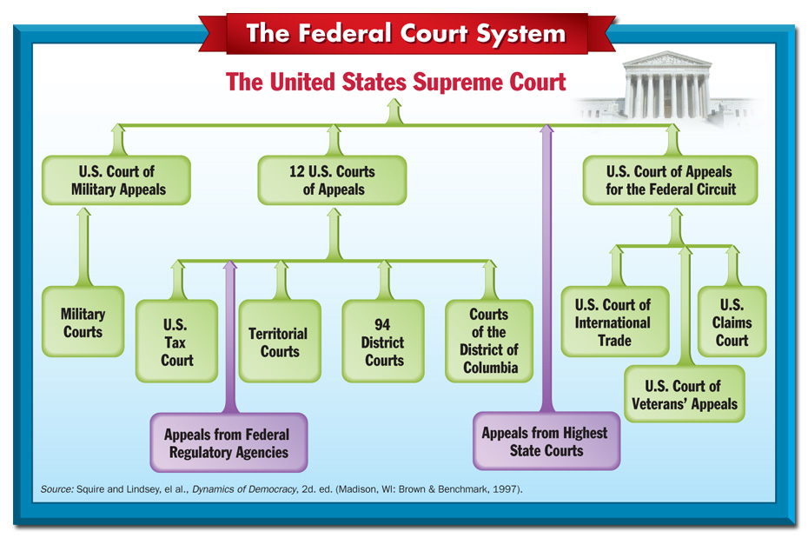

Slide 12
Hamilton vs. Jefferson
Federalist
STRONG national government
Government-assisted economic development
Tariffs
Subsidies
National Bank
Assume war debts of states
Congress granted 20 year charter to the bank
Pro-British
Anti-Federalist
WEAK national government
Anti Hamilton in every way
Agrarian (Farm) based society
Anti-wealthy society
Pro- French

Slide 13
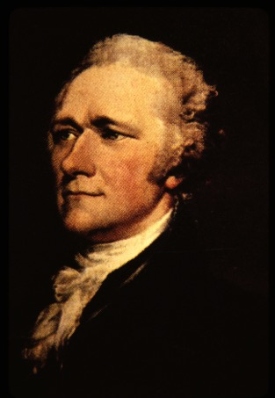
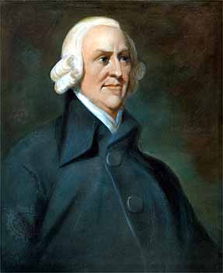
Hamilton’s Financial Plan
Report on Public Credit (1790)
Plan to shape fiscal policies of admin to favor wealthier groups.
In return wealthy would loan money to gov’t
Prosperity would trickle down to the masses
Report on Manufactures (1791)
Advocated promotion of factory system and capitalism (Adam Smith’s Wealth of Nations written in 1776)
Basis of his tariff plan to protect American manufacturers

Slide 14
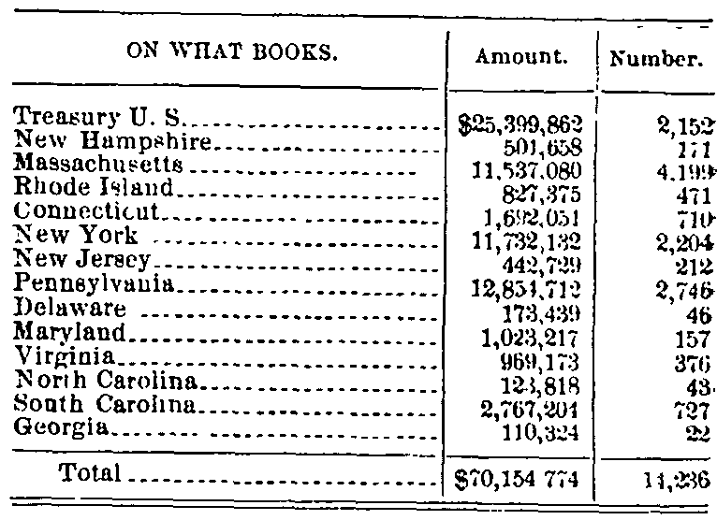
5 Components of A-Ham Plan
Funding
Pay back gov’t debt to bondholders them off with interest
Purpose to bolster national credit
Assumption of State Debts
Cement states to national gov’t
States with large debts favored (MA); states with little to no debt did not (VA)
Became a north v. south issue
Compromise: north got assumption of debts while south got national capital moved to Potomac

Slide 15
Tariffs
8% tariff on imports
Source of revenue but also aimed at protecting infant US industries.
Excise Taxes
1791 – $.07/gal tax on whiskey
Flowed freely in backcountry areas
A Ham not worried of effects on these ppl as they were mostly Anti-Feds

Slide 16
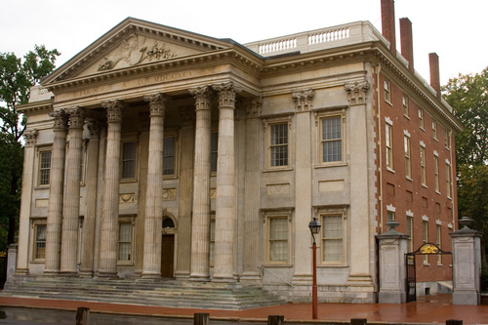
National Bank
Biggest issue
Treasury would place surplus revenue here
Gov’t would be major stock holder, but bank would be private institution
“Loose Constructionism” – powers not delegated to the national gov’t in Constitution are not prohibited by virtue of necessary and proper (elastic) clause.
Strongly Opposed by Anti-Feds
GW signed bank measure into law Feb. 1791
“Strict Constructionism” – Bank NOT within power of Congress to create
Jefferson and Madison felt states’ rights would be jeopardized by huge central bank.
Moneyed interests would take precedence over farmers
State banks would not be able to compete.

Slide 17
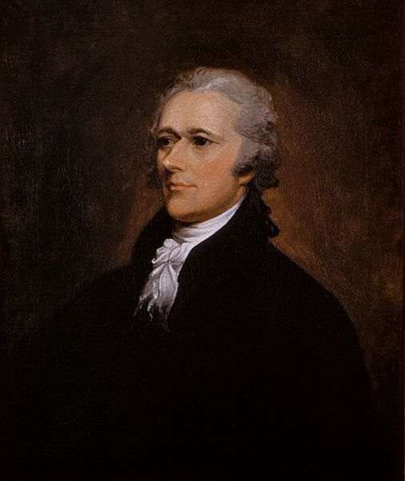
Political Parties
Political parties emerged over the following issues:
Relationship between national government and states – Federalists favored a stronger national government, Democratic-Republicans favored a smaller federal gov.
Economic Policy – Hamilton’s Financial Plan (Federalists) would strengthen the federal government – the creation of the BUS was NOT mentioned in Constitution
Hamilton argued the Necessary and Proper, or elastic clause
Foreign Affairs – Federalists favored Great Britain – trade and $, Democratic-Republicans favored France – saw French Rev. as an extension of American Rev.

Slide 18
FEDERALISTS
Emerged from the “federalists” who supported the Constitution in 1780s
Believed in gov’t run by the elite
Rich had more time to study problems of governing
Intelligent, educated and culturally literate
John Jay – “Those who own the country ought to govern it”
Distrusted the common people
Feared rule by “mobocracy”
Believed democracy too important to be left to the ppl.Supported a strong central gov’t
Fed’l gov’t should encourgae business, not interfere with it.
Dominated by merchants, manufacturers and shippers
Most lived on eastern seaboard where commerce flourished.
Pro-British in Foreign Policy
Trade with GB was key to Hamilton’s plan
Many Feds were mild Loyalists

Slide 19
JEFFERSONIAN REPUBLICANS
Advocated for rule of the ppl, for the ppl
Should be literate, but believed that “masses” could be taught
Appealed to middle-class (farmers, laborers, artisans, small shopkeepers)
Government that governed best, governed least
Bulk of power should be retained by states.
Limit federal power through strict interpretation of Constitution.
National debt was a curse that should be paid off ASAP
Believed in freedom of speech
Basically pro-French

