Slide 1
Podcast!
https://15minutehistory.org/2013/05/01/episode-21-causes-of-the-u-s-civil-war-part-1/

Slide 2
The Country Goes To War
Mr. Winchell
APUSH Period 5

Slide 3
1860 Election
Red – Lincoln
Yellow – Bell
Blue – Douglas
Green – Breckinridge
Purple – Non-Voting Territories
http://faculty.umf.maine.edu/walter.sargent/public.www/web%20232/sumter%20page.html
Notes:
Discussion:
Discuss popular vote and electoral vote.

Slide 4
Election of 1860
November 6, 1860: Lincoln Elected President
December 20, 1860: South Carolina secedes
January 9, 1861: Mississippi secedes
January 10, 1861: Florida secedes
January 11, 1861: Alabama secedes
January 19, 1861: Georgia secedes
January 26, 1861: Louisiana secedes
February 1, 1861: Texas secedes
March 4, 1861: Abraham Lincoln is inaugurated
Notes:
Was it the decision that all Americans were happy with?

Slide 5
Election of 1860 Secession?
YES
NO
“We,…the people of South Carolina…have solemnly declared that the Union heretofore existing between this state and the other states of North America, is dissolved….”
South Carolina Declarations
“Shall the people of the South secede from the Union in consequence of the election of Mr. Lincoln….? I tell you frankly, candidly, and earnestly that I do not think that they ought.”
Alexander H. Stephens - Georgia
Source: http://loc.harpweek.com/LCPoliticalCartoons

Slide 6
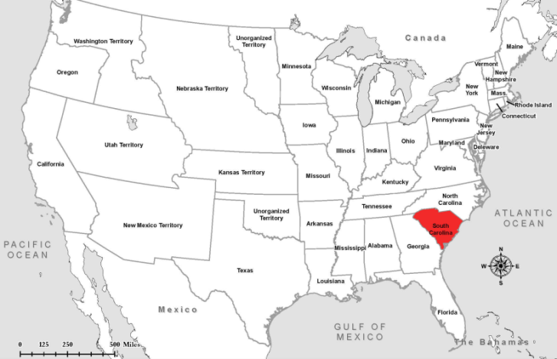
South Carolina Secedes
December 20, 1860

Slide 7
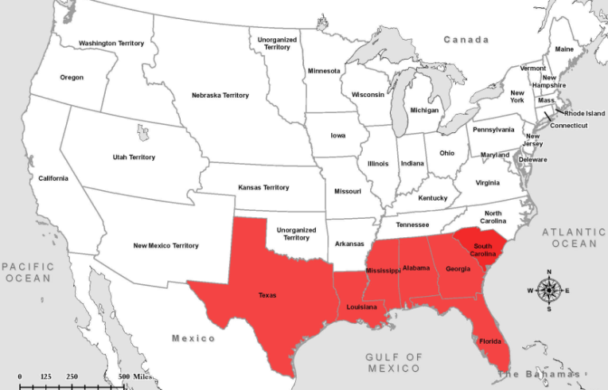
Secession January & February, 1861

Slide 8
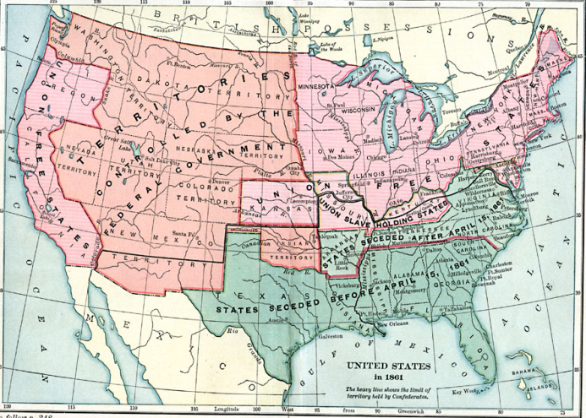
1861

Slide 9
Excerpt, First Inaugural Address Abraham Lincoln, President of the United States of America
March 4, 1861
“Apprehension seems to exist among the people of the Southern States that by the accession of a Republican Administration their property and their peace and personal security are to be endangered. There has never been any reasonable cause for such apprehension. Indeed, the most ample evidence to the contrary has all the while existed and been open to their inspection. …. I have no purpose, directly or indirectly, to interfere with the institution of slavery in the States where it exists. I believe I have no lawful right to do so, and I have no inclination to do so.
…there needs to be no bloodshed or violence, and there shall be none unless it be forced upon the national authority. The power confided to me will be used to hold, occupy, and possess the property and places belonging to the Government…..
We are not enemies, but friends. We must not be enemies. Though passion may have strained it must not break our bonds of affection….
Notes:
Discussion:
What is the tone of this speech?
How does the speech reflect the events of the past decade?
What does he state are the intentions of his government?
What is he hoping for?

Slide 10
Lincoln’s First Inaugural Address The Public Reacts
“For myself, I am free to declare that the election of LINCOLN (about which I entertain no doubt) ought to be regarded as an act of determined hostility; and I regard it, also, as immediately threatening the peace and safety of the South. As such, we should not wait till we experience the first or least of its pernicious consequences; but, foreseeing them, put ourselves at once in the attitude of independence, and thus escape or be prepared to defend ourselves against them. It may be that conflict and bloodshed will ensue.”
F.D.Richardson, Esq. of South Carolina
Notes:
Discussion:
What is this person concerned about? Do they believe Lincoln’s promises? Why or why not?

Slide 11
Lincoln’s First Inaugural Address The Public Reacts
“Col. ORR calls Mr. K.'s attention to the results of the teachings of Black Republicanism, as developed in resistance to the Fugitive Slave Law, the inveigling of slaves, the raid of JOHN BROWN, and the recent insurrectionary movements in Texas, and asks -- can it be prudent, safe or manly, to submit to the domination of a party whose declared purpose is to destroy us and subvert our whole social and industrial policy?”
F.D.Richardson, Esq. of South Carolina

Slide 12
Fort Sumter
Notes:
Discussion:
Who owns forts in South Carolina – the state or the federal government?
Describe possible options and consequences that Lincoln had (to claim ownership and reinforce Ft. Sumter / to abandon ownership / to not reinforce Ft. Sumter)

Slide 13
Lincoln’s First Inaugural Address The Public Reacts
“The whole message receives almost universal commendation from the Union men, and censure and repudiation from the Secessionists. The latter regard the declaration of the intention to defend and hold the Federal property as a declaration of war and coercion.
Prominent gentlemen in Charleston sent advices here to-day to the effect that the Star of the West, or any other vessel, attempting to reach Fort Sumter, or enter the harbor under the American flag, would be fired upon by the batteries and troops.”
Our Washington Dispatches, Wednesday, Jan. 9 New York Times
Notes:
Discussion:
Let students decide what they would have done. Should the government:
Abandon the forts and let the South have them?
Reclaim the forts taken by Southern states?
Hold only those forts still in federal hands?
Or choose some other course of action?

Slide 14
Fort Sumter April 12-14, 1861
Notes:
South Carolina called for the surrender. Major Robert Anderson refused. Fort was bombarded. Surrendered the next day.
Anderson from Kentucky, former slave owner, sympathetic to South. P.G.T. Beauregard was Anderson’s student at West Point. On April 6th Lincoln sent a supply boat carrying food and water--not reinforcements--and left it to the Confederates to fire the first shot.
Image information:
Images of Fort Sumter with Union Commander, Robert Anderson on the right and P.G.T. Beauregard on the left.

Slide 15
Fort Sumter April 12-14, 1861
Notes:
Discussion:
What kind of message did Lincoln's decision to reinforce Ft. Sumter send to each group of people?
There were warnings that the South would consider the reinforcement of federal forts to be an act of war. Ask: Do you think that Lincoln decided to start a war when he made his decision to reinforce Ft. Sumter? Why or why not?

Slide 16
The War Begins
Lincoln’s decision to resupply Ft. Sumter was stroke of genius
Fulfilled Inaugural Address pledge to hold federal property in rebel states
Forced rebels to make decision to start war
Davis decided to take fort before resupply ships arrived
Beauregard shelled fort April 12-13, 1861
Anderson surrendered April 13
Lincoln called for 75,000 volunteers to put down rebellion on April 15
Va., N.C., Tenn. & Ark. Seceded & joined CSA

Slide 17
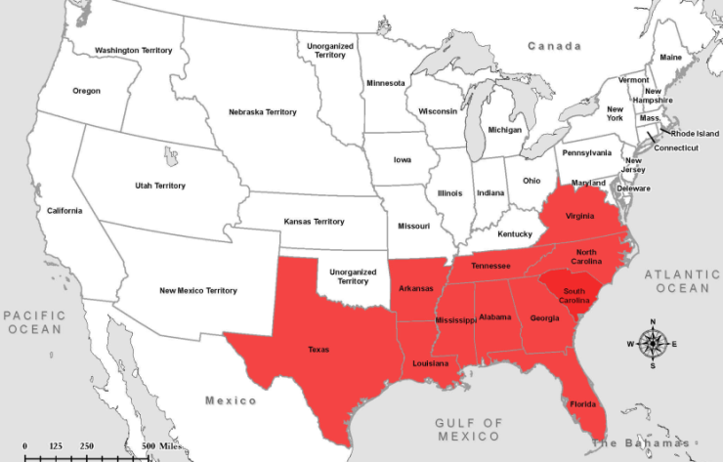
Secession
April - June, 1861
Notes:
April 17, 1861- Virginia secedes
May 6, 1861- Arkansas secedes
May 20, 1861- North Carolina secedes
June 8, 1861- Tennessee secedes
Border states loyal to Union: Missouri, Kentucky, Maryland, Delaware.
1863 - West Virginia seceded from Virginia

Slide 18
Secession

Slide 19
And the War Came
North seeks action to preserve Union
April 13, 1861--Fort Sumter, S.C, falls
April 15--Lincoln calls out Northern state militias to suppress Southern insurrection
April-May--Upper South secedes
Border states--slave states remain in Union
War defined as effort to preserve Union

Slide 20
The Union Responds
Notes:
Lincoln calls for volunteers on April 15, 1861.

Slide 21
The Confederacy Responds
Notes:
States in the Confederacy soon followed.

Slide 22
“Our popular government has often been called an experiment. Two points in it our people have already settled – the successful establishing and the successful administering. One still remains: its successful maintenance against a formidable internal attempt to overthrow it.” Abraham Lincoln

Slide 23
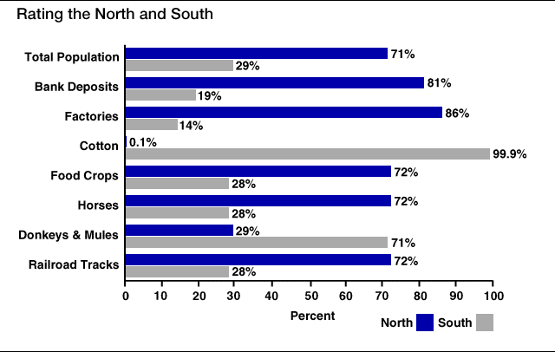
Resources…

Slide 24
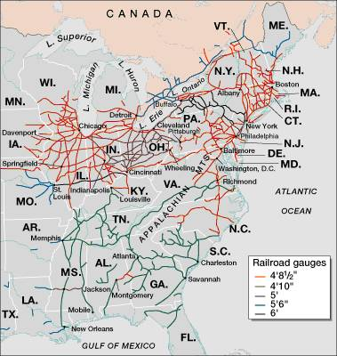
Railroad Lines, 1860

Slide 25
Adjusting to Total War
North must win by destroying will to resist
Total War--a test of societies, economies, political systems as well as armies
South adopts defensive strategy--North must fight in unfamiliar, hostile terrain
Lincoln adopts two-front strategy
capture Confederate capital, Richmond, Va.
seize control of the Mississippi River
deploy navy to blockade Southern ports

