Slide 1
The Federalist Period
Mr. Winchell
APUSH
Period 3

Slide 2
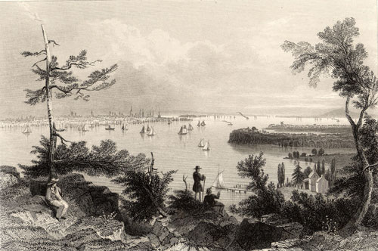
The Federalist Period, 1789-1800
“We are in a wilderness without a single footstep to guide us.”

Slide 3
DO NOW PRESENTED BY:

Slide 4
Constitutional Interpretation
Strict Interpretation?
“Only do what the Constitution says the President can do.”
Limits the power of government
Loose Interpretation?
Elastic Clause
The Congress shall have power …To make all laws which shall be necessary and proper for carrying into execution the foregoing powers, and all other powers vested by this Constitution in the government of the United States, or in any department or officer thereof.
Strengthens the power of government

Slide 5
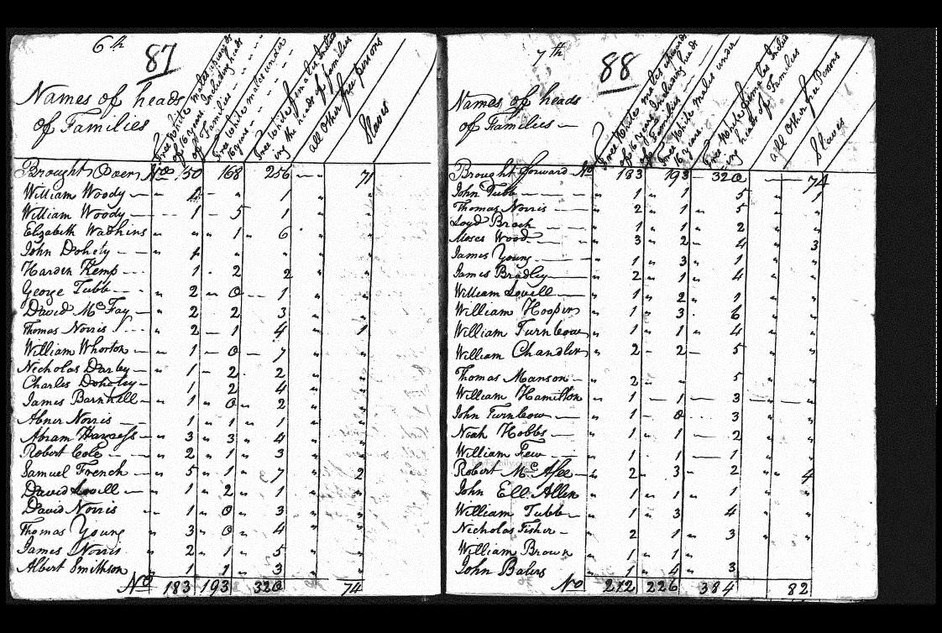
A. America in 1790
Population nearly 4 million
doubling every 25 years
90% of Americans lived on farms
Public debt large ($52 million) – revenue low.
Threats from GB and Spain threatened fragile unity of US

Slide 6
Washington’s Presidency
Established:
State Department (Foreign Affairs)
Thomas Jefferson
Treasury (Finance)
Alexander Hamilton
War
Henry Knox
Presidential Cabinet

Slide 7
Judiciary Act of 1789
Established federal and state court systems with Supreme Court overseeing all.
Established judicial chain of command.
Federalists wanted strong national institutions.
Ensured federal judges (not state) would have final say on interpreting the Constitution.

Slide 8
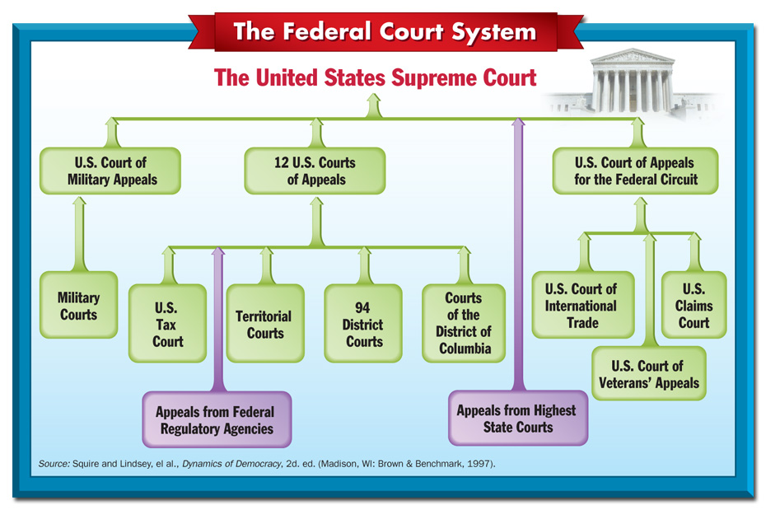

Slide 9
Hamilton vs. Jefferson
Federalist
STRONG national government
Government-assisted economic development
Tariffs
Subsidies
National Bank
Assume war debts of states
Congress granted 20 year charter to the bank
Pro-British
Anti-Federalist
WEAK national government
Anti Hamilton in every way
Agrarian (Farm) based society
Anti-wealthy society
Pro- French

Slide 10
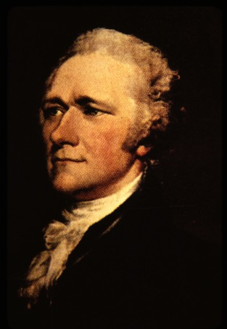
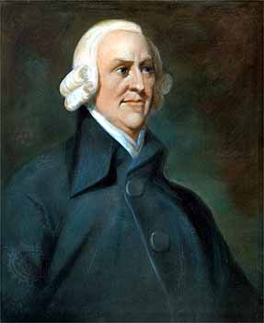
D. Hamilton’s Financial Plan
Report on Public Credit (1790)
Plan to shape fiscal policies of admin to favor wealthier groups.
In return wealthy would loan money to gov’t
Prosperity would trickle down to the masses
Report on Manufactures (1791)
Advocated promotion of factory system and capitalism (Adam Smith’s Wealth of Nations written in 1776)
Basis of his tariff plan to protect American manufacturers

Slide 11
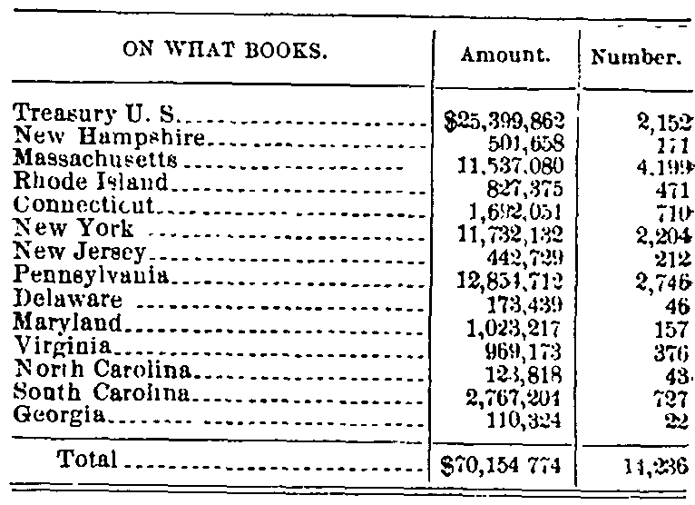
5 Components of A-Ham Plan
Funding
Pay back gov’t debt to bondholders them off with interest
Purpose to bolster national credit
Assumption of State Debts
Cement states to national gov’t
States with large debts favored (MA); states with little to no debt did not (VA)
Became a north v. south issue
Compromise: north got assumption of debts while south got national capital moved to Potomac

Slide 12
Tariffs
8% tariff on imports
Source of revenue but also aimed at protecting infant US industries.
Excise Taxes
1791 – $.07/gal tax on whiskey
Flowed freely in backcountry areas
A Ham not worried of effects on these ppl as they were mostly Anti-Feds

Slide 13
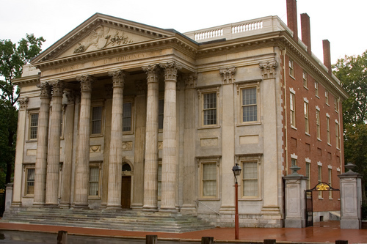
National Bank
Biggest issue
Treasury would place surplus revenue here
Gov’t would be major stock holder, but bank would be private institution
“Loose Constructionism” – powers not delegated to the national gov’t in Constitution are not prohibited by virtue of necessary and proper (elastic) clause.
Strongly Opposed by Anti-Feds
GW signed bank measure into law Feb. 1791
“Strict Constructionism” – Bank NOT within power of Congress to create
Jefferson and Madison felt states’ rights would be jeopardized by huge central bank.
Moneyed interests would take precedence over farmers
State banks would not be able to compete.

Slide 14
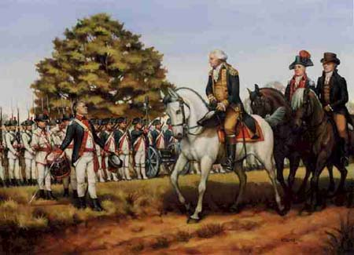
Whiskey Rebellion
SW Penn ppl hit hard by excise tax
“Whiskey Boys” torched bldgs, tarred and feathered tax collectors, talked of “secession”
GW summoned militia of several states (13,000) – escorted by GW and A Ham themselves
First display of fed’l gov’t “ensuring domestic tranquility”
Jeffersonians condemned action as a “brutal display of force” and gained more followers.

Slide 15
FEDERALISTS
Emerged from the “federalists” who supported the Constitution in 1780s
Believed in gov’t run by the elite
Rich had more time to study problems of governing
Intelligent, educated and culturally literate
John Jay – “Those who own the country ought to govern it”
Distrusted the common people
Feared rule by “mobocracy”
Believed democracy too important to be left to the ppl.Supported a strong central gov’t
Fed’l gov’t should encourgae business, not interfere with it.
Dominated by merchants, manufacturers and shippers
Most lived on eastern seaboard where commerce flourished.
Pro-British in Foreign Policy
Trade with GB was key to Hamilton’s plan
Many Feds were mild Loyalists

Slide 16
JEFFERSONIAN REPUBLICANS
Advocated for rule of the ppl, for the ppl
Should be literate, but believed that “masses” could be taught
Appealed to middle-class (farmers, laborers, artisans, small shopkeepers)
Government that governed best, governed least
Bulk of power should be retained by states.
Limit federal power through strict interpretation of Constitution.
National debt was a curse that should be paid off ASAP
Believed in freedom of speech
Basically pro-French

Slide 17
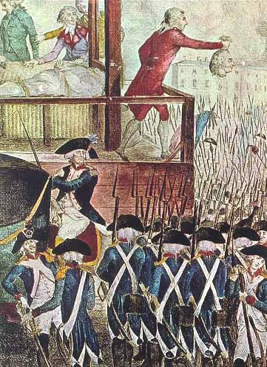
First Test: French Revolution
French declared themselves a “republic” but carnage heavier than in American Rev.
Jeffersonians thought it unfortunate, but probably necessary
Hamiltonians thought it downright frightening
US?
GB got dragged into conflict and now US had to take sides
US still obligated under Franco-American Alliance of 1778
US military weak

Slide 18
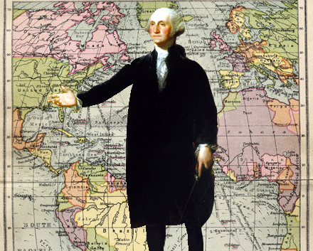
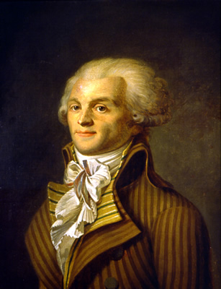
Washington’s Neutrality Proclamation (1793)
US would be neutral
Warned US citizens to be impartial to both sides.
Jefferson furious – GW did not consult Congress
Hamilton supported it.
Citizen Genet
French diplomat in US who felt Neutrality Proclamation not a true reflection of US feelings towards France
Went to ppl directly to ask for money and supplies for war cause
GW booted him out of country.

Slide 19
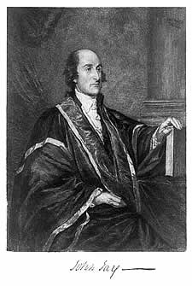
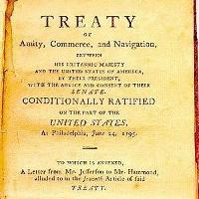
Second Test: Jay’s Treaty
GB a thorn in US side
constantly harrassing US frontier settlers
Seized 300 US ships and impressed (stole) US sailors.
GB stayed in posts in violation of 1783 peace treaty
Sold firearms and alcohol to Natives who attacked US settlers.
Feds did NOT want war with GB (75% of import duties from GB trade)
Jeffersonians wanted embargo
GW sent J. Jay to work some magic in 1794
A Ham tipped Brits off as to what Jay would offer
John Jay’s hands tied
GB renewed pledge to leave posts
GB would pay for recent seizures of ships, sailors
GB did not guarantee they would not do it in the future though
AND US forced to pay PRE-Revolution debts owed to GB
Good one Jay! But did avert war with GB which would have been disaster.
Jeffersonian outrage resulted in creation of Democratic Republican Party

Slide 20
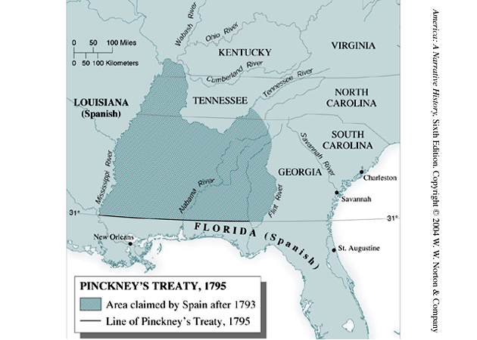
Pinckney Treaty
Now Spain??
Spain worried about Anglo-American alliance – ready to give up some rights in North America
Granted US rights to navigate Mississippi and port of New Orleans
Yielded large tract of land north of Florida (north of 31st parallel)

Slide 21
Washington’s Precedents
Two terms
“Mr. President”
Cabinet
Neutrality
Special Relationship with Great Britain
Farewell Address

Slide 22
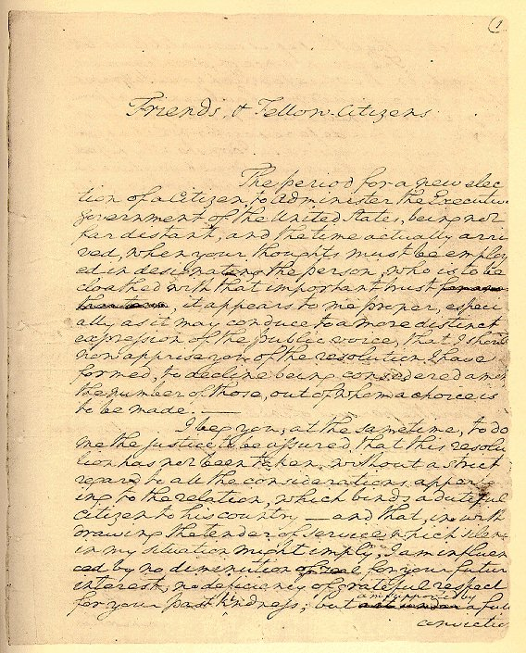
F. Washington’s Farewell Address
Refused third term
Set precedent for two-term presidency
GW exhausted physically and tired of verbal abuse from TJ for becoming partisan
Farewell Address
Warned of evils of political parties
Warned of entangling alliances (like treaty with France)
Isolationism became dominant foreign policy for next 100 yrs.

Slide 23
Washington’s Farewell
Washington’s Farewell Address
Retired after two terms
Preserve treaties and avoid alliances
Condemned political parties and partisan conflicts
Warned of sectionalism and to preserve unity
Religion and morality and diffusion of knowledge (education)

Slide 24
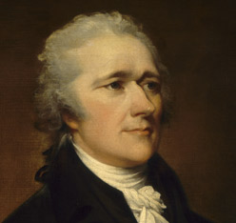
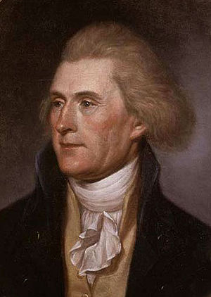
First Political Party System (1789-1824)
Alexander Hamilton
Thomas Jefferson
Federalists
National policies
Strong central government
Loose constructionists
Commerce and manufacturing
Urban
The rich, the well-born, the able; merchants, bankers
Pro-British
Anti-French revolution
Northeast
Democratic-Republicans
States rights
Strong local/state governments
Strict constructionists
Agricultural
Rural
Small farmers, plantation owners, artisans
Anti-British
Pro-French Revolution
West and South

Slide 25
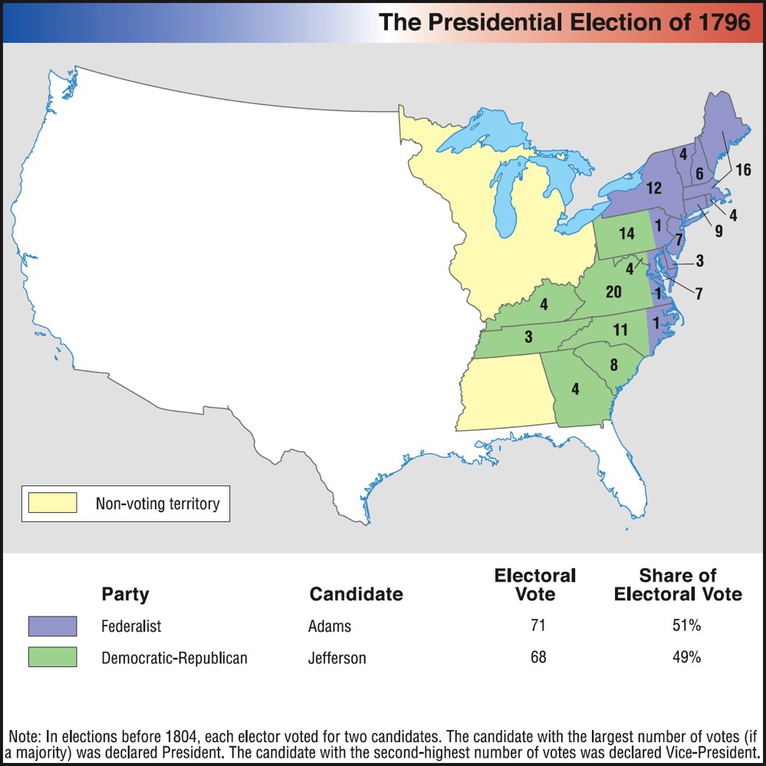
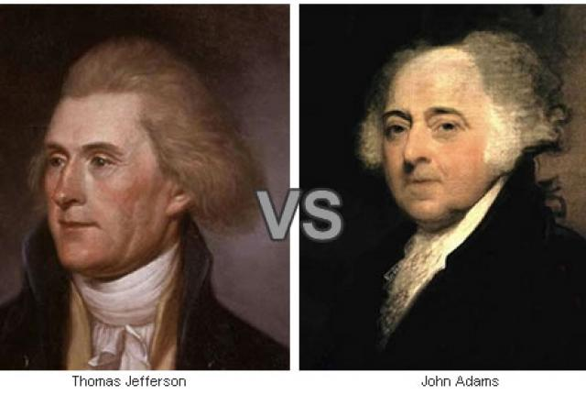
Election of 1796

Slide 26
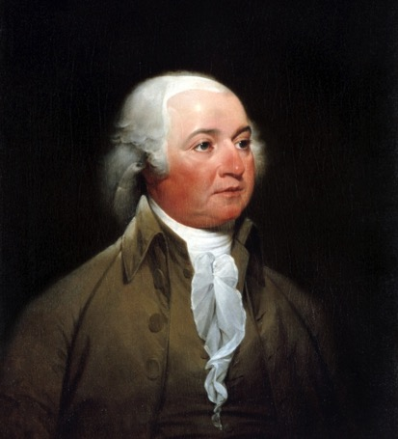
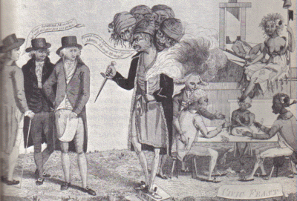
G. John Adams
Election
1796 - Defeats TJ 71 -66 in Electoral College
TJ becomes VP
Foreign Flare-Ups
France
Saw Jay’s Treaty as a violation of 1778 Franco-American Treaty
Seized 300 merchant vessels by mid-1797.
XYZ Affair
John Adams sent delegation to France to work it out
Approached by 3 French agents (“X, Y and Z”) who demanded loan and bribe of 250,000 to talk to French foreign minister Talleyrand.
US delegates scoffed, “Millions for defense, but not one cent for tribute (bribes)”
Negotiations broke down
Undeclared Hostilities with France 1798-99
US expanded its 3 ship Navy
US Marine Corps established
Embargo with France imposed
Adams tried to avoid full-blown war

Slide 27
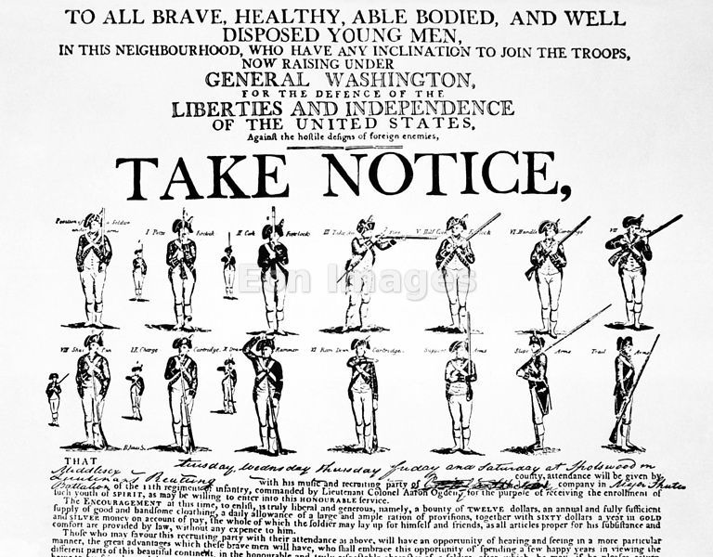
War Avoided
John Adams sent new envoy to France in 1800
Napoleon accepted – more bent on European conquest, not war with US
Improved Relations made Louisiana Purchase possible 3 years later.
Adams felt dodging this bullet was his finest achievement.
22 year alliance between US and Fr. Dissolved.
US would pay US shippers damage claims

Slide 28
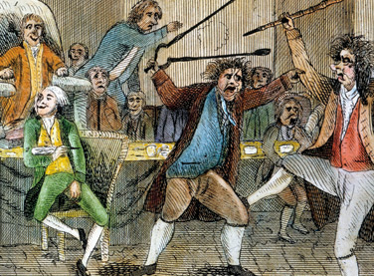
Alien and Sedition Acts (1798)
Purpose: to reduce power of Jeffersonians and silence anti-war opposition
Alien Act
Attack on pro-Jeffersonian “aliens”
Raised residency requirements for US citizenship from 5 yrs to 14 yrs.
President could deport “dangerous” foreigners.
Sedition Act
Anyone who impeded policies of the gov’t or falsely criticized its officials would get heavy fine and imprisonment.
Direct violation of 1st Amendment
Expired day before Adams left office.

Slide 29
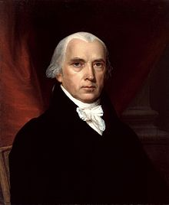
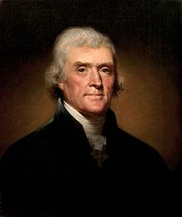
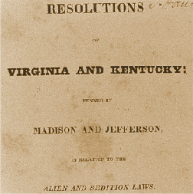
Virginia and Kentucky Resolutions (1798)
Republicans felt Alien and Sedition Acts were unconstitutional
Jefferson and Madison secretly penned two resolutions that asserted that states have the right to nullify unconstitutional laws passed by Congress.
Federalists retorted that the people, not states created Constitution and that the Supreme Court and not states determined the constitutionality of laws.
No other states but VA and KY adopted resolutions, but southern states would use this later in 19th century to support nullification and secession.

Slide 30
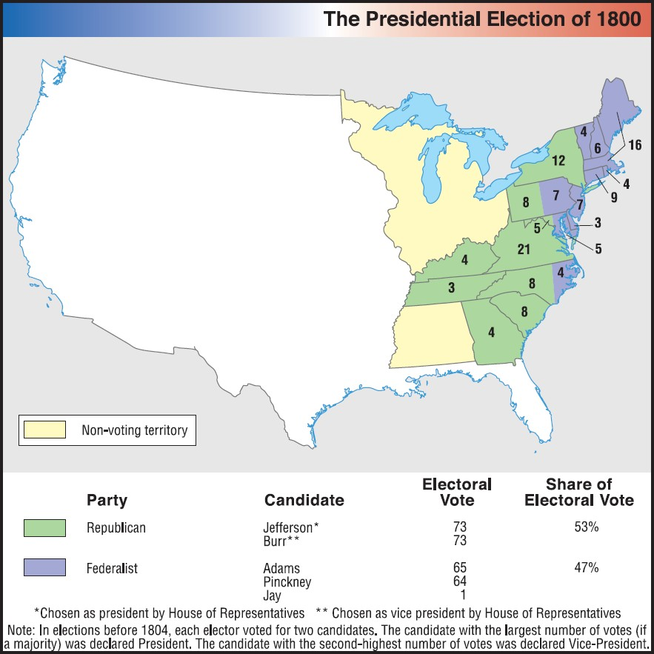
Revolution of 1800

Slide 31
