Slide 1
Do Now
What cultural, economic, and political conflicts characterized the 1920s?
How did these conflicts represent a change in American values?

Slide 2
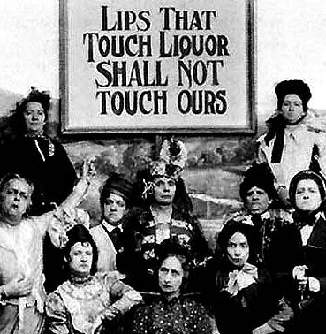
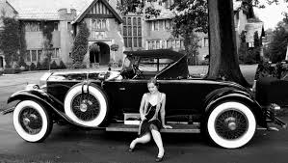
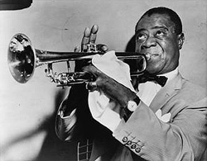
The Politics of the 1920s
Mr. Winchell
APUSH
Period 7

Slide 3
During the 1920s, there are many changes within the United States…
We will examine 3 forms of changes in American Society:
1. What were some political changes?
2. What were some economic changes?
3. What were some social changes?

Slide 4
Essential Questions
Why did the U.S. experience so much political and social change during the 1920s?
Why did the 1920s see the emergence of the “consumer society”?
What issues led to Prohibition in the 1920s, and what problems contributed to its failure?
Why did many see the 1920s as a period of rebellion by American youth?
What changes occurred to marriage and the American family structure in the 1920s?
How did government economic policies during the 1920s lead to the Great Depression?
Notes:
*

Slide 5
Quote to Consider…
Whenever a dominant culture believes that it is under attack, it will respond with measures that it hopes will protect its fundamental values. The America of the 1920s was no exception to this rule.

Slide 6
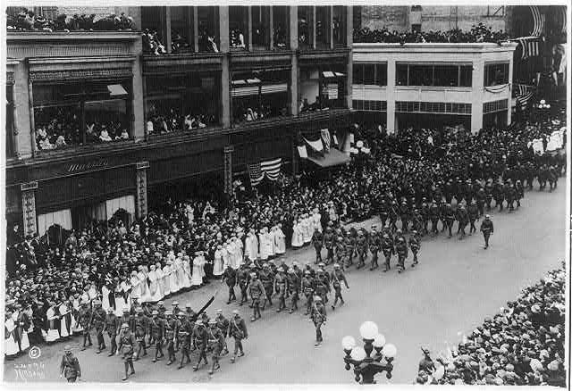
America at the Start of the Decade
Victorious in World War I
Treaty of Versailles defeated
Period of isolationism
Republican ascendancy
Returning WWI soldiers parading in Minneapolis
Notes:
By the dawn of the 1920s, the United States had emerged from World War I as one of the world’s superpowers; however, it remained unwilling to accept the role of world leader. President Woodrow Wilson fell short of his goal of “making the world safe for democracy” with the Treaty of Versailles and the League of Nations when the Senate rejected the treaty. Without a U.S. presence in the League of Nations, the international organization lacked the credibility needed to maintain world peace.
Unwilling to consider the possibility of sending U.S. soldiers into another foreign war, most Americans favored an isolationist policy in dealing with international affairs. The election of Warren Harding in 1920 began a period of Republican Party dominance that lasted throughout the decade: from 1921 until 1933, Republicans controlled both the White House and Congress.
*

Slide 7
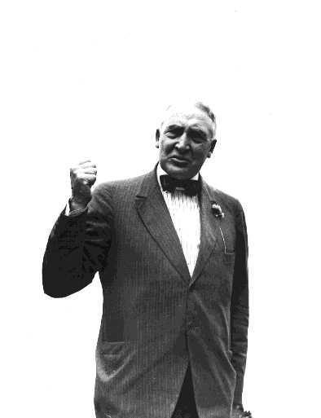
The Election of 1920
GOP nominated Ohio Sen. Warren G. Harding
“Normalcy”
Democrats ran Ohio Gov. James M. Cox
Coolidge as GOP VP candidate
FDR as Democratic VP candidate
Republican landslide
Warren G. Harding
Notes:
After the Senate’s rejection of the Treaty of Versailles and the defeat of the League of Nations, Republican leaders saw an opportunity to regain the White House after Democrat Woodrow Wilson’s two terms. They nominated Ohio Senator Warren G. Harding for president. Harding, realizing that Americans wanted to put the war behind them, promised to return the nation to “normalcy.” When questioned as to what the term meant, Harding explained that it referred not to the “old order,” but rather to “a steady way of doing things,… normal procedure, in a natural way, without excess.” However, it later became evident that he had little grasp of the major issues facing the country at the time. The Republicans nominated as Harding’s running mate Calvin Coolidge, who as Massachusetts governor had gained fame for breaking the Boston Police Strike.
The Democrats nominated Ohio Governor James M. Cox. His running mate was Franklin D. Roosevelt, who had served as Undersecretary of the Navy after a career in New York state politics. Cox and Roosevelt promised to continue Wilson’s ideas as set forth in the Treaty of Versailles and to join the League of Nations.
The American public proved unwilling to continue the policies that they believed had entangled the United States in World War I, and the Democrats lost in a landslide. Harding and Coolidge received more than 60 percent of the popular vote, and more than 400 electoral votes.
*

Slide 8
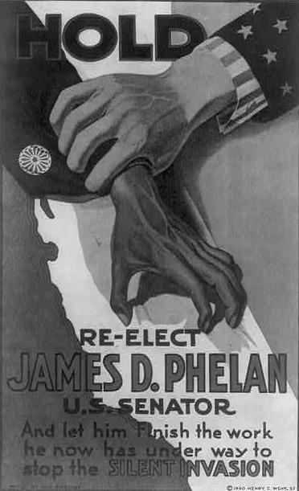
Nativism
Came out of various worries following WWI
Prejudice against foreign-born people
Evident in immigration quotas, rise of the Ku Klux Klan
Also led to “Red Scare”
An anti-immigrant poster from California Senator James Phelan’s campaign, 1920
Notes:
Various conditions in the immediate aftermath of WWI led many Americans to turn inward, favoring not just isolationism but nativism as well. The Progressive movement, while fighting for new social and political rights, also stoked suspicions about anyone not perceived as a “native born” American. A post-war recession also fueled nativism: along with the influx of returning servicemen, many became concerned about foreign-born persons taking jobs from Americans in an already difficult economy.
Nativism led to a resurgence of anti-immigrant organizations such as the Ku Klux Klan, and to the passage of new laws limiting the number of immigrants allowed in the U.S. each year, based on country of origin. In addition, a “Red Scare” gripped the nation after the 1917 Bolshevik Revolution in Russia. Terrorist acts by various radical groups raised fears that a similar revolution might occur in the U.S. Wilson’s Attorney General A. Mitchell Palmer looked to find and arrest possible communists infiltrators, commonly referred to as “Reds.”
*

Slide 9
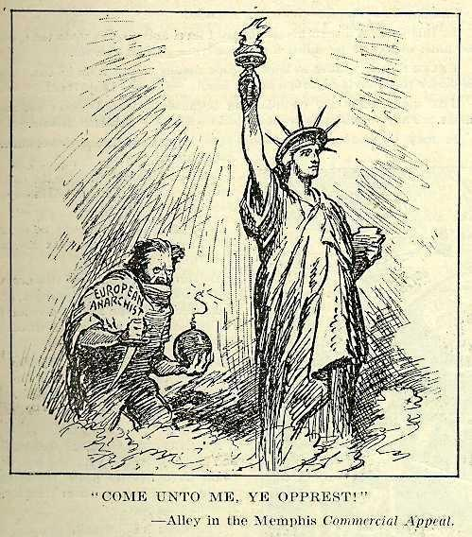
The “Red Scare”
Begun by Russia’s Bolshevik Revolution (1917)
Fear of communist revolution in the U.S.
Heightened by 1919 anarchist bombings
Passage of various sedition laws
Notes:
Nativism and the fear of a communist revolution led to what became known as the “Red Scare.” The 1917 Bolshevik Revolution in Russia, as well as strikes and other activities by anarchists in the U.S., led many to believe that a similar upheaval could happen in America.
In 1919, anarchist bombings targeted several American industrialists and political leaders. Though unsuccessful, the bombings led many Americans to believe that such groups were attempting to overthrow the government. Strikes by radical labor unions, such as the Industrial Workers of the World (IWW), also worried many Americans, who believed that foreign radicals had actually orchestrated these unions’ strikes and other activities.
In response to these perceived threats, Congress enacted sedition laws such as the Sedition Act of 1918, and the government arrested and imprisoned several radical leaders, including noted anarchist Emma Goldman and union leader and Socialist presidential candidate Eugene V. Debs. In addition, Attorney General A. Mitchell Palmer initiated a number of raids in order to round up and arrest suspected radicals.
“Who do the figures represent?,” “What is the significance of the caption?,” and “What message is the artist trying to convey?”
*

Slide 10
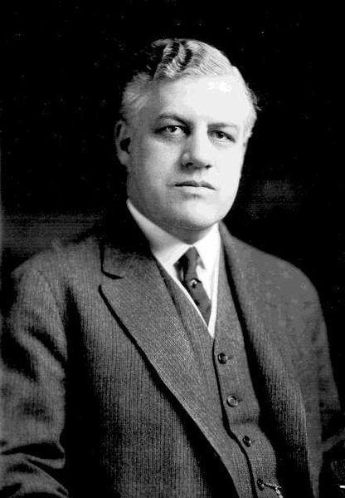
The Palmer Raids
U.S. Attorney General A. Mitchell Palmer
Sought to eliminate radical influence in the U.S.
Appointed J. Edgar Hoover to lead investigations
Many persons jailed or deported illegally
Rights of many suspects violated
A. Mitchell Palmer
Notes:
Palmer detained thousands of suspected anarchists and radicals. Under his leadership, the Justice Department and J. Edgar Hoover (who had been appointed to lead the investigations) conducted what became known as the “Palmer Raids.” Hoover actively sought out suspected radicals, collecting information on more than 150,000 persons. He had approximately 10,000 of them arrested for sedition and other assorted charges. The government arrested many on little or no supporting evidence and denied them fundamental due-process rights during interrogation. Later commissions ruled that the government had illegally detained or deported many of these suspects.
Palmer asserted that an attempted communist revolution would occur in the U.S. on May 1, 1920. However, many ridiculed him when this predicted revolution never occurred. Once touted as the probable Democratic nominee for President in 1920, Palmer’s popularity declined, and he never became a factor in the race for the nomination.
*

Slide 11
“The Case Against the ‘Reds’”
…It has been impossible in so short a space to review the entire menace of the internal revolution in this country as I know it, but this may serve to arouse the American citizen to its reality, its danger, and the great need of united effort to stamp it out, under our feet, if needs be. It is being done. The Department of Justice will pursue the attack of these "Reds" upon the Government of the United States with vigilance, and no alien, advocating the overthrow of existing law and order in this country, shall escape arrest and prompt deportation.
It is my belief that while they have stirred discontent in our midst, while they have caused irritating strikes, and while they have infected our social ideas with the disease of their own minds and their unclean morals we can get rid of them! and not until we have done so shall we have removed the menace of Bolshevism for good.
Attorney General A. Mitchell Palmer
Forum, issue 63 (1920)
Notes:
*

Slide 12
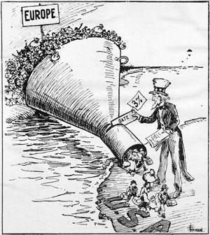
Immigration Quotas
Emergency Quota Act (1921)
Immigration Act of 1924
Limited annual number of immigrants from a nation to 2% of number of immigrants living in the U.S. in 1890
Immigration from most Asian nations stopped
Some groups given preference over others
A cartoon satirizing the quota system
Notes:
Nativism also led to the establishment of quotas limiting the number of immigrants from each country. Having established the quota system with the Emergency Quota Act of 1921, lawmakers refined it with the Immigration Act of 1924. This law limited immigration from each European nation to two percent of the number of immigrants from that nation living in the U.S. at the time of the 1890 census. In particular, the quota discriminated against persons from eastern and southern Europe, most of whom did not speak English and were mainly Catholic and Jewish. Most immigrants from these nations did not begin arriving in the U.S. in any great numbers until after 1890. By the time the baseline year shifted to 1920, the number of new immigrants allowed in the U.S. had shrunken dramatically as well, so only a few persons from southern and eastern Europe were allowed in.
However, immigrants from northern and western Europe took priority in the system. In addition, the law put no quotas into place on immigration from Latin America. Also, some groups with relatives already in the United States, such as the wives and minor children of U.S. citizens, received non-quota status and could enter the U.S.
The quota system established by the Immigration Act of 1924 remained in place with few modifications until the passage of the Immigration Act of 1965.
*

Slide 13
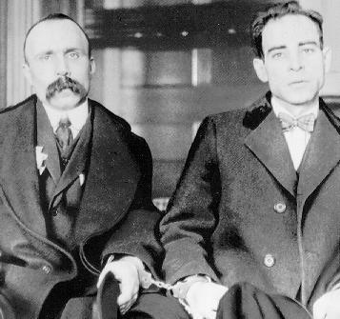
Sacco & Vanzetti
Charged with robbery and murder
Convicted on highly circumstantial evidence
Sentenced to death
Many protested convictions and sentence
Both executed in 1927
i
Bartolomeo Vanzetti and Nicola Sacco
Notes:
One of the most sensational examples of anti-immigrant bias in the 1920s was the case of Nicola Sacco and Bartolomeo Vanzetti, Italian immigrants who authorities arrested in 1920 on charges of robbery and the murder of a payroll guard in South Braintree, Massachusetts. To many, the pair represented everything that Americans feared. They were not native-born, and they seemed to represent the opposite of American values: both were anarchists, and both had evaded the draft during World War I.
Authorities based the case against the pair on highly circumstantial evidence. Witnesses stated the murderers “appeared to be Italians,” but could not identify Sacco or Vanzetti as the perpetrators. The judge ignored the alibis that both had presented, and even made prejudicial statements regarding their nationality. Found guilty, they were convicted and sentenced to death.
Their conviction resulted in worldwide protest. Many believed that they had been found guilty simply because of their anarchist affiliations, or because they were immigrants. Legal appeals went on for years, but came to nothing. Some petitioned the Massachusetts governor to commute the men’s sentences, but after reviewing the court transcripts and personally interviewing Vanzetti, he decided to let the sentence stand. The men were executed in 1927.
Ballistics tests unavailable at the time of the trial later showed that the pistol found on Sacco at the time of his arrest indeed fired the shot that killed the guard; however, the tests did not prove that Sacco had pulled the trigger.
In the last letter before their execution, the pair wrote, “Friends and Comrades, now that the tragedy of this trial is at an end, be all as of one heart. Only two of us will die. Our ideal, you our comrades, will live by millions; we have won, but not vanquished. Just treasure our suffering, our sorrow, our mistakes, our defeats, our passion for future battles and for the great emancipation.”
*

Slide 14
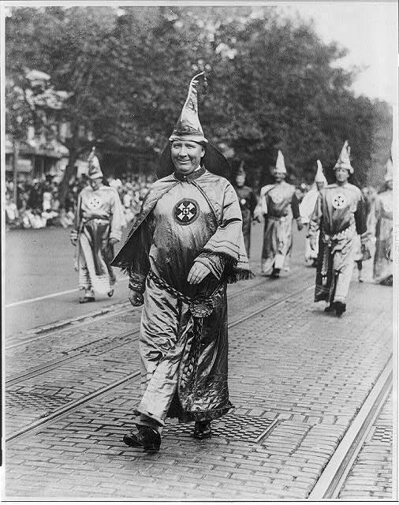
Rebirth of the Ku Klux Klan
Promoted “100% Americanism”
Opposed Catholics, Jews, immigrants, unions, and socialists, as well as African Americans
Membership swelled to nearly 4.5 million by 1924
Leadership paid Klansmen to recruit new members
Dr. Hiram Wesley Evans, an Atlanta dentist, headed the resurgent KKK
Notes:
The climate of fear that nativism and the Red Scare fed helped bring back the Ku Klux Klan, all but extinct since Reconstruction. The “new” Klan, founded by Dr. Hiram Wesley Evans, touted itself as supporting “100 percent Americanism,” opposing not only African Americans, but also groups such as labor unions, socialists, Catholics, Jews, and immigrants.
In addition, the Klan supported the prohibition of alcohol and promised to help enforce the law. By 1924, the Klan boasted nearly 4.5 million members, primarily because its leadership encouraged members to find new recruits and gave them substantial kickbacks from the sale of Klan regalia.
*

Slide 15
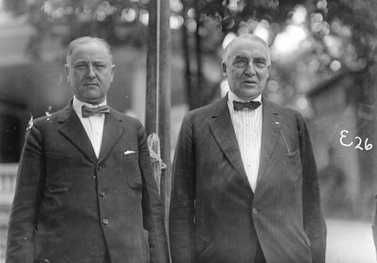
Harding Administration Scandals
“Ohio Gang”
Harding too trusting and disconnected from complex issues
Several advisers and Cabinet members deeply involved in corruption and graft
Harding with Attorney General Harry Daugherty (left), who resigned under corruption charges
Notes:
Though generally considered a decent man, President Harding had a great deal of difficulty staffing his administration with people not involved in criminal activity. When he took office in 1921, he brought with him a number of friends and advisers from his political career in Ohio. This coterie, known as the “Ohio Gang,” included Harry Daugherty, Albert B. Fall, and Charles R. Forbes, all of whom received high-level political appointments. In addition, Harding did not have much of a grip on the issues of the day, remarking to a friend, “I can’t make a…thing out of this tax problem. I listen to one side, and they seem right, and then…I talk to the other side and they seem just as right, and here I am where I started.” His disconnectedness from complex issues and tendency to trust the undeserving likely led to the major scandals that marked his administration.
Harding did manage to make some significant appointments to his Cabinet, including Secretary of Commerce Herbert Hoover, Secretary of the Treasury Andrew Mellon, and Secretary of State Charles Evans Hughes. However, he also appointed many men of lesser ability and even lower morals, including Veterans’ Bureau head Forbes, who was convicted of selling government hospital supplies to private businesses. His head of the Office of Alien Property also was convicted of bribery. Authorities implicated Attorney General Daugherty in several bribery and corruption scandals; while never convicted, he resigned in disgrace. Secretary of the Interior Fall was convicted of bribery in the Teapot Dome scandal, becoming the first Cabinet member ever sentenced to prison.
*

Slide 16
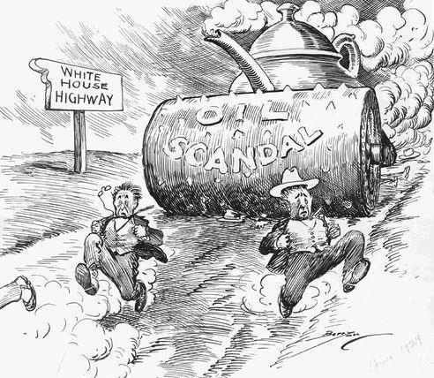
The Teapot Dome Scandal
Naval oil reserve in Wyoming
Interior Secretary Fall illegally sold reserves to private companies
Fall found guilty of accepting bribes
Harding died before scandal became public
A political cartoon depicting the scandal as a steamroller
Notes:
Of the multiple Harding Administration scandals, probably the 1923 Teapot Dome scandal remains the best known. It involved the illegal leasing of two naval oil reserves (one in Teapot Dome, Wyoming; the other in Elk Grove, California) by Secretary of the Interior Albert Fall. According to subsequent investigations, Fall had convinced Secretary of the Navy Edwin Denby to give control of the oil fields to the Department of the Interior. Fall then sold the reserves to oilmen Harry F. Sinclair and Edward L. Doheny, keeping the money for himself.
When the Wall Street Journal noticed Fall suddenly spending large sums of money for personal reasons, it investigated and reported that Fall had sold the reserves illegally. However, Harding defended his Secretary of the Interior, stating that Fall had committed no wrongdoing. The Senate voted to look into the matter further. Soon after, Fall and Denby resigned their positions. The government tried Sinclair on charges of conspiracy, but the judge declared a mistrial and charged Sinclair with jury tampering when it emerged that he had hired a private detective to monitor the jurors. Sinclair was later sentenced to six months in jail. Authorities charged Fall with accepting bribes; he was convicted, sentenced to a year in prison, and fined $100,000.
Harding died before the Senate could begin hearings, so the extent of any possible personal involvement or how the scandal would have affected his presidency remains unknown to historians, who generally rate his tenure in office a dismal failure.
*

Slide 17
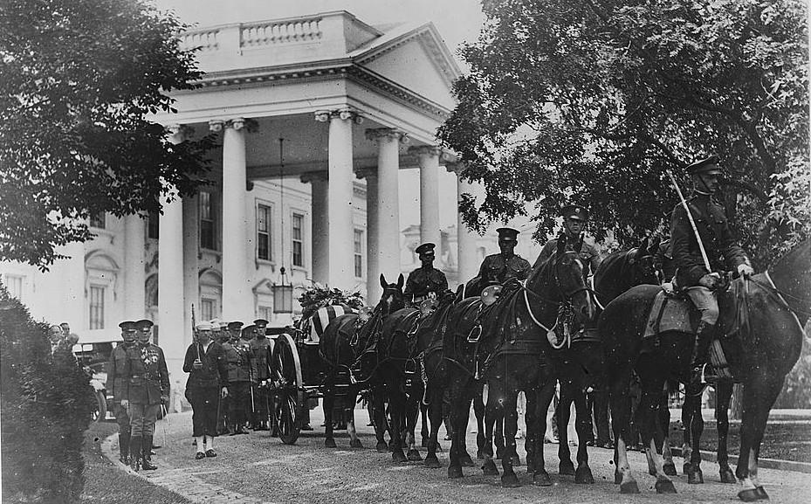
Harding Dies, Coolidge Takes Office
August 1923, in San Francisco
Died before scandals broke; reputation soon destroyed
Coolidge notified at his father’s home
His father, a notary public, swore him in
Harding’s body leaving the White House after lying in state
Notes:
President Harding died suddenly in 1923 while returning from a trip to Alaska. His health had become a concern earlier that year, when he had a severe bout of influenza from which he had never fully recovered. In addition, he had nearly collapsed while giving a speech in Seattle earlier in the trip, complaining of violent cramps and indigestion. Doctors thought he had food poisoning and ordered him to San Francisco to rest and recuperate. There he suffered what was most likely a fatal heart attack. Some historians surmise that he had become aware of the extent of his associates’ involvement in what emerged later as major scandals and that the stress of this contributed to his illness as well.
Since the scandals that would stain Harding’s presidency had not yet surfaced, many mourned his death as the sudden loss of a great president. However, by the time his tomb was constructed in Marion, Ohio, the scandals had become public knowledge and were already diminishing his place in history. The formal dedication of his tomb did not occur until 1930, when the furor over the scandals had subsided.
At the time of Harding’s death, Vice President Calvin Coolidge was visiting his father’s home at Plymouth Notch, Vermont. A phone call in the middle of the night notified him, urging him to take the presidential oath of office as soon as possible to succeed the late president. Coolidge called Attorney General Daugherty to get the exact wording of the oath, which Coolidge’s father (a licensed notary public) administered by the light of a kerosene lantern. Later, as insurance that he had officially assumed the presidency, a federal judge administered the oath in order to forestall any controversy that a father could not legally swear in his son as president.
*

Slide 18
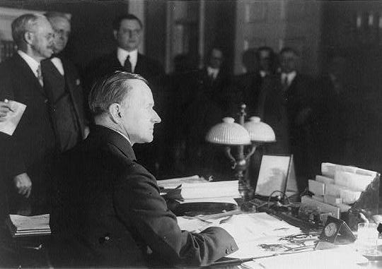
Coolidge as President
Pro-business economic policies
Continued high tariff rates
Wanted to give businesses tax credits to spur growth
“Silent Cal”
Coolidge signing a tax bill, 1926
Notes:
President Coolidge adhered to many of the same Republican pro-business policies, and frequently made mention of his economic philosophy in his writings and speeches. His more-famous quotes bear this out: “The chief business of the American people is business,” and, “The man who builds a factory builds a temple—the man who works there worships there.” He continued Harding’s policy of high tariff rates and supported tax credits for businesses as a way of encouraging industrial growth and increasing employment, a forerunner to the “trickle-down” theory of economics that became popular more than half a century later.
Coolidge tended to be introspective and spoke relatively infrequently, hence his nickname “Silent Cal.” Once, a reporter who had bet another correspondent that he could get Coolidge to say more than two words asked the president to make a statement. Aware of the bet, Coolidge replied, “You lose.” The humorist Dorothy Parker, in reference to Coolidge, once remarked, “He must have been weaned on a pickle.”
*

Slide 19
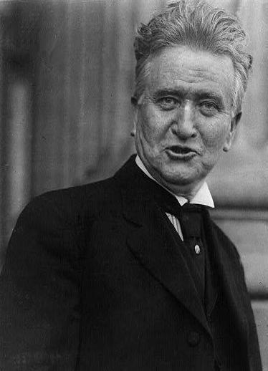
The Election of 1924
Republicans nominated Coolidge
Democrats ran John W. Davis
La Follette named as Progressive candidate
Coolidge won handily without the Southern vote
Robert M. La Follette
John W. Davis
Notes:
After serving the remainder of Harding’s term, Coolidge ran in 1924 for his own four-year term. He easily received the Republican nomination and selected Charles G. Dawes as his running mate. The Democrats nominated West Virginia Congressman John W. Davis as their presidential candidate, with Charles W. Bryan (younger brother of former presidential candidate William Jennings Bryan) as his prospective vice president. Davis’s conservative voting record in Congress led many liberal Democrats to leave the party, aligning with the Progressives led by Senator Robert M. La Follette.
Coolidge won the election easily, carrying most of the country except for the Democratic “Solid South.” La Follette won only his home state of Wisconsin. Overall, Coolidge garnered 72 percent of the electoral vote and 54 percent of the popular vote.
*

Slide 20
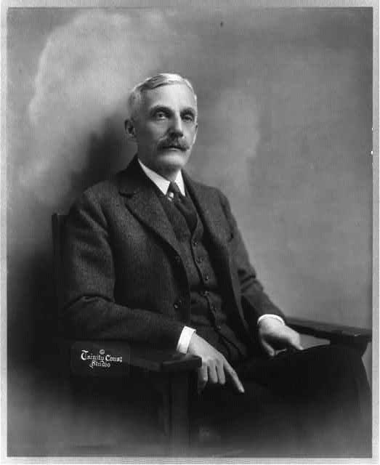
Mellon’s Economy
Served as Treasury Secretary under three presidents
Sought to increase revenue and cut spending
Pushed through substantial tax cuts for the higher tax brackets
Became unpopular at start of Depression
Andrew W. Mellon
Notes:
Andrew W. Mellon—the only person to serve as Secretary of the Treasury under three presidents (Harding, Coolidge, and Hoover)—had a great deal of influence on U.S. monetary policy during the 1920s. Under Mellon, the government took strides to increase revenue and cut spending, while at the same time providing substantial tax cuts for most income brackets.
Mellon believed that persons in higher tax brackets would be more likely to pay their fair share if tax rates were “reasonably” set. In Mellon’s view, by lowering taxes on businesses, the extra income would filter down to other sectors of the economy. While middle- and lower-class taxpayers also benefited from Mellon’s tax cuts, many of those taxpayers felt that Mellon’s economic policies favored the wealthy almost completely.
With the 1929 stock market crash and subsequent Great Depression, many blamed Mellon and his policies for the economic decline, and his popularity waned. Shortly before Franklin Roosevelt’s election in 1932, Mellon resigned to become U.S. Ambassador to Great Britain. FDR eliminated many of Mellon’s tax and budget cuts in order to help pay for his New Deal programs.
*

Slide 21
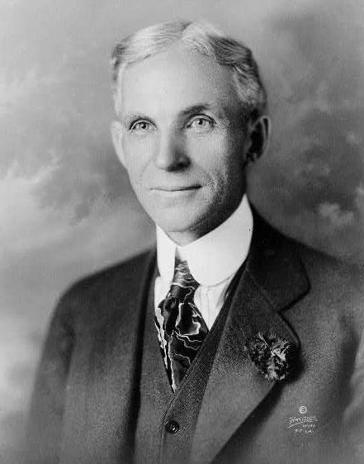
Henry Ford
Introduced mass-production techniques to auto industry
Could produce more cars for less money
Anti-union
Used thugs and spies to enforce plant discipline
Henry Ford
Notes:
No person in the industry did more to make the automobile a necessity for most Americans than Henry Ford. In order to make automobiles affordable for the average person, he developed mass-production techniques that put the price of the Model T in reach of middle-class Americans. By 1925, Ford’s assembly lines were turning out more than 9000 cars per day, and the cost of the vehicle had dropped below $300 (around $3700 today). The Model T worked well enough for the American public, but for many years the company only produced black cars (in Ford’s words, “The customer can have a car painted any color as long as it is black”). In actuality, Ford painted the cars black because of its shorter drying time on the assembly line than any other color.
Quickly becoming a billionaire, Ford was revered as a giant of capitalism. Many, however, despised him for refusing to allow his workers to unionize and for employing thugs to enforce “plant discipline.” Workers learned to use the “Ford whisper”—talking softly without moving one’s lips—to make it harder for Ford’s spies to overhear their conversations.
By the end of the 1920s, other manufacturers (especially General Motors) were selling comparable vehicles at lower prices. In 1927, Ford shut down his entire operation in order to retool for the Model A. His competitors overtook Ford in sales, and while he continued to make a great deal of money selling cars, he never regained the position of market superiority he once had.
*

Slide 22
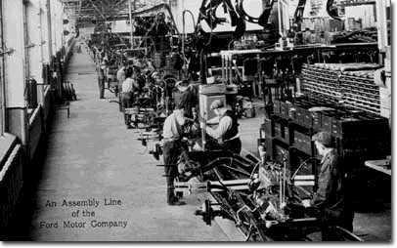
The Assembly Line
Became widespread due to its success in the auto industry
Improved efficiency by breaking tasks into small steps
Industry itself created specialized divisions
Productivity increased dramatically
Workers at individual stations on an assembly line at Ford Motor Company
Notes:
As demand for automobiles increased, Ford, General Motors, and other manufacturers looked for ways to provide enough supply to meet demand. These companies realized that they could produce many more automobiles in much less time by adopting the assembly line production method in their factories. To do this, manufacturers would first break a complex task (such as building an automobile) into several simpler, repetitive tasks. Therefore, an individual worker would need little specialized knowledge to do his job. If he were ill, quit, or was fired, management could easily put another worker at that station and continue with production.
As the success of the automobile assembly line became known, other industries followed suit and began to develop their own assembly lines. Similarly, many industries started to compartmentalize functions of the business itself into various departments, each with its own manager and dedicated team of employees.
By the end of the decade, industrial productivity had increased dramatically, more than 30 percent from its pre-1920 level. However, wages rose at a much less robust rate—only eight percent from the end of World War I. Many workers essentially became replaceable cogs in the great machinery of manufacturing, as many of the skills craftsmen had developed over the years practically died out.
*

Slide 23
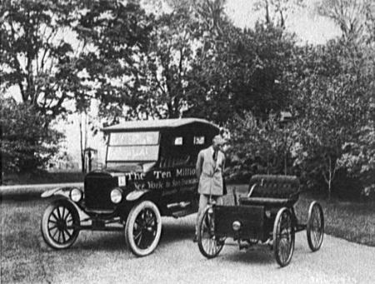
“Welfare Capitalism”
Many industrialists worried about creation of unions
Created programs to give workers mostly non-wage benefits
Ford’s “$5 per day” plan
Reduced absenteeism and employee turnover
Henry Ford standing between the first and ten millionth Fords produced, 1924
Notes:
Many industrialists began to offer workers greater benefits to steer them away from the powerful lure of labor unions. In many relatively high-wage jobs, such as those in the automobile industry, management sought to placate workers by providing them with non-wage benefits, including health care, housing, in-house training, recreational sports teams, and social clubs. This approach became known as “welfare capitalism.” While some philanthropic rationale might have existed behind it, its purpose above all was to ensure workers did not quit, and that they did not form unions.
In order to purposely make his workers happy while keeping them on task, Henry Ford created what was known as the “$5 per day” plan. Ford Motor Company increased the daily wage of workers to $5, more than twice the going rate of most automotive companies. However, workers didn’t actually make $5 per day: They received $2.34 per day, plus $2.66 if they could demonstrate that they lived a “good life.” The company assessed this through its Sociological Department, which investigated workers for qualities such as sobriety, thrift, “family values,” and “good morals.”
Following Ford’s example, many businesses began to offer higher pay, shorter workdays, and other benefits to workers. The practice of welfare capitalism greatly reduced absenteeism, as well as the rate of employee turnover. On the other hand, companies—Ford in particular—sometimes relied on spies to make sure that workers were living up to their end of the welfare-capitalist concept (i.e., that they weren’t trying to unionize).
*

Slide 24
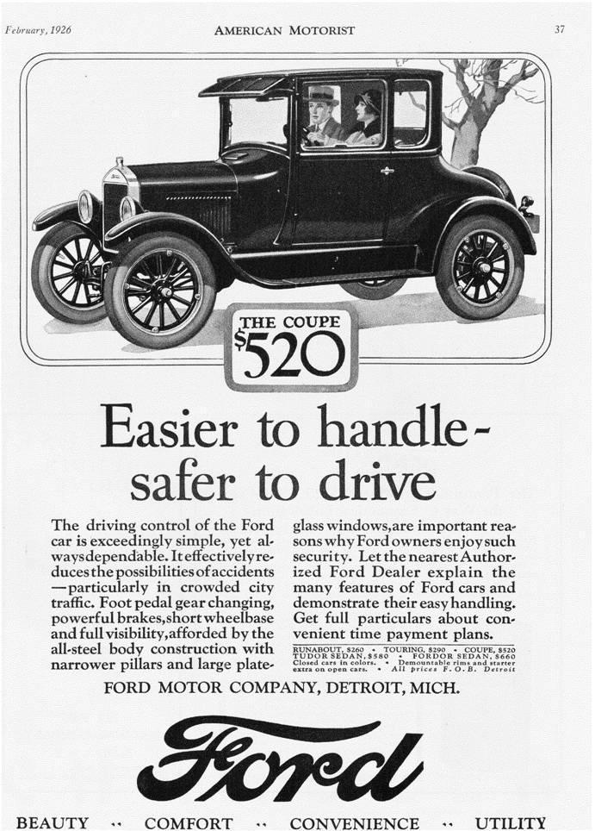
The Automobile: Positive Effects
Created jobs; spawned related industries
Tourism
Sense of freedom
Allowed rural people to connect with towns and cities
Helped to create suburbs
A typical Ford advertisement
Notes:
The widespread acceptance of the automobile had a greater impact on American life than any other invention or innovation of the 1920s. Mass production by Ford and other automobile manufacturers made cars more affordable, and the ability to buy them on an installment plan put them in reach of most families.
The automobile not only created jobs for factory workers, but also gave rise to a number of related industries. Gas stations provided cars with essentials such as fuel, oil, and tires. The auto-glass and steel industries boomed. Drivers finding themselves far from home frequented fast-food restaurants and “motor hotels,” which soon became known simply as “motels.”
The automobile changed American society as well. Teenagers could now go on dates more or less unescorted. People could travel to places farther away more easily, allowing residents of rural areas to visit cities (and vice versa). Families could pile into the car and vacation throughout the country. Above all, the automobile gave a sense of freedom to their owners, who now could move about more quickly and essentially at will, rather than being tied to a train schedule and a designated route.
Whereas trails and dirt roads once crossed the American landscape, modern highways of crushed stone or asphalt took their place. Since people could drive to work, they could live farther away from densely populated urban areas, in less populated surrounding areas that became known as “suburbs.”
*

Slide 25
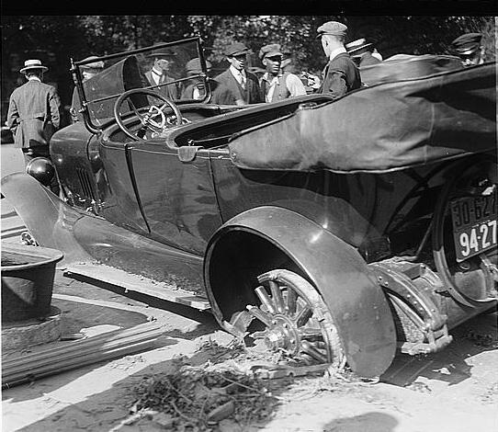
The Automobile: Negative Effects
Increased accident rates
Traffic jams
Decline of public transportation systems in cities
Air pollution from auto exhaust
Cluttering of roadsides with billboards
An early 1920s automobile accident
Notes:
Along with its many benefits, the automobile generated its fair share of problems. A major increase in the number of cars on the road resulted in the inevitable rise in the number of car accidents. Over the course of the decade, hundreds of Americans died; thousands suffered injuries.
In addition, people began to realize that city streets and highways could not effectively deal with all of the vehicles now traveling them. Traffic jams and gridlock became common in many American cities, with cars unable to move for hours during the so-called “rush hour.” Regardless of this increase in street traffic, the development of public transportation systems in many major cities began to drop off. Urbanites turned away from the scheduled, regular routes of streetcars, cable cars, and the like toward the perceived autonomy and convenience that cars represented.
Negatives also included certain byproducts of automobile usage: Many cities and communities saw a rise in air pollution due to the exhaust released by cars’ internal-combustion engines. Smog soon became a problem in many American cities. As populations became more mobile, advertising signs and billboards began to clutter the landscape.
*

Slide 26
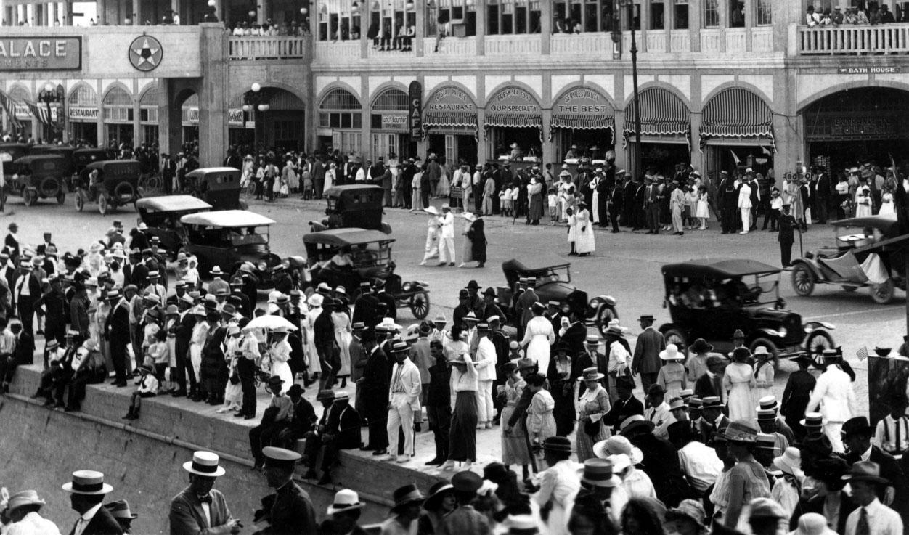
Urban vs. Rural Life
For the first time, urban dwellers outnumbered rural ones
Ethnic and social differences
Rural and urban dwellers clashed on issues such as religion and alcohol consumption
New York City in the 1920s
Notes:
In the 1920s, for the first time more Americans lived in cities (at the time, areas of 2500 or more) than in rural areas. Fifty-four million out of a total population of 106 million claimed urban residence. More than 16 million lived in cities with 500,000 or more people. The trend continued through the decade, with more than 19 million moving to cities.
City life engendered significant changes in the lives of new residents. Fewer children worked because of compulsory education laws, and fewer women worked outside the home. Generally, middle-class women in the workforce worked in professional jobs and were married without children.
In general, rural dwellers described themselves as primarily white and Protestant, holding traditional moral and religious values. They viewed their counterparts in the cities as mostly immigrant and saw cities dominated by Catholics and Jews, as well as full of corruption. In contrast, city residents saw their rural counterparts as backwards “hicks.” Two of the biggest issues on which rural and city dwellers disagreed were fundamentalist religious beliefs and the legal consumption of alcohol. The conflict would continue throughout the decade.
*

Slide 27
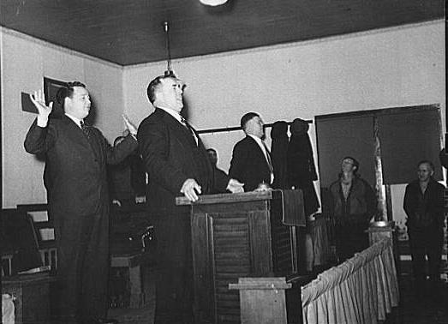
Fundamentalism
Refers to elements “fundamental to belief” in a religion
Frequently dealt with literal interpretation of an inerrant Bible
Tent shows and religious revivals
A Fundamentalist service
Notes:
While many sought to lose themselves in the consumer society and prosperity of the 1920s, still others saw a need to return to older, simpler concepts of religion and basic morality. While the term “fundamentalism” originated in 1920, the ideas of the Fundamentalist movement actually had their origins in a series of Bible conferences that began in 1876. The movement flourished with the release of a 12-volume publication (later distilled to four volumes) called The Fundamentals: A Testimony of the Truth (1909), which covered several basic tenets of Christian belief and sought to move away from more-liberal views that natural scientific phenomena could explain many of the events of the Bible. Instead, Fundamentalists believed in the literal interpretation of an inerrant Bible.
While Fundamentalism existed prevalently in the southern and western United States and thrived in rural areas, the original movement emerged from an urban setting. In areas where the movement flourished, tent shows and religious revivals celebrating Fundamentalist beliefs became common. Fundamentalist preachers such as Billy Sunday and Aimee Semple McPherson became national celebrities.
*

Slide 28
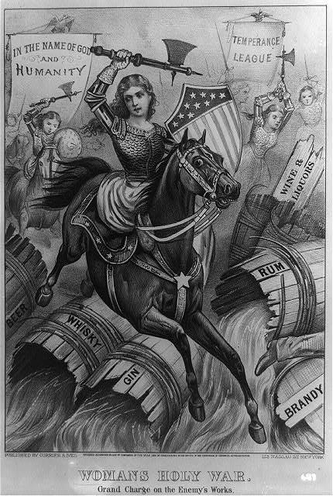
Prohibition: Origins
Origins in Jacksonian era
Anti-Saloon League, Temperance League, Women’s Christian Temperance Union
Influence of WWI
State and local prohibition laws
The 18th Amendment (1920)
An 1874 cartoon about the Temperance League
Notes:
While many think of Prohibition as simply a 1920s phenomenon, the movement actually had its roots in the early 19th century, as far back as the Jacksonian era. Groups such as the Anti-Saloon League, the Temperance League, and the Women’s Christian Temperance Union sought to outlaw the sale and consumption of alcoholic beverages as far back as the Gilded Age. During the Progressive Era, many reformers perceived a link between alcohol and many of the nation’s social problems.
America’s entry in World War I also helped fuel the trend towards Prohibition. Many saw the manufacture of alcoholic beverages as a waste of grain which could be used to feed civilian populations, or could be used to help feed doughboys in the field. In addition, many equated drinking with foreign populations—especially Germans, America’s enemies in the war—and sheer patriotism helped reduce consumption in the U.S. The Lever Food and Fuel Control Act of 1917 prohibited the use of grain in manufacturing alcoholic beverages, and many state and local governments passed laws making their jurisdictions “dry” even before the 18th Amendment was ratified.
On January 29, 1920, the 18th Amendment went into effect, and national prohibition of alcohol became law.
*

Slide 29
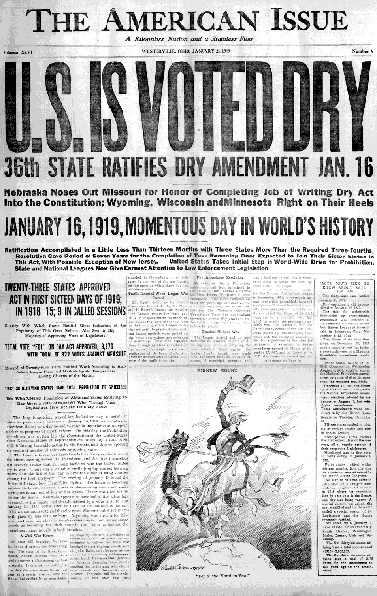
The 18th Amendment
Section 1. After one year from the ratification of this article the manufacture, sale, or transportation of intoxicating liquors within, the importation thereof into, or the exportation thereof from the United States and all territory subject to the jurisdiction thereof for beverage purposes is hereby prohibited.
Section 2. The Congress and the several States shall have concurrent power to enforce this article by appropriate legislation.
Section 3. This article shall be inoperative unless it shall have been ratified as an amendment to the Constitution by the legislatures of the several States, as provided in the Constitution, within seven years from the date of the submission hereof to the States by the Congress.
A newspaper announces ratification of the amendment
Notes:
Congress first approved the 18th Amendment in 1917, and then sent it to the states for ratification. It reached the required two-thirds mark on January 16, 1919, when the state government of Nebraska passed it. Forty-six of 48 states eventually voted to ratify, with only Rhode Island and Connecticut voting against. It became law on January 29, 1920, one year after its ratification.
Many states and local government agencies had already established prohibition laws on their own, but the 18th Amendment instituted the first and only nationwide prohibition in America. The amendment forbade the sale, manufacture, transportation, or importation of alcoholic beverages. However, the amendment did not ban the consumption of alcoholic beverages, and establishments and individuals could still serve or enjoy liquor as long as they had a bill of sale proving that they had bought the spirits before the 18th Amendment took effect.
The 18th Amendment instituted Prohibition, but did not specify any means for enforcing it. However, it did allow federal and state governments to enact legislation for providing enforcement. In addition, for the first time in U.S. history, the text of the amendment specified a seven-year time limit for ratification. Most subsequent constitutional amendments would also include similar language.
*

Slide 30
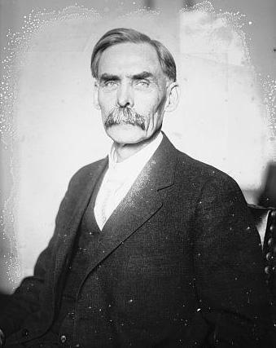
The Volstead Act
Also known as the “National Prohibition Act”
Sponsored by Rep. Andrew Volstead
Defined an “intoxicating liquor”
Set penalties for violation of the act
Representative Andrew Volstead
Notes:
While the 18th Amendment permitted Prohibition in 1920, it did not specify what constituted an “intoxicating liquor,” nor did it establish penalties for violations. The National Prohibition Act—more commonly known as the Volstead Act, after its sponsor, Representative Andrew Volstead—attempted to answer these questions.
According to the Volstead Act, any beverage that contained more than 0.5 percent alcohol violated the act. However, “liquors” that contained more than 0.5 percent alcohol not designed for human consumption were allowed. In addition, the act kept legal any alcohol used for medicinal purposes (prescribed by a physician and provided by a pharmacist), as well as for religious observances by ministers, priests, and rabbis.
Persons who violated the Volstead Act faced fines up to $1000, as well as six months imprisonment. Persons convicted of subsequent violations could be fined up to $2000 and sentenced up to five years imprisonment. The Volstead Act did not bar the consumption of alcoholic beverages purchased prior to ratification of the 18th Amendment. Soon after the Volstead Act became law, the Bureau of Internal Revenue legalized certain quantities of homemade alcohol stronger than 0.5 percent, stating that home brew was legal as long as it “cheered” and not “intoxicated.”
*

Slide 31
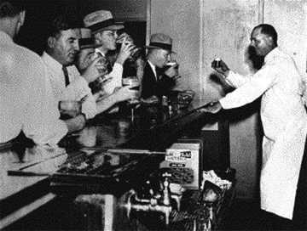
Speakeasies
Establishments that sold illegal liquor
Highly profitable
“Blind pigs”
Law enforcement often bribed
Patrons bellying up to the bar for illegal intoxicants
Notes:
While Prohibition closed many saloons, breweries, and distilleries, those who still wanted to drink usually found a way to do so. Speakeasies were underground saloons which sold illegal liquor and frequently provided a place for people to drink, mingle, and listen to music. The term “speakeasy” had actually come into use before Prohibition, allegedly first used by a Pittsburgh woman who wanted to sell liquor without a license. When her customers wanted to buy more whiskey, she advised them to “speak easy.”
As Prohibition became less and less popular, many speakeasies not only provided alcohol, but served food and hosted live bands and floor shows. Some of the seedier establishments became known as “blind pigs.” These establishments provided a place to drink, and not much else; their operators would often charge admission for a lawful attraction (such as an animal exhibit) and “give” patrons drinks.
Owners of speakeasies ran the risk of arrest and punishment for violating state and federal law. However, the profits proved so great that many were willing to run the risk. Authorities arrested few speakeasy owners, since many of them bribed police and other law enforcement officers not to investigate their establishments, or to at least provide advance warning of an imminent raid.
*

Slide 32
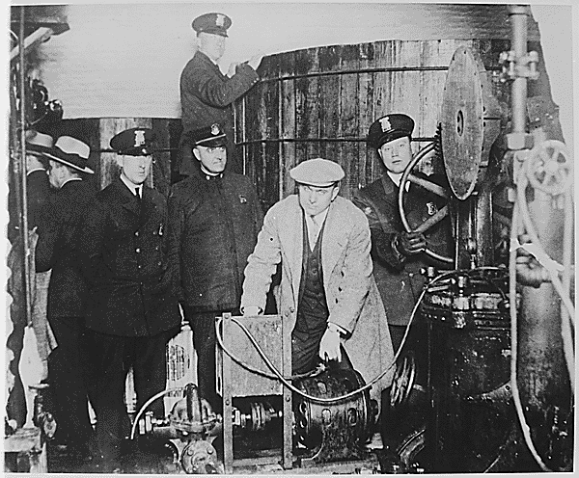
Prohibition: Enforcement
Bureau of Prohibition
Originally a division of the Treasury Dept., later moved to Justice Dept.
Enforcement proved nearly impossible
Underfunded
Use of alcohol for medicinal and religious purposes still legal
Plainclothes and uniformed officers posing with an illegal still
Notes:
While many believed in Herbert Hoover’s assessment of Prohibition as a “Noble Experiment,” the government did not accurately predict the costs or effort needed for enforcement. The Volstead Act created the Prohibition Unit, devoted to enforcement as a division of what today is the IRS. By 1927, it had become the Bureau of Prohibition, an entity in the Treasury Department. Both versions of the organization indicated the government’s approach to enforcement as a tax-evasion issue. In 1930, the Justice Department folded the bureau into the FBI. Originally, the government appropriated only about $5 million for enforcement; estimates later ballooned to about $300 million. At any rate, the government never had more than 2500 agents devoted to enforcing Prohibition.
However, some Prohibition agents had moderate success. New York agents Izzy Einstein and Moe Smith frequently used disguises to infiltrate bootlegging rings, at times dressing as husband and wife looking to buy illegally manufactured liquor.
In some instances, people found ways of legally skirting the Prohibition laws. Pharmacists, for example, could legally dispense medications based on alcohol. The consumption of sacramental wine increased by nearly one million gallons in Prohibition’s first two years.
*

Slide 33
Prohibition: Successes and Failures
Successes:
Failures:
Per capita consumption of alcohol decreased
Public drunkenness arrests declined
Deaths from alcoholism dropped
Fewer workers squandered paychecks on drinking
“Drys” insisted on abstinence, forcing many moderates to become lawbreakers
Strict enforcement nearly impossible
Skyrocketing enforcement costs
Rise of organized crime
Some poisoned by homemade liquor
Notes:
While many might argue that Prohibition failed outright, it did have several positive results. Per capita consumption of alcohol dropped from 2.6 gallons per year in the years prior to World War I, to less than one gallon by the early 1930s. Arrests for public intoxication declined dramatically, and the number of deaths due to alcoholism dropped by 80 percent. In addition, fewer workers squandered their paychecks on liquor, and financial stresses on marriages and families were somewhat reduced.
However, the failures of the “Noble Experiment” far outweighed its successes. In many locations (especially big cities), liquor was available to anyone willing to pay for it. The “drys” (those in favor of Prohibition) forced many moderates into illegal behavior by demanding complete abstinence; many saw drinking beer and wine as an integral part of their culture and not an illegal act. The federal government greatly underestimated manpower and funding necessary for enforcement. At no time did the federal government have more than 2500 Prohibition agents nationwide. It had allocated $5 million for enforcement costs, but later estimated those costs close to $300 million. In New York, authorities arrested more than 7000 persons for violating the Volstead Act, but secured only 17 convictions. By 1925, several states had enacted laws forbidding local police to investigate Prohibition violations.
Another serious problem concerned the quality of illicit alcohol. In some instances it proved toxic, causing several cases of blindness or other related illnesses. By 1927, more than 50,000 people nationwide had died from drinking poisonous liquor.
*

Slide 34
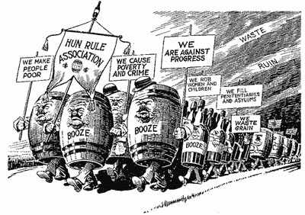

Slide 37
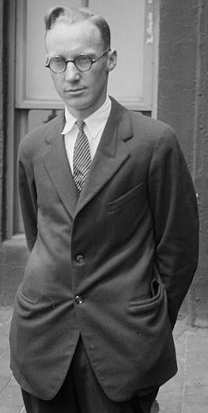
The Scopes Trial: Origins
Tennessee’s Butler Act (1925) prohibited teaching Darwinian evolution
ACLU offered to defend any teacher who violated the law
Biology teacher John Scopes agreed to test the law
Scopes taught evolution in class and was arrested
John T. Scopes
Notes:
In rural Dayton, Tennessee, a biology teacher named John T. Scopes tested the prevailing Fundamentalist control of education in the state. Passed in 1925, Tennessee’s Butler Act forbade the teaching of Darwinian evolution in state-funded schools. The American Civil Liberties Union looked to challenge this law in court and offered to defend any teacher willing to become the defendant in such a case. Scopes readily agreed, and reading aloud from a state-mandated textbook, said, “We have now learned that animal forms may be arranged so as to begin with the simple one-celled forms and culminate with a group that includes man himself.” Shortly after teaching the lesson, authorities arrested Scopes and charged him with violating the Butler Act. His trial was scheduled in Dayton for July 1925.
*

Slide 38
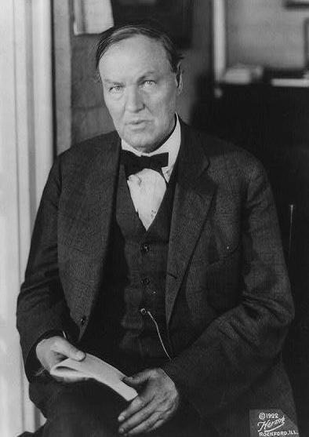
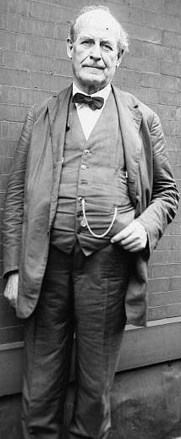
Scopes: The Attorneys
William Jennings Bryan for the prosecution:
Former Secretary of State and three-time presidential candidate
“Expert witness” on the Bible
Clarence Darrow for the defense:
Noted defense attorney
Staunch agnostic
Clarence Darrow
William Jennings Bryan
Notes:
As the date for Scopes’s trial neared, the World Christian Fundamentals Association invited William Jennings Bryan to serve as special prosecutor. Bryan had been Secretary of State under Woodrow Wilson and a three-time Democratic candidate for president, and was a strict Fundamentalist and outspoken critic of evolution. Once Bryan had joined the prosecution, the ACLU secured the help of noted defense attorney Clarence Darrow to represent Scopes. Darrow, famous for his acceptance of controversial cases such as the previous year’s Leopold and Loeb murder case, had a reputation as a staunch agnostic.
As soon as it began, the trial blossomed into a national sensation and was covered by several major media outlets. Thousands flocked to Dayton to watch the action unfold. But as it progressed, it became less of an issue of a teacher’s rights than a fight over the roles of science and religion in society.
*

Slide 39
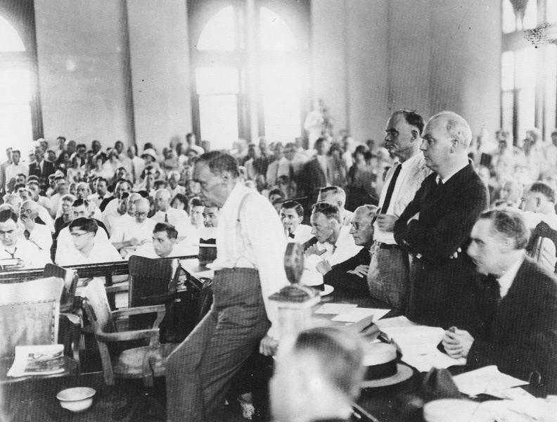
Scopes: The Trial
Extensively covered by newspapers and radio
Trial held on courthouse lawn
Circus-like atmosphere; prosecution frequently the butt of jokes
High point of trial occurred when Darrow questioned Bryan as “expert witness” on Bible
A scene from the trial
Notes:
As the trial opened in June 1925, it quickly became the talk of the nation. News media from across the country sent reporters to cover the trial, and Chicago’s WGN radio provided on-air coverage of testimony. Noted writer and journalist H.L. Mencken also provided analysis of each day’s testimony for the Baltimore Sun.
The oppressive heat and the size of the crowd led to holding the trial on the courthouse lawn. The event took on a circus-like atmosphere: Locals set up lemonade stands to cater to thirsty witnesses and audience members. Trained chimpanzees were brought in to perform.
Correspondents and cartoonists tended to poke fun at and ridicule Bryan and the prosecution more frequently than Darrow and the defense. Mencken, for example, called the citizens of Dayton “hillbillies” and “peasants,” portraying Fundamentalists in a less than flattering light.
However, the high point of the trial occurred when Darrow called Bryan as an “expert witness” on the Bible. Darrow skillfully forced Bryan to admit under questioning that not everything in the Bible could be taken literally, severely damaging Bryan’s credibility.
*

Slide 40
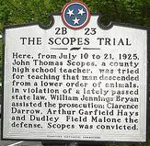
Scopes: Verdict and Aftermath
Trial lasted eight days
Jury found Scopes guilty in nine minutes
Scopes fined $100
Verdict overturned on technicality in 1927
Butler Act repealed in 1967
Supreme Court ruled laws against teaching evolution unconstitutional in 1968
A historical marker in Dayton, Tennessee
Notes:
After eight days of testimony, the Scopes Trial ended in a guilty verdict. The jury took only nine minutes to find Scopes guilty of violating the Butler Act, and the judge imposed a fine of $100.
After the verdict, Bryan remained in Tennessee, traveling hundreds of miles giving speeches. Five days after the end of the trial, however, Bryan died suddenly in his sleep, probably due to exhaustion from the strain of the trial as well as the summer heat.
In 1927, the Tennessee Supreme Court overturned Scopes’ conviction on a technicality because the judge had set the sentence in the case (the $100 fine) and not the jury; Tennessee law barred judges from levying fines over $50. State authorities elected not to retry the case. The Butler Act remained state law in Tennessee until 1967, when the state legislature repealed it.
The U.S. Supreme Court in Epperson v. Arkansas (1968) ruled unconstitutional all state laws forbidding the teaching of evolution in schools for violating the First Amendment’s establishment of religion clause.
*

Slide 41
A Clash of Cultures
"Old" Culture | "New" Culture
Emphasized Production | Emphasized Consumption
Character | Personality
Scarcity | Abundance
Religion | Science
Idealized the Past | Looked to the Future
Local Culture | Mass Culture
Substance | Image
Notes:
41

Slide 42
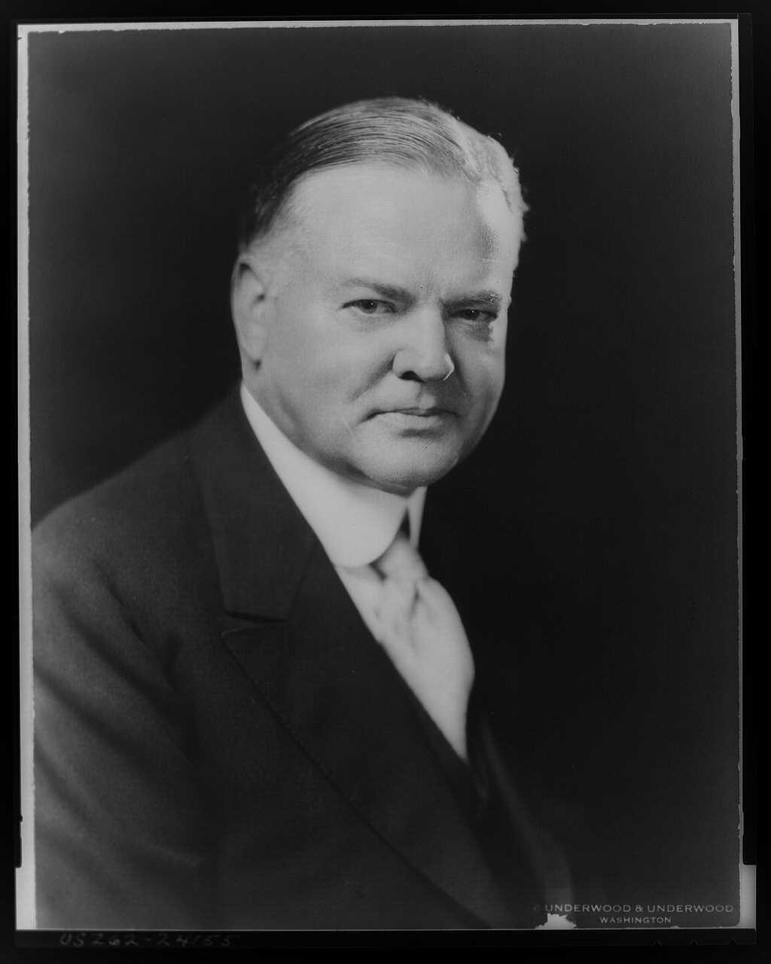
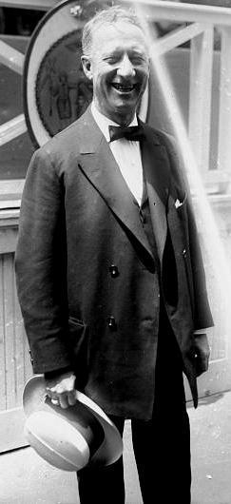
The Election of 1928
Coolidge chose not to run
Republicans nominated Herbert Hoover
Democrats ran Al Smith
Many suspicious of Smith for being “big city” and Catholic
Hoover landslide, but Smith proved Democrats still strong
Herbert Hoover
Al Smith
Notes:
Many expected President Calvin Coolidge to seek a second full term in 1928. However, Coolidge shocked Republicans when he chose not to run. With no incumbent, Republicans looked for another candidate to hold the White House. They chose Secretary of Commerce Herbert Hoover. Few candidates had his credentials: Not only had he served in Coolidge’s Cabinet, he had also assisted in the rebuilding of Europe after World War I. Known as a great leader and a humanitarian who had pulled himself up by his own bootstraps, Hoover had made a fortune as a mining engineer before entering public service.
The Democrats nominated New York Governor Al Smith. Many were doubtful of Smith’s chances, as a product of New York City’s Tammany Hall political machine and the first Catholic nominated for the presidency. As a “wet,” he supported the repeal of Prohibition.
Hoover won the election in a landslide. Some historians deny that Smith’s “big city” image or religious affiliation cost him the election, but rather that the “Coolidge prosperity” kept many voters squarely in the Republican column. However, As Hoover would find out after taking office, this prosperity was largely superficial. In addition, changes were sweeping the nation that would help the Democrats in upcoming elections: Many working-class voters came out for Smith and deserted the Republicans. Most major metropolitan areas, having been strongly for Coolidge in 1924, voted for Smith in 1928. Agricultural states also saw marked increases in Democratic votes.
*

Slide 43
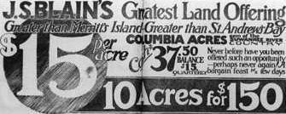
Economic Problems
Decline in agriculture, textiles, coal
High tariffs and poor European economic policies
Uneven distribution of wealth
Overproduction
Overuse of credit
Overspeculation in real estate and stocks
An ad for real estate during the Florida land boom of the 1920s
Notes:
Certain major industries declined during the 1920s, including agriculture, coal mining, and textiles. A great deal of the decade’s industrial growth occurred in only a few industries. Three automobile companies accounted for 90 percent of all production; a small number of bankers controlled nearly 50 percent of the banking industry.
Money pouring out of Europe to repay debts from World War I left little at home to buy American-made goods; meanwhile, high tariffs on European imports kept much revenue from flowing back to Europe. American and European businesses suffered.
Although many viewed the 1920s as an “era of prosperity,” the vast majority of people in America were middle class or poor. Since most of the real wealth in the country lay in the hands of only a few people, most citizens didn’t have the cash to purchase goods. Coolidge only made the discrepancy worse by cutting taxes on the wealthy.
American industry produced much more than consumers could buy. Installment buying helped maintain demand, but at a high price. Many consumers overextended themselves and could not repay their debts. In addition, many companies’ profits existed only on paper—not the money itself, merely the promise of payment.
Many believed that speculation in real estate—and especially in stocks—would result in easy money. Many investors in the stock market bought stock “on margin,” in which they paid 10 percent of the stock’s value and owed the other 90 percent on credit. If the stock continued to climb in value, the investor was safe. However, if the value of the stock declined the broker would make a “margin call,” demanding payment for the rest of the amount owed. If the investor couldn’t pay the other 90 percent, the broker would sell the stock, hoping to recoup his losses. As the market as a whole declined in value, this process became a vicious circle, further driving down stock prices.
*

Slide 44
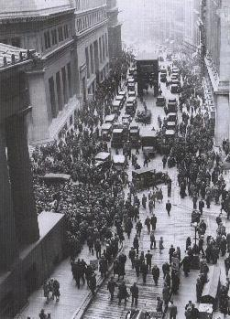
The Stock Market Crash
Panic started on October 24
Biggest decline on October 29
$14 billion lost that day; $30 billion that week
A mostly steady decline until 1932
Businesses began to lay off workers
Many banks failed
A crowd gathers outside the New York Stock Exchange following the crash
Notes:
The bubble finally burst in the fall of 1929. On October 24th, a market panic began called “Black Thursday.” Brokers frantically tried to unload shares of rapidly declining stocks, but the market righted itself to some extent by the end of the day as bankers poured millions into the market. On October 29—forever known as “Black Tuesday”—the bottom dropped out. In one day, the market lost $14 billion in value; for the week, close to $30 billion. Within six months, the market had lost nearly 85 percent of its value. Short periods of stability notwithstanding, the market continued to decline, and in July 1932, it closed at its lowest value since the 19th century.
Many companies lost a great deal of value as stocks collapsed had began to lay off much of their workforce, which raised the unemployment rate. Also, many banks had unwisely bought stocks on margin with much of their depositors’ money; when the crash occurred, a large number of banks failed, their depositors’ money gone.
*

Slide 45
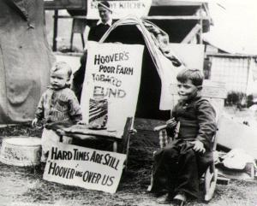
The Depression Begins
Hoover believed in limited government involvement
Opposed direct aid in favor of charitable organizations
“Trickle-down” economic theory
Unemployment skyrocketed
Economy continued to decline
Children in front of signs blaming Hoover for the country’s economic woes
Notes:
While the crash did not cause the Depression, it marked the end of the boom years of the 1920s. Hoover, in office only seven months at the time of the crash, found the country sinking into an economic calamity that he could not solve.
While his administration did provide some relief, Hoover believed in limited government involvement. He also opposed direct relief payments to individuals, feeling that it destroyed self-worth. Instead, he supported private relief efforts, such as those by churches and groups such as the American Red Cross.
In practical terms, Hoover believed in what would later be called “trickle-down economics,” in which money pumped into the “top” of the economy (e.g., industry, banks, railroads) would “trickle down” to the working class because of more research and development as well as increased salaries. Unfortunately, little of this money reached those most in need.
However, Hoover’s actions were too little, and too late. By the time he left office, more than 25 percent of the American workforce was unemployed. More than 9000 banks had closed, losing more than $2.5 billion in deposits. Clearly, more dramatic action would need to be taken in order to solve the problems of the deepening Great Depression.
*

