Slide 1
Do Now
How was immigration an indirect cause of the Progressive movement?
How was industrialization a cause of the Progressive movement?

Slide 2
The Progressives A Reaction to Excesses of Industrialization
Mr. Winchell
Period 6-7
APUSH

Slide 3
Progressive Era What to know
Origins of Progressivism
Progressive attitudes and motives
Muckrakers
Social Gospel
Municipal, state, and national reforms
Political: suffrage
Social and economic: regulation
Socialism: alternatives
Black America
Washington, Du Bois, and Garvey
Urban migration
Civil rights organizations
Women's role: family, work, education, unionization, and suffrage
Roosevelt's Square Deal
Managing the trusts
Conservation
Taft
Pinchot-Ballinger controversy
Payne-Aldrich Tariff
Wilson's New Freedom
Tariffs
Banking reform
Antitrust Act of 1914

Slide 4
Progressives Were a Diverse Group
Different reform movements (not United)
Moral and Social Reforms | Political End Corruption Increase Democracy | Economic Stabilize the Banking and Economy
Women’s Rights | Curtail Power of Big Business | Labor Recognition

Slide 5
Progressives=Reform Movement
Progressive movement a reaction to the excesses of industrialization.
(negative effects of Industrialization)
Poverty
Corruption- Municipal, State and Federal
Working conditions
Organizing the Economy
Immigrant living conditions
Immigrant “social issues associated with immigrants, pejorative- dirty, non-English speakers, Alcohol abuse…
WASP movement- concerned with changes- a movement to regain control…

Slide 6
Progressives Rise Because…
Rapid industrialization (Laissez Faire economics) and urbanization (Social Darwinism) causes intolerable problems
Middle class WASPs were driving force behind movement
Need for reform
Need for order
Need to remedy industrial problems
Psychological view= “Tension Frustration Thesis” desire to regain power lost due to changes in society, corporations, immigrants, urbanization”

Slide 7
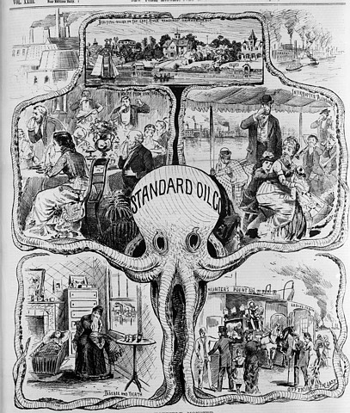
Raking Muck with the Muckrakers
Beginning about 1902, a group of aggressive ten- and fifteen-cent popular magazines, such as Cosmopolitan, Collier’s, and Everybody’s, began flinging the dirt about the trusts.
In 1902, Lincoln Steffens launched a series of articles in McClure’s entitled “The Shame of the Cities,” in which he unmasked the corrupt alliance between big business and the government.
Ida M. Tarbell launched a devastating exposé against Standard Oil.
Jacob Riis- exposed problems of the poor in NYC- How the other half lives

Slide 8
Progressive Constitutional Amendments
16th Amendment= Income Taxes
17th Amendment= Direct Election of Senators
18th Amendment= Prohibition of Alcohol
19th Amendment= Womens Vote

Slide 9
Gov Steps in to Attack business: Laws Passed
Interstate Commerce Commission: Gov Agency to oversee = regulate on RR. (TR)
Elkins Act- regulate RR – no specials to friends (TR)
Hepburn Act- regulate RR- no free passes- Bribery (TR)
Meat Inspection Act-
Pure Food and Drug Act- Gov regulate food industry, and drugs- The Jungle- Upton Sinclair-
Clayton Anti-Trust Act- attacks Big Business (Wilson)
Federal Trade Commission-
Federal Reserve System- Organizes the Banking system, regulate the money supply
Federal Income Tax

Slide 10
Central (Main) Ideas
Bi-Partisan- Both parties had members
Progress – things are getting better
Society was capable of improvement
Government Intervention was needed-
to limit big Business
To end political corruption
Solve social problems of alcohol abuse

Slide 11
Issues:
Social Reforms- Prohibition, support for immigration reform
Women’s Suffrage
Anti-Corruption- Federal, State, City Reform
Trust Busting- limiting big business

Slide 12
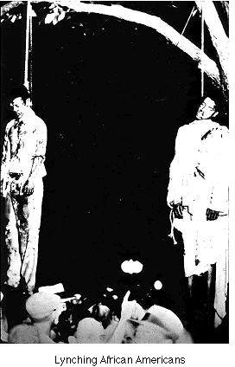
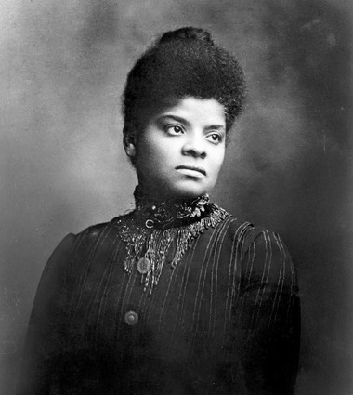
African American Muckraker Ida B Wells
Journalist
Exposed lynching of African Americans in the south
Tried to work for Federal Law
Not much support

Slide 13
Political Reforms
City, State and Federal
City Managers- an appointed manger to prevent corruption in the cities.
Commission- appointed community members to Government bodies- to reduce corruption (outside party politics)
Goal to expand Democracy and counter Corruption
Initiative- citizens can bring issues to the ballot
Referendum- vote of the citizens on an issue
Recall- voters can remove an elected official from office-

Slide 14
Women’s Issues
Poverty, Alcoholism, Child Labor, Prostitution, Public Health, Birth Control, Prohibition
Middle class women, more educated, different vocations, nurses, teaching, medicine, social work…
Leaders
Susan B. Anthony (Early Suffragette)
Elizabeth Cady Stanton (Early Suffragette)
Jane Addams- Hull House (Social Reformer)
Ida B. Wells (protested lynching)
Margaret Sanger (Birth Control advocate)
Alice Paul
Mary Chapman Catt

Slide 15
Women’s Suffrage
National American Women’s Suffrage Association (NAWSA)
Long movement
Begins as a state movement- Southern opposition and Northern cities
Changes to Federal Constitutional Amendment 19th Amendment
Wilson (Democrat) will back the amendment 1917
Becomes part of Constitution 1920

Slide 16
Prohibition
WCTU- Women’s Christian Temperance Union long time advocate of anti-alcohol movement
18th Amendment Passed during WWI

Slide 17
Social Gospel Gospel of Wealth
Christian movement- contrast to Gospel of Wealth
Task of Christianity is to rescue the poor”
Create the kingdom of god on Earth
Salvation Army- example
“Salvation was not merely an individual matter but also a question of Constituting a just Society.”
View of Wealthy
God rewards with wealth
Individual should work hard to get ahead
Philanthropy-wealthy return wealth to up lift society- Universities…
“It’s your duty to get rich”

Slide 18
The Jungle by Upton Sinclair
1906
Highlighted the problems associated with the Meat Packing Industry in Chicago
Exploitation of immigrants
“I aimed for America’s heart, but hit them in the stomach instead”
Poor working conditions
Spurred Changes:
Pure Food and Drug Act- regulated food industries
Food and Drug Administration -Test and Certify Drugs
Meat Inspection Act- Inspection and labeling of Meat

Slide 19
Issues for women: factory reform; temperance; suffrage; child labor laws
Muller v. Oregon (1908)
Supreme Court accepts special laws protecting women and children in the workplace
Employers previously had had total control over the workplace
Right to Contract overruled because of need to “procreate the race”.

Slide 20
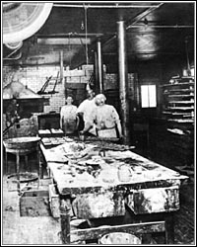
Lochner v. New York (1905)
- overturned a N. Y. law establishing a 10-hour workday for bakers
No special interest to protect workers present to void private party contract rights
In 1917 Court will finally change its views

Slide 21
Gradual change from unregulated capitalism to belief that employers and government had responsibility to workers and society
Many states passed tougher laws regulating sweatshops (after the Triangle fire)
Workers’ compensations laws gave injured workers insurance for lost income
States begin to limit alcohol sales but cities will remain “wet” due to large immigrant populations

