Slide 1
Do Now
What was the South Atlantic System and how did it impact economic development in the Northern Colonies?
What was salutary neglect and how did it impact colonial society?

Slide 2
The Rise of Colonial Assemblies: Mercantilism, Navigation Acts and Salutary Neglect
Mr. Winchell
APUSH Period 2 Day 4

Slide 3
Essential Question
To what extent did British policies both assist and hurt the development of American colonial identity?

Slide 4
Questions to Consider…
IDENTITY: To what extend did British American colonists develop a sense of identity separate from that of English men and women?
IDENTITY: What factors encouraged and what factors impeded the development of an ‘American’ identity?
POLITICS AND POWER: In what ways did British American colonists model their political institutions on England? How did these colonists adapt these institutions in a way that seemed uniquely ‘American’?

Slide 5
Mercantilism
a country’s ultimate goal was self-sufficiency and that all countries competed to get the most gold and silver. Basically, you wanted to sell more to other countries than you bought from them.

Slide 6
Salutary Neglect
England didn’t actually enforce most of its rules in return for the colonies’ continued loyalty.
King appointed governor in most colonies, but colony-appointed officials had a strong influence on the governors. Colonies became more and more independent.

Slide 7
British Control?
Navigation Act (1651): anything shipped in/out of the colonies had to be on British ships.
1660/1663: sugar and tobacco only exported to England, imports had to come through England
Dominion of New England: King James II was aggressive. Revoked charters in NE, put whole region under a royally appointed military officer.

Slide 8
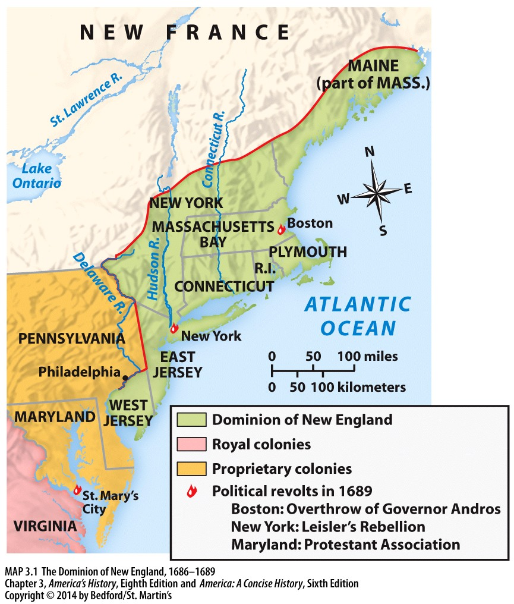

Slide 9
Glorious Revolution
1688-James II overthrown, constitutional monarchy created, weakening the throne.
In America, Protestant colonists revolted in MA, Maryland, NY.
Puritans shipped Dominion of NE leader back to England
Notes:
Protestant colonists in Massachusetts, Maryland, and New York rebelled; Puritan leaders accused Andros of Catholic sympathy and shipped him back to England. William and Mary broke up the Dominion of New England and created a new royal colony with Maine and Plymouth. The new charter gave the vote to all male property owners regardless of faith; rebellions occurred in Maryland and New York. The Glorious Revolution began a non-authoritarian era to the colonies and allowed restoration of self-government in Massachusetts and New York.

Slide 10
SOUTH ATLANTIC SYSTEM
New England Farmers: Bread, Lumber, Fish, Meat, Wheat, Corn to the West Indies.
1750’s: 2/3 of New England’s Exports and ½ of Middle Colonies Exports went to the West Indies.
Sugar from the Indies to England.
Slaves to the West Indies.
Manufactured Goods, textiles, iron goods to the US.
Notes:
The Northern Maritime Economy
A. The Urban Economy
1. American merchants – West Indian trade created American merchant fortunes and urban industries among sugar producers, distillers, fishermen, and export businesses.
2. American cities – Transatlantic commerce spurred the growth of port cities; by 1750, major cities included Newport and Charleston with 10,000 people each; Boston had 15,000 residents; and New York had nearly 18,000. The largest port was Philadelphia, whose population reached 30,000 by 1776.
3. American shippers and teamsters – American shippers traversed Atlantic but also the Hudson and Delaware rivers; teamsters transported wheat, corn and flour to urban markets; transportation spurred new businesses such as taverns, horse stables, and barrel-making shops.
.

Slide 11
Urban Economy
1. Upper classes
Upper classes – Wealthy merchants dominated American cities; imitated British upper classes through architecture, consumption, and genteel culture.
2. Middle ranks
Middle ranks – Artisans and shopkeepers made up nearly half the population. Innkeepers, butchers, seamstresses, shoemakers, weavers, bakers, carpenters, masons and other skilled workers lived in modest comfort, but most artisans were not well-to-do.
3. Lower classes
Lower classes – Laboring men and women made up 30 percent of urban population; they were dockworkers and unskilled wageworkers, washerwomen, wool-spinners, servants, or prostitutes.
Notes:
11

Slide 12
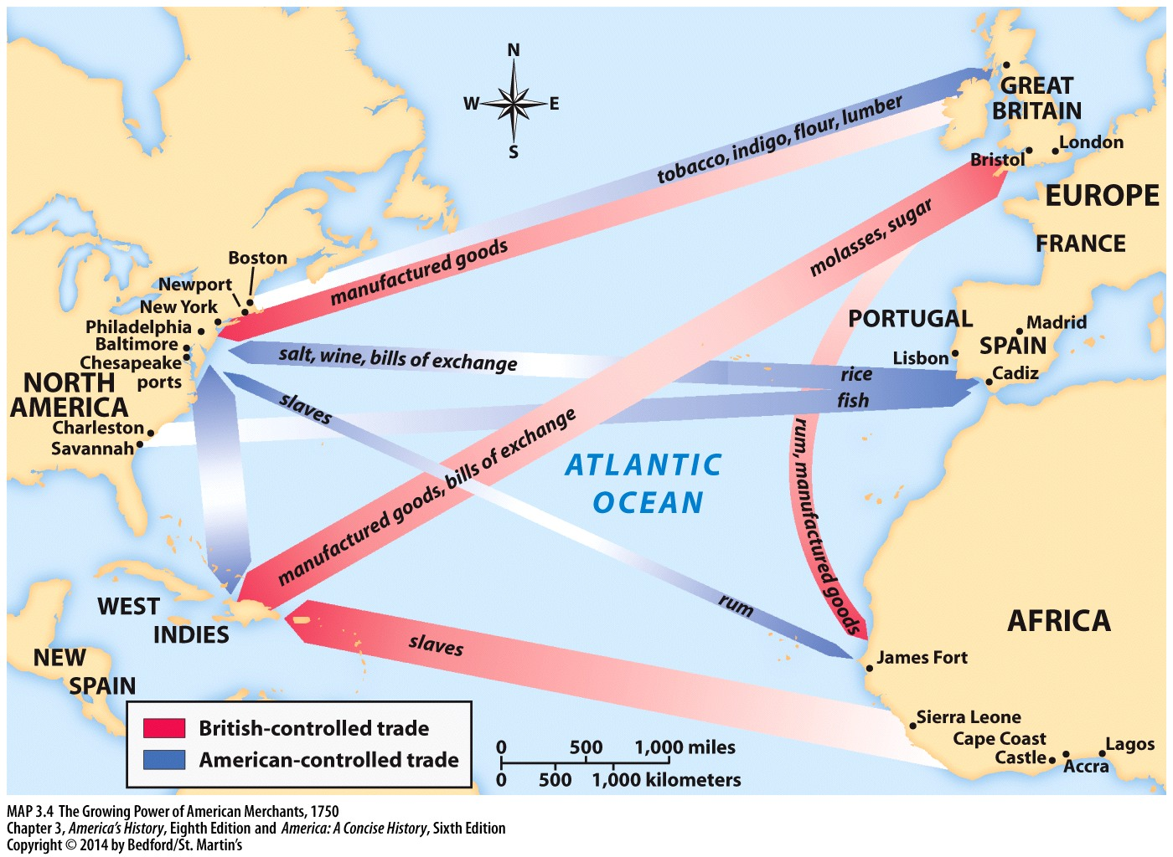

Slide 13
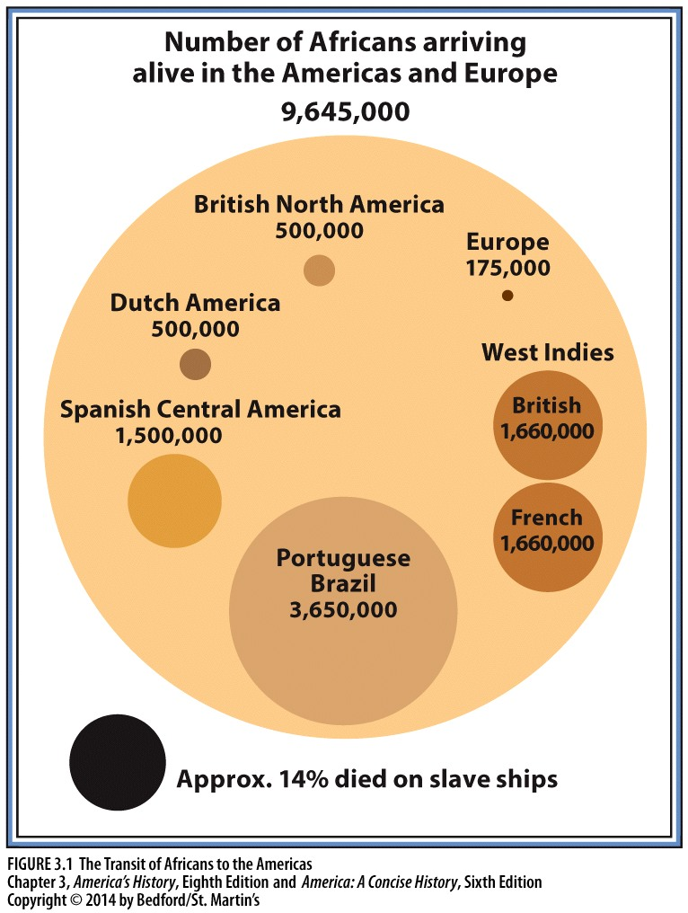

Slide 14
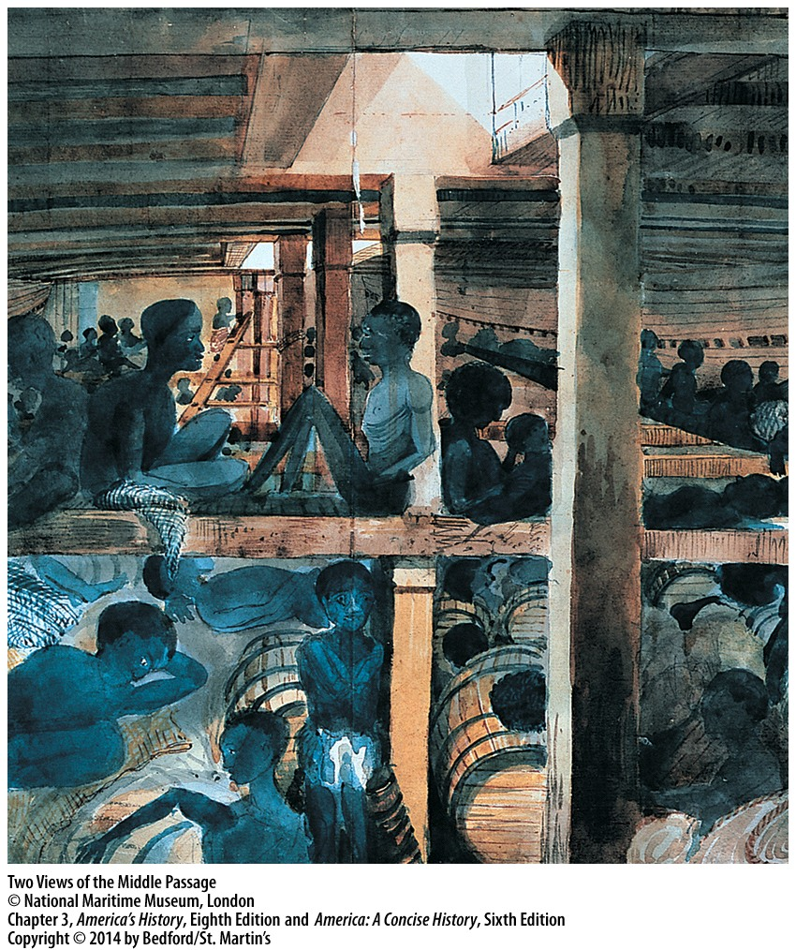
Notes:
1. What was the Middle Passage that is depicted in these two images? (Answer: The Middle Passage was the journey African slaves endured on the ships that brought them from Africa to the New World. The ships were notoriously overcrowded and filthy, and the mortality rate among Africans on the journey was quite high).
2. How does the image on the right differ from the one on the left? Why might the artist have painted the scene in this way? (Answer: The image on the right is painted as if the artist were there in the ship’s hold, whereas the other is a cutaway aerial view. The conditions are far from comfortable, but the African passengers do not look miserable, sick, or malnourished. The artist, a ship’s officer, might have been seeking to minimize the brutality of the trip.)
3. What is the source of the image on the left? Do you think it was intended to convey a particular message, or not? (Answer: The image on the left was the actual plan for a Liverpool slave ship designed to hold 482 Africans packed in very tightly. It was created to be informational—to show how shippers could utilize the space to transport as many Africans as possible. The image was printed by England’s Abolitionist Society to show the inhumanity of the slave trade and slavery itself. Though it does not show sickness, filth, or starvation, it clearly conveys the difficult conditions the African passengers endured.)
14

Slide 15
The New Politics of Empire, 1713–1750
The Rise of Colonial Assemblies
– Post-Glorious Revolution, assemblies in the colonies sought to limit the power of the crown; colonial elite led assemblies; men of wealth could be elected, but all men who owned property could vote.
MA, NC, NJ, PA: Assembly ignored king’s requirement to pay the royal governor.
Took control of taxation
Assemblies were ruled by the colonial elite, but common people had input.

Slide 16
Salutary Neglect
Bureaucrats in England relaxed control over colonies when they were happy with the relationship (pleased by financial benefits); colonists took advantage of this relationship by increasing the power of their representative assemblies.
Sir Robert Walpole (Leader of the House of Commons post Glorious Revolution) practice a policy of patronage.
Patronage: giving offices and salaries to political friends.
Walpole: “Let sleeping dogs lie.”
These policies accidentally created a developing American identity.

Slide 17
Mercantilism and the American Colonies
Britain allowed Americans to own ships and transport goods
Colonists made significant gains in control of exports during 18th century
Increased trade relationship with the French sugar islands.
Lack of currency in colonies further complicated financial relationships
In 1751, Parliament passed the Currency Act, which barred New Englanders from establishing new banks and prohibited the use of publicly issued paper money to pay for private debts
The English attempted to regain control of colonial economic pursuits. In the late 1740s, British officials vowed to reassert their power in America—an initiative that proved to have disastrous results.

Slide 18
Salutary Neglect
After the Glorious Revolution, England lost focus on the colonies.
They had the right to veto ANY colonial law, but only used it 469 out of a possible 8563 laws!
As long as the MONEY kept flowing into England, the Crown was content to leave the colonies alone.

Slide 19
Salutary Neglect
The colonies tried to trade with the French in the West Indies.
To keep this from happening, the British passed the Molasses Act in 1733 which forced the colonies to buy Molasses from the British NOT the French!
BUT England never enforced this!!

Slide 20
Salutary Neglect
Without English control, the colonies began to develop their own….
Economy
Culture
Government
What effect would these developments have on the colonies?
Notes:
Review 3 factors for the Revolution here!!!!

