Slide 1
Do Now
QUIZ!!!!!

Slide 2
The Development of Colonial Identities
Mr. Winchell
APUSH
Period 2

Slide 3
Essential Question:
How did different values lead to different American subcultures in the Chesapeake, Southern, New England, & Middle colonies?

Slide 4
Four Colonial Subcultures
The different values of the migrants dictated the “personality” of the newly created colonies; led to distinct (not unified) colonies
The Chesapeake
New England
Middle Colonies
The Lower South

Slide 5
Chesapeake Colonies: Virginia & Maryland

Slide 6
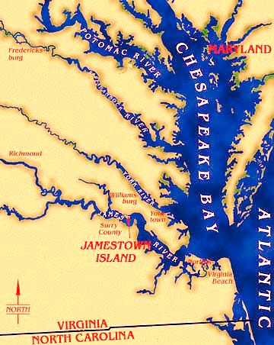
Chesapeake Colonies

Slide 7
Entrepreneurs in Virginia
Jamestown was settled in 1607 along the Chesapeake Bay:
the location was unhealthy but easy to defend from Spanish ships (but not from inland Indians)
Settlers had no experience in founding a settlement
Colonists expected to become immediately wealthy & failed to plant crops or prepare for long-term habitation in America
Chesapeake colonists did not work for the common good & many starved to death
Notes:
Clash of cultures; settlers had no experience in founding a settlement-they simply did that they knew. This did not work

Slide 8
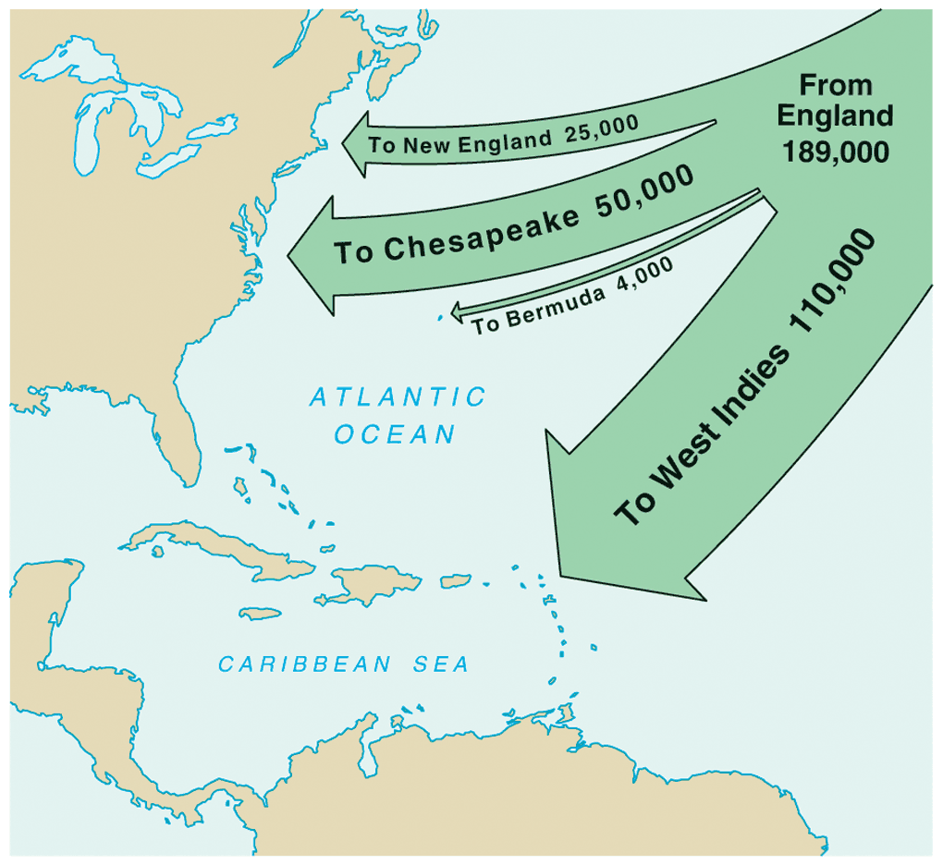
English Migration, 1610-1660
Virginia’s growth was due largely to headrights

Slide 9
Why was 1619 a pivotal year for the Chesapeake settlement?

Slide 10
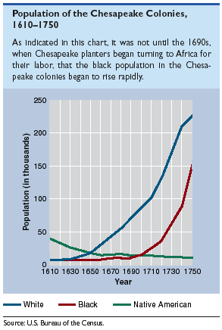
Population of the Chesapeake Colonies: 1607-1750

Slide 11
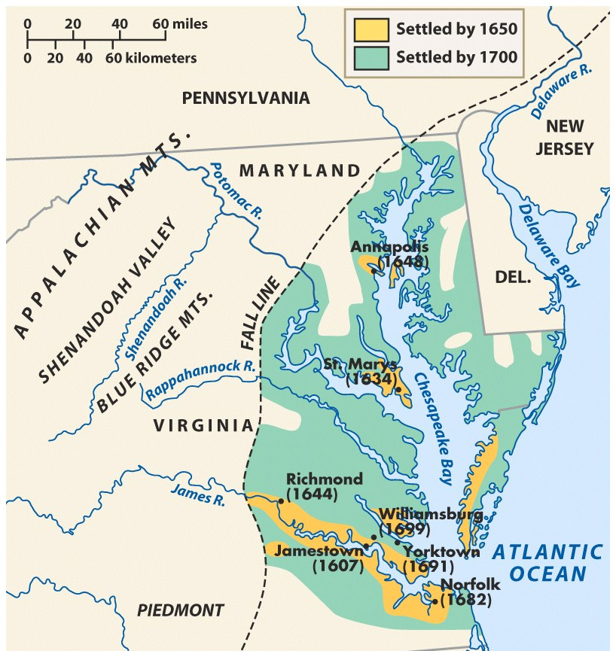
The Maryland Colony

Slide 12
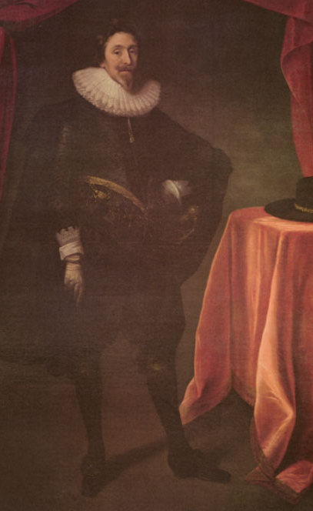
Maryland: A Refuge for Catholics
Initiated by Sir George Calvert (Lord Baltimore) as a refuge for English Catholics
In 1632, Charles I granted a charter for Maryland
To recruit laborers, Lord Baltimore required toleration among Catholics & Protestants

Slide 13
Maryland: A Refuge for Catholics
Wealthy Catholics proved unwilling to relocate to America so Maryland became populated largely by poor Protestant farmers & indentured servants:
Maryland had few large tobacco plantations
Farmers (mostly poor tobacco planters) lived in scattered riverfront settlements

Slide 14
New England Colonies

Slide 15
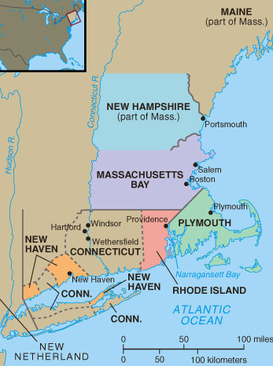
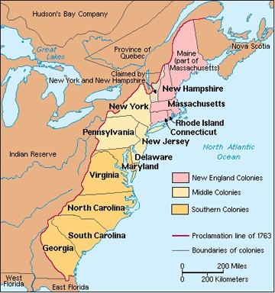
New England Colonies, 1650

Slide 16
Reforming England in America
Queen Elizabeth’s reconciliation of Anglican & Catholic conflicts appeased many, but created 2 factious groups of extremists:
Catholics (many settled in Maryland)
Puritans who wanted Anglican Church stripped of Catholic rituals (made up of conservative “Puritans” & radical “Pilgrims”)

Slide 17
The Pilgrims in Plymouth
Pilgrims were separatists who refused to worship in the Anglican Church, fled to Holland to avoid compromising religious beliefs
Migrated to America in order to maintain distinct identity & settled in New England
Formed the Mayflower Compact to create a “civil body politick” among settlers (became the 1st American form of self-gov’t)

Slide 18
The “Mayflower Compact” Reading & Discussion
What are the Pilgrims agreeing to do by signing the Mayflower Compact?
Is this a religious or a political document? Explain

Slide 19
“The Great Migration”
Puritans were more conservative than Pilgrims & wished to remain within the Church of England:
Believed in predestination, fought social sins, & despised Catholic rituals in the Anglican Church
In 1629, many Puritans felt King Charles I was ruining England
From 1630-1640, John Winthrop led 16,000 Puritans to the Massachusetts Bay colony

Slide 20
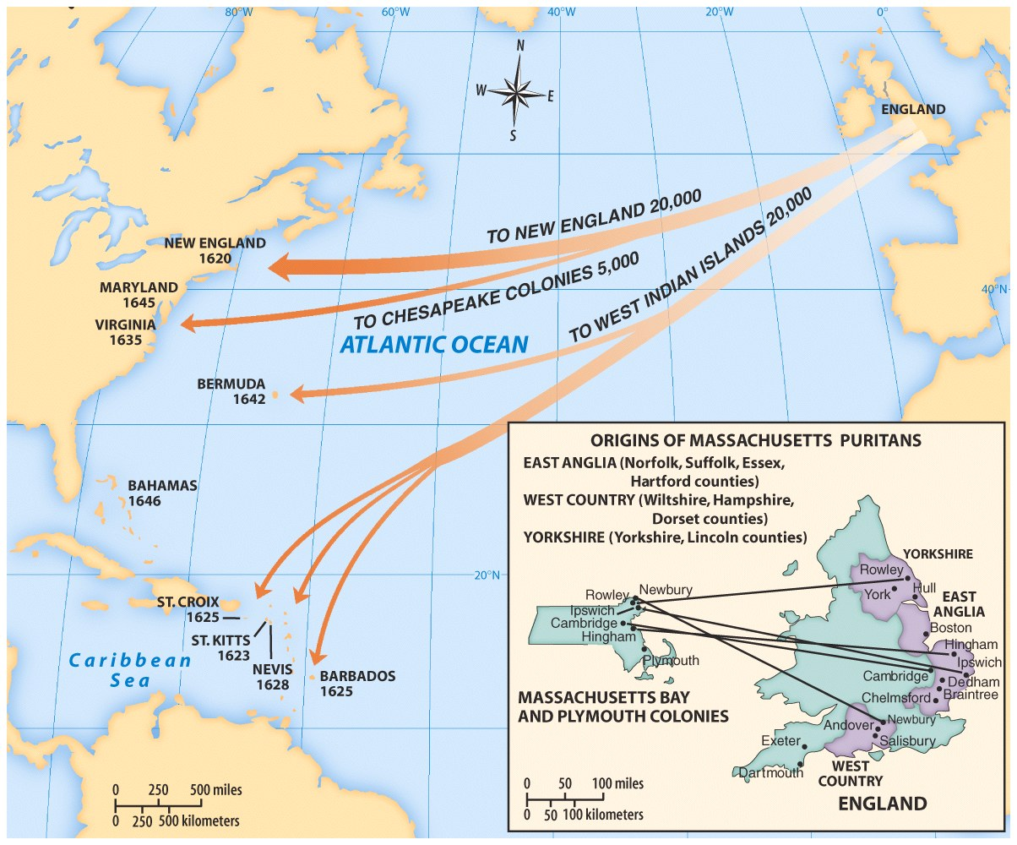
The Great Puritan Migration

Slide 21
“A City on a Hill”
Winthrop emphasized a common spiritual goal: to create a “city on a hill” as beacon of righteousness
New England experienced unique demographic & social trends:
Settlers usually came as families
NE was a generally healthy place to live
Settlers sacrificed self-interest for the good of the community

Slide 22
“A City on a Hill”
As Mass Bay colony grew beyond Boston, towns began to develop their own unique personalities:
Each town was independently governed by local church members (Congregationalism)
Allowed voting by all adult male church members (women & blacks joined but could not vote)
Officials were responsible to God, not their constituents

Slide 23
“A City on a Hill”
NE town gov’ts were autonomous & most people participated due to common religious values
Massachusetts Bay was more peaceful than other colonies:
Passed a legal code called the Lawes and Liberties in 1648 to protect rights & order
Created civil courts to maintain order & mediate differences

Slide 24
Limits of Dissent: Roger Williams
Puritans never supported religious toleration, esp Roger Williams:
Williams was a separatist who questioned the validity of the colony’s charter because the land was not bought from natives
Promoted “liberty of conscience” where God (not leaders) would punish people for their “wrong” religious ideas
Expelled to Rhode Island in 1636

Slide 25
Limits of Dissent: Anne Hutchinson
Anne Hutchinson believed she was directly inspired by God:
Believed that “converted” people are not subject to man’s laws, only subject to God’s laws (Antinomianism)
Hutchinson challenged Mass Bay’s religious leaders
She was banished to Rhode Island

Slide 26
Mobility and Division
After absorbing Plymouth, the Massachusetts colony grew & spawned 4 new colonies:
New Hampshire
Rhode Island
Connecticut
New Haven

Slide 27
Complete the following chart then identify the most significant similarities & differences between the Chesapeake & New England colonies
 | Chesapeake | New England
Political
Economic
Social

Slide 28
The Middle Colonies: New York, New Jersey, Pennsylvania, Delaware

Slide 29
The Middle Colonies, 1685

Slide 30
New York
NY was established as “New Netherlands” by the Dutch West India Co. (the great economic rival to England & Spain)
Its small population was diverse; included Finns, Swedes, Germans, Africans, & Dutch
In 1664, the English fleet captured the colony with little resistance
Notes:
With support of Iroquois who hated the French. Focused on fur trade, shipping for English & French colonies, & picking off Spanish conquistador ships

Slide 31
Pennsylvania
Pennsylvania founded by a radical religious sect called Quakers
Quakers believed in “Inner Light”:
Rejected idea of original sin & predestination
Believed that each person could communicate directly with God
All are equal in eyes of God & can be saved (conversion was essential to faith)
Notes:
(derogatory term for those who “tremble at the word of the Lord”)

Slide 32
Penn's "Holy Experiment"
Quakers were persecuted in New England for their beliefs; William Penn founded Pennsylvania in 1681 as a “holy experiment”
As a society run on Quaker principles that promoted religious toleration & protection of the rights of property-less
Appealed to English, Welsh, Irish, German immigrants

Slide 33
William Penn & Native Americans
Quick Discussion Question:
In what ways was Penn’s “holy experiment” in Pennsylvania similar to Winthrop’s “city on a hill?”

Slide 34
Settling Pennsylvania
Immigration to PA led to a very ethnically, nationally, & religiously diverse population
Quarrels were common (unlike homogeneous VA & Mass Bay colonies), but PA prospered
In 1701, Penn granted self-rule to PA colonists & independence to Delaware counties

Slide 35
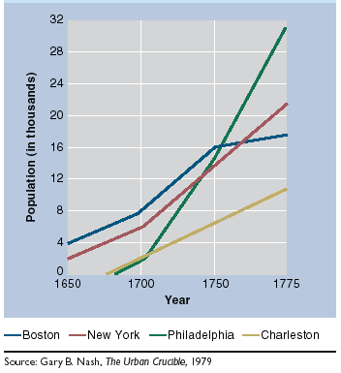
Urban Population Growth: 1650-1775

Slide 36
The Lower South

Slide 37
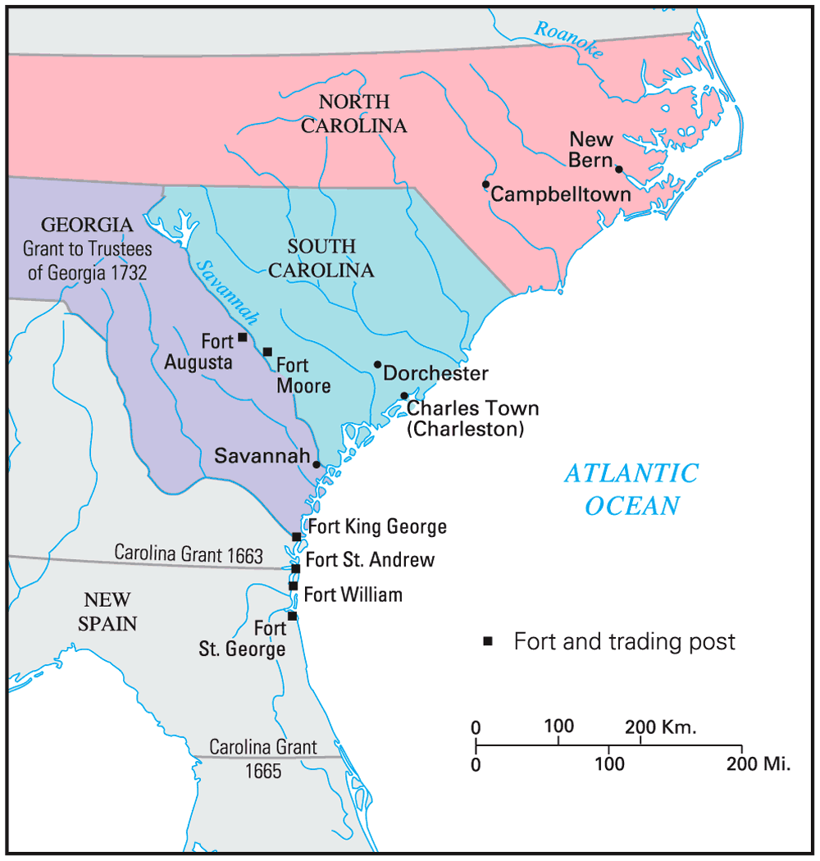
Settling the Lower South

Slide 38
Carolina
Although Carolina relied on slave labor & agriculture (& therefore looked like Chesapeake colonies) it was very different due to:
Diversity of settlers
Environment very different from the Chesapeake
No “Solid South” yet

Slide 39
Proprietors of the Carolinas
Carolina was established as a “political utopia” & experimented with early forms of democracy
Carolina was granted a charter in 1663 to eight “proprietors” to reward their loyalty:
Proprietors were inspired by John Locke & created a government led by wealthy lawmakers but with veto power for average citizens
But Carolina had difficulty recruiting settlers in its first years

Slide 40
Founding of Georgia
Georgia was in many ways a “social utopia” because it offered a fresh start for many of the lowest English citizens
Georgia was founded in 1732 by James Oglethorpe as a strategic buffer between the Carolinas & Spanish Florida
Oglethorpe offered Georgia as a refuge for imprisoned debtors from England
By 1751, Georgia was a small colony with a slave-owning plantation society

Slide 42
Conclusions
All the colonies faced early an struggle to survive
Distinct regional differences intensified & persisted throughout the colonial period
It was not until the American Revolution that colonists began to see themselves as a distinct “American” people

Slide 43
Essential Question:
How and why did different values lead to different American subcultures in the Chesapeake, Southern, New England, & Middle colonies?

