Slide 1
Do Now
In what ways was the US’ reluctance to enter WWII similar to WWI?
In what ways was it different?

Slide 2
The US in WWII -Reluctantly Dragged Into War
Mr. Winchell
APUSH
Period 7

Slide 3
GUIDING QUESTION
To what extent did the Second World War bring about lasting change in the American society, economy and government?

Slide 4
From Neutrality to Undeclared War
But, FDR was able to get $1 billion from Congress to expand the U.S. navy
Roosevelt openly expressed his favor for an Allied victory & took steps to ready the U.S. for war
In 1937, FDR unsuccessfully tried to convince world leaders to “quarantine the aggressors”
Everything changed in 1939 with the Nazi-Soviet Pact & the German invasion of Poland

Slide 5
FDR’s Quarantine Speech
“It seems to be unfortunately true that the epidemic of world lawlessness is spreading. When an epidemic of physical disease starts to spread, the community approves and joins in a quarantine of the patients in order to protect the health of the community against the spread of the disease.”

Slide 6
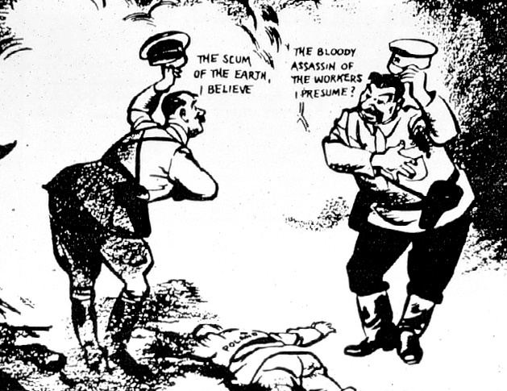
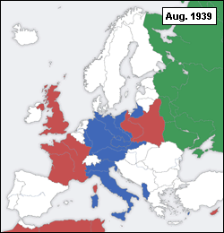

Slide 7
From Neutrality to Undeclared War
“The destroyer-for-bases deal is the most important action in the reinforcement of our national defense that has been taken since the Louisiana Purchase” —FDR
When WW II began in 1939, FDR got Congress agree to a cash & carry policy to aid the Allies:
The U.S. would trade with the Allies but would not offer loans & would not deliver American products to Europe
In addition, FDR traded 50 old destroyers with England for 8 naval bases
FDR responded with all-out aid to the Allies but did not call for war

Slide 8
From Neutrality to Undeclared War
Isolationists
Appalled by this departure from neutrality & FDR’s involvement of the US in a foreign war
Their “Fortress of America” idea argued that Germany was not a threat to the US
Interventionists
Groups like the Committee to Defend America by Aiding the Allies called for unlimited aid to England
They argued that the events in Europe did impact the security of US
“The future of western civilization is being decided upon the battlefield of Europe”
—CDAAA chair, William Allen White
St. Louis Dispatch headline: “Dictator Roosevelt Commits Act of War”

Slide 9
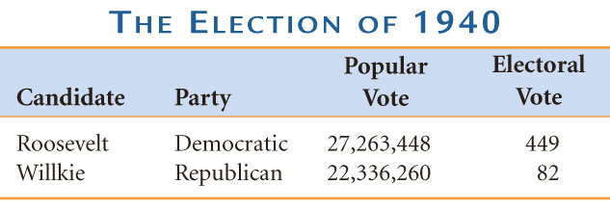
From Neutrality to Undeclared War
Interventionists had the majority of public sentiment on their side:
Congress appropriated $10 billion for preparedness in 1940
FDR called for America’s 1st peacetime draft
In the election of 1940, FDR was overwhelmingly elected for an unprecedented 3rd term

Slide 10
From Neutrality to Undeclared War
By 1940, England remained the only active opposition to Hitler but was running out of money
FDR called for a Lend-Lease Act:
US can sell or lend war supplies to Allied nations
Congress put $7 billion to allow England full access to US arms
US Cash and Carry Program
X

Slide 11
Four Freedoms
“The first is freedom of speech and expression--everywhere in the world.
The second is freedom of every person to worship God in his own way--everywhere in the world.
The third is freedom from want--which, translated into world terms, means economic understandings which will secure to every nation a healthy peacetime life for its inhabitants-everywhere in the world.
The fourth is freedom from fear--which, translated into world terms, means a world-wide reduction of armaments to such a point and in such a thorough fashion that no nation will be in a position to commit an act of physical aggression against any neighbor--anywhere in the world.”

Slide 12
From Neutrality to Undeclared War
In 1941, FDR & Churchill met to secretly draft the Atlantic Charter:
The U.S. & Britain discussed military strategy if America were to enter the war
They discussed post-war goals of liberty, free trade, & disarmament
In 1941, Hitler broke the Nazi-Soviet Pact & attacked Russia

Slide 13
From Neutrality to Undeclared War
FDR brought US to the brink of war & opened himself to criticism:
In Sept 1941, US polls showed 80% of Americans supported US neutrality in WW II
FDR had to wait for the Axis to make a decisive move…which Japan delivered on Dec 7, 1941

Slide 14
Showdown in the Pacific
Japan took full advantage of the European war to expand in Asia:
Attacked coastal China
Seized French & Dutch colonies in East Indies & Indochina
Signed the Tripartite Pact with Germany & Italy in 1940
FDR retaliated against Japan with fuel, iron, & oil sanctions
The US now faced a possible 2-ocean war…
…but Germany was still seen as the primary danger

Slide 15
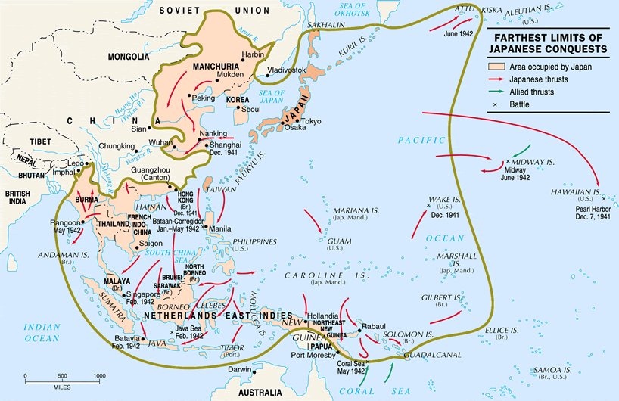
The Greater East Asia-Prosperity Company
Rich in Tin, Oil, Rubber

Slide 16
Showdown in the Pacific
In 1941, the US & Japan were unable to diplomatically resolve their differences, so the U.S.:
froze all Japanese assets in USA
Banned all oil sales to Japan
Hideki Tojo sent an envoy to negotiate for a resolution
Dec 7, 1941—US naval fleet in Pacific was crippled by surprise attack; 8 battleships sunk & 2400 Americans were killed
US wanted the Japanese removed from China
Japan wanted an end to sanctions & a free hand to China
This was really a stall tactic intended to hide Japanese military preparations for an attack on Pearl Harbor

Slide 17
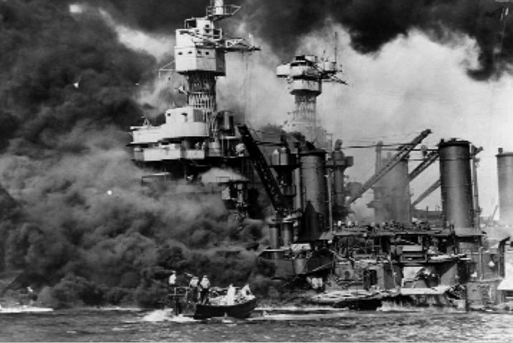
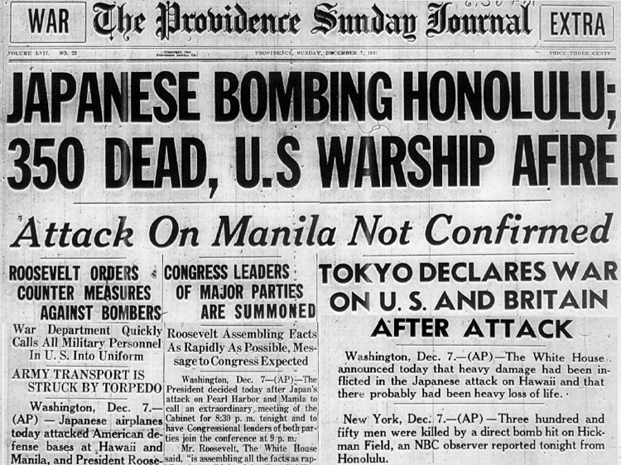
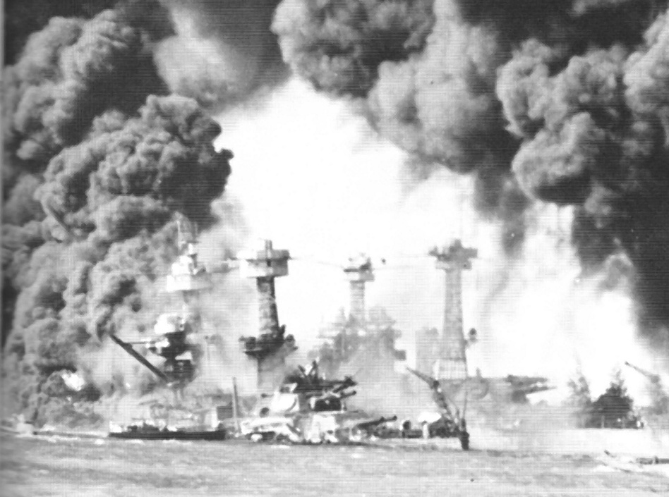

Slide 18
Showdown in the Pacific
After Pearl Harbor:
Congress declared war against Japan on Dec 8, 1941
Italy & Germany declared war on US on Dec 11, 1941
The US was now fully involved in WW II & public opinion was behind the war effort to end the European Axis threat & to seek revenge for Pearl Harbor against Japan

Slide 19
MOBILIZING THE ECONOMY
1. Industrial Production
War Production Board (later: Office of War Mobilization)
By 1944, war production double that of all Axis powers
“cost-plus” basis
Results:
end of Depression;
consolidation of U.S. industry
Notes:
Faragher, Out of Many, 3rd Ed.; http://wps.prenhall.com/hss_faragher_outofmany_ap/

Slide 20
Effects of War Spending
Notes:
Faragher, Out of Many, 3rd Ed.; http://wps.prenhall.com/hss_faragher_outofmany_ap/

Slide 21
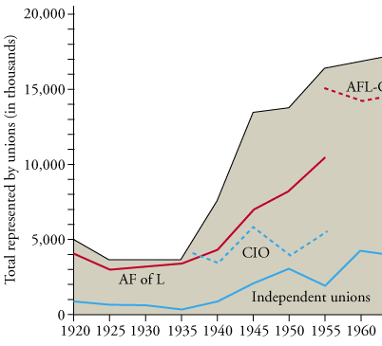
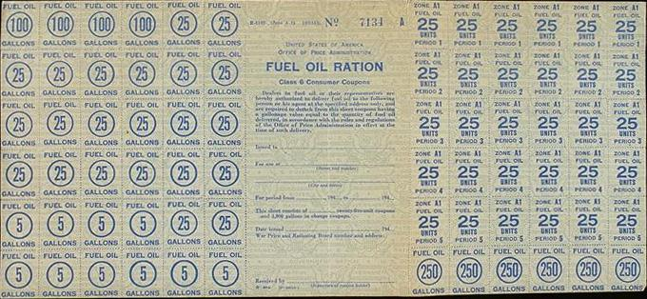
MOBILIZING THE ECONOMY
2. Rationing and Price Controls
Office of Price Administration
rationing
Anti-Inflation Act
3. Controlling Labor
”no-strike” pledges
Smith-Connally Anti-Strike Act (War Labor Disputes Act) (1943)
personal income
union membership: major increase
Labor Union Membership, 1920-1960
Ration Card
Notes:
Pojer (ration card); Brinkley 10e (union membership)

Slide 22
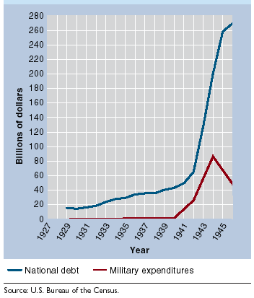
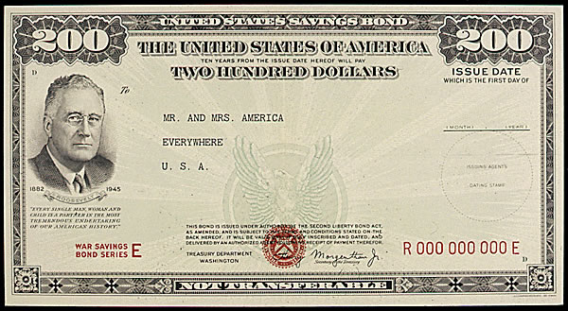
MOBILIZING THE ECONOMY
4. Farmers – farm income doubled, as in World War I
5. Financing the War: $321 billion total! cost $100 billion for 1945 alone
Income Tax (Revenue Act of 1942 – 94%!, everyone, withholding)
Liberty Bonds
Military Expenditures and the National Debt, 1929-1945
War Bond
Notes:
Bond – Pojer; Nash, The American People 6e; http://wps.ablongman.com/long_nash_ap_6/0,7361,592970-,00.html

Slide 23
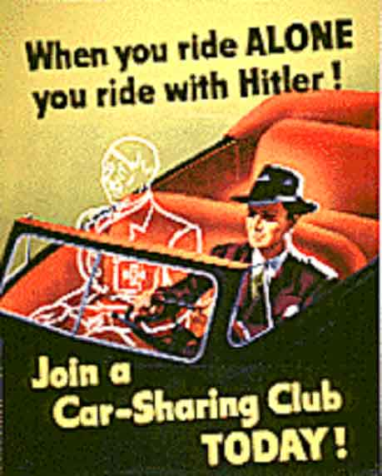
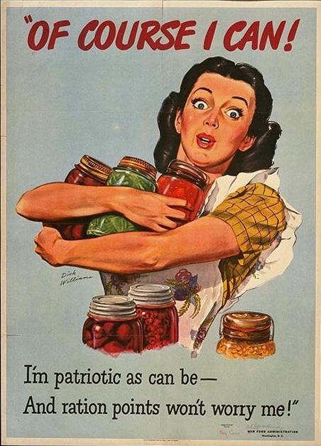
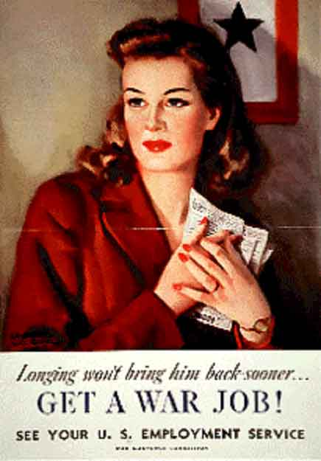
MOBILIZING THE ECONOMY
6. Propaganda
Office of War Information
Result: largely avoided anti-German hysteria of WWI
anti-Japanese hysteria on West Coast
Notes:
Wadsworth.com (Ride Alone); Pojer (“Of Course”)

Slide 24
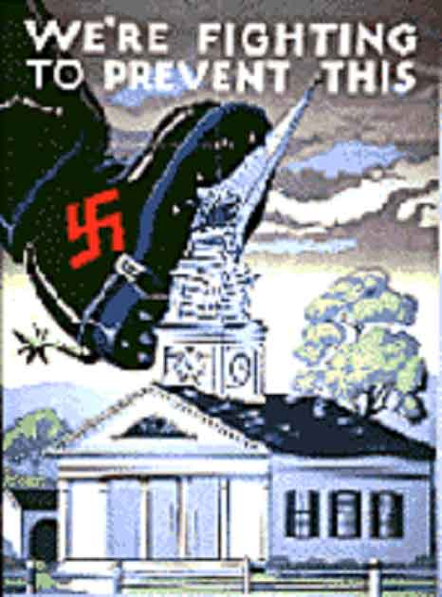
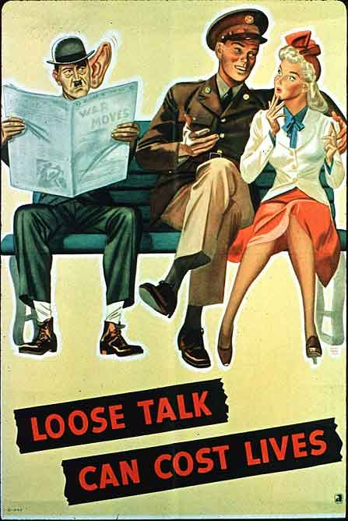
MOBILIZING THE ECONOMY
Notes:
Wadsworth.com (boot); Wadsworth.com (“Loose Talk”)

Slide 25
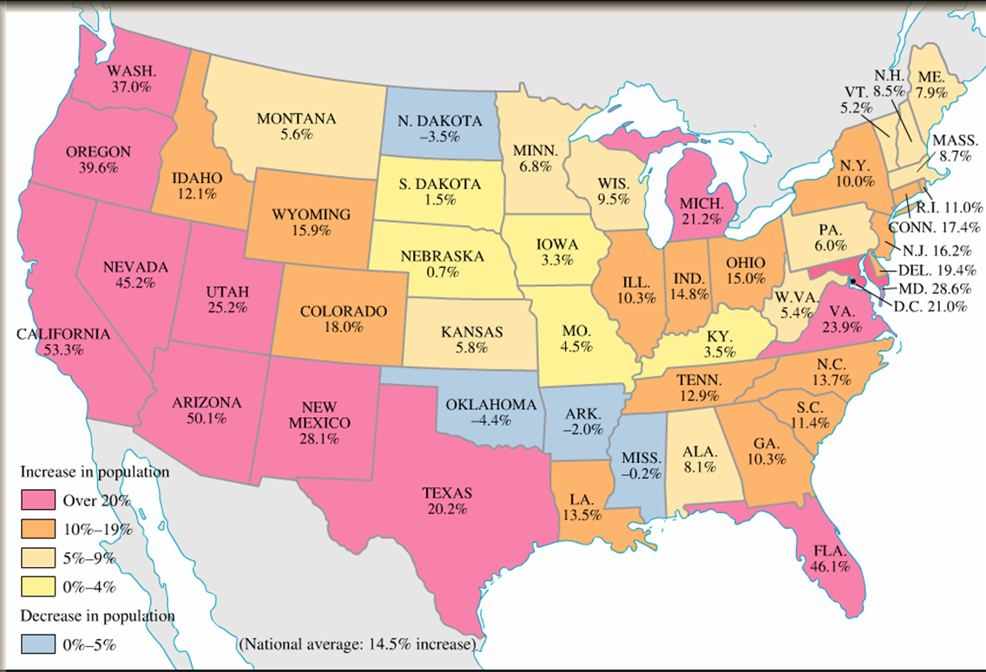
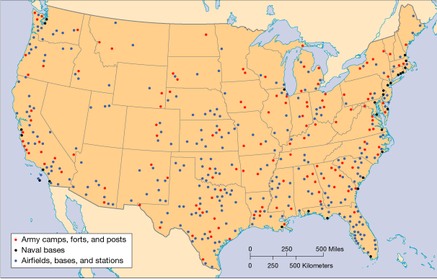
EFFECTS ON THE HOMEFRONT: IMPACT ON SOCIETY: Demographic Shifts
Urbanization
Migration to West, esp. California
rapid industrialization of some western states (California)
Henry J. Kaiser – Kaiser Steel
South –military posts and defense installations
Population Shifts 1940-1950
Wartime Army Camps, Naval Bases, and Airfields
Notes:
A Nation on the Move, 1940-1950; American migration during the 1940s was the largest on record to that time. The farm population dropped dramatically as men, women, and children moved to war-production areas and to army and navy bases, particular on the West Coast. Well over 30 million Americans migrated during the war. Many returned to their rural homes after the war, but 12 million migrants stayed in their new locations. Notice the population increases on the West Coast, as well as in the Southwest and Florida. American Pageant 13e
Wartime Bases: Faragher, Out of Many, 3rd Ed.; http://wps.prenhall.com/hss_faragher_outofmany_ap/

Slide 26
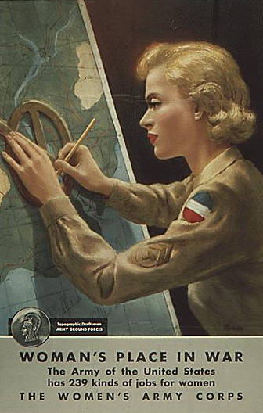
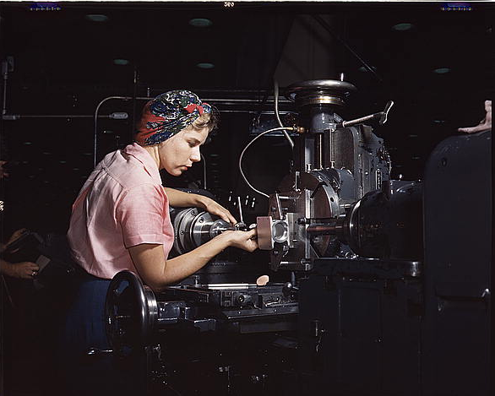
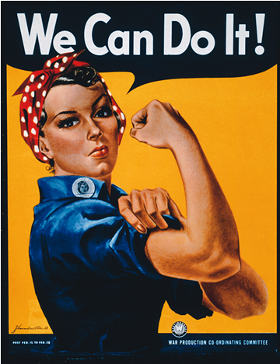
EFFECTS ON THE HOMEFRONT: WOMEN, WORK AND FAMILY
Armed Forces - 200K+ women; non-combat roles: clerical jobs in WACS and WAVES.
Work Force - 6.5 million women entered (57% increase)
concentrated in government clerical jobs
"Rosie the Riveter"
Families – “8-hour orphans”, juvenile delinquency, crime
Surveys of time: real concern that families were negatively impacted by war
Notes:
Pojer (womans place, woman working)
“WE Can Do It” - http://teachpol.tcnj.edu/amer_pol_hist/_browse1950.htm Description: We Can Do it. Color poster by J. Howard Miller.Credit: National Archives and Records Administration

Slide 27
IMPACT ON SOCIETY: Minorities & Rights
Second Great Migration
Race riots - Detroit and New York (1943)
Armed Forces: Million+ served; in segregated units
Efforts to end discrimination: black unions, threatened marches (A. Philip Randolph on Washington 1942) - pressure on companies with gov’t contracts
FDR’s response:
Executive order prohibiting discrimination in defense plants
Fair Employment Practices Commission to investigate discrimination
Results:
Significant decrease in number willing to accept status of second class citizens.
Repudiation of Nazi racism strengthened civil rights efforts
Notes:
^{Brinkley 11th} Ed.

Slide 28
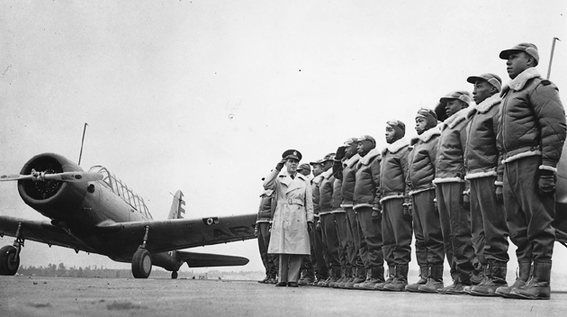
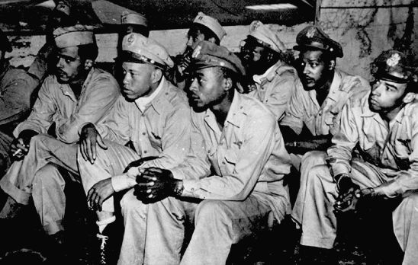
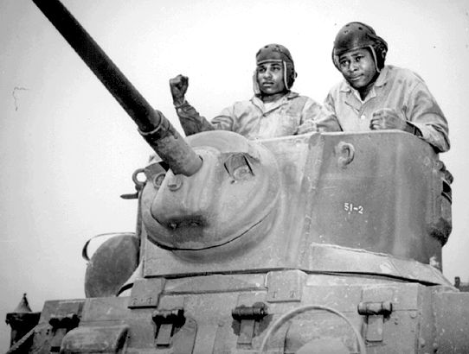
Segregated Units
Notes:
Pojer

Slide 29
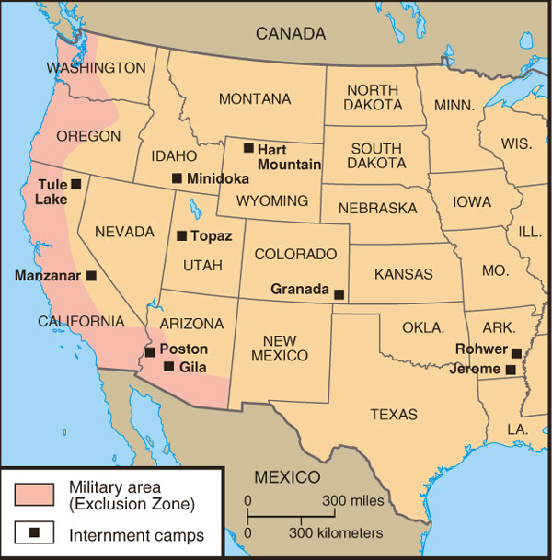
EFFECTS ON THE HOMEFRONT: IMPACT ON MINORITIES & CIVIL RIGHTS
Japanese Americans
Internment
Executive Order 8066
Korematsu v. U.S. (1944)
In re Endo (1944)
Japanese American Internment Camps
Notes:
Divine America Past and Present Revised 7th Ed.

Slide 30
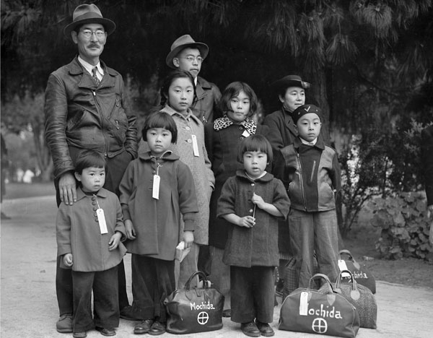
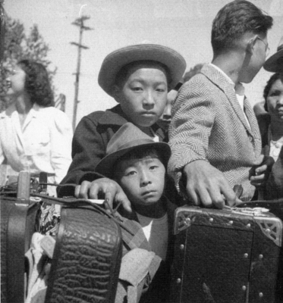
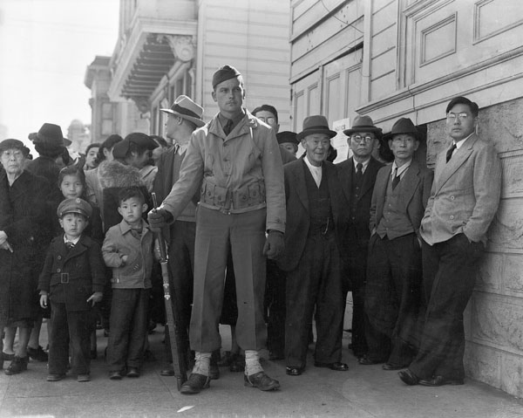
Japanese-American Internment
Japanese-American store
Members of the Mochida family awaiting evacuation bus
Awaiting baggage inspection upon arrival at Assembly Center, Turlock, CA, May 2, 1942
Crowd of onlookers on the first day of evacuation from the Japanese quarter in San Francisco
Notes:
http://teachpol.tcnj.edu/amer_pol_hist/_browse1950.htm Description: "Following evacuation orders, this store was closed. The owner, a University of California graduate of Japanese descent, placed the "I AM AN AMERICAN" sign on the store front the after Peral Harbor." Oakland, CA, April 1942. Dorothea Lange. Credit: National Archives and Records Administration
"Members of the Mochida family awaiting evacuation bus. Identification tags were used to aid in keeping a family unit intact during all phases of evacuation. Mochida operated a nursery and five greenhouses on a two-acre site in Eden Township." In 1942 Executive Order 9066 ordered the removal of 110,000 civilians of Japanese descent, including 71,000 American citizens, from the western United States, placing them in internment camps. By Dorothea Lange, Hayward, California, May 8, 1942 National Archives and Records Administration, Records of the War Relocation Authority (210-GC-153)
"A crowd of onlookers on the first day of evacuation from the Japanese quarter in San Francisco, who themselves will be evacuated within three days." By Dorothea Lange, San Francisco, California, April 1942 National Archives and Records Administration, Records of the War Relocation Authority
http://teachpol.tcnj.edu/amer_pol_hist/_browse1950.htm Description: "These young evacuees of Japanese ancestry are awaiting their turn for baggage inspection upon arrival at this Assembly Center." Turlock, CA, May 2, 1942. Dorothea Lange.

Slide 31
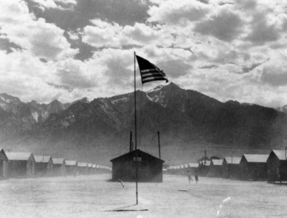
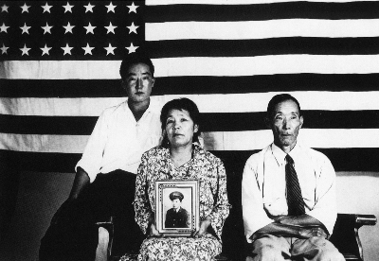
Japanese-American Internment
War Relocation authority center, Manzanar, California. July 3, 1942
Newly arrived evacuees outside of mess hall at noon, Tanforan Assembly Center. San Bruno, CA, April 29, 1942. (National Archives and Records Administration)
The Hirano family, Colorado River Relocation Center, Poston, AZ
Notes:
http://teachpol.tcnj.edu/amer_pol_hist/_browse1950.htm Description: This assembly center has been open for two days. Only one mess hall was operating today. Photograph shows line-up of newly arrived evacuees outside of this mess hall at noon. Tanforan Assembly Center. San Bruno, CA, April 29, 1942. Dorothea Lange.
http://teachpol.tcnj.edu/amer_pol_hist/_browse1950.htm Description: The Hirano family, left to right: George, Hisa, and Yasbei. Colorado River Relocation Center, Poston, AZ. Keywords: World War II, internment Credit: National Archives and Records Admini
Keywords: World War II, internment Credit: National Archives and Records Administration
http://teachpol.tcnj.edu/amer_pol_hist/_browse1950.htm Description: "Dust storm at this war Relocation authority center where evacuees of Japanese ancestry are spending the duration." Manzanar, California. July 3, 1942. Dorthea Lange. Keywords: World War II, internment Credit: National Archives and Records Administration

Slide 32
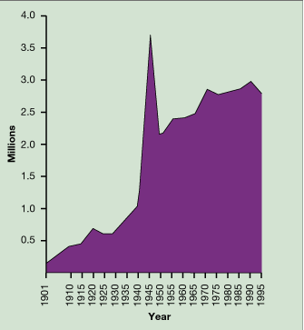
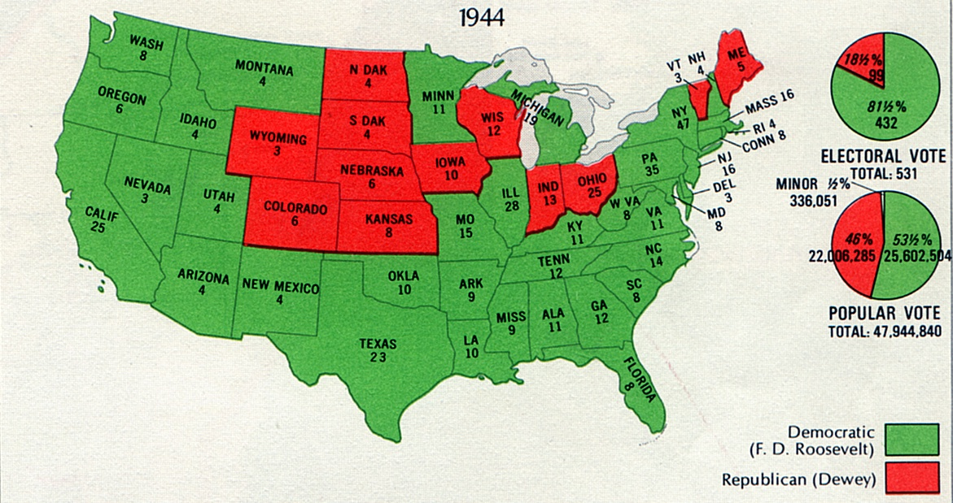
GOVERNMENT AND POLITICS: EXPANSION OF GOVERNMENT POWER
New Deal programs - partially eliminated (Ex: WPA, CCC).
Vast expansion of power for federal government
Election of 1944
FDR ran for unprecedented fourth term
Thomas E. Dewey (Rep Gov NY) – biggest issue: govt control over peoples’ lives
Harry S Truman
Employees in the Executive Branch, 1901–1995
Presidential Election of 1944
Notes:
Election 1944 - http://teachpol.tcnj.edu/amer_pol_hist/_browse1950.htm
Employees Executive Branch - Faragher, Out of Many, 3rd Ed.; http://wps.prenhall.com/hss_faragher_outofmany_ap/

