Slide 1
Do Now
Identify the political, economic, and social causes of the Civil War in the organizer on your notes!

Slide 2
Why Fight? The Goals of War from Northern and Southern Points of View
Mr. Winchell
APUSH
Period 5

Slide 3
Key Concepts

Slide 4
AP Prompt

Slide 5
What is the “United States”?
The Southern decision to secede was based on old arguments:
The USA was a “compact between states,” not a national gov’t “above the states”
Therefore, states could leave the Union freely & peacefully
States’ rights must be protected as a guarantee of liberty
Individuals have the right to own property (slaves) & have the right to have their property returned (Fugitive Slave Law)
Southerners had threatened secession during a Congressional debate over slavery in 1790, the Missouri Crisis of 1820, the Nullification Crisis of 1832, & the crisis over California in 1850
Notes:
Threats of secession were nothing new. Some Southerners had threatened to leave the Union during a Congressional debate over slavery in 1790, the Missouri Crisis of 1819 and 1820, the Nullification Crisis of 1831 and 1832, and the crisis over California statehood in 1850. In each case, the crisis was resolved by compromise. Many expected the same pattern to prevail in 1861.
Drawing on arguments developed by John C. Calhoun, the convention held that the states were sovereign entities that could leave the Union as freely as they joined. Among the many indictments of the northern states and people, nothing seems more central than the issue of trust with respect to the capture and return of fugitive slaves

Slide 6
The Secession Crisis
The Withdrawal of the South
“fire eaters” demand withdrawal of southern states from union after 1860 election
President Buchanan told Congress that no state had the right to secede form the Union, but suggested that the federal government had no authority to stop a state if it did (!)
Seceding states immediately seized federal property within their boundaries

Slide 7
The War Begins
Lincoln’s decision to resupply Ft. Sumter was stroke of genius
Fulfilled Inaugural Address pledge to hold federal property in rebel states
Forced rebels to make decision to start war
Davis decided to take fort before resupply ships arrived
Beauregard shelled fort April 12-13, 1861
Anderson surrendered April 13
Lincoln called for 75,000 volunteers to put down rebellion on April 15
Va., N.C., Tenn. & Ark. Seceded & joined CSA

Slide 8
The Failure of Compromise
After Southern guns fire on Northern ship at Fort Sumter, one last effort at compromise
Senator John Crittenden: permanent slavery and reestablish Missouri Compromise Line
Remaining southern states are willing to accept the plan, Northern Republicans and Lincoln are not

Slide 9
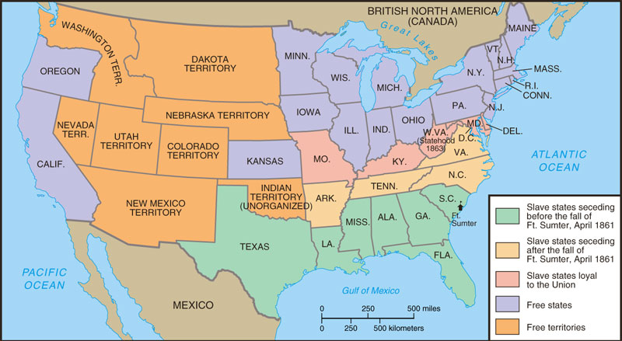
Secession

Slide 10
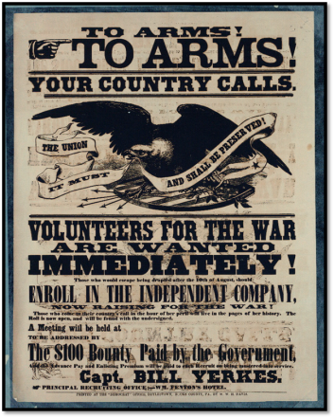
The Union Responds
Notes:
Lincoln calls for volunteers on April 15, 1861.

Slide 11
“Our popular government has often been called an experiment. Two points in it our people have already settled – the successful establishing and the successful administering. One still remains: its successful maintenance against a formidable internal attempt to overthrow it.” Abraham Lincoln

Slide 12
Union vs Confederacy
Population of 22 million
Owned…
90% of industry
97% of firearm production
70% of railroad lines
Most banking and commerce
Loyalty of the Navy
Enrollment Act of 1863
Substitution and Commutation
Pay a substitute or pay $300 ($5,400) to avoid draft
“A rich man’s war but poor man’s fight”
New York Draft Riots (1863)
Population of 9 million
3.5 million are slaves
Defensive War
Cotton Diplomacy
Hoped to earn foreign recognition

Slide 13
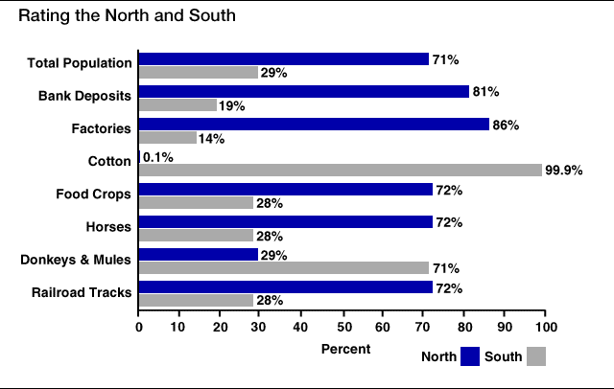
Resources…

Slide 14
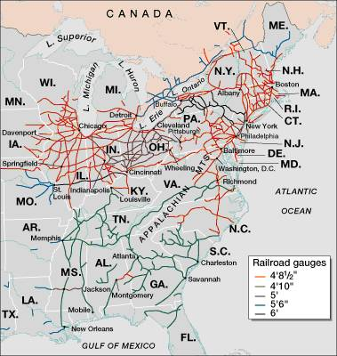
Railroad Lines, 1860

Slide 15
Adjusting to Total War
North must win by destroying will to resist
Total War--a test of societies, economies, political systems as well as armies
South adopts defensive strategy--North must fight in unfamiliar, hostile terrain
Lincoln adopts two-front strategy
capture Confederate capital, Richmond, Va.
seize control of the Mississippi River
deploy navy to blockade Southern ports

Slide 16
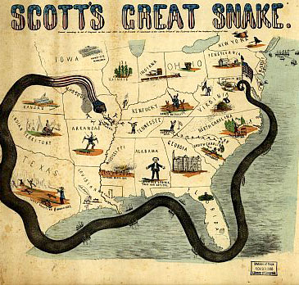
Union Strategy
Anaconda Plan
Naval blockade surrounding the CSA
Mississippi River
Divide the CSA in two
Richmond
Capture the capital with trained urban fighters

Slide 17
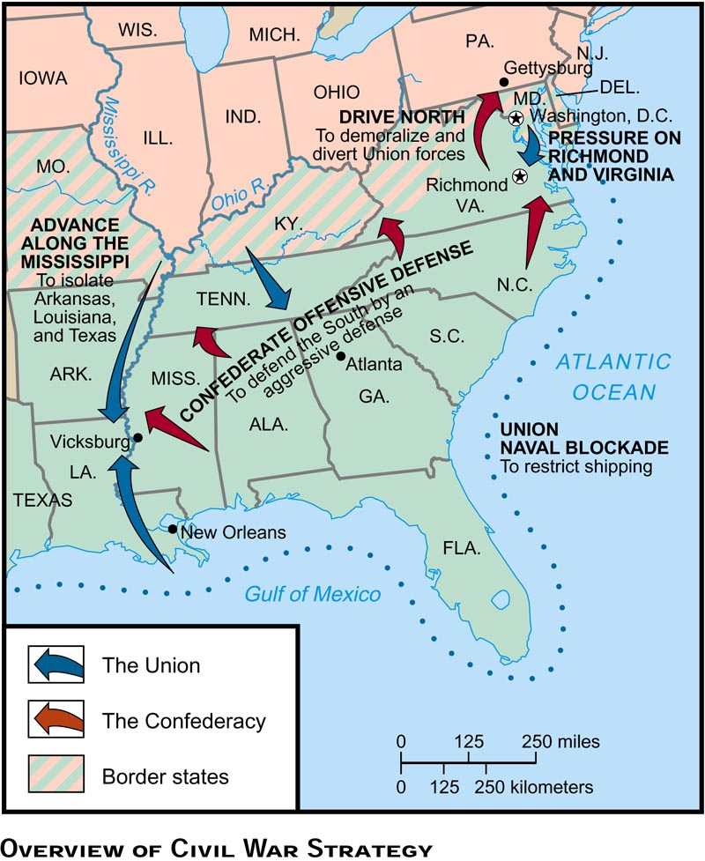

Slide 18
The Diplomatic Struggle
From 1861 to 1862, the Confederacyused “cotton diplomacy” to get England & France to aid them:
Napoleon III favored the South but wanted England to do so 1st
England offered “belligerent” status to the CSA; but otherwise chose a hands-off policy
By 1863, “King Cotton” diplomacy failed because Egyptian & Indian cotton filled the European demand

Slide 19
Advantages, Disadvantages, Strategy
 | Union | Confederacy
Advantages | - Lots of supplies and men - Transportation system (RR’s) - Factories and food production - Lincoln is a good Pres. | - Lots of money from cotton - Strong military schools and leaders - On the defense/know the territory - Strong desire to win - The south is BIG!
Disadvantages | - Bad generals/weak military in the beginning - On the offense | - Poor supply lines - Poor Transportation Less men for fighting Slavery
Strategies | - Anaconda Plan: 1. Take Richmond 2. Split south in ½ - take Miss R. 3. Blockade S. ports | - Survival as a nation - Defensive – sit and wait - If you can, attack the North
Generals | - George McClellan - George Meade - Joseph Hooker - Ambrose Burnside - Ulysses S. Grant - William Sherman | - Robert E. Lee - Stonewall Jackson - Joe Johnston - James Longstreet

Slide 20
Freeing the Slaves Should Be the Primary War Aim; Preserving the Union Should Be the Primary War Aim
Horace Greeley – “The Prayer of Twenty Millions” (August 19, 1862)
Abraham Lincoln – “Reply to Horace Greely” (August 22, 1862)
We think you are unduly influenced by the councils, the representations, the menaces, of certain fossil politicians hailing from the border Slave states. Knowing well that the heartily, unconditionally loyal portion of the white citizens of those states do not expect nor desire that slavery shall be upheld to the prejudice of the Union- we ask you to consider that slavery is everywhere the inciting cause and sustaining base of treason: the most slaveholding sections of Maryland and Delaware being this day, though under the Union flag, in full sympathy with the rebellion, while the free labor portions of Tennessee and of Texas, though writing under the bloody heel of treason, are unconquerably loyal to the Union… It seems to us the most obvious truth, that whatever strengthens of fortifies Slavery in the Border States strengthens also Treason, and drives home the wedge intended to divide the Union. Had you from the first refused to recognize in those States, as here, any other than unconditional loyalty – that which stands for the Union, whatever may become of Slavery, those States would been, and would be, far more helpful and less troublesome to the defenders of the Union than they have been, or now are.
I would save the Union. I would save it the shortest way under the Constitution. The sooner the national authority can be restored, the nearer the Union will be “the Union as it was.” If there be those who would not save the Union unless they could at the same time save slavery, I do not agree with them. My paramount object in this struggle is to save the Union, and it is not either to save or destroy slavery. If I could save the Union without freeing any slave, I would do it, and if I could save it by freeing all the slaves, I would do it; and if I could do it by freeing some and leaving others alone, I would also do that. What I do about slavery and the colored race I do because I believe it helps to save this Union: and what I forbear I forbear because I do not believe it would help to save the Union. I shall do less whenever I shall believe doing hurts the cause, and I shall do more whenever I shall believe doing more will help the cause.

