Slide 1
Do Now-Respond to the prompt on your notes using the quote below:
"My paramount object in this struggle is to save the Union, and is not either to save or to destroy slavery. If I could save the Union without freeing any slave I would do it, and if I could save it by freeing all the slaves I would do it; and if I could save it by freeing some and leaving others alone I would also do that."
—Abraham Lincoln, 1862

Slide 2
Fighting the War: The Intertwining Nature of Military and Political Actions in Civil War America
Mr. Winchell
APUSH 2018-2019
Period 5

Slide 3
Outline
Justifications of Secession
Lincoln’s 1st Inaugural
Border States and Civil Liberties
Wartime Advantages
Economics of Wartime

Slide 4
Key Concepts
5.3.I: The North’s greater manpower and industrial resources, the leadership of Abraham Lincoln and others, and the decision to emancipate slaves eventually led to the Union military victory over the Confederacy in the devastating Civil War.
  B: Lincoln and most Union supporters began the Civil War to preserve the Union, but Lincoln’s decision to issue the Emancipation Proclamation reframed the purpose of the war and helped prevent the Confederacy from gaining full diplomatic support from European powers. Many African Americans fled southern plantations and enlisted in the Union Army, helping to undermine the Confederacy.

Slide 5
AP Prompt
Evaluate the differing goals and approaches to the Civil War, comparing Northern and Southern perspectives.

Slide 6
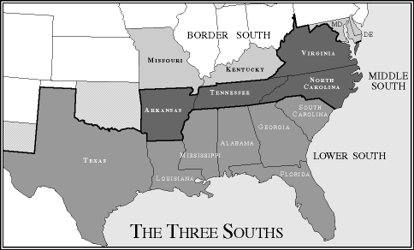
Slavery Over Time

Slide 7
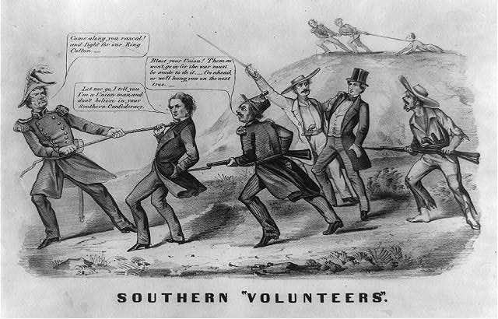

Slide 8
What is the“United States”?
The Southern decision to secede was based on old arguments:
  The USA was a “compact between states,” not a national gov’t “above the states”
  Therefore, states could leave the Union freely & peacefully
  States’ rights must be protected as a guarantee of liberty
Individuals have the right to own property (slaves) & have the right to have their property returned (Fugitive Slave Law)
Southerners had threatened secession during a Congressional debate over slavery in 1790, the Missouri Crisis of 1820, the Nullification Crisis of 1832, & the crisis over California in 1850
Notes:
Threats of secession were nothing new. Some Southerners had threatened to leave the Union during a Congressional debate over slavery in 1790, the Missouri Crisis of 1819 and 1820, the Nullification Crisis of 1831 and 1832, and the crisis over California statehood in 1850. In each case, the crisis was resolved by compromise. Many expected the same pattern to prevail in 1861.
Drawing on arguments developed by John C. Calhoun, the convention held that the states were sovereign entities that could leave the Union as freely as they joined. Among the many indictments of the northern states and people, nothing seems more central than the issue of trust with respect to the capture and return of fugitive slaves

Slide 9
The Secession Crisis
The Withdrawal of the South
  “fire eaters” demand withdrawal of southern states from union after 1860 election
  President Buchanan told Congress that no state had the right to secede form the Union, but suggested that the federal government had no authority to stop a state if it did (!)
  Seceding states immediately seized federal property within their boundaries

Slide 10
Stephens’ Cornerstone Speech
What does the new Confederate Constitution rest on, according to its new Vice President?

Slide 11
Lincoln’s First Inaugural
Assess the goals of Lincoln’s presidency, according to his First Inaugural.

Slide 12
The War Begins
Lincoln’s decision to resupply Ft. Sumter was stroke of genius
  Fulfilled Inaugural Address pledge to hold federal property in rebel states
  Forced rebels to make decision to start war
Davis decided to take fort before resupply ships arrived
  Beauregard shelled fort April 12-13, 1861
  Anderson surrendered April 13
Lincoln called for 75,000 volunteers to put down rebellion on April 15
Va., N.C., Tenn. & Ark. Seceded & joined CSA

Slide 13
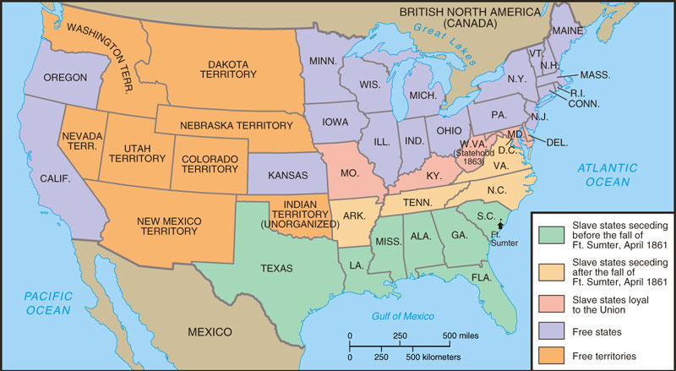
Secession

Slide 14
The Failure of Compromise
  After Southern guns fire on Northern ship at Fort Sumter, one last effort at compromise
  Senator John Crittenden: permanent slavery and reestablish Missouri Compromise Line
  Remaining southern states are willing to accept the plan, Northern Republicans and Lincoln are not

Slide 15
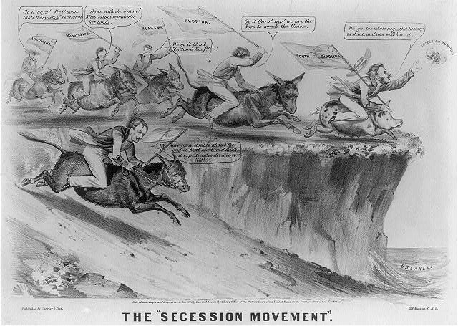

Slide 16
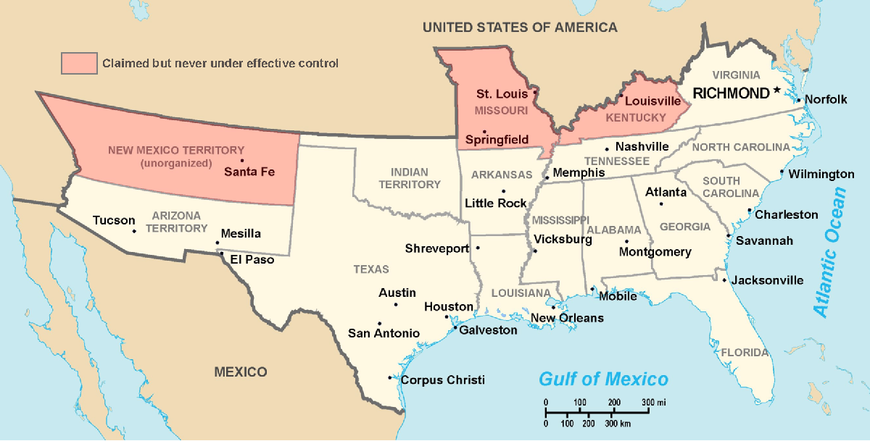
Secession & the Formation of the Confederate States of America
The CSA constitution resembled the U.S., but with 4 key changes: (1) it protected states’ rights, (2) guaranteed slavery, (3) referenced God, & (4) prohibited protective tariffs
On Feb 4, 1861, the Confederate States of America were formed
Mississippi Senator Jefferson Davis was elected CSA president
Notes:
Some wished to “let the South depart in peace”

Slide 17
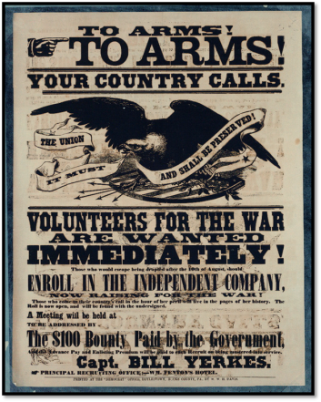
The Union Responds
Notes:
Lincoln calls for volunteers on April 15, 1861.

Slide 18
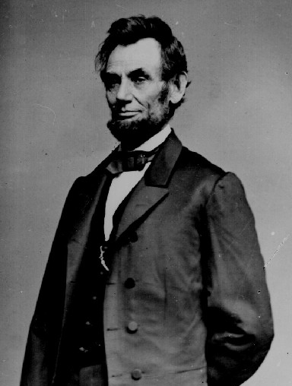
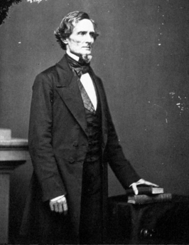
Political Leadership During the Civil War
During the Civil War, President Jefferson Davis had a difficult time:
The CSA Constitution protected states’ rights
so state governors could refuse to send him money or troops
CSA currency inflated
by 7,000%
During the Civil War, President Lincoln used “emergency powers” to protect “national security”
Suspended habeas corpus (Laws requiring evidence before citizens can be jailed)
Closed down newspapers that did not support the war
The national government in the USA and CSA relied on volunteer armies in the beginning,
but soon needed conscription (draft) to
supply their armies with troops

Slide 19
Political Leadership During the Civil War
Lincoln expanded his powers:
  declared martial law
  Imprisoned “subversives”
  briefly closed down a few newspapers
Davis was less effective:
  concerned mainly with military duties
  neglected the economy
  obstructed by state governors who resisted conscription

Slide 20
Lincoln and the draft
Ongoing problem recruiting Union soldiers
“Cause” of the war was vague – “Preserving the Union?”
Both sides resorted to conscription (draft) by 1863
Union law allowed purchase of a substitute recruit for $300 fee
“Rich man’s war, poor man’s fight”

Slide 21
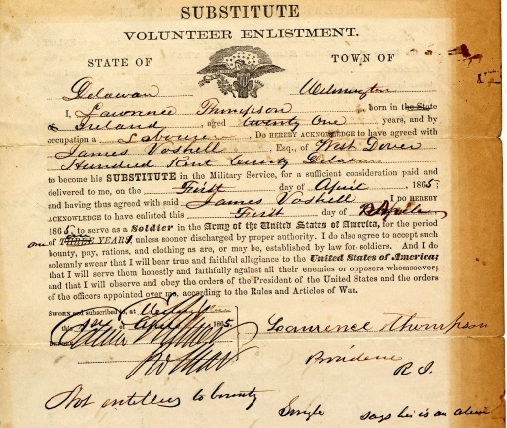
Conscription & Substitutes

Slide 22
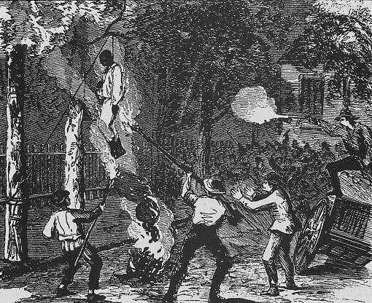
NYC Draft Riots

Slide 23
Union vs Confederacy
Population of 22 million
Owned…
  90% of industry
    97% of firearm production
  70% of railroad lines
  Most banking and commerce
Loyalty of the Navy
Enrollment Act of 1863
  Substitution and Commutation
    Pay a substitute or pay $300 ($5,400) to avoid draft
    “A rich man’s war but poor man’s fight”
    New York Draft Riots (1863)
Population of 9 million
  3.5 million are slaves
Defensive War
Cotton Diplomacy
  Hoped to earn foreign recognition

Slide 24
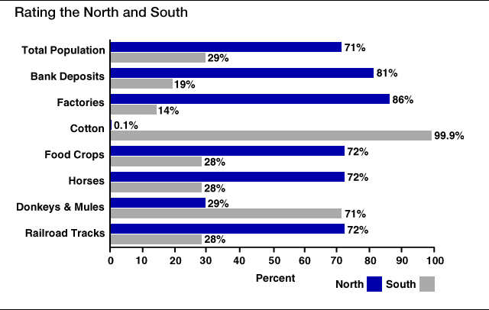
Resources…

Slide 25
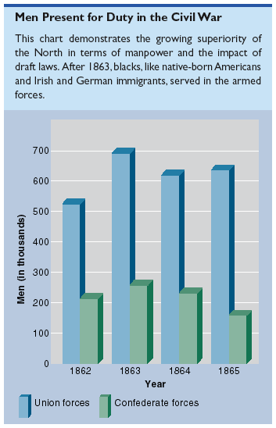
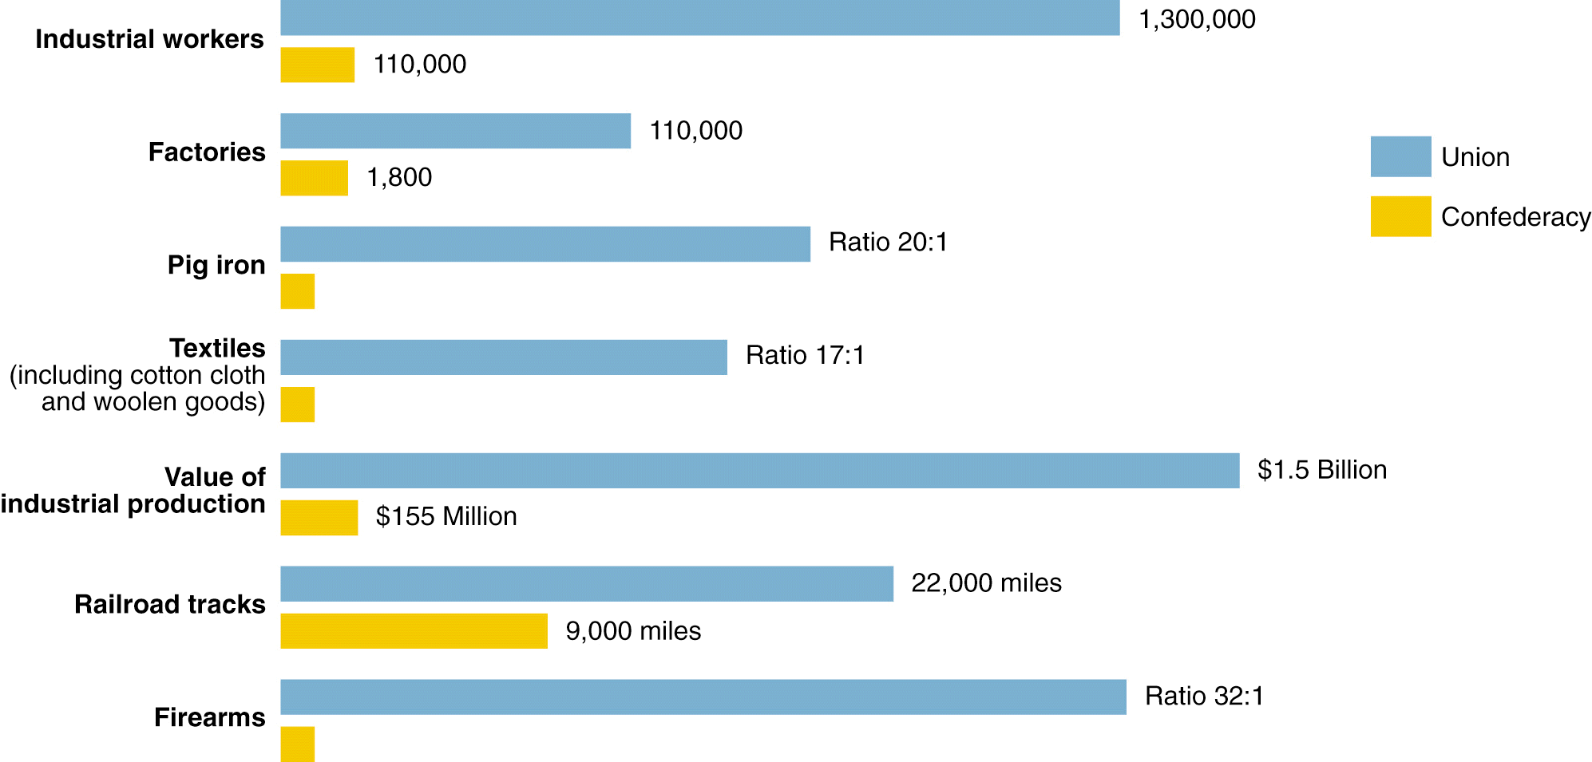
Resources of the Union and the Confederacy, 1861

Slide 26
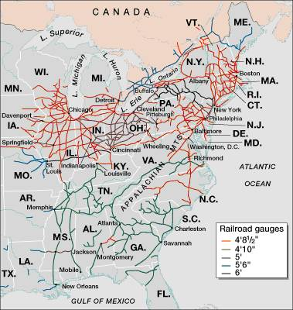
Railroad Lines, 1860

Slide 27
Adjusting to Total War
North must win by destroying will to resist
Total War--a test of societies, economies, political systems as well as armies
South adopts defensive strategy--North must fight in unfamiliar, hostile terrain
Lincoln adopts two-front strategy
  capture Confederate capital, Richmond, Va.
  seize control of the Mississippi River
  deploy navy to blockade Southern ports

Slide 28
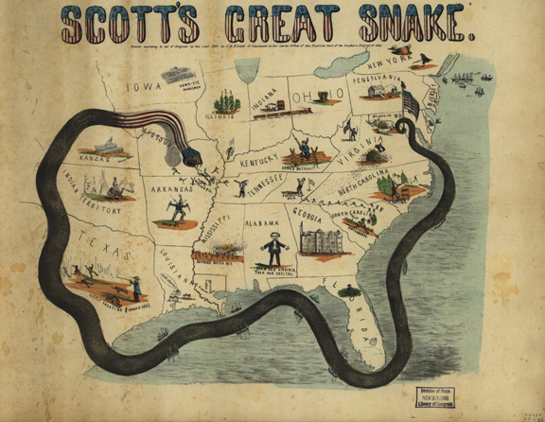
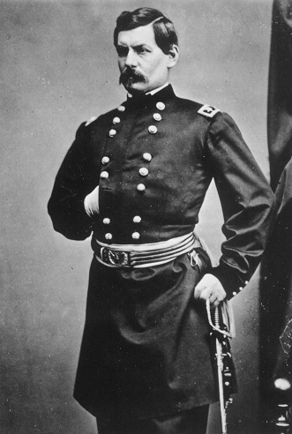
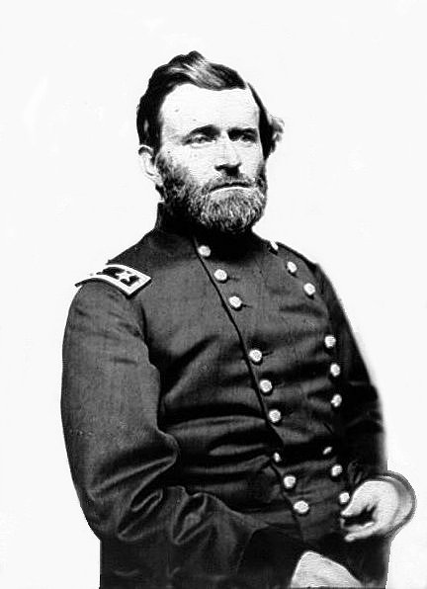
Winfield Scott’s Anaconda Plan
Southern strategy was an “offensive defense”: drag out the war & strategically attack the North to destroy Northern morale
Take the CSA capital at Richmond
Take control of the Mississippi River
George McClellan was in charge of Army of the Potomac
Ulysses Grant in the West
Divide the West from South
Blockade the Southern coast
Notes:
This plan maximized the North’s industrial advantages but required better leadership than North had

Slide 29
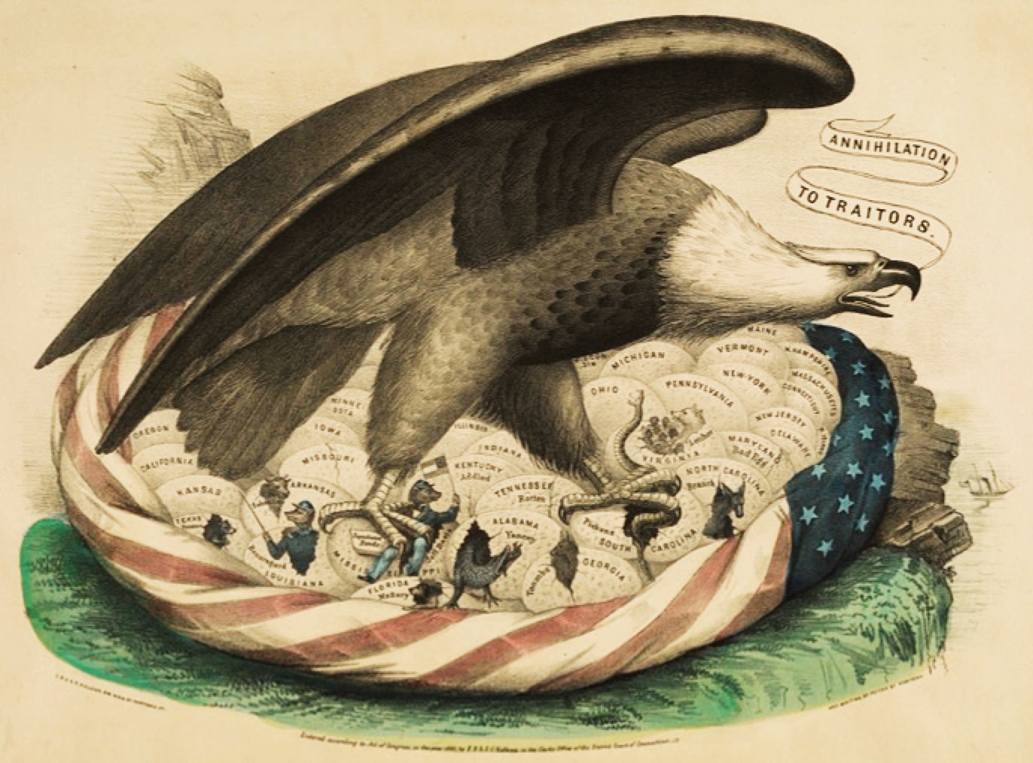
The Union

Slide 30
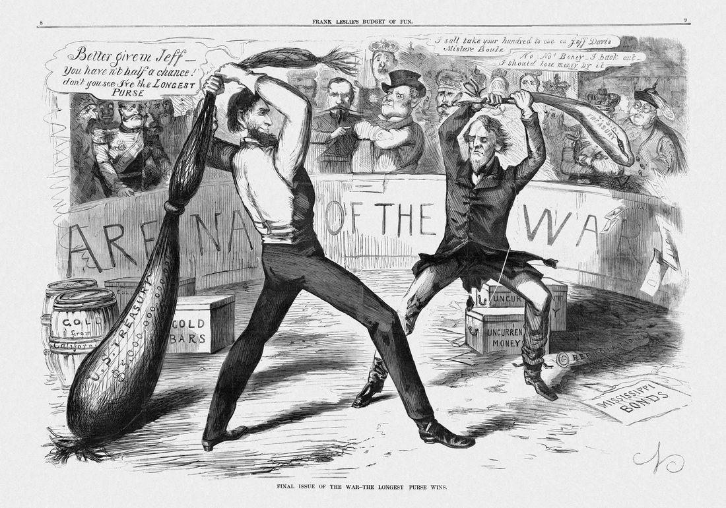

Slide 31
The Diplomatic Struggle
From 1861 to 1862, the Confederacy used “cotton diplomacy” to get England & France to aid them:
  Napoleon III favored the South but wanted England to do so 1st
  England offered “belligerent” status to the CSA; but otherwise chose a hands-off policy
By 1863, “King Cotton” diplomacy failed because Egyptian & Indian cotton filled the European demand
  “Successful revolutions have generally succeeded because of foreign intervention”

Slide 32
Advantages, Disadvantages, Strategy
 | Union | Confederacy
Advantages | - Lots of supplies and men - Transportation system (RR’s) - Factories and food production - Lincoln is a good Pres. | - Lots of money from cotton - Strong military schools and leaders - On the defense/know the territory - Strong desire to win - The south is BIG!
Disadvantages | - Bad generals/weak military in the beginning - On the offense | - Poor supply lines - Poor Transportation Less men for fighting Slavery
Strategies | - Anaconda Plan: 1. Take Richmond 2. Split south in ½ - take Miss R. 3. Blockade S. ports | - Survival as a nation - Defensive – sit and wait - If you can, attack the North
Generals | - George McClellan - George Meade - Joseph Hooker - Ambrose Burnside - Ulysses S. Grant - William Sherman | - Robert E. Lee - Stonewall Jackson - Joe Johnston - James Longstreet

Slide 33
Freeing the Slaves Should Be the Primary War Aim;
Preserving the Union Should Be the Primary War Aim
Horace Greeley – “The Prayer of Twenty Millions” (August 19, 1862)
Abraham Lincoln – “Reply to Horace Greeley” (August 22, 1862)
We think you are unduly influenced by the councils, the representations, the menaces, of certain fossil politicians hailing from the border Slave states. Knowing well that the heartily, unconditionally loyal portion of the white citizens of those states do not expect nor desire that slavery shall be upheld to the prejudice of the Union- we ask you to consider that slavery is everywhere the inciting cause and sustaining base of treason: the most slaveholding sections of Maryland and Delaware being this day, though under the Union flag, in full sympathy with the rebellion, while the free labor portions of Tennessee and of Texas, though writing under the bloody heel of treason, are unconquerably loyal to the Union… It seems to us the most obvious truth, that whatever strengthens of fortifies Slavery in the Border States strengthens also Treason, and drives home the wedge intended to divide the Union. Had you from the first refused to recognize in those States, as here, any other than unconditional loyalty – that which stands for the Union, whatever may become of Slavery, those States would been, and would be, far more helpful and less troublesome to the defenders of the Union than they have been, or now are.
I would save the Union. I would save it the shortest way under the Constitution. The sooner the national authority can be restored, the nearer the Union will be “the Union as it was.” If there be those who would not save the Union unless they could at the same time save slavery, I do not agree with them. My paramount object in this struggle is to save the Union, and it is not either to save or destroy slavery. If I could save the Union without freeing any slave, I would do it, and if I could save it by freeing all the slaves, I would do it; and if I could do it by freeing some and leaving others alone, I would also do that. What I do about slavery and the colored race I do because I believe it helps to save this Union: and what I forbear I forbear because I do not believe it would help to save the Union. I shall do less whenever I shall believe doing hurts the cause, and I shall do more whenever I shall believe doing more will help the cause.

