Slide 1
Do Now
Mark Neely, Lincoln and Civil Liberties

Slide 2
Lincoln and the Republicans: Actions and Legislation During the Civil War
Mr. Winchell
APUSH 2018-2019
Period 5

Slide 3
AP Prompt
Evaluate the extent to which the Republican Party took advantage of wartime politics to shape the political future of the nation.

Slide 4
Lincoln’s Politics and Civil War
Lincoln and Congress
Radical Republicans
Conservative Republicans
War Democrats
Copperheads/Peace Democrats
Clement Vallandigham

Slide 5
Lincoln and Freedoms
Constitutional Powers and Rights
Martial Law (Maryland)
Suspension of habeas corpus
Prisoners of war, spies, aiders and abettors of the enemy, draft dodgers.
Ex parte Merryman (1861)
Ex parte Milligan (1866)
Freedom of the Press
“Must I shoot a simple soldier boy who deserts, while I must not touch a hair of a wily agitator who induces him to desert?
New York Journal of Commerce
New York World
Fake story: 400,000 draft men

Slide 6
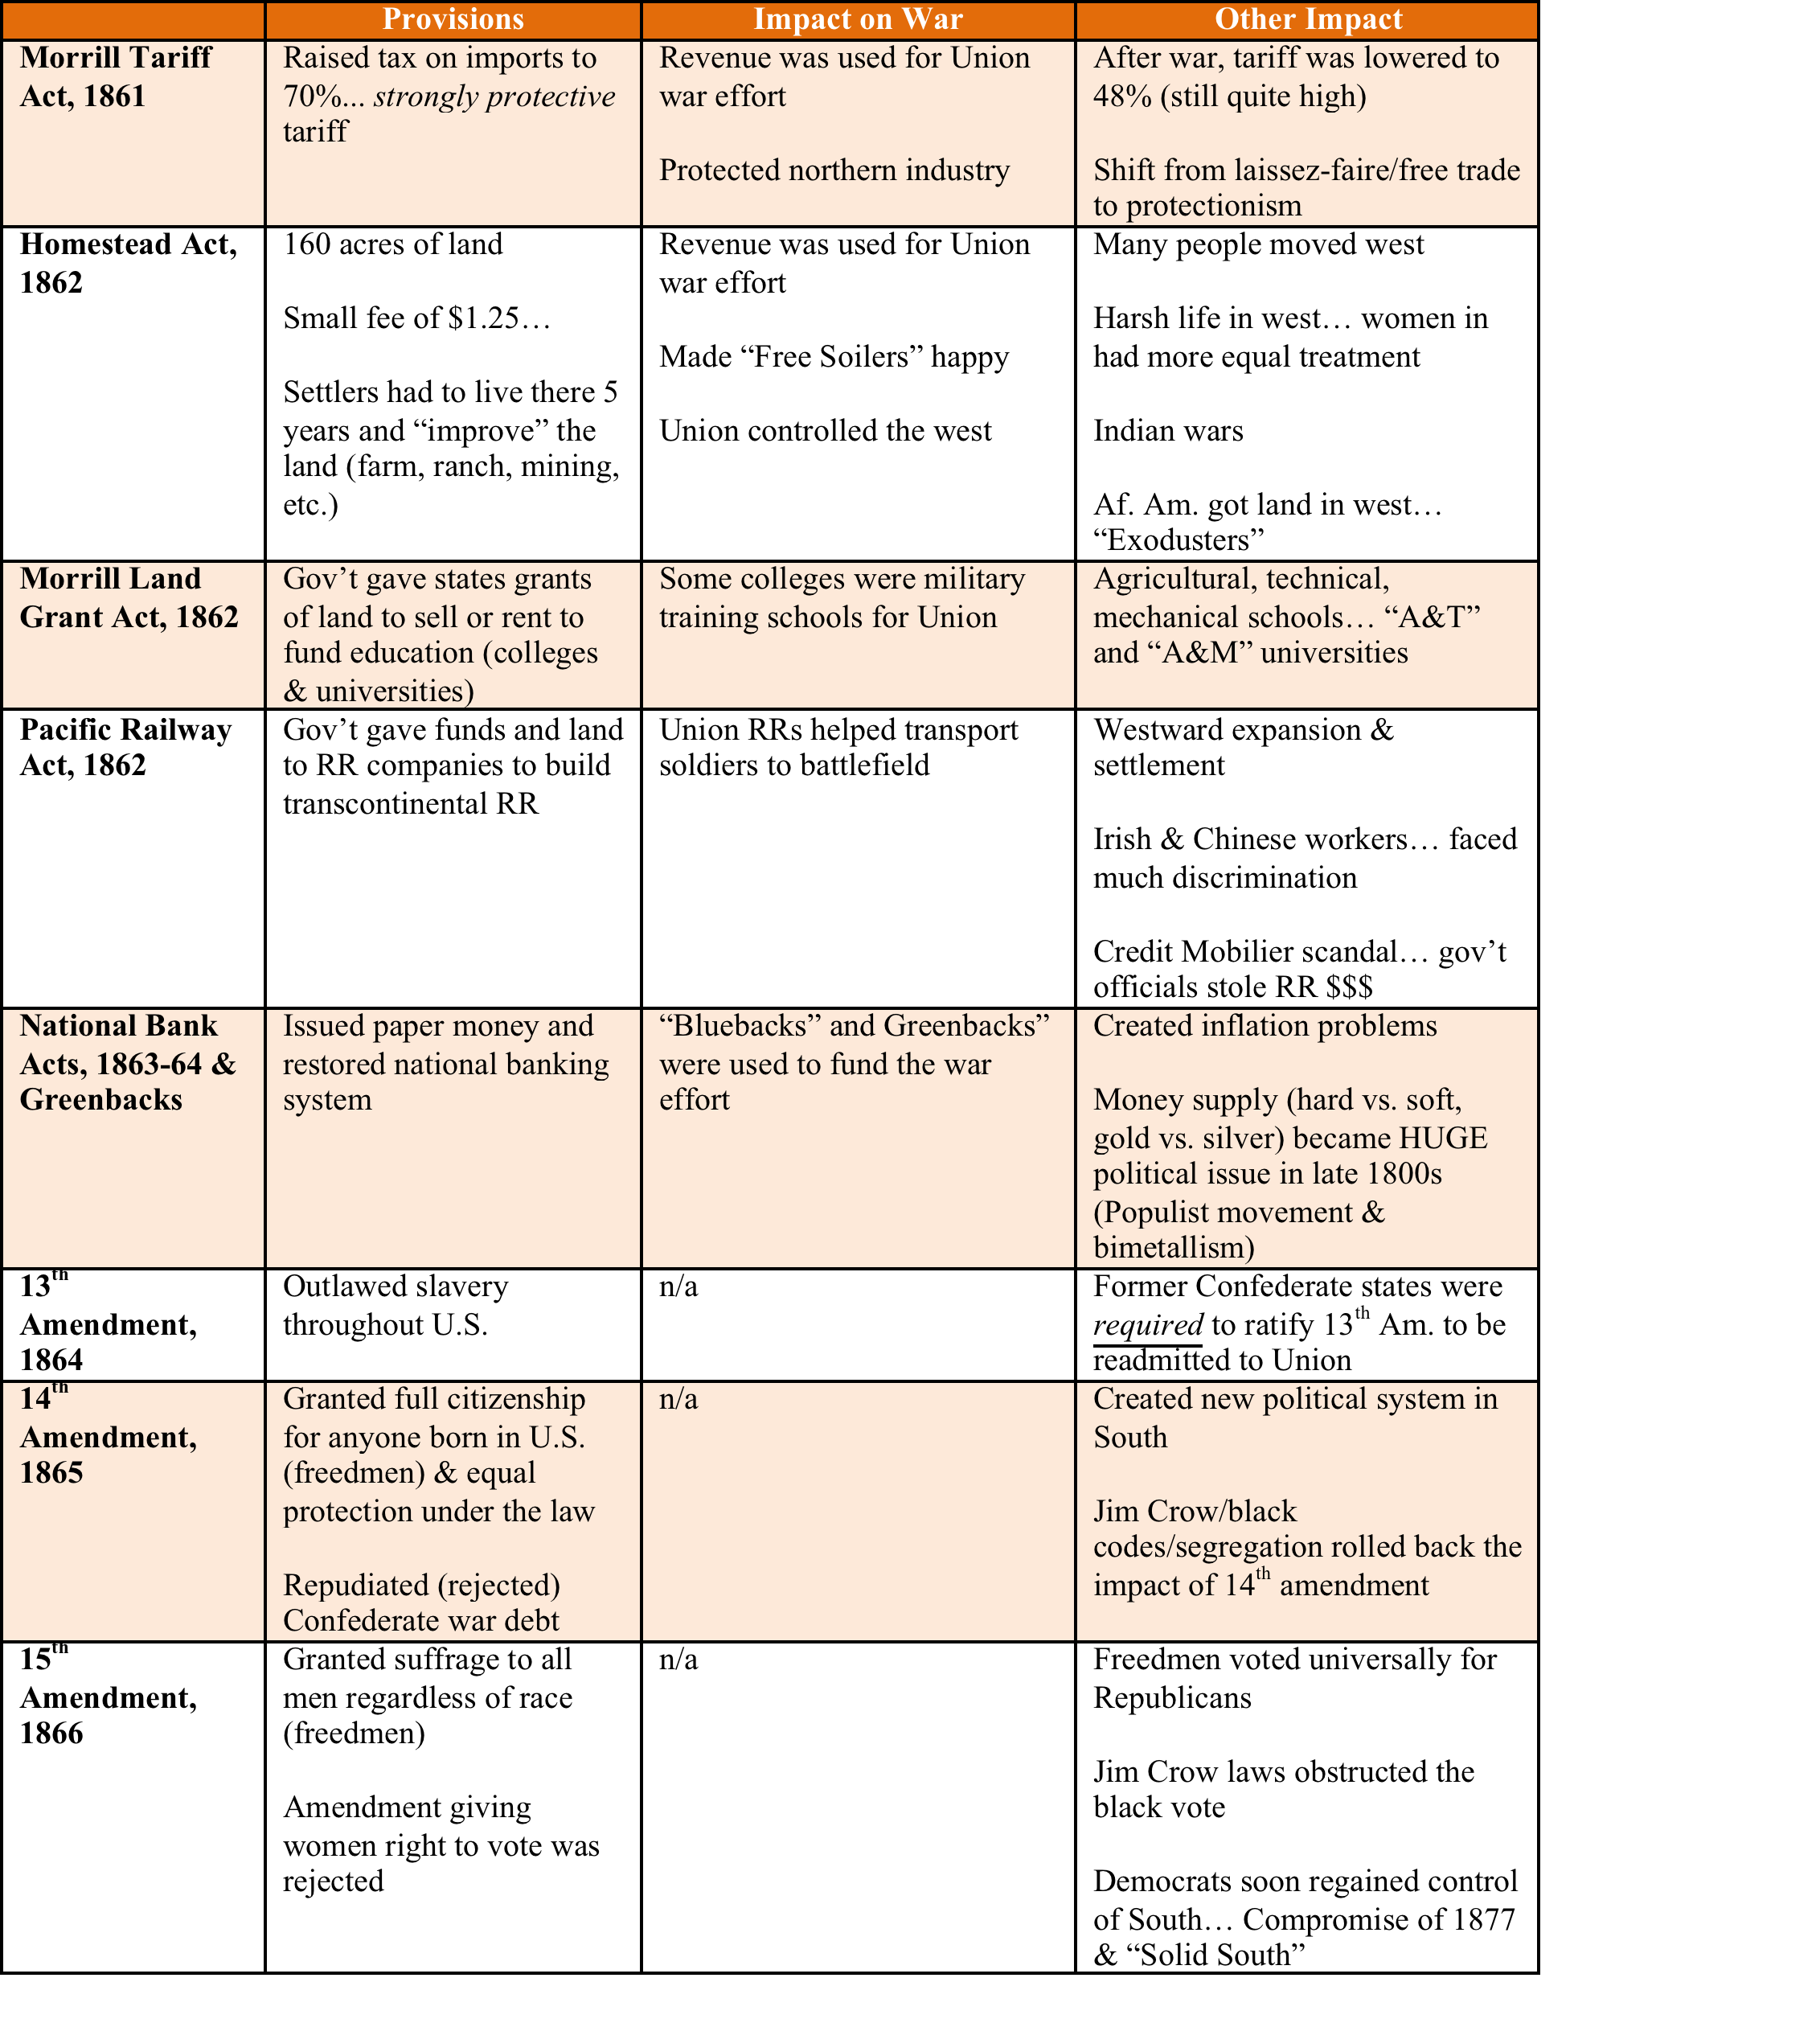

Slide 7
Lincoln’s War Machine & the Impact of Railroads

