Slide 1
Do Now-Respond to the quote on your notes:
"My paramount object in this struggle is to save the Union, and is not either to save or to destroy slavery. If I could save the Union without freeing any slave I would do it, and if I could save it by freeing all the slaves I would do it; and if I could save it by freeing some and leaving others alone I would also do that." —Abraham Lincoln, 1862

Slide 2
7. Why Fight? The Intertwining Nature of Military, Politics, and Economics in Civil War America
Mr. Winchell
APUSH
Period 5

Slide 3
AP Prompt
Evaluate the differing goals and approaches to the Civil War, comparing Northern and Southern perspectives.

Slide 4
Outline
Northern and Southern War Goals
Civil War Politics and Civil Liberties-Keeping the Border States “Loyal”
Military Progress of the Early Conflict
The Domestic War-Civil War on the Home Front

Slide 5
Do Now
Video: Ed Ayers on the Civil War

Slide 6
What is the“United States”?
The Southern decision to secede was based on old arguments:
The USA was a “compact between states,” not a national gov’t “above the states”
Therefore, states could leave the Union freely & peacefully
States’ rights must be protected as a guarantee of liberty
Individuals have the right to own property (slaves) & have the right to have their property returned (Fugitive Slave Law)
Southerners had threatened secession during a Congressional debate over slavery in 1790, the Missouri Crisis of 1820, the Nullification Crisis of 1832, & the crisis over California in 1850
Notes:
Threats of secession were nothing new. Some Southerners had threatened to leave the Union during a Congressional debate over slavery in 1790, the Missouri Crisis of 1819 and 1820, the Nullification Crisis of 1831 and 1832, and the crisis over California statehood in 1850. In each case, the crisis was resolved by compromise. Many expected the same pattern to prevail in 1861.
Drawing on arguments developed by John C. Calhoun, the convention held that the states were sovereign entities that could leave the Union as freely as they joined. Among the many indictments of the northern states and people, nothing seems more central than the issue of trust with respect to the capture and return of fugitive slaves

Slide 7
The Secession Crisis
The Withdrawal of the South
“fire eaters” demand withdrawal of southern states from union after 1860 election
President Buchanan told Congress that no state had the right to secede form the Union, but suggested that the federal government had no authority to stop a state if it did (!)
Seceding states immediately seized federal property within their boundaries

Slide 8
Secession

Slide 9
Lincoln’s First Inaugural
Assess the goals of Lincoln’s presidency, according to his First Inaugural.

Slide 10
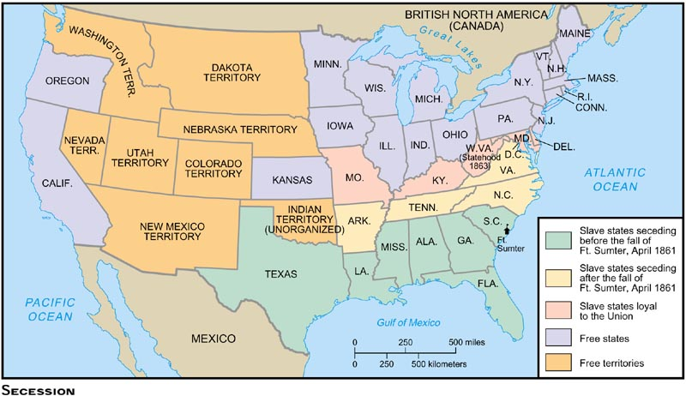
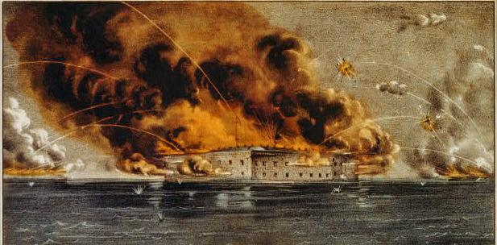
In April 1861, federal soldiers refused Confederate demands to vacate at Fort Sumter in SC
When Lincoln sent aid to soldiers, Confederates fired on the fort
The firing on Fort Sumter proved to be the start of the Civil War

Slide 11
The Failure of Compromise
After Southern guns fire on Northern ship at Fort Sumter, one last effort at compromise
Senator John Crittenden: permanent slavery and reestablish Missouri Compromise Line
Remaining southern states are willing to accept the plan, Northern Republicans and Lincoln are not

Slide 12
After Fort Sumter, the upper South states seceded and joined the Confederacy
Not all slave states seceded; Those that stayed in the Union were called “border states”

Slide 13
Border States
Delaware
Maryland
Strong Confederate sympathies, but voted unionism
Surrounded D.C.
Lincoln declared martial law and suspended habeas corpus
Arrested 1/3 of Maryland’s General Assembly
Kentucky
Declared neutrality
“I hope to have God on my side, but I must have Kentucky.” – Abraham Lincoln
Missouri
State legislature voted overwhelmingly for unionism
Pro-Confederate Governor Claiborne Jackson called out state militia
West Virginia
Yeoman farmers in western Virginia who did not own many slaves
Seceded from Virginia and officially recognized as a state in 1862

Slide 14
Stephens’ Cornerstone Speech
What does the new Confederate Constitution rest on, according to its new Vice President?

Slide 15
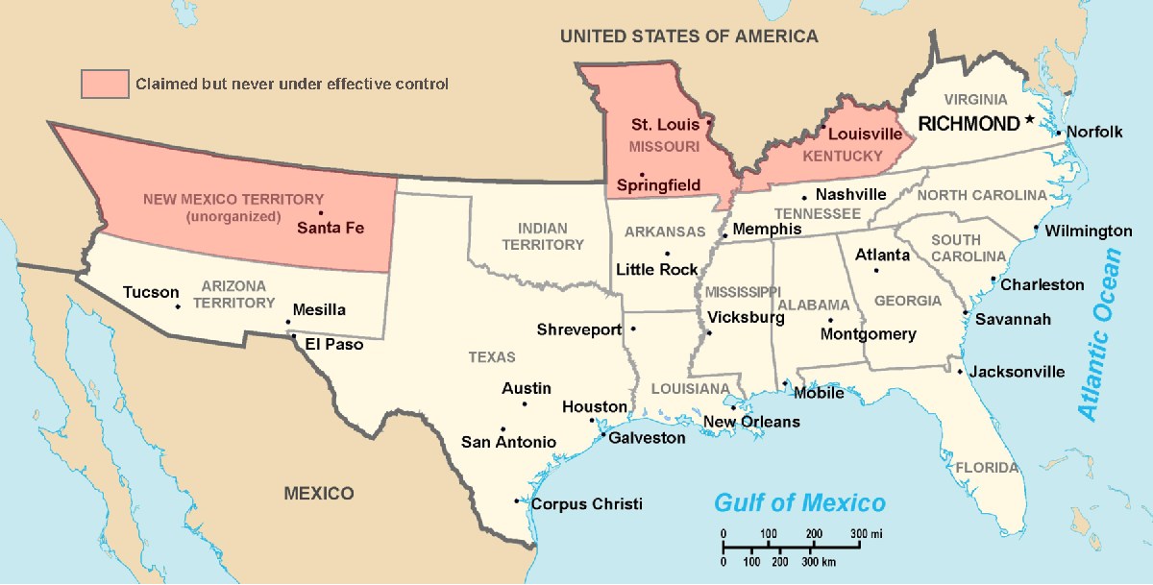
Secession & the Formation of the Confederate States of America
The CSA constitution resembled the U.S., but with 4 key changes: (1) it protected states’ rights, (2) guaranteed slavery, (3) referenced God, & (4) prohibited protective tariffs
On Feb 4, 1861, the Confederate States of America were formed
Mississippi Senator Jefferson Davis was elected CSA president
Notes:
Some wished to “let the South depart in peace”

Slide 16
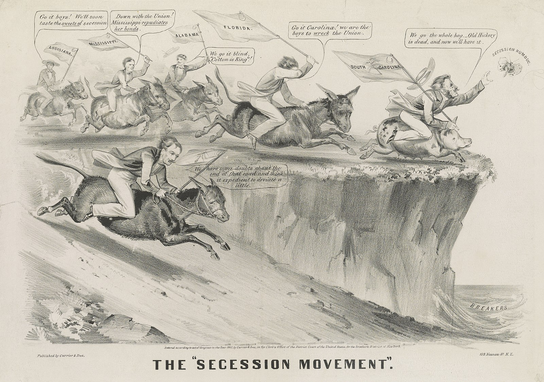

Slide 17
The Union Responds
Notes:
Lincoln calls for volunteers on April 15, 1861.

Slide 18
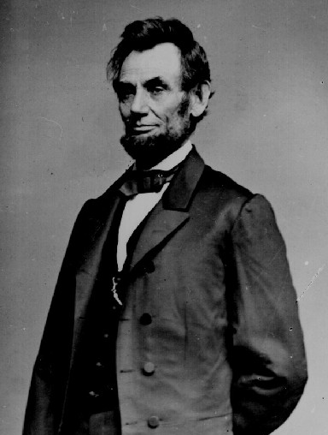
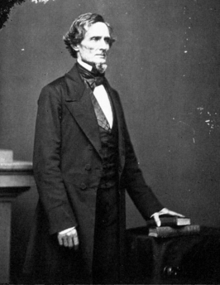
Political Leadership During the Civil War
During the Civil War, President Jefferson Davis had a difficult time:
The CSA Constitution protected states’ rights so state governors could refuse to send him money or troops
CSA currency inflated by 7,000%
During the Civil War, President Lincoln used “emergency powers” to protect “national security”
Suspended habeas corpus (Laws requiring evidence before citizens can be jailed)
Closed down newspapers that did not support the war
The national government in the USA and CSA relied on volunteer armies in the beginning, but soon needed conscription (draft) to supply their armies with troops

Slide 19
Political Leadership During the Civil War
Lincoln expanded his powers:
declared martial law
Imprisoned “subversives”
briefly closed down a few newspapers
Davis was less effective:
concerned mainly with military duties
neglected the economy
obstructed by state governors who resisted conscription

Slide 20
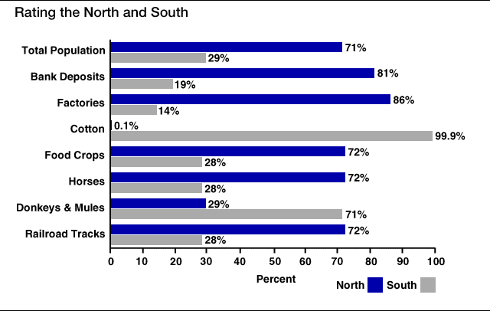
Comparing the Union and Confederacy
Union
Confederacy
Populations
18.5 million
Finance
$234,000,000
Agriculture
Advantage in corn, wheat, horses, and livestock
Industry
101,000 factories with 1.1 million factory workers
20,0000 miles of railroad
97% of firearm production
Troop Enlistment
2,672,341 enlistment
Loyalty of the Navy
Populations
5.5 million free
3.5 million slave
Finance
$74,000,000
Agriculture
Advantage in cotton, rice, and tobacco
Industry
21,000 factories with 111,000 factory workers
9,000 miles of railroad
Troop Enlistment
750,000 to 1.2 million enlistment
Defensive War and Cause
Hope of Cotton Diplomacy

Slide 21
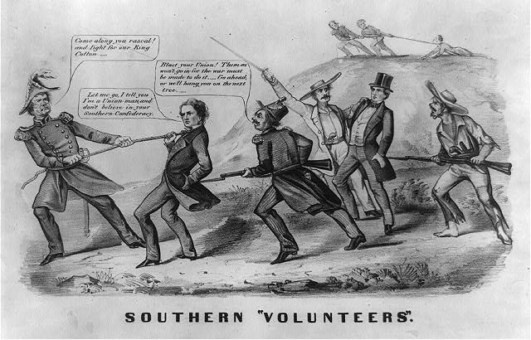

Slide 22
Mini-Q
Evaluate the relative advantages and disadvantages of both sides of the Civil War conflict.

Slide 23
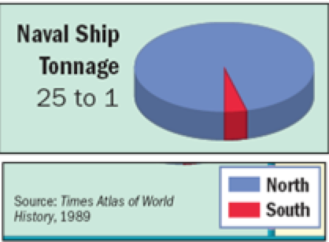
Document 1

Slide 24
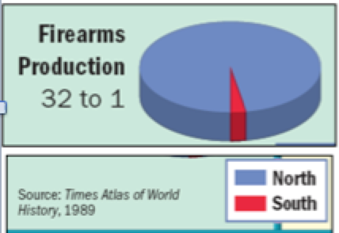
Document 2

Slide 25
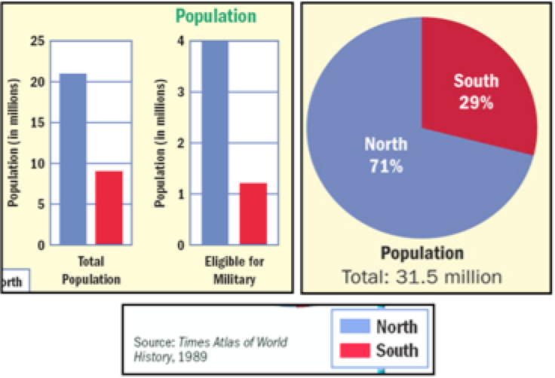
Document 3

Slide 26
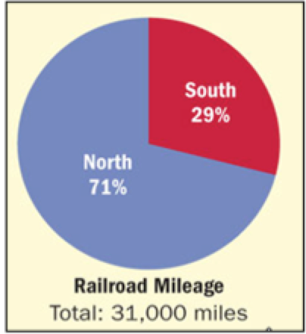
Document 4

Slide 27
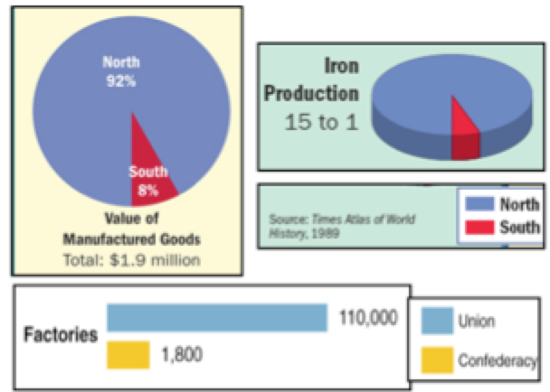
Document 5

Slide 28
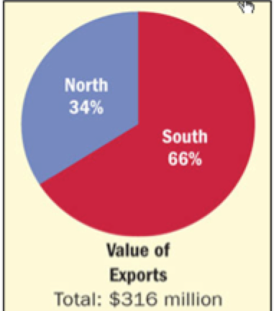
Document 6

Slide 29
At the outbreak of the Civil War, the North had lots of advantages
But, the North had challenges to overcome
The North had to invade the South to win
Larger population for troops
It would be difficult to maintain enthusiasm and support for the war over a long period of time
Greater industrial capacity
Huge edge in railroad transportation

Slide 30
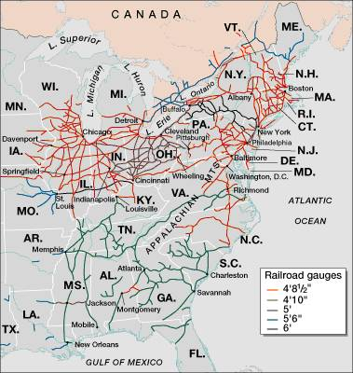
Railroad Lines, 1860

Slide 31
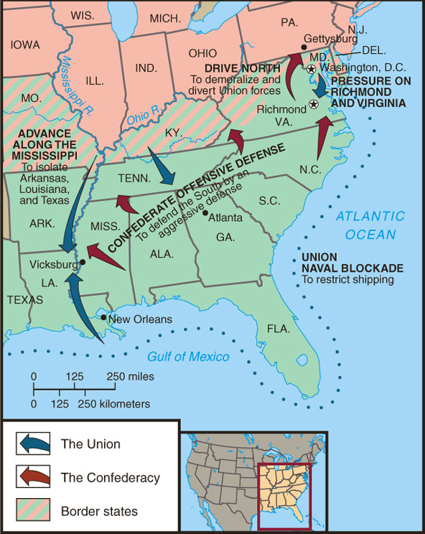
Although outnumbered and less industrial, the Confederacy had advantages
President Davis knew that the Confederacy did not have to “win” the war…
the South only had to drag out the fight and make the North quit

Slide 32
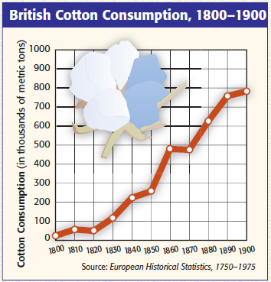
The Confederacy could use “King Cotton Diplomacy” to entice England and France to support the South

Slide 33
The Diplomatic Struggle
From 1861 to 1862, the Confederacy used “cotton diplomacy” to get England & France to aid them:
Napoleon III favored the South but wanted England to do so 1st
England offered “belligerent” status to the CSA; but otherwise chose a hands-off policy
By 1863, “King Cotton” diplomacy failed because Egyptian & Indian cotton filled the European demand
“Successful revolutions have generally succeeded because of foreign intervention”

Slide 34
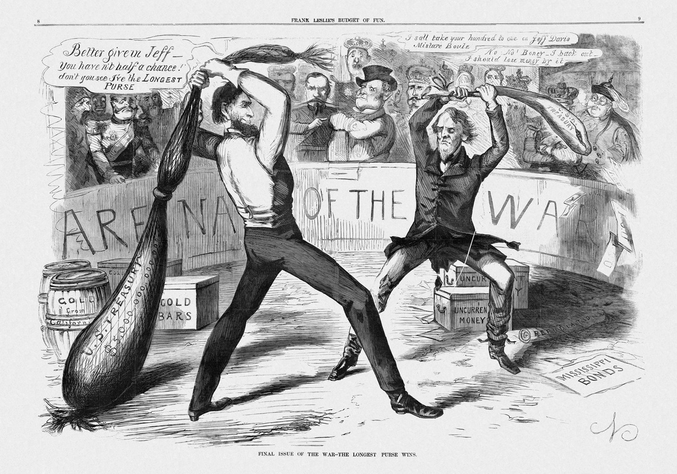

Slide 36
1st Battle of Bull Run
Battle | Date | CSA General | USA General | Winner | Significance
1st Battle of Manassas/ 1st Battle of Bull Run | July 1861 | Beau-regard | McDowell | CSA | Shattered hopes of a quick Union victory

Slide 37
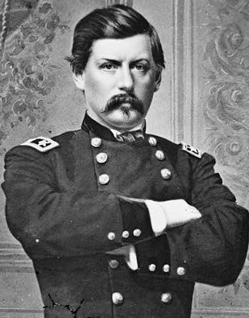
McClellan in the Peninsula
“Make no movement until the preparations are as complete as circumstances permit.”

Slide 38
Peninsula Campaign
Battle | Date | CSA General | USA General | Winner | Significance
Peninsula Campaign | Mar.- July 1862 | Johnston & Lee | McClellan | CSA | McClellan was overly cautious Union failed to seize Richmond; withdrew from the peninsula Lincoln temporarily removed McClellan from command

Slide 39
Early Campaigns and Battles
Northern achievements by 1862
Total naval supremacy
Confederate troops cleared from West Virginia, Kentucky, much of Tennessee
New Orleans captured
Confederate achievements by 1862
- First Battle of Bull Run won by South
Stall campaign for the Mississippi at Shiloh
Defend Richmond from capture

