Slide 1
Do Now
What was the general theme and purpose of Lincoln’s First Inaugural Address? Why?

Slide 2
The Evolution of War Aims: Lincoln’s First Inaugural Address Through His Last
Mr. Winchell
APUSH 2018-2019
Period 5

Slide 3
AP Prompt
Evaluate the extent to which military actions and events created political change during the Civil War.

Slide 4
Outline
Today’s Texts!
Douglass on Slavery
Letters from Horace Greeley & Lincoln’s Response
Emancipation Proclamation & Response
Gettysburg Address
Lincoln’s Second Inaugural Address

Slide 5
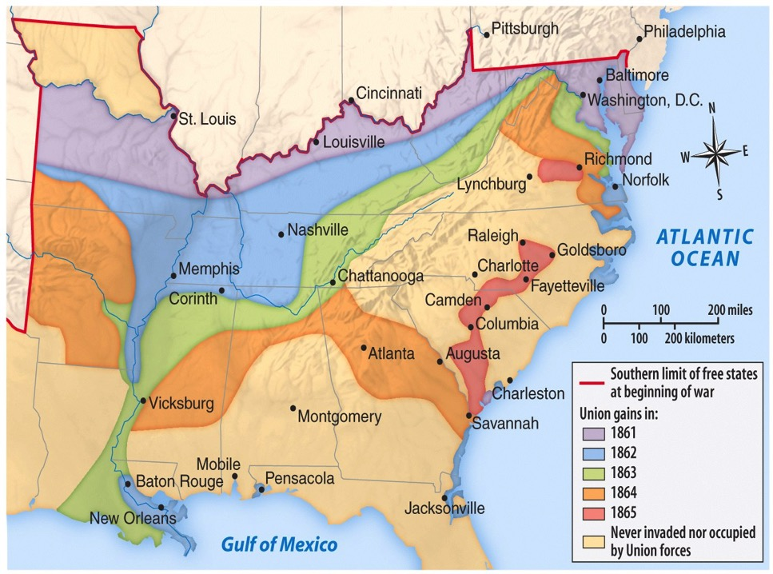
Eastern Theater
Western Theater

Slide 6
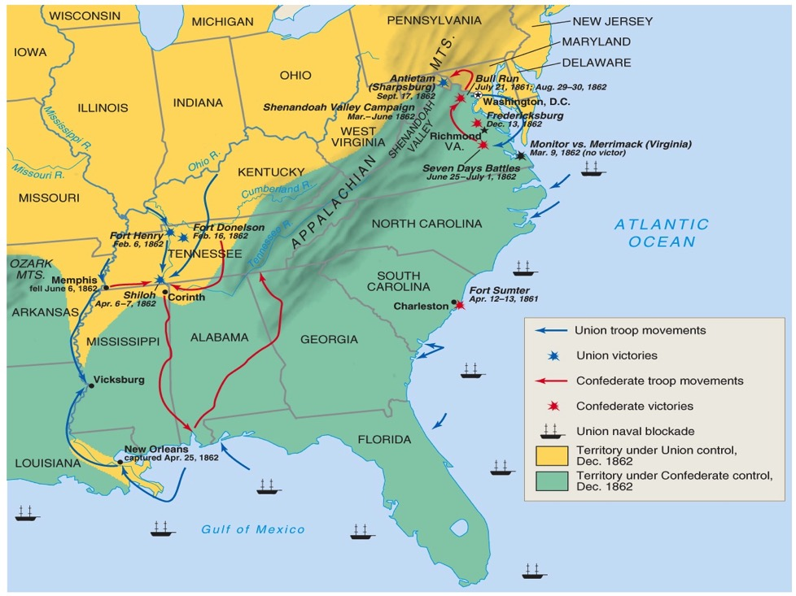
Theater/Battles 1862

Slide 7
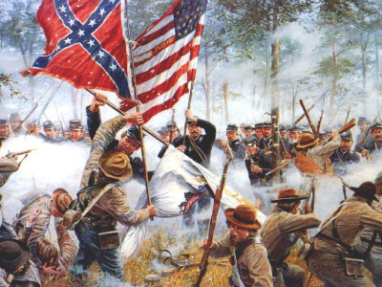
Turning Points of the Civil War
First Battle of Bull Run (July 1861)
First major battle of the war
Union significantly defeated by Confederates
Myth of quick war leads to realization of long and costly war
Antietam (September 1862)
Robert E. Lee defeated by George McClellan
Bloodiest day in war: 22,000 killed or wounded
Lincoln soon issues Emancipation Proclamation
Vicksburg (May-July 1863)
Union control of the Mississippi River, cutting the CSA in two
Gettysburg (July 1863)
CSA’s Lee’s offensive into Pennsylvania to force peace by the Union or earn foreign support
Pickett’s Charge and failure and near destruction of CSA military
Deadliest battle of the entire war: over 50,000 casualties
Widely considered the turning point of the war for a Union victory

Slide 8
1st Battle of Bull Run
Battle | Date | CSA General | USA General | Winner | Significance
1st Battle of Manassas/ 1st Battle of Bull Run | July 1861 | Beau-regard | McDowell | CSA | Shattered hopes of a quick Union victory

Slide 9
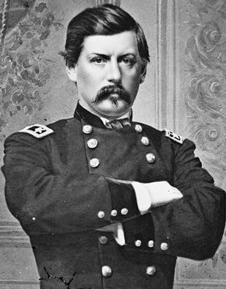
McClellan in the Peninsula
“Make no movement until the preparations are as complete as circumstances permit.”

Slide 10
Peninsula Campaign
Battle | Date | CSA General | USA General | Winner | Significance
Peninsula Campaign | Mar.- July 1862 | Johnston & Lee | McClellan | CSA | McClellan was overly cautious Union failed to seize Richmond; withdrew from the peninsula Lincoln temporarily removed McClellan from command

Slide 11
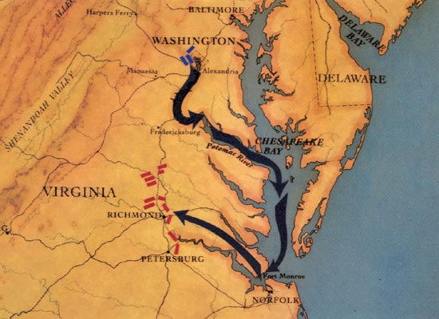

Slide 12
Frederick Douglass
The Reasons for Our Troubles (FTR 581)

Slide 13
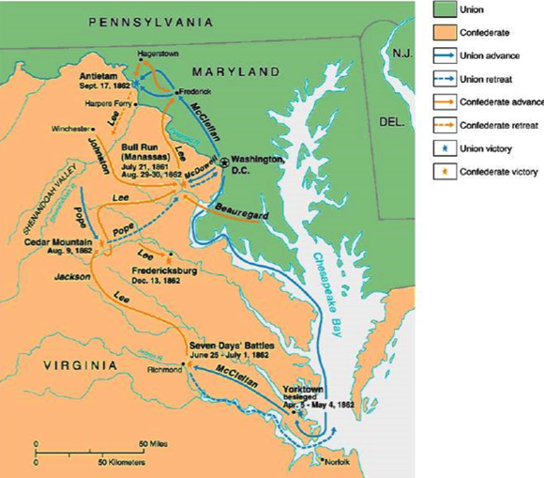
Battle of Antietam

Slide 14
Battle of Antietam
Battle | Date | CSA General | USA General | Winner | Significance
Battle of Antietam | Sept. 1862 | Lee | McClellan | USA | Union foiled Lee’s invasion of the North Lincoln issued Emancipation Proclamation Ended hopes of foreign aid for CSA McClellan didn’t pursue, so Lincoln permanently revoked McClellan’s command

Slide 15
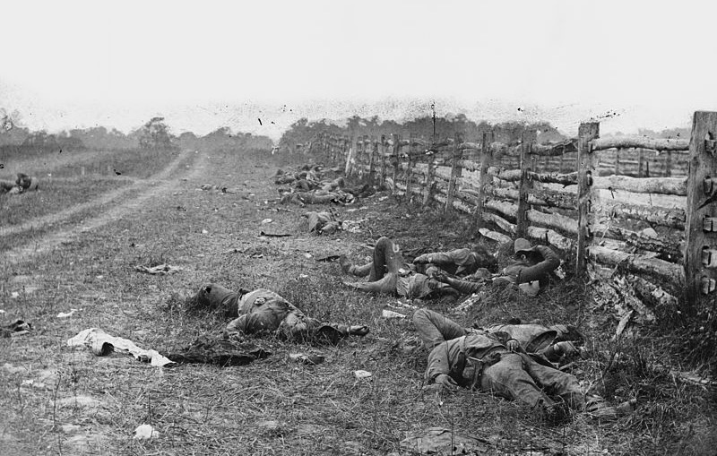
Battle of Antietam

Slide 16
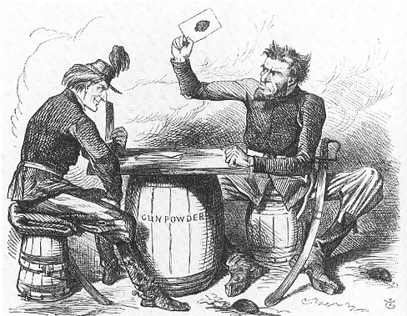

Slide 17
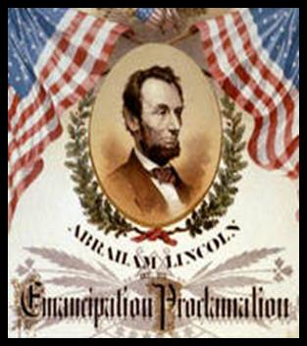
EMANCIPATION PROCLAMATION
Abolitionists pressured Lincoln to free the slaves.
After the Battle of Antietam, he announced that the slaves would be freed.
Became effective on Jan. 1, 1863, in those states still in rebellion.
Emancipation Proclamation did not end slavery in US
Lincoln’s “first” step towards ending slavery.
“Final step” 13th Amendment to the Constitution on Dec. 1865 would legally and constitutionally abolish slavery.
On January 1, 1863, Lincoln said,
“the character of the war will be changed. It will be one of subjugation . . . .The (Old) South is to be destroyed and replaced by new propositions and ideas.”

Slide 18
Emancipation Proclamation

Slide 19
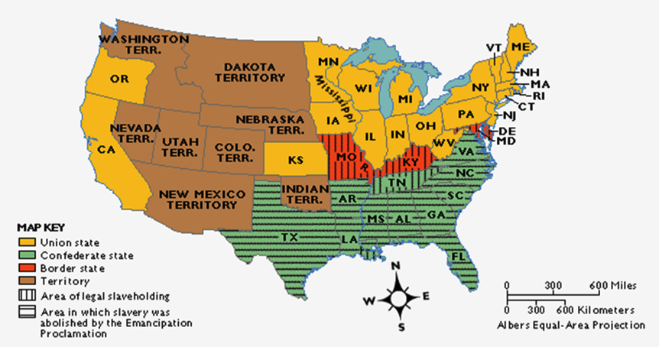
Emancipation Proclamation

Slide 20
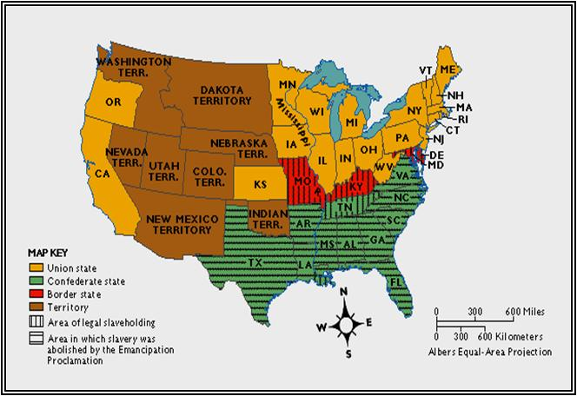
EMANCIPATION PROCLAMATION
Kept Great Britain from siding with the South
and becoming an ally.
War was now a war to
abolish slavery
destroy the South
preserve the Union
ALSO…no chance of a negotiated settlement

Slide 21
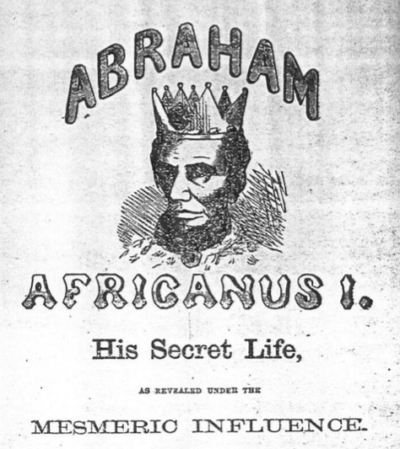
Emancipation Controversy

Slide 22
The Union and Blacks/Slaves
The idea of ending slavery was difficult for Lincoln
Border states were slave states, ex. Kentucky
Slavery is constitutional
Racism in the North and among Democrats
Re-election in 1864?
Confiscation Acts (1861, 1862)
Captured fugitive slaves not to be returned to owners and forfeited to the Union army (contraband)
Emancipation Proclamation (January 1, 1863)
“freed” slaves in Confederate states
Slavery became an “official” cause of war
Army of Freedom
54th Massachusetts (Glory) - unequal pay
200,000 participants; 37,000 casualties
Thirteenth Amendment (December 1865)
“If slaves will make good soldiers, our whole theory of slavery is wrong.” - Georgia general

Slide 23
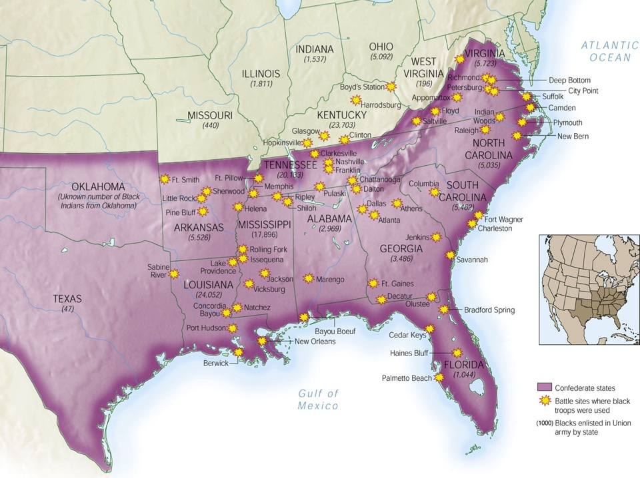
African Americans in Civil War

Slide 24
Battle of Gettysburg
Battle | Date | CSA General | USA General | Winner | Significance
Battle of Gettysburg | July 1863 | Lee | Meade | USA | Union foiled Lee’s 2nd invasion of the north Confederacy could not continue to replace large losses of soldiers HIGH POINT OF THE CSA Lincoln’s Gettysburg Address redefined the meaning of the war

Slide 25
Gettysburg Address
Four score and seven years ago our fathers brought forth on this continent a new nation, conceived in liberty, and dedicated to the proposition that all men are created equal. Now we are engaged in a great civil war, testing whether that nation, or any nation, so conceived and so dedicated, can long endure. We are met on a great battle-field of that war. We have come to dedicate a portion of that field, as a final resting place for those who here gave their lives that that nation might live. It is altogether fitting and proper that we should do this.
But, in a larger sense, we can not dedicate, we can not consecrate, we can not hallow this ground. The brave men, living and dead, who struggled here, have consecrated it, far above our poor power to add or detract. The world will little note, nor long remember what we say here, but it can never forget what they did here. It is for us the living, rather, to be dedicated here to the unfinished work which they who fought here have thus far so nobly advanced. It is rather for us to be here dedicated to the great task remaining before us—that from these honored dead we take increased devotion to that cause for which they gave the last full measure of devotion—that we here highly resolve that these dead shall not have died in vain—that this nation, under God, shall have a new birth of freedom—and that government of the people, by the people, for the people, shall not perish from the earth.

Slide 26
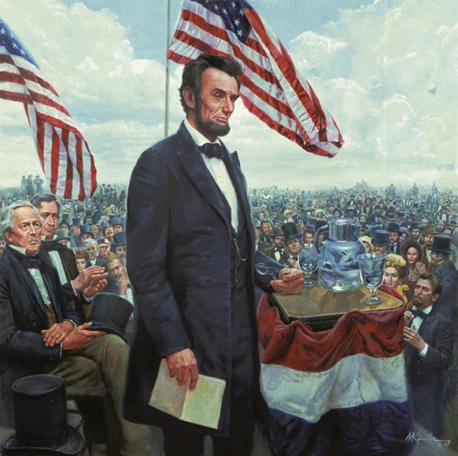
Gettysburg Address

Slide 27
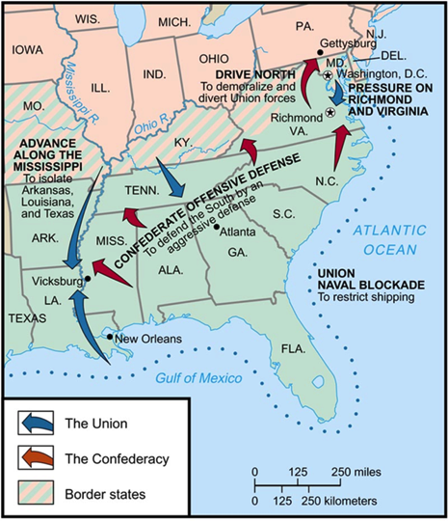
Siege of Vicksburg

Slide 28
Siege of Vicksburg
Battle | Date | CSA General | USA General | Winner | Significance
Siege of Vicksburg | May-July 1863 | Pemberton | Grant | USA | Union gained control of the Mississippi River Confederacy was split in half, east from west

Slide 29
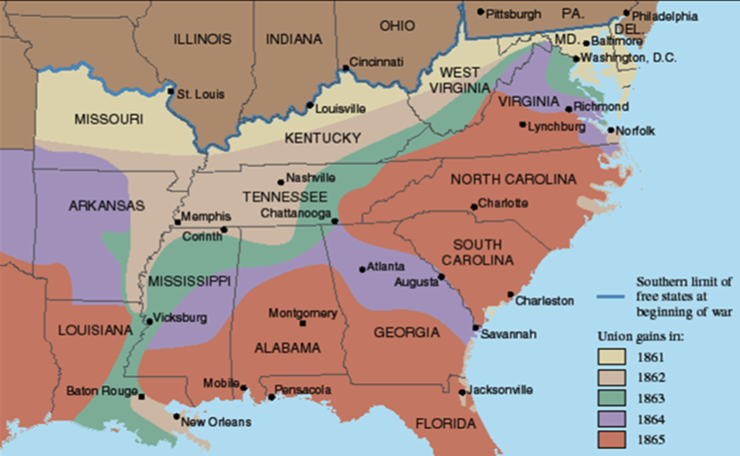
Slow Progress of the War

Slide 30
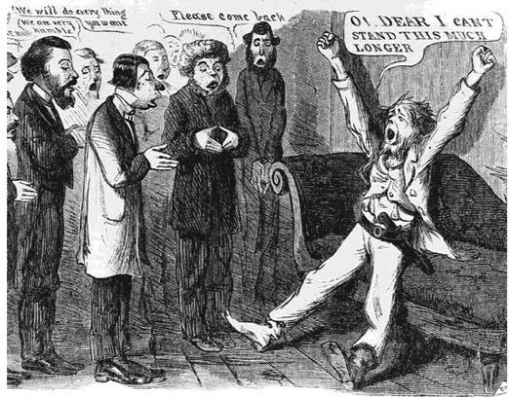
“Peace” Democrats
Opposed emancipation
Wanted immediate end to war
Wanted to restore Confederacy to the Union through negotiation
Nicknamed “Copperheads”

Slide 31
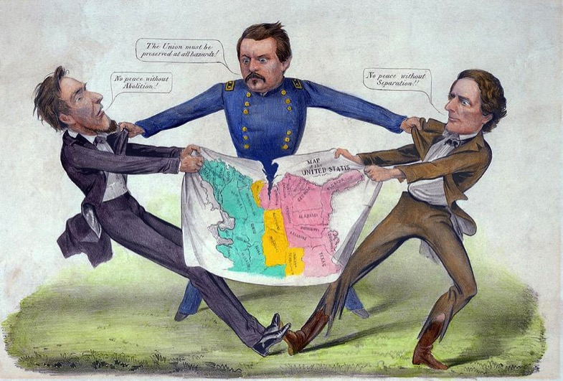
McClellan the Peacemaker?

Slide 32
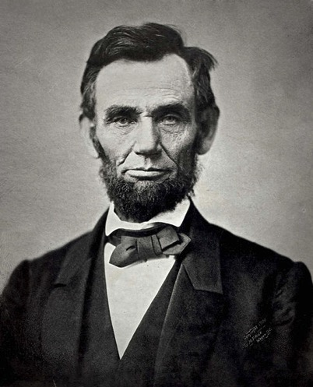
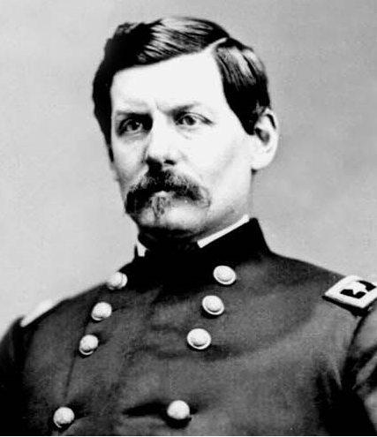
Election of 1864
Abraham Lincoln
Republican
George McClellan
Democrat

Slide 33
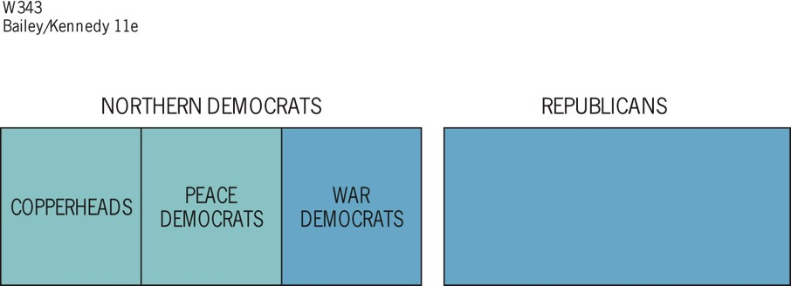
Notes:
Figure 21.1 Union Party, 1864 The blue area
represents the Union party.

Slide 34
Sherman Scorches Georgia
Georgia’s conquest:
It was entrusted to General William Tecumseh Sherman
He captured Atlanta in September 1864, burned the city in November 1864
Sherman with 6000 troops cut a sixty-mile swath of destruction through Georgia
Major purposes of Sherman’s march:
destroy supplies destined for the Confederate army
weaken the morale of the men at the front by waging war on their homes

Slide 35
Sherman Scorches Georgia
Sherman was a pioneer practitioner of “total war”:
His success in “Shermanizing” the South was attested by increasing numbers of Confederate desertions
All his methods were brutal
He probably shortened the struggle and hence saved lives
The discipline of his army at times broke down
After seizing Savannah as a Christmas present for Lincoln, his army veered north into South Carolina, where the destruction was even worse:
Sherman’s conquering army rolled deep into North Carolina by the time the war ended

Slide 36
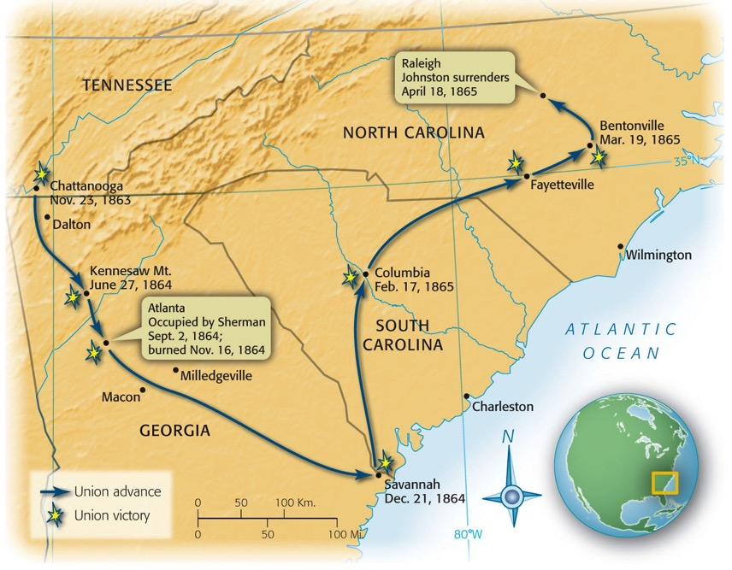
Map 21-6 p450
Notes:
Map 21.6 Sherman’s March, 1864–1865

Slide 37
Election of 1864
Abraham Lincoln (R)
Ran as National Union Party
Andrew Johnson (D) as VP running mate
Fall of Atlanta ensured re-election
George McClellan (D)

Slide 38
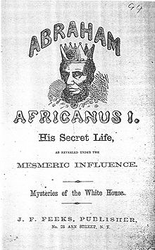
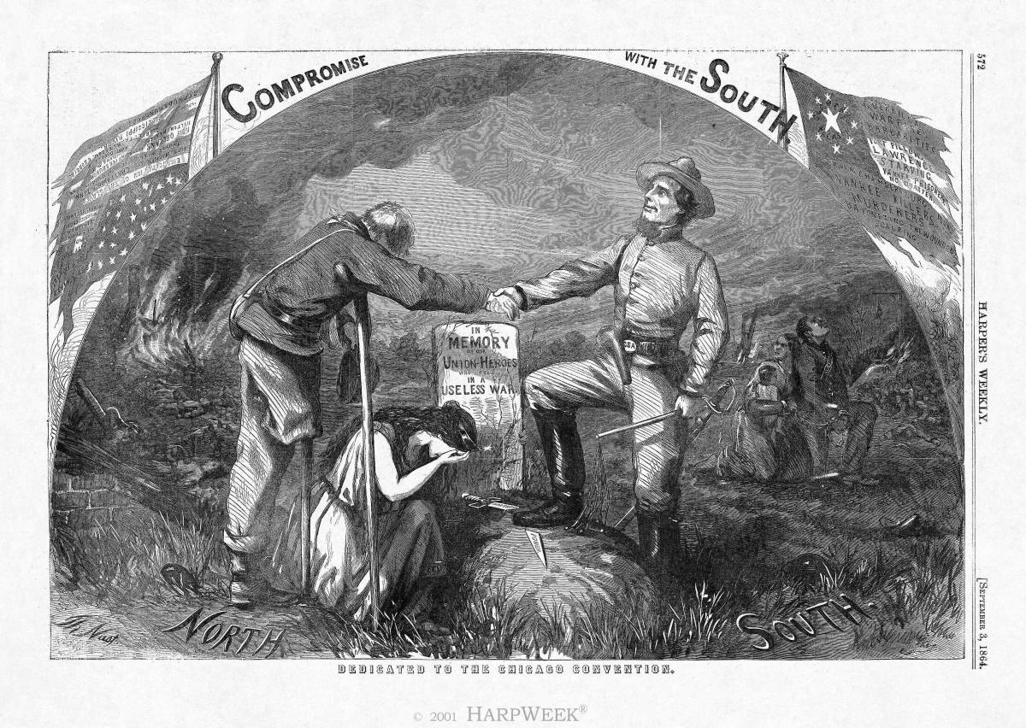
Lincoln’s Politics and Civil War
Lincoln and Congress
Radical Republicans
Conservative Republicans
War Democrats
Copperheads/Peace Democrats
Clement Vallandigham (OH) and Fernando Wood (NY)
Constitutional Powers and Rights
Ex parte Merryman (1861)
Suspension of habeas corpus by Lincoln unconstitutional
Ex parte Milligan (1866)
Civilians cannot be tried in military courts if civil courts still operating
Copperhead Propaganda

Slide 39
Lincoln’s 2nd Inaugural

Slide 40
AP Prompt
Evaluate the extent to which military actions and events created political change during the Civil War.

