Slide 1
Do Now
‘The years of war tried our devotion to the Union; the time of peace may test the sincerity of our faith in democracy.’
Herman Melville, 1866

Slide 2
9. Reconstruction: Goals, Strategies, and Political Conflict
Mr. Winchell
APUSH
Period 5

Slide 3
AP Prompt
Evaluate the extent to which Presidential Reconstruction demonstrated change in American politics

Slide 4
Lincoln’s 2nd Inaugural

Slide 5
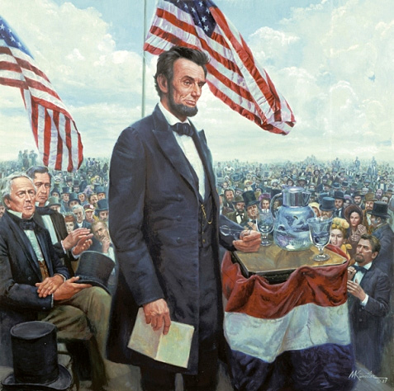
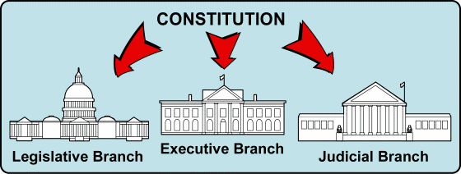
As the Civil War was ending, President Lincoln promised a Reconstruction Plan for the Union with “malice towards none and charity for all”
But, the Constitution gave no guidelines on how to readmit states to the Union
The President and Congress disagreed over how to treat the Southern states
Abraham Lincoln’s Second Inaugural Address

Slide 6
Thirteenth Amendment
Standing in the way of full emancipation was the U.S. Constitution
Process was started on passing an amendment (passed after Lincoln’s death)
Simply stated: “Neither slavery nor involuntary servitude, except as punishment for crime whereof the party shall have been duly convicted, shall exist within the United States, or any place subject to their jurisdiction.”

Slide 8
Effects of the War
Political changes:
The Civil War established that the national gov’t is supreme over the states
With no Southern opposition, Republicans passed new laws: Homestead Act (1862), Morrill Act (1862), a protective tariff, land grants to RR companies, & a national banking system
Long-term effects: balance of power shifted between the North and South
Notes:
gave free land to western settlers
created new colleges

Slide 9
North/West: Political Effects
Republican Congress pushed through their agenda unopposed
Homestead Act of 1862
Any one could claim up to 160 acres of land and buy it for a cheap price after living/farming it for 5 years
Morill Land Grant of 1862
Set public land aside for public education (Land-Grant Colleges)
Tariff Bills
Without the South to resist the North jacked up tariffs to protect America’s growing industry
Construction began on the Transcontinental Railroad
National Bank Act
Banks could join national banking system
Could then buy gov’t bonds and issue paper currency
Created first national banking system since Jackson killed the Bank of the US in 1836
Infringement on Civil Liberties
“supervised” voting
Writ of Habeas Corpus
Freedom of Speech
Abolishment of Slavery
Confiscation Acts: Union army could confiscate any Confederate property including slaves (essentially freed slaves when the Union army took over)
Emancipation Proclamation: freed all slaves in CSA territory
13th Amendment: banned slavery
Massive Expansion of Federal Power
Aggressively enforce laws
Protect Civil Rights
14th Amendment granted citizenship to all African-Americans
1st Social Welfare program (Freedmen’s Bureau)
Print currency
Conscription

Slide 10
Economic Effects
North financed the war ($2.6 BILLION) by the sale of government bonds. Still not enough:
Raising tariffs (Morrill Tariff); adding excise taxes; and instituting the first income tax
Greenbacks: issued by U.S. Treasury but not redeemable for gold; led to inflation
Modernizing northern economy: no real significant change; CON: workers’ wages did not keep up w/ inflation; PRO: modernized and consolidated the industries

Slide 11
Social Effects
Women:
Filled in for men who were off fighting (fields, factories, offices, stores, gov) in North & South
Served as military nurses
Effects:
Field of nursing opened to women
Opened the door for equal voting rights

Slide 12
Social Effects
Biggest group impacted: former slaves (3.5 in South, 500K in border states)
13th Amendment banned slavery
Tragic human loss as result of war:
620K men died
$15 billion in war costs & damaged property
Destroyed slavery and southern economy
Catalyst for transformation to modern industrial society

Slide 13
The Aftermath of the Nightmare
The extreme states’ righters were crushed
The national government, tested in the fiery furnace of war, emerged unbroken
Nullification and secessions were laid to rest
The Civil War was the supreme test of American democracy
The preservation of democratic ideals was subconsciously one of the major objectives of the North

Slide 14
What Was Settled?
Slavery
Secession
State v. Federal Supremacy

Slide 15
What Wasn’t Settled?
Extent of States’ Rights
Civil Rights
Civil Liberties During Wartime
Reach of the Federal Government

Slide 16
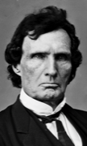
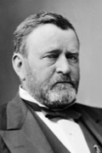
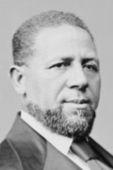
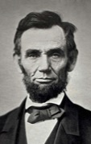
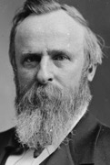
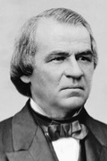
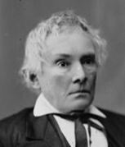
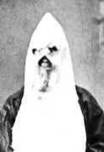
Political Spectrum of Reconstruction
Radicals
Moderates
Unionists
Redeemers
KKK
Federal Supremacy
Black Civil Rights
Military Occupation
States’ Rights
Blacks as Second-Class Citizens
Home Rule

Slide 17
Key Questions
1. How do we bring the South back into the Union?
4. What branch of government should control the process of Reconstruction?
2. How do we rebuild the South after its destruction during the war?
3. How do we integrate and protect newly- emancipated black freedmen?

Slide 18
Carl Schurz’s Report on Southern Defiance
What does Shurz warn about Southern loyalty and response to the end of the Civil War?

Slide 19
Convention of Freedmen-Virginia
What is the initial complaint of these freed slaves?
What similarity does paragraph 2 hold to Shurz’s argument above?
What solutions does the convention propose?

Slide 20
Reconstruction, Phase 1 Lincoln’s Plan
Proclamation of Amnesty and Reconstruction (1863)
Full presidential pardons for
1. Oath of allegiance,
2. Accept end of slavery
Ten Percent Plan
Confederate state reestablished once 10% of voters affirmed allegiance and loyalty
Wade-Davis Bill (1864)
Second Inaugural Address
“with malice toward none; with charity for all”
Lincoln’s Assassination
April 14, 1865

Slide 21
Freedmen’s Bureau
Bureau of Refugees, Freedmen, and Abandoned Lands in March 1865
Food, shelter, medicine for freed blacks and displaced whites
Education of blacks and colleges
Viciously attacked and ridiculed by Northern racists and bitter Southerners

Slide 22
“Radical Republicans” in Congress rejected Lincoln’s plan because it was too lenient on ex-Confederates
They favored a plan that protected blacks, required 50% of state citizens to swear a loyalty oath, and banned ex-Confederate leaders from serving in gov’t
(Wade-Davis Bill)
When the Civil War ended and Lincoln was assassinated, the government did not have a Reconstruction Plan in place

Slide 23
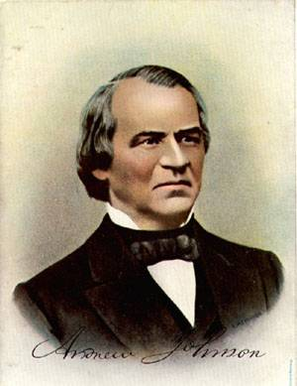
President Andrew Johnson
Jacksonian Democrat.
Anti-Aristocrat.
White Supremacist.
Agreed with Lincoln that states had never legally left the Union.
Damn the negroes! I am fighting these traitorous aristocrats, their masters!

Slide 24
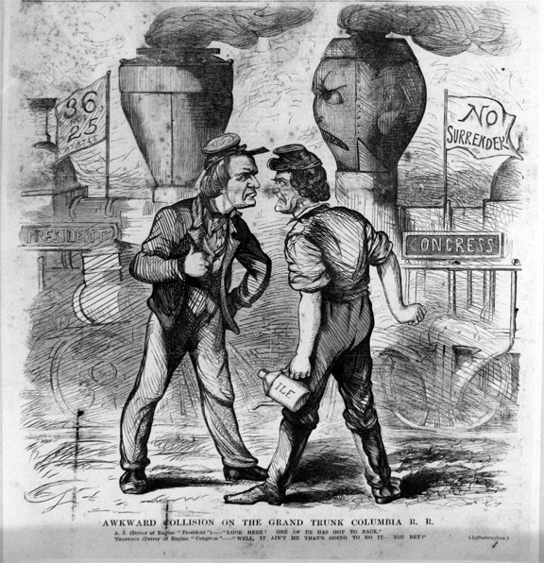
Reconstruction, Phase 2 Andrew Johnson’s Plan
Reconstruction Plan
Pardons for loyalty oath
No pardons for Confederate leaders and owned $20,000 taxable property
Admitted Confederate states with appointed governors who established voting procedures for state legislatures
States must abolish slavery and secession clauses from state constitutions
Effects
Former confederates elected to office
Black codes enacted
Vetoes
Civil Rights Act of 1866
Freedmen’s Bureau extension
Awkward Collision on the Grand Trunk Columbia R.R.
November, 1866

Slide 25
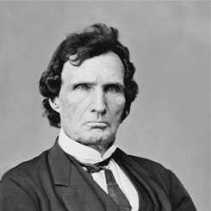
Joint Committee on Reconstruction
Joint committee of 15 members from the House and Senate
"inquire into the condition of the States which formed the Confederate States of America, and report whether they, or any of them, are entitled to be represented in either house of Congress.“
Recommendations:
Fourteenth Amendment
Reconstruction Acts
Rep. Thaddeus Stevens (R-PA)

Slide 26
Black Codes
Based on previous slave codes
Designed primarily to limit economic opportunity for blacks
Provisions
Sign annual labor contracts
Only allowed occupations of farmer or servant unless paid a tax
Restricted movement; vagrancy
Limited types of property to own
Civil Rights Act of 1866
Congress overturns black codes
Johnson vetoes the bill
Congress overrode it

Slide 27
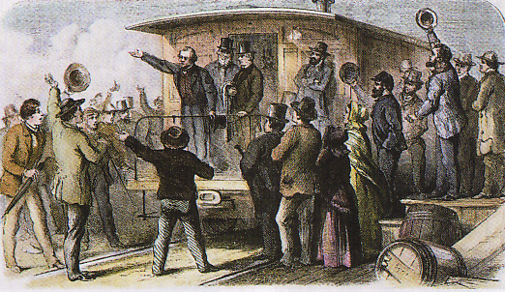
Mid-Term Elections of 1866
Radical Republicans launch massive electoral campaign in response to Johnson’s vetoes
Johnson’s Swing Around the Circle
Republican Supermajorities in both houses
175 in House
Need 113 for majority
39 in Senate
Need 34 for majority

