Slide 1
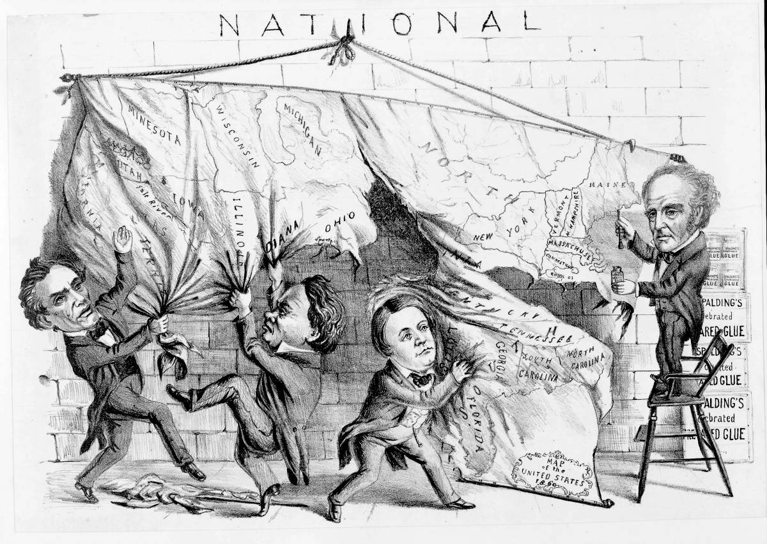
Overview
Literary Abolitionists
Bleeding Kansas
Increased Political Division
The New Republicans
Elections of 1856
Dred Scott
The Introduction of Lincoln
The election of 1860
Secession of the South

Slide 2
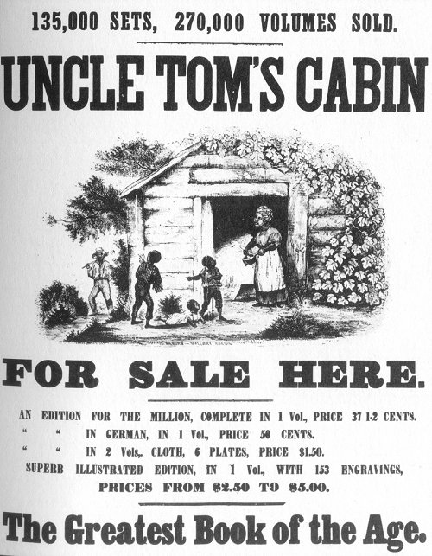
Abolitionist Literature
Outrage over the intensified Fugitive Slave Act sweeps the North! – led to abolitionist literature.
Uncle’s Tom Cabin (written by Harriet Beecher Stowe) – a novel telling the story of a friendly and loveable slave Tom and an escaped slave trying to save her son for the slave trade market.
Uses themes of the Second Great Awakening and emotion language – a huge seller (MAKES SLAVERY A MORAL ISSUE NOT AN ECONOMIC ISSUE)!
The Impending Crisis of the South (by Hinton Helper) – used statistics and data to prove that non-slave owning whites were hurt the most by slavery.
Uses rational and logic to justify the end of slavery.

Slide 3
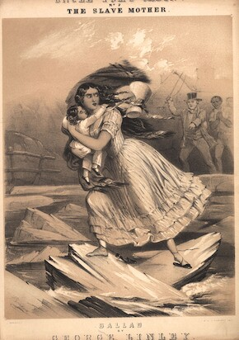
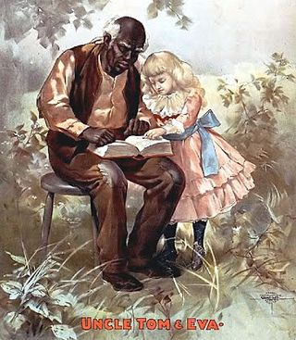
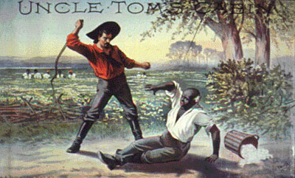
Uncle Tom’s Cabin
"So you're the little woman who wrote the book that made this great war!"
- Abraham Lincoln

Slide 4
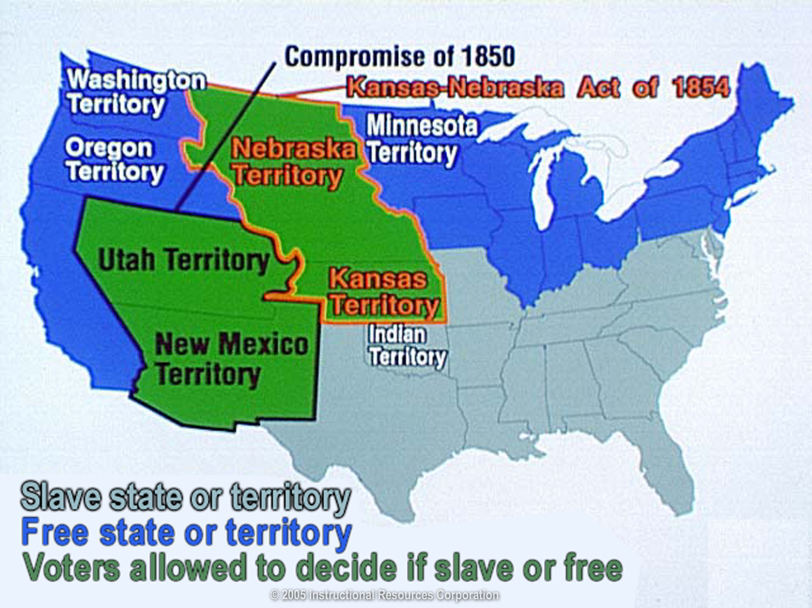
A Review: The Kansas-Nebraska Act
Stephen Douglas (Illinois senator) - wanted the railroad to go thru Chicago.
1854 - introduced a bill to organize a territory (Split a large chuck into two pieces – Kansas and Nebraska).
Nebraska territory - railroad could run through.
South would oppose the bill – so…included a provision to let the new territory decide for itself the status of slavery (popular sovereignty).
Ended the Missouri Compromise (Nebraska above the 36-30 split).
South was happy and the northern abolitionists were upset – slavery is now allowed to grow!
Violence and conflict to come!

Slide 5
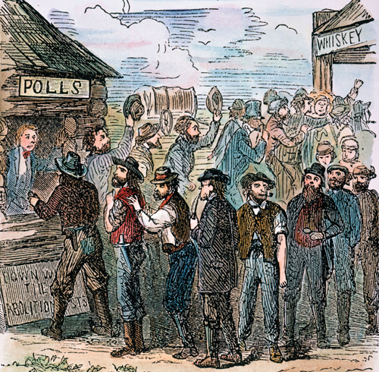
Kansas Votes
Huge migration to Kansas after the act passed!
1855 - elections held.
Missourians (slave state) – illegally voted in Kansas (nicknamed “border ruffians”).
1500 legal voters in Kansas at the time.
6000 votes in the election.
This resulted in a pro-slavery government being elected in Kansas.
Abolitionists who protested the corrupt election set up their own government in Topeka.

Slide 6
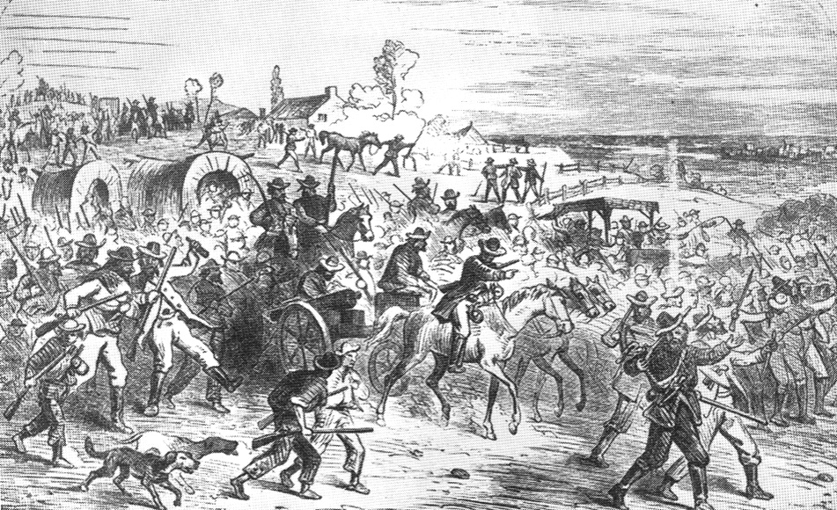
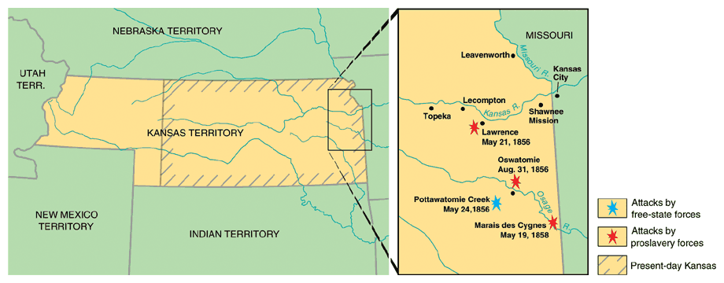
“Bleeding” Kansas
Anti-slavery and pro-slavery forces both organized in opposition to each other, leading to violence.
Ex: Proslavery men (800) burned down the Abolitionist headquarters, printing presses, and looted homes/stores in Lawrence (anti-slavery town) – called the Sack of Lawrence.
John Brown (abolitionist who stated God had sent him to fight slavery) - attacked the settlement of Pottawatomie and killed 5 men.
Known as the Pottawatomie Massacre - led to more violence and guerilla warfare (200+ deaths as a result!).
Nicknamed Bleeding Kansas!

Slide 7
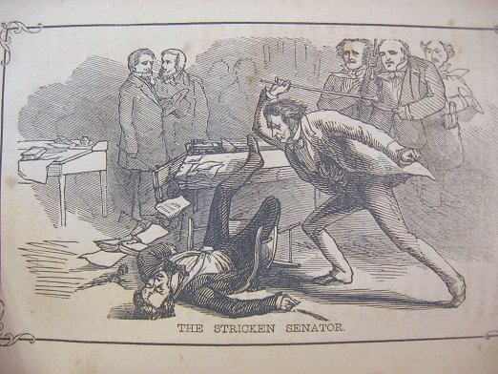
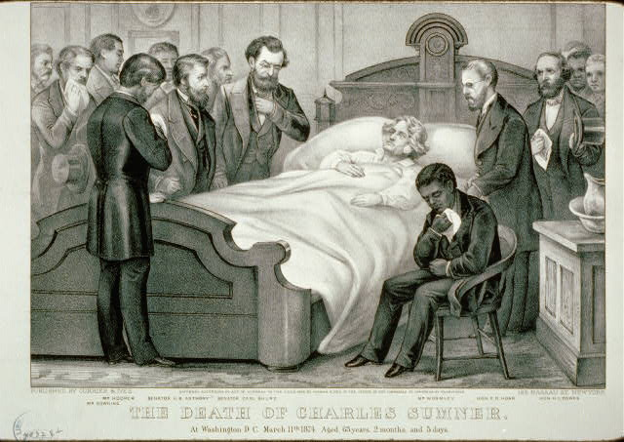
“Bleeding” Kansas bleeds into Washington DC
May 1854 - Violence from Bleeding Kansas makes its way to DC!
Sen. Charles Sumner (Mass) gave a speech attacking slavery.
Sen. Andrew Butler (SC) a slavery defender - enraged by the speech.
A few days later… Butler’s nephew (Preston Brooks) attacks Sumner on the floor of the Senate with a cane until he was unconscious – known as the Sumner Caning.
Sumner - injured so severely that he couldn’t return to the Senate for four years.
Both Sumner and Brooks became heroes in their own regions (N & S).
Violence over slavery is everywhere and further splits the N and S.

Slide 8
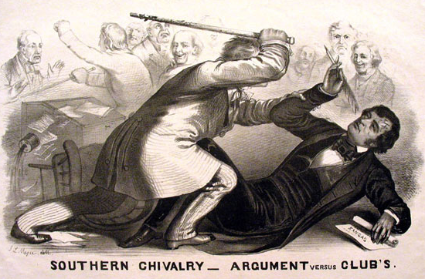

Slide 9
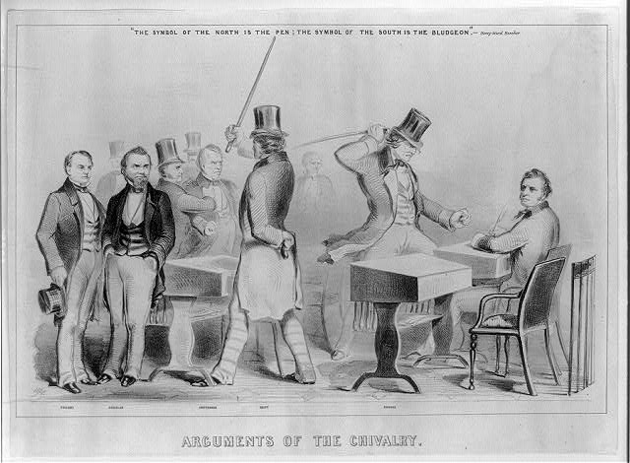

Slide 10
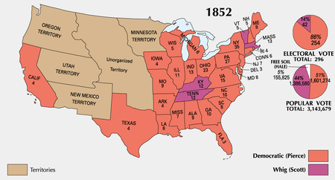
The Birth of the Republican Party
New parties emerge due to rifts over slavery
Whigs are weak (losing members over the issue of slavery) – lost 1852 election and Democrat Franklin Pierce wins.
Know-Nothing Party – pro native-born Americans (nativism) - split over the slavery issue.
Free-Soil Party – anti-extension of slavery into the territories and pro white laborer.
Republican Party – created in opposition to the K-N Act and opposed the extension of slavery (wanted the Missouri Compromise back) and were pro North (Tariffs and industry).
A combination of ex-Whigs, antislavery Democrats, and Free-Soilers.

Slide 11
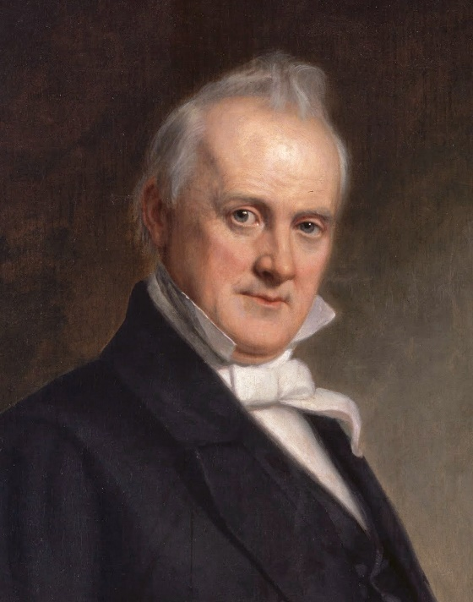
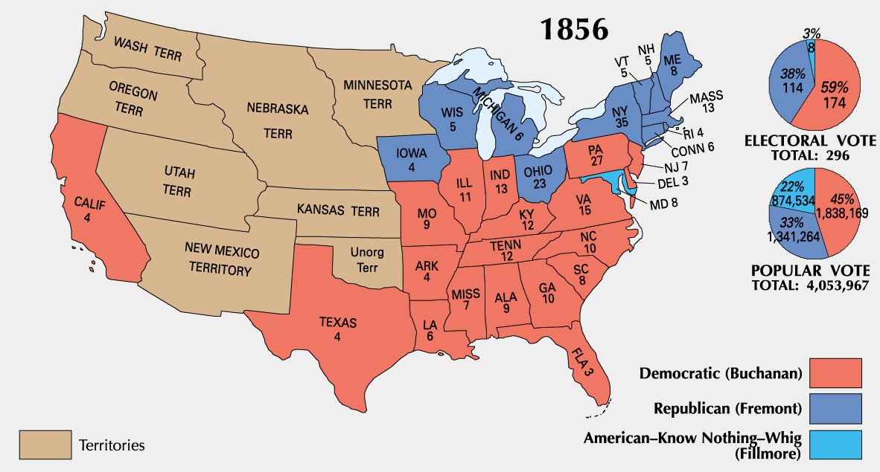
The Election of 1856
Franklin Pierce – not popular due to “Bleeding Kansas.”
Democrats - nominate James Buchanan.
Republicans - nominated John C Fremont .
Whig Party and Know-Nothing Party alliance - nominated Millard Fillmore.
Buchanan wins - who won with only 45% of the popular vote (3rd party ticket election).
Buchanan - timid and indecisive…would be one of the weakest Presidents (not good in a time of national crisis.
Rep’s stick around, Know-nothings decline – nation is still split N and S.

Slide 12
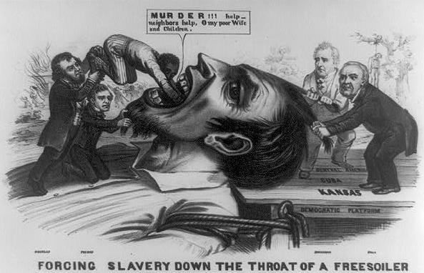

Slide 13
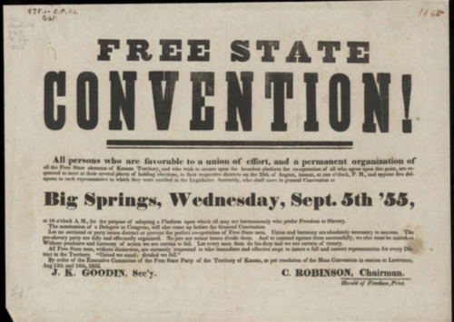
Back In Kansas - The Lecompton Constitution
Proslavery government (in Lecompton) - wrote a constitution that protected slavery.
Voted down by Free-soilers (greatly outnumbered slave supporters).
Pres. Buchanan - supported Lecompton Constitution.
Stephen Douglas angry! – pro popular sovereignty.
Douglas - convinced Congress to authorize another referendum (population vote) on the Lecompton Constitution - voted down again.
Northern Democrats - Douglas is a hero!
Southern Democrats - Douglas is a traitor!
Kansas was eventually admitted as a free state in 1861.

Slide 14
Dred Scott v. Sanford
Background on the Scotts
Born a slave in VA.
Taken to Illinois and Wisconsin territory.
Returned to St. Louis.
Sued for his freedom when his master died.
Could freedom granted in a free state be taken away by returning to a slave state?
Ruling
Scott lacked legal standing because he was a slave and did not have citizenship – therefore can’t sue anyone.
Slaves were property, and the 5th amendment states that Congress can’t take property without due process.
Congress had no authority to deprive persons of their slave property anywhere, whether a state was “free” or “slave.”
Summary
States could prohibit slavery, but the federal government had no authority on the issue.
Missouri Compromise had deprived citizens of their right to own slaves and was therefore unconstitutional.
Challenged popular sovereignty.

Slide 15
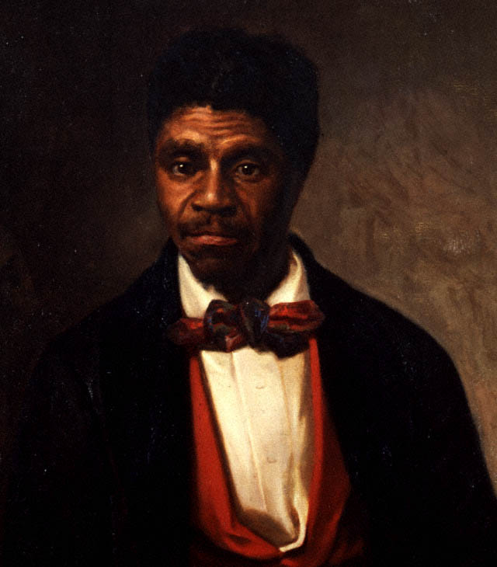
Dred Scott Continued.
Court ruling - immediate explosion of the sectional debate.
Southerners happy! – promotes unlimited expansion of slavery in the territories.
Buchanan timidly endorsed the Dred Scott decision - also trying to resolve controversy in Kansas.
Continuing fights over control of the territorial government had left no clear majority for or against slavery.
The Kansas controversy would also add to the sectional crisis…

Slide 16
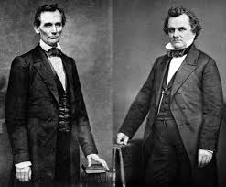
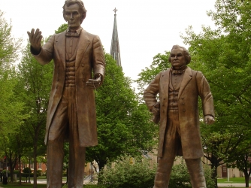
Lincoln-Douglas Debates
During this crisis…Congressional elections of 1858.
One important Race: Illinois Senate Race.
Held 7 debates around the state.
Difference between candidates.
Democrat S. Douglas – experienced and poised for a run for President.
Republican A. Lincoln – newbie and one time congressman.
Views on slavery.
Douglas
Popular sovereignty – let states choose.
Lincoln
Did not think the two races could live together as equals.
Opposed expansion of slavery – but not an abolitionist.
Thought it would die a natural death

Slide 17
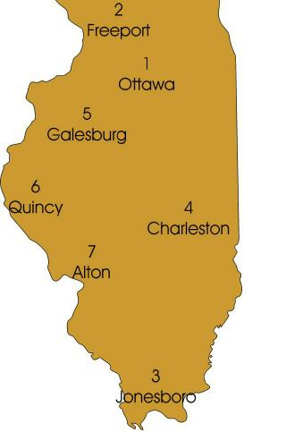
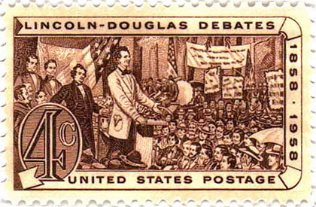
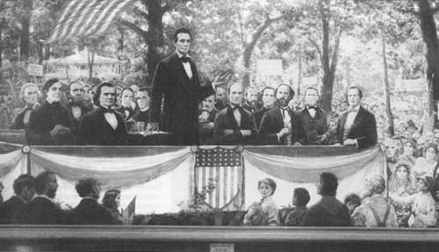
The Freeport Doctrine
In the Second Debate…
Lincoln asked how Douglas could reconcile popular sovereignty with Dred Scott ruling.
His answer: Freeport Doctrine – Slavery could not exist anywhere without support from the local police, regardless of what the SC says.
Douglas won the Senate seat – Lincoln had made himself nationally prominent.

Slide 18
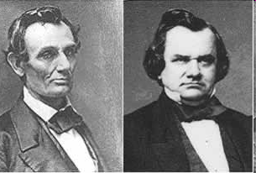
Lincoln-Douglas Debates
LINCOLN said…
A house divided against itself cannot stand
I believe this government cannot endure, permanently half slave and half free.
It will become all one thing or all the other.
Slavery is a MORAL ISSUE It is either right… or it is wrong.
DOUGLAS said…
In the Dred Scott Decision, the Supreme Court had decided the issue of slavery forever
Slavery was legal, if and when citizens voted to support it.

Slide 19
Harper’ Ferry
1859 - John Brown leads an attack on Harpers Ferry (arsenal – give guns to slaves to start an uprising).
His goal: lead a slave uprising in the South (using the weapons seized to arm slaves) – No slaves came and US troops/local militia arrived quickly.
Brown surrendered - was executed (hanged) along with his supporters shortly after trial.
Brown became a martyr for the abolitionist movement!
This promoted the ideas that:
White southerners that they could not live safely in the Union.
Abolitionist forces were willing to violently overthrow their way of life.
The perception that the Republican party had supported this raid (not true).

Slide 20
The Election of 1860
The Democratic Party - ripped in two…
Southerners who wanted slavery - John Breckinridge.
Moderate Northerners - Stephen Douglas.
Republicans - Abraham Lincoln
The Constitutional Union party - John Bell
Lincoln wins – only received 39% of the popular vote!
Fragmented election (four candidates running) – wins the majority of electoral votes.
The Southern response - immediately demanded an end to the Union.
South Carolina called a special convention to discuss secession….

Slide 21
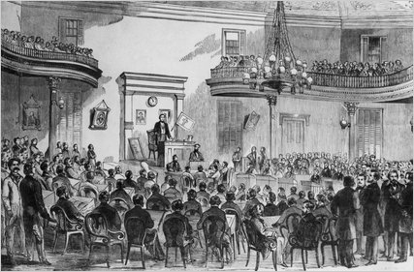
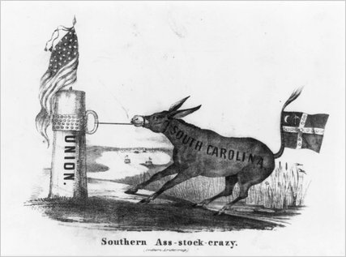
Southern Secession
Secession Convention held - “Republic of South Carolina” is declared on Dec 20th, 1860.
Question: Can a state legally secede?
Response:
Buchanan’s response - Believed the south couldn’t constitutionally succeed, but…
Lame Duck president and surrounded by pro-slavery advisors – therefore ineffectual.
Last attempt at compromise…Crittenden Compromise- Guaranteed protection south below 36-30 and allow expansion above the line (by popular sovereignty).
Lincoln rejects it!

Slide 22
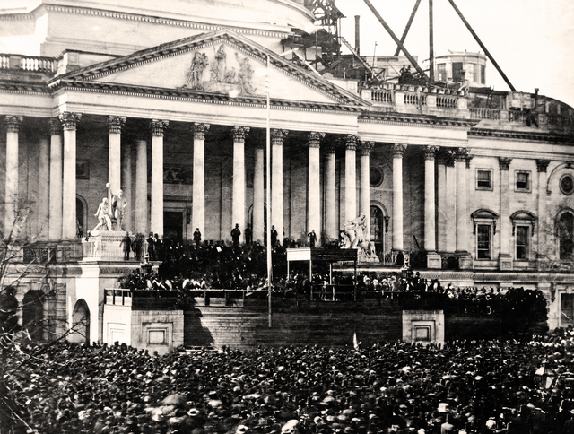
Southern Secession Continued…
By Feb 1861 - 6 other states had seceded (Fl, Ga, Ms, Al, La, Tx).
Seized all federal property within their boundaries - Forts, arsenals, govt. offices, etc.
Formed Confederate States of America ( Jefferson Davis elected as President).
Montgomery, Al - capital (later moved to Richmond, VA).
March 1861 – Lincoln enters the oval office…NOW WHAT!?
Stay Tuned!

