Slide 1
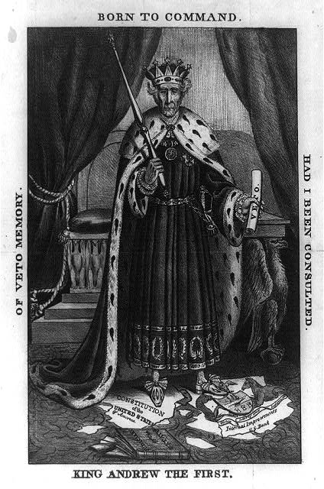

Slide 2
Context
Simple Example:
The historical context is there is the Election of 1832 between the Jackson Democrats and Whig Party.
Complex Example:
The Election of 1832 pitted the Jackson Democrats campaigning for the common man against the Whigs who supported national policies, such as a national bank and protective tariffs.

Slide 3
Audience
Simple Example
The intended audience is people who do not like Jackson as an abuser of power.
Complex Example
The cartoonist appealed to potential undecided voters to garner support for the Whig candidate by criticizing Jackson's abuse of power.

Slide 4
PURPOSE
Simple Example:
The purpose of the political cartoon is to make Andrew Jackson look like an absolute monarch and abuser of power.
Complex Example:
The cartoon intends to expose President Jackson as an absolute monarch rather than be limited by the U.S. Constitution.

Slide 5
Point of View
Simple Example:
The point of view of the artist is he is critical of Andrew Jackson since he drew him as a king and destroyer of the Bank.
Complex Example:
The portrayal of Jackson as an absolute monarch stems from a pro-Whig advocate of the Bank of the United States.

Slide 6
Unraveling an APUSH DBQ
Thesis, Structure (Road Map), Context, Outside Information, Synthesis, Document Analysis and HIPP

Slide 7
FIRST
Read the prompt: List all SFI you
can think of before reading the
documents: Outside Information
SECOND
DBQ Breakdown
Notes:
To view this presentation, first, turn up your volume and second, launch the self-running slide show.

Slide 8
Third
Structure
Create an outline
P1: Introduction with Thesis, Context and “road map” (Structure)
Body P2: Evidence #1
Body P3: Evidence #2
Body P4: Evidence #3
P5: Conclusion, including Synthesis
Notes:
Presentations are a powerful communication medium.

Slide 9
Next
Place your OI and Documents into the outline.
Then: Write
Introduction Paragraph with thesis statement (1 point) and Context (1 point) and Road Map/ Structure (1 point)
Context: What generally had been going on in this era or previously with this general theme? This must be 2-3 sentences. Make sure it’s relevant! Does not suppot or refute your thesis.
During the era of…, it was a time of…, it had evolved or changed into…
Watch out for fluff!!

Slide 10
Remember
No first person
Use at least 6 of the documents
Use outside information
Don’t make up information. Before you write, do a fact check: Are you sure this is fact? Did you read it somewhere or did we talk about it?
Is your information (especially counterclaim, synthesis and context) relevant? Does it help prove your argument or is it altogether different stuff?
Well, duh factor.
Example: “There were casualties during the war.”

Slide 11
Analyzing Documents
For EACH Document that you are using, include at least 3 sentences:
1 sentence of description: “in the painting depicting the Trail of Tears, thousands of Cherokee are forced off their land… (Document G)”
1 sentence of HIPP: The point of view is to show the audience the pain and suffering that was endured when more than 25% of the Cherokee population was killed during this event.”
1 sentence that ties back to your thesis: “This proves that Jacksonian Democrats were not guardians of liberty because a significant population residing within the United States were stripped of their life, liberty and happiness.”

Slide 12
Analyzing Documents
For EACH Document that you are using, include at least 3 sentences:
1 sentence of description: “John C. Calhoun addresses Congress about his fears that territorial expansion may lead to disunion (Document B)”
1 sentence of HIPP: “Calhoun’s purpose is to convince the legislature that a system of roads and canals– the American System– is a method of keeping the Union united.”
1 sentence that ties back to your thesis: “This contributes to the idea that this time was an era of good feeling because the disunity caused by westward expansion could be solved and was supported by creating geographical lines of communication.”

Slide 13
Analyzing Documents - HIPP
Elaborate on ONE of the following for EACH document
Context- What events, trends surrounded this document (map, chart)
The early 19th century was a time of market revolution when men left the home to work in factories. The abuse of labor in these factories led George Evans to write his “Working Men’s Declaration of Independence.” (Doc A)
Audience - Who is the intended primary audience? Who else would hear or see it?
Jackson’s bank veto message was written to appeal mostly to western and southern farmers. (Doc B)
John Randolph’s address is meant for Congress, so it should know of its duties to regulate commerce. (Doc A)

Slide 14
Analyzing Documents - HIPP
Point of view - Who wrote this document? Adjectives to describe him/her/them?
Calhoun’s point of view in his address is that he fears territorial expansion may lead to sectionalism (Doc B)
Daniel Webster is writing from the perspective that he feels Jackson is overstepping his executive power by vetoing the bank charter. (Doc C)
Purpose - What is the author trying to accomplish? Why?
The painting clearly illustrates the Cherokee Indian Removal with the purpose of showing the massive amount of people affected and the hardships they endured (Doc G)
One of the purposes of the 2 presidential election maps is to illustrate the emergence of a new party system, including competing factions within the Republican party.
Underline it! Underline the HIPP phrase or sentence that you use for each document

Slide 15
4. Citing the Documents
Never write, “According to Document A, ….”
DO write, “The government condoned and encouraged Americans to move west and settle on Native American lands. (Document A)
DO write, “According to an 1879 flyer, the government was encouraging the settlement of millions of acres of Native American lands in Kansas. (Document A)

Slide 16
Using Specific Facts as Evidence (SFI)
Make sure to include at least 2-3 pieces of Outside Information: specific facts (people, laws, events) not referenced in the documents to support each category
Always tie the evidence back to your thesis. How does this information help to prove your thesis is true?

Slide 17
Avoid…
Just describing the documents. This only proves that you can read.
Quoting from the documents. You can and should use the document as evidence without quoting!

