Slide 1
The Election of 1860 & Secession
HIS 103

Slide 2
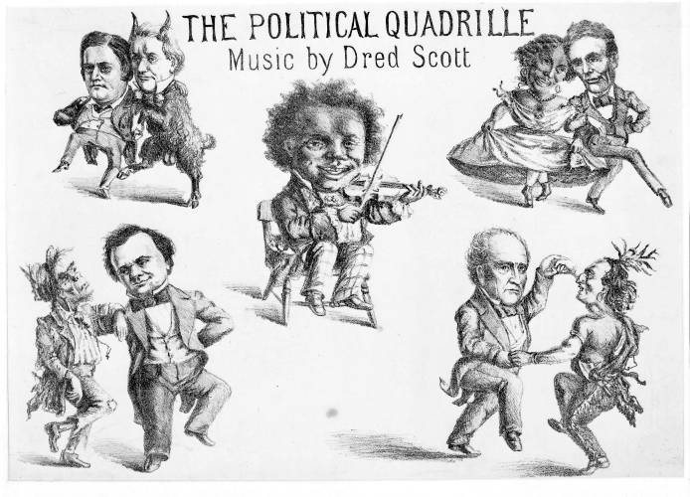
The Candidates
Southern Democrats:
Nominated John Breckenridge
Platform called for slave code for territories
Northern Democrats:
Nominated Stephen Douglas
Platform endorsed Freeport Doctrine
Republicans:
Nominated Abraham Lincoln
Platform denounced slavery but also Brown’s raid
Constitutional Union party:
Nominated John Bell

Slide 3
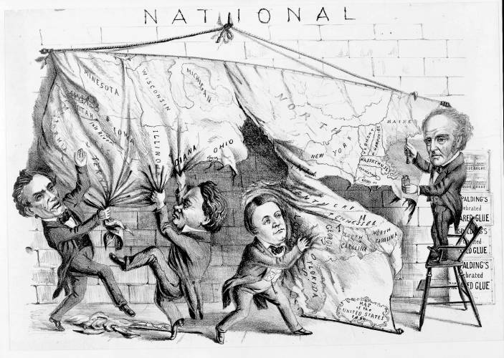
1860 Political Cartoon

Slide 4
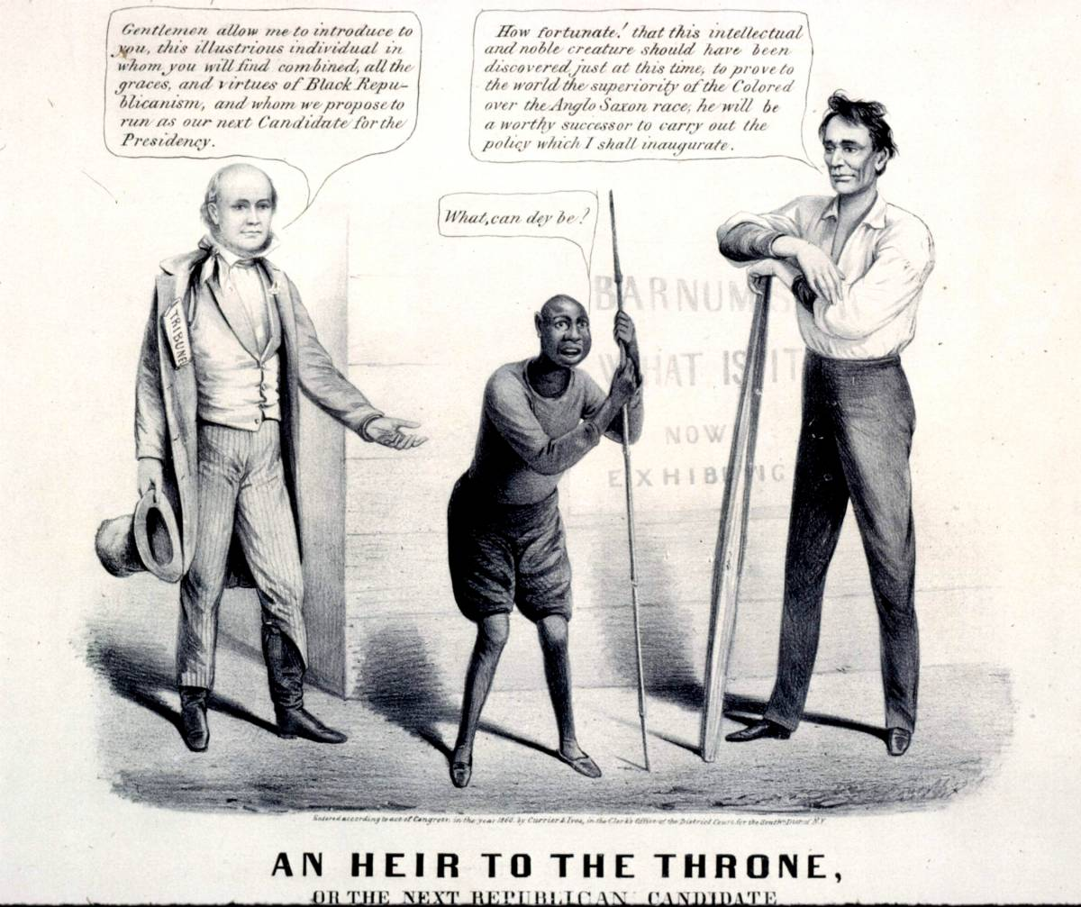
1860 Political Cartoon

Slide 5
The Election of 1860
Republicans focused on corruption in Buchanan Administration
Southern Democrats spread rumors of slave uprisings
Douglas spent last weeks of campaign in South, warning against secession
Lincoln won without receiving any Southern votes

Slide 6
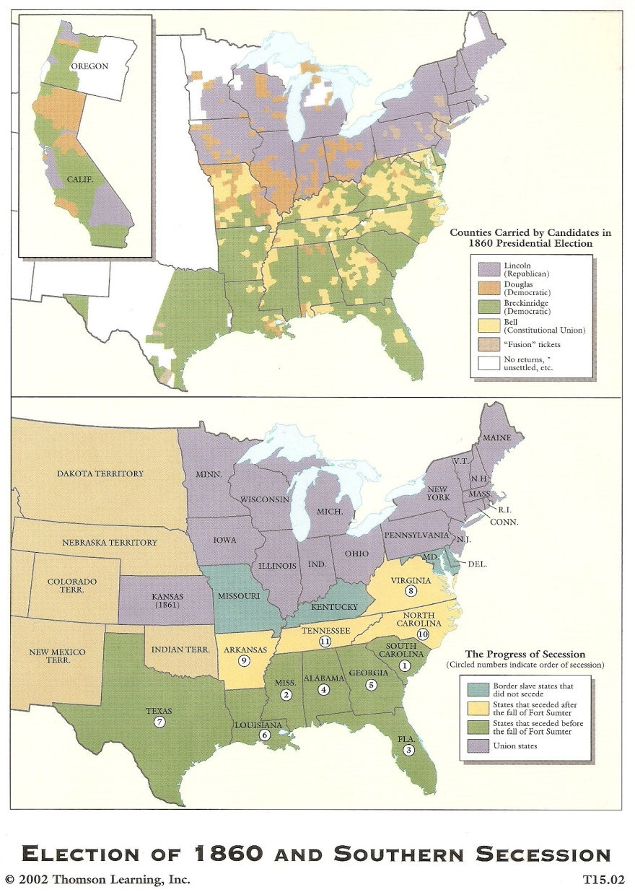
Secession
80% average approval of secession in state conventions
Declarations made it clear slavery was underlying cause
Defense of secession based on 2 arguments:
State sovereignty preceded national sovereignty
Right of revolution

Slide 8
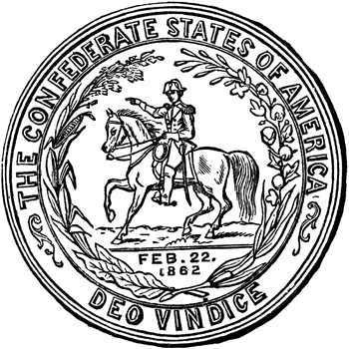
The Confederate States of America
Constitutional convention met in Montgomery, Ala. Feb. 4, 1861
Mostly copied U.S. Constitution
Emphasized states’ rights
Guaranteed protection of slavery
Provisional government established:
Jefferson Davis named President
Alexander Stephens named Vice President

Slide 9
FACTS ABOUT THE CIVIL WAR
Most tragic moment in American history----the struggle for the heart and soul of America.
Equality of all men in question
Both sides fighting to preserve their traditions
Brother vs brother---family vs family
1 out of 4 soldiers would die in this conflict
10,000 battles in the Civil War
War has been called the War for Southern Independence and the War Against Northern Aggression.

Slide 10
FACTS ABOUT THE CIVIL WAR
War would destroy 1 America and build another.
Almost as many died in this war as all wars combined before and since.
It is America’s bloodiest war.
1 out of 7 Civil War soldiers injured would die in field hospitals, whereas, in the Vietnam War, 1 out of 270 injured soldiers would die in MASH units.
First war of the Industrial Revolution---new weapons would cause massive destruction against outdated military tactics.

Slide 11
Inauguration of Jefferson Davis

Slide 12
Northern Responses
Buchanan denounced secession as unconstit-utional, but said it couldn’t be stopped by force
Blamed it on Republicans
Called for obedience to Fugitive Slave law, amendment to protect slavery & annexation of Cuba
Lincoln said revolution was only a “moral right when exercised for a morally justifiable cause”
Radical Republicans preferred peaceful separation to any further compromises

Slide 13
Last-Ditch Compromise Attempts
Crittenden Compromise in Senate offered 6 unrepealable amendments
House proposed 3 compromises:
Admitting New Mexico as slave state
Resolution calling for obedience to Fugitive Slave law & repeal of personal liberty laws
13th Amendment to guarantee slavery against any future interference

Slide 14
The Failure of Compromise
Crittenden Plan: extend the Missouri Compromise line to the Pacific
Lincoln rejects
does not think it will end secession
viewed as repudiation of Republican principles
Buchanan takes no action to stop secession
Some wish to “let the South depart in peace”

Slide 15
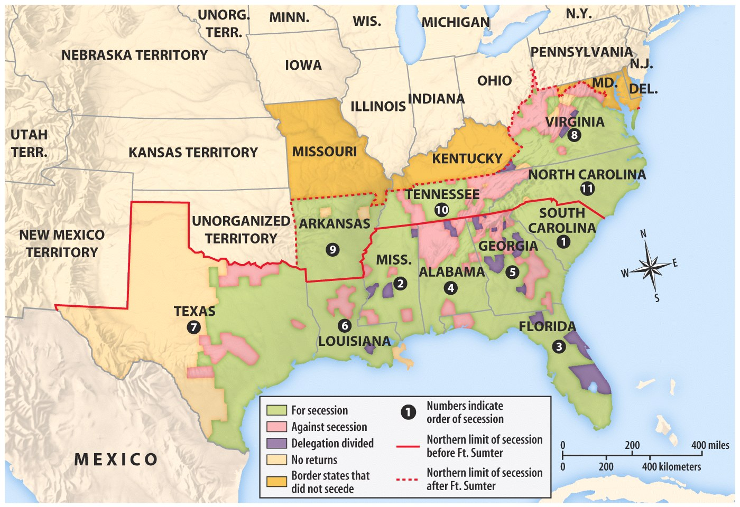

Slide 16
Lincoln’s First Inauguration, 1861

Slide 17
The War Begins
Lincoln’s decision to resupply Ft. Sumter was stroke of genius
Fulfilled Inaugural Address pledge to hold federal property in rebel states
Forced rebels to make decision to start war
Davis decided to take fort before resupply ships arrived
Beauregard shelled fort April 12-13, 1861
Anderson surrendered April 13
Lincoln called for 75,000 volunteers to put down rebellion on April 15
Va., N.C., Tenn. & Ark. Seceded & joined CSA

Slide 18
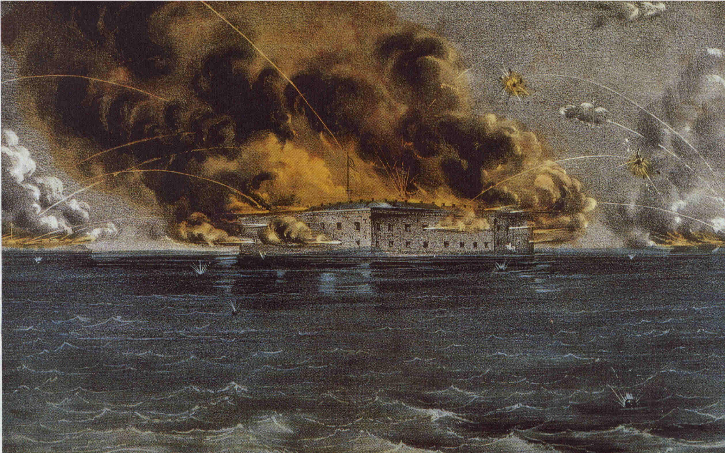
The Attack on Ft. Sumter

Slide 19
And the War Came
North seeks action to preserve Union
April 13, 1861--Fort Sumter, S.C, falls
April 15--Lincoln calls out Northern state militias to suppress Southern insurrection
April-May--Upper South secedes
Border states--slave states remain in Union
War defined as effort to preserve Union

Slide 20
Secession

Slide 21
Adjusting to Total War
North must win by destroying will to resist
Total War--a test of societies, economies, political systems as well as armies

Slide 22
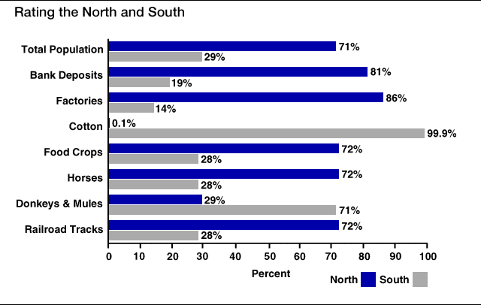
Resources…

Slide 23
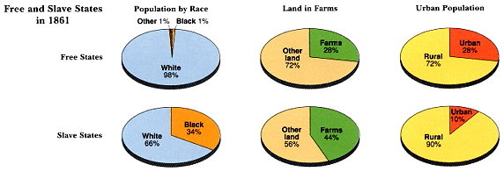
Slave/Free States Population, 1861

Slide 24
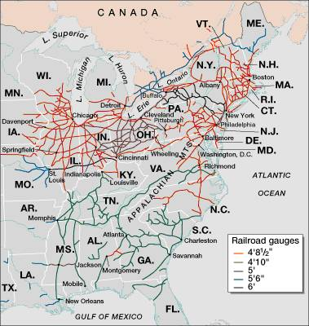
Railroad Lines, 1860

Slide 25
Prospects, Plans, and Expectations
South adopts defensive strategy--North must fight in unfamiliar, hostile terrain
Lincoln adopts two-front strategy
capture Confederate capital, Richmond, Va.
seize control of the Mississippi River
deploy navy to blockade Southern ports

Slide 26
Lincoln wrote to the antislavery editor Horace Greeley in August 1862, even as he was about to announce the Emancipation Proclamation:
“If I could save the Union without freeing any slave, I would do it; and if I could save it by freeing all the slaves, I would do it; and if I could do it by freeing some and leaving others alone, I would also do that.”

Slide 27
Jefferson Davis On the War
"I tried all in my power to avert this war. I saw it coming, for twelve years I worked night and day to prevent it, but I could not. The North was mad and blind; it would not let us govern ourselves, and so the war came, and now it must go on till the last man of this generation falls in his tracks, and his children seize the musket and fight our battle, unless you acknowledge our right to self government. We are not fighting for slavery. We are fighting for Independence, and that, or extermination".........

Slide 28
Regarding the Civil War, the London Times (November 7, 1861) editorialized
“The contest is really for empire on the side of the North and for independence on that of the South, and in this respect we recognize an exact analogy between the North and the Government of King George III, and the South the Thirteen Revolted Provinces.”

Slide 29
Abraham Lincoln (1809-1865), Kentucky born like Jefferson Davis, was aware of Kentucky’s crucial importance. In September 1861 he remarked,
“I think to lose Kentucky is nearly the same as to lose the whole game. Kentucky gone, we cannot hold Missouri, not, I think, Maryland. These all against us, and the job on our hands in too large for us. We would as well consent to separation at once, including the surrender of this capital, Washington, D.C.

Slide 30
LINCOLN'S "NECESSARY" ACTIONS
Suspended “civil liberties” or parts of the Constitution
writ of habeas corpus: Protects from unfair arrest and trial by jury.
Occupation of Baltimore: Controlled by military---- “martial law”
Arrested over 15,000 civilians: Without “probable cause”---suspicious “Rebel” sympathizers.
Closed “rebel” newspapers: Violated 1st amendment rights of “free speech and press”.
First Income Tax
Greenbacks
1st paper money

Slide 31
Overview of Civil War Strategy

Slide 32
Union Strategy
Anaconda Plan
Naval blockade surrounding the CSA
Mississippi River
Divide the CSA in two
Richmond
Capture the capital with trained urban fighters

Slide 33
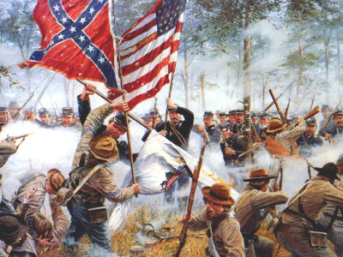
Turning Points of the Civil War
First Battle of Bull Run (July 1861)
First major battle of the war
Union significantly defeated by Confederates
Myth of quick war leads to realization of long and costly war
Antietam (September 1862)
Robert E. Lee defeated by George McClellan
Bloodiest day in war: 22,000 killed or wounded
Lincoln soon issues Emancipation Proclamation
Vicksburg (May-July 1863)
Union control of the Mississippi River, cutting the CSA in two
Gettysburg (July 1863)
CSA’s Lee’s offensive into Pennsylvania to force peace by the Union or earn foreign support
Pickett’s Charge and failure and near destruction of CSA military
Deadliest battle of the entire war: over 50,000 casualties
Widely considered the turning point of the war for a Union victory

Slide 34
Mobilizing the Home Fronts
1862--North & South begin conscription
Northern mobilization
finance war through taxes, bonds, paper money
private industry supplies Union armies well
Confederate mobilization
government arsenals supply Confederate armies
efforts to finance lead to runaway inflation
transportation system inadequate

Slide 35
Political Leadership: Northern Success and Southern Failure
Lincoln expands wartime powers
declares martial law
imprisons 10,000 "subversives" without trial
briefly closed down a few newspapers
Jefferson Davis
concerned mainly with military duties
neglects civilian morale, economy
lacks influence with state governments

Slide 36
Early Campaigns and Battles
Northern achievements by 1862
total naval supremacy
Confederate troops cleared from West Virginia, Kentucky, much of Tennessee
New Orleans captured
Confederate achievements by 1862
stall campaign for the Mississippi at Shiloh
defend Richmond from capture

Slide 37
Extensive Legislation Passed Without the South in Congress
1861 – Morrill Tariff Act
1862 – Homestead Act
1862 – Legal Tender Act
1862 – Morrill Land Grant Act
1862 – Emancipation Proclamation (1/1/1863)
1863 – Pacific Railway Act
1863 – National Bank Act

