Slide 1
Ending the Civil War
Mr. Winchell
APUSH Period 5

Slide 2
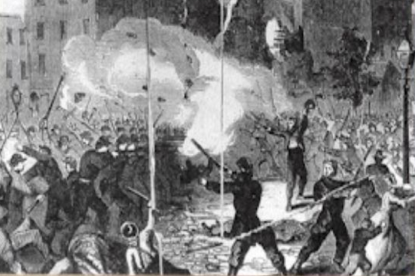
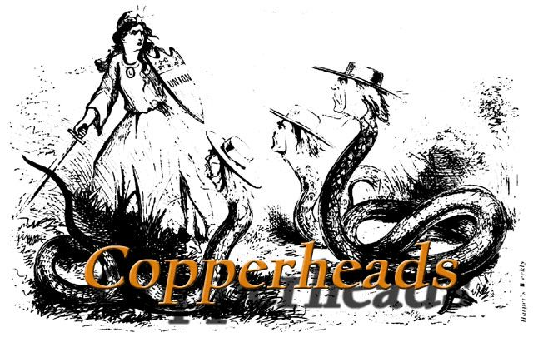
The Tide Turns in 1863
By early 1863, the North & South both faced morale problems:
South—economic & diplomatic collapse, runaway slaves, & many yeomen refused to fight
North—consistent losses against Lee, draft riots in NYC, anti-war “Copperheads” played on war failures & racial anxieties
New York City Draft Riot

Slide 3
Fight to the Finish
But by 1863, the war began to turn in favor of the North:
Northern supremacy in industry & manpower began to take its toll on the exhausted South
The North began enlisting blacks into the Union army; 200,000 fought as soldiers & many others served as labor in the Northern war effort

Slide 4
Sherman Scorches Georgia
Georgia’s conquest:
Entrusted to General William Tecumseh Sherman
He captured Atlanta in September 1864, burned the city in November 1864
Sherman with 6000 troops cut a sixty-mile swath of destruction through Georgia
Major purposes of Sherman’s march:
destroy supplies destined for the Confederate army
weaken the morale of the men at the front by waging war on their homes (see Map 21.6)

Slide 5
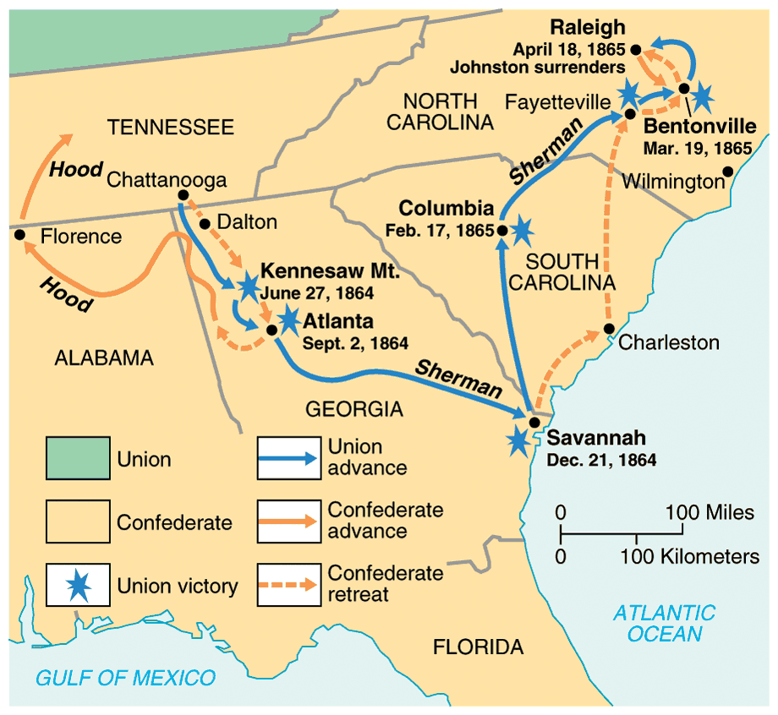
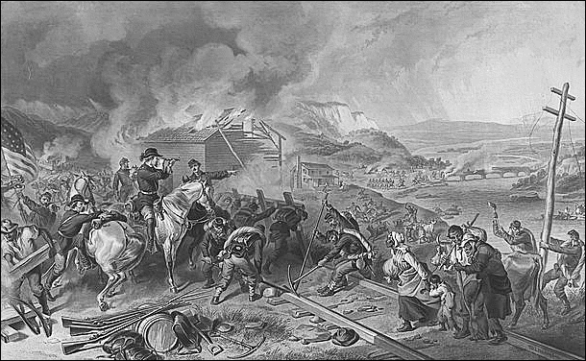
The Civil War
Grant began a siege on Richmond and…
Due to Grant’s success in the west, Lincoln made Grant supreme commander of Union army in 1864; Grant devised a strategy to invade the South on all fronts
In July 1863, General Grant took Vicksburg & gained control of the Mississippi River
Lee led an attack into the North, but lost at Gettysburg; North’s 1st real victory in the east
William Sherman began his “march to the sea” (Atlanta to Savannah) & destroyed everything of military value

Slide 6
Sherman Scorches Georgia
Sherman was a pioneer practitioner of “total war”:
His success in “Shermanizing” the South was attested by increasing numbers of Confederate desertions
All his methods were brutal
He probably shortened the struggle and hence saved lives
The discipline of his army at times broke down
After seizing Savannah as a Christmas present for Lincoln, his army veered north into South Carolina, where the destruction was even worse:
Sherman’s conquering army rolled deep into North Carolina by the time the war ended

Slide 7
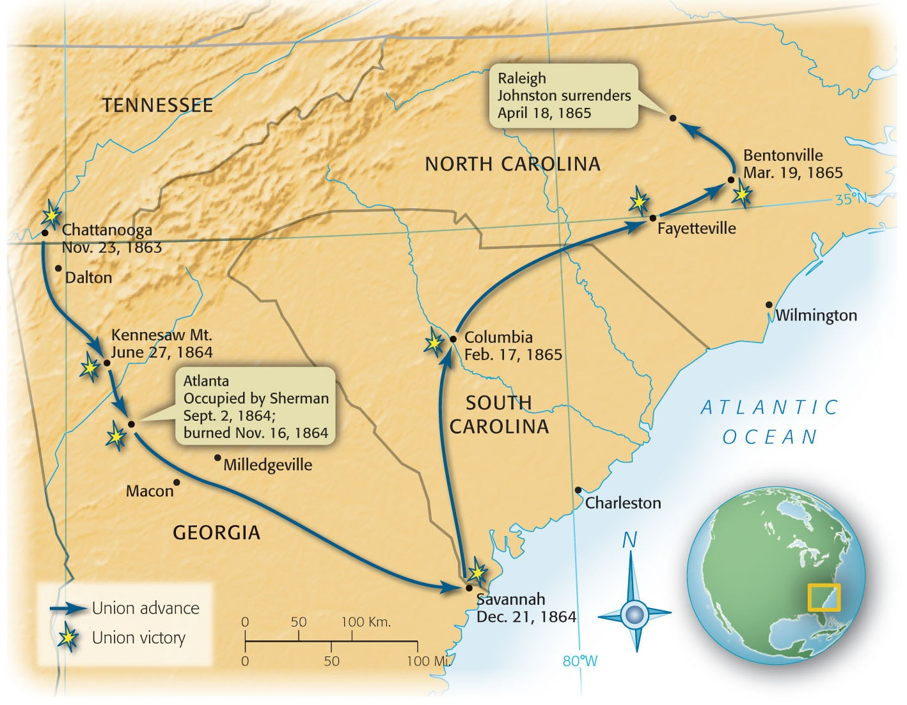
Map 21-6 p450
Notes:
Map 21.6 Sherman’s March, 1864–1865

Slide 8
Sherman’s Neckties

Slide 9
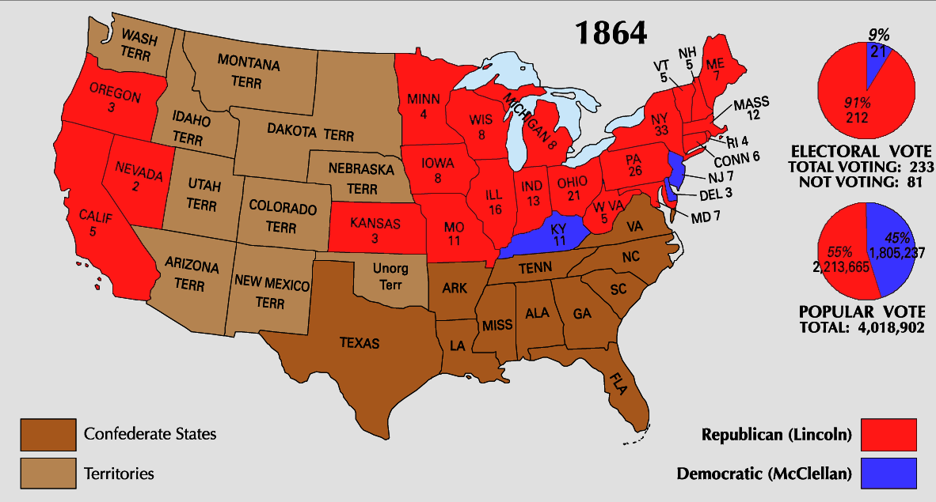
Election of 1864
Meanwhile, Lincoln faced a tough re-election in 1864 against General George McClellan:
War failures were a key issue
Radical Republicans considered dropping Lincoln from the ticket
But, when Atlanta fell during Sherman’s “March to the Sea,” Lincoln regained support and was overwhelmingly reelected
In his 2nd inaugural address, Lincoln promised a Reconstruction Plan for the Union with “malice towards none & charity for all”

Slide 10
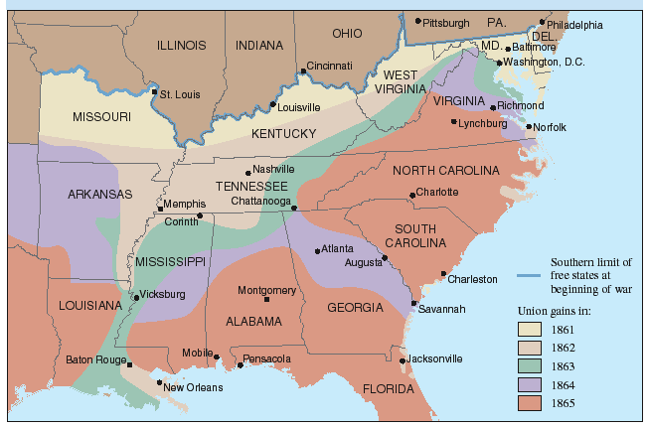
Union Gains in the Civil War by 1865
In April 1865, Grant faced off with Lee outside Richmond;
Lee was cut off from the South

Slide 11
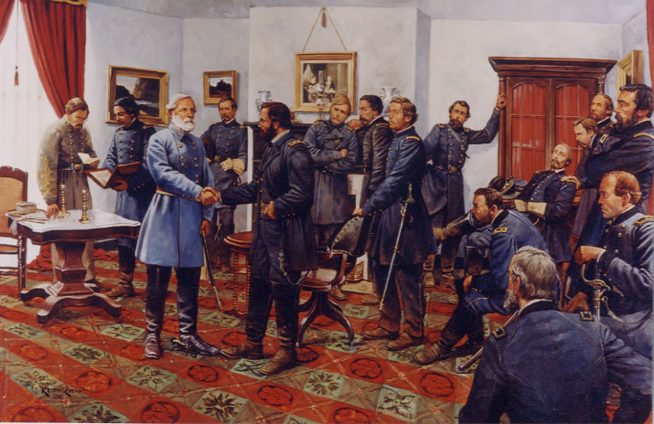
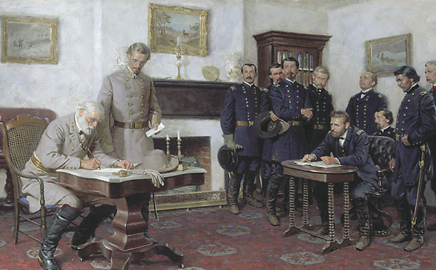
On April 9, 1865, Lee surrendered to Grant at Appomattox Courthouse, ending the fighting of Civil War

Slide 12
https://www.youtube.com/watch?v=Q344cZglv8E

Slide 13
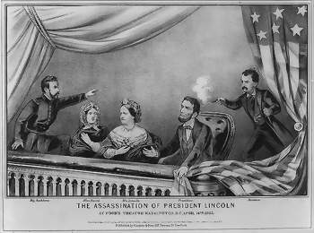
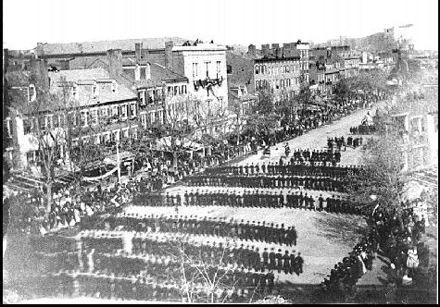
The Death of Lincoln
Northern celebration was short lived; On April 14, 1865, Lincoln was shot by pro-Southerner John Wilkes Booth

Slide 14
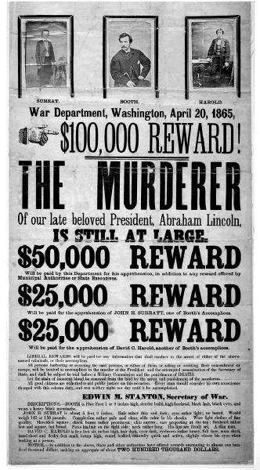
The Assassination of Lincoln
April 14th, 1865 (5 days after Lee had surrendered) - John Wilkes Booth assassinated President Lincoln.
He and his wife were watching a play at Ford’s Theatre in DC.
The plot also included targeting the VP and Sec of State.
Lincoln expired in the arms of victory, at the very pinnacle of his fame
His dramatic death erased the memory of his shortcomings and caused his nobler qualities to stand out in clearer relief
Negative impact on the South – Lincoln’s plan for southern state re-entry – easy without harsh punishments.
However…that didn’t happen once the Radical Republicans in Congress controlled Reconstruction.

Slide 15
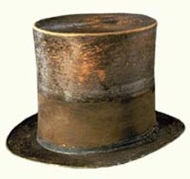
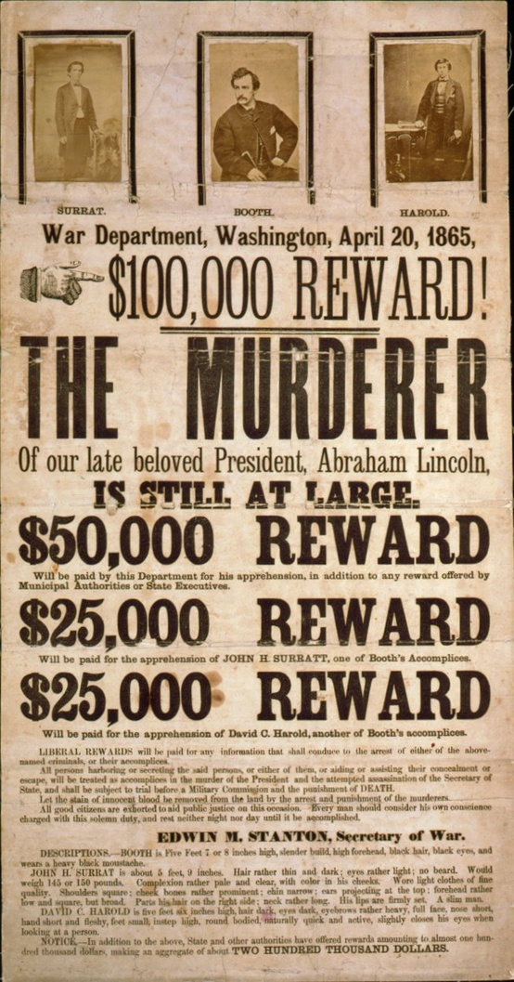
More on Lincoln’s Assassination
Lincoln had been plagued by dreams predicting his death
Sic Semper Tyrannis (Thus Always to Tyrants)
“The South is Avenged”
Irony
Lincoln’s Death hurt the south
Lincoln was planning on being very lenient to the Confederate States
Many other politicians wanted to stick it to the south, and now they had their chance

Slide 16
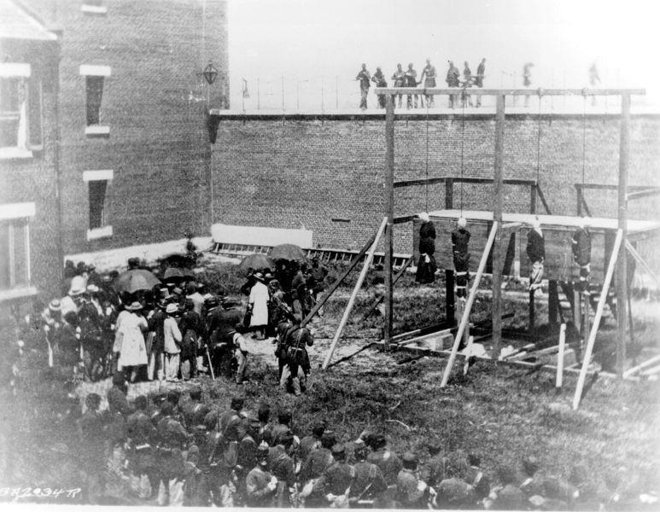
All Assassins Are Hung

Slide 17
The Outcomes of the War
The Nation is changed!
Economic cost: estimated $3.5 billion
North takes off economically!
South is absolutely devastated (everything is burned and needs to rebuilt and their economic system is gone).
Human Cost – 360K in N and 260K in S. Wounded – 275K in N and 225K in S.
Political Outcome - 13th amendment is passed (no more slavery).
Narrowly passing Congress (approved by ¾ of the states - including southern ones).
What to do with all these freed slaves???

Slide 18
Effects of the War
Social changes:
618,000 troops were dead
Women in both the North & South were forced to take on more non-domestic roles
13th Amendment ended slavery
Nativism decreased as many immigrants fought in Civil War

Slide 19
Effects of the War
Ended the Southern argument over nullification & states’ rights
Political changes:
The Civil War established that the national gov’t is supreme over the states
With no Southern opposition, Republicans passed new laws: Homestead Act (1862), Morrill Act (1862), a protective tariff, land grants to RR companies, & a national banking system
Notes:
gave free land to western settlers
created new colleges

Slide 20
The Aftermath of the Nightmare
The extreme states’ righters were crushed
The national government, tested in the fiery furnace of war, emerged unbroken
Nullification and secessions were laid to rest
The Civil War was the supreme test of American democracy
The preservation of democratic ideals was subconsciously one of the major objectives of the North

Slide 21
North/West: Political Effects
Republican Congress pushed through their agenda unopposed
Homestead Act of 1862
Any one could claim up to 160 acres of land and buy it for a cheap price after living/farming it for 5 years
Morill Land Grant of 1862
Set public land aside for public education (Land-Grant Colleges)
Tariff Bills
Without the South to resist the North jacked up tariffs to protect America’s growing industry
Construction began on the Transcontinental Railroad
National Bank Act
Banks could join national banking system
Could then buy gov’t bonds and issue paper currency
Created first national banking system since Jackson killed the Bank of the US in 1836
Infringement on Civil Liberties
“supervised” voting
Writ of Habeas Corpus
Freedom of Speech
Abolishment of Slavery
Confiscation Acts: Union army could confiscate any Confederate property including slaves (essentially freed slaves when the Union army took over)
Emancipation Proclamation: freed all slaves in CSA territory
13th Amendment: banned slavery
Massive Expansion of Federal Power
Aggressively enforce laws
Protect Civil Rights
14th Amendment granted citizenship to all African-Americans
1st Social Welfare program (Freedmen’s Bureau)
Print currency
Conscription

Slide 22
Conclusions
The turning point of the war: 1863
The Civil War began as a conflict “to preserve the Union,” but by 1863 it became a war for human liberty (Emancipation Proclamation was issued)
The South dominated the early campaigns of the war, but by 1863 (Gettysburg) the weight of Northern industry & population wore down the South

Slide 23
Let’s Laugh…

Slide 24
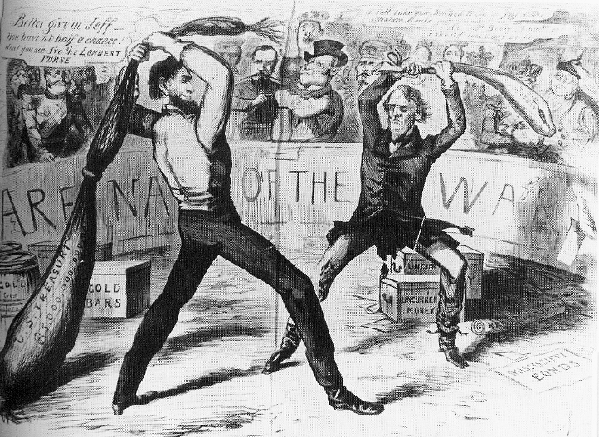

Slide 25
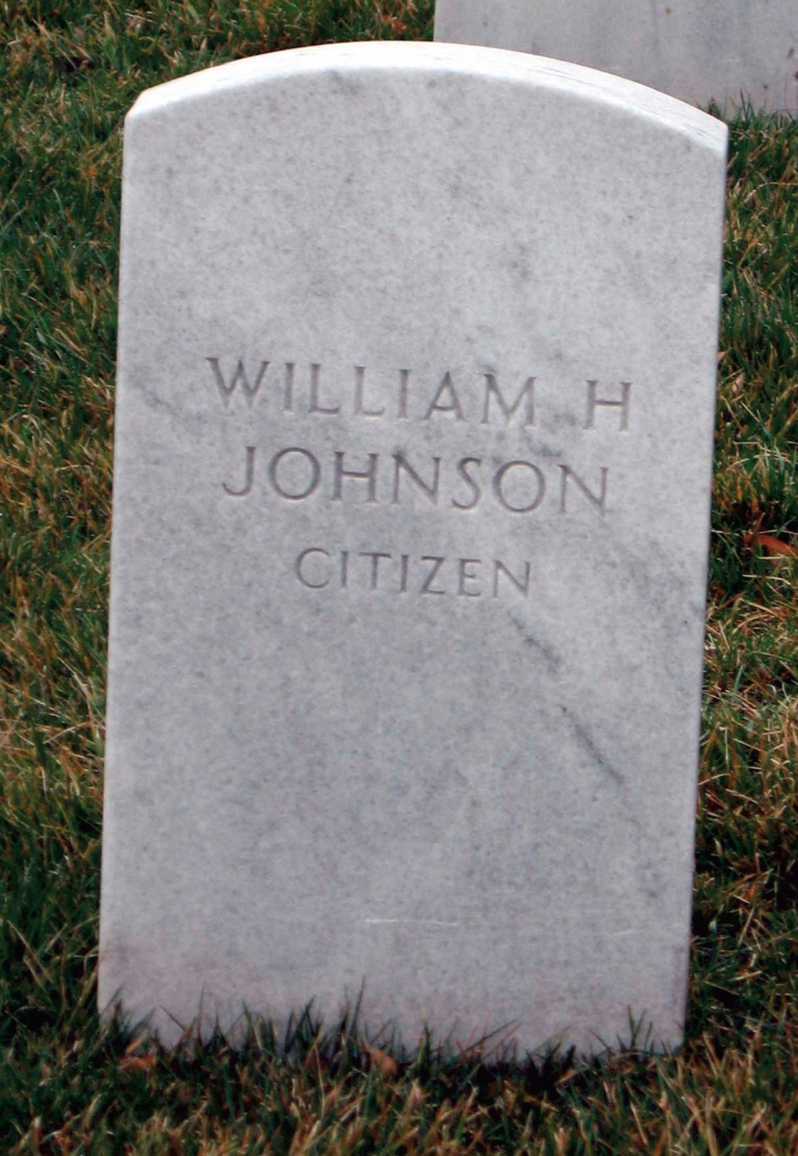
p461
Notes:
Grave of William H. Johnson, 1864 Johnson was a free
black man who worked as Lincoln’s personal valet in
Springfield and accompanied him to Washington, D.C. when
he assumed the presidency. When lighter-skinned mulatto
White House staffers rejected him for his dark skin, Lincoln
helped Johnson find other employment in the Treasury and
Navy Departments, writing “The bearer of this card, William
Johnson (colored), came with me from Illinois, and is a worthy
man, as I believe. A. Lincoln.” In November 1863 Lincoln
requested that Johnson accompany him to deliver his famous
address at Gettysburg, where they both contracted smallpox.
Lincoln recovered in a few days Johnson, with a more severe
case, died in January 1864. Lincoln arranged for him to be
buried at Arlington National Cemetery and wrote the one word
epitaph for his tombstone: “Citizen,” a succinct and
stinging rebuke of the racist reasoning of the Dred Scott
decision.

Slide 26
Discuss
Was the decision by Southern states to secede the best choice?
What was the problem?
In teams, brainstorm possible alternatives to secession the South could have taken in 1861
Would a legal argument in the Supreme Court (that the states agreed to join the Union & could leave at any time) have been more effective than its military tactic?

