Slide 1
The Roaring 1850’s…Kansas-Nebraska Act, Bleeding Kansas, Dred Scott and an Old man Getting Beaten with a Cane in the Senate
Mr. Winchell
APUSH
Period 5

Slide 2
Do Now Presented BY:
How did Westward Expansion increase sectionalism and tensions between North and South?
How did the expansion of industry (Period 4 SYNTHESIS!) increase sectionalism and tensions between North and South?

Slide 3
Compromise of 1850
Allowed for ‘Popular Sovereignty’ in the new territories of Utah and New Mexico.
California enters the Union as a free state.
Strengthens and enforces Fugitive Slave Act in the North.

Slide 4
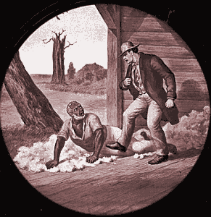
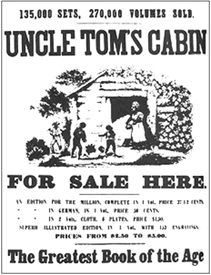
Uncle Tom’s Cabin
Book about the cruelty of slavery
Moved many to join the cause of abolition
Increased tension between the North and South

Slide 5
The Kansas-Nebraska Act
Proposed in May of 1854 by Stephen Douglass .
Centered on the notion of "Popular Sovereignty."
Concerned the land which had previously been decided upon by the Missouri Compromise of 1820.
Dividing the region into two territories.
Kansas: Popular Sovereignty would decide the slave status
Nebraska: Slavery was prohibited

Slide 7
Civil War in Kansas
Many Americans emigrated to Kansas in order to affect the vote on slavery.
Southern pro-slavery factions, called "border ruffians," fought heavily with northern abolitionists.
The term "Bleeding Kansas" describes the civil war that erupted in the new territory.
A Congressional committee was established in 1856 to deal with the problems in Kansas.

Slide 8
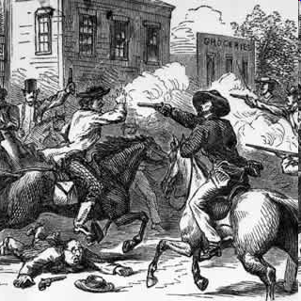
Bleeding Kansas
Northern and Southern settlers both flooded into Kansas
Supporters of slavery invaded an abolitionist town, burned a hotel, looted home and destroyed newspaper presses
Anti-slavery forces retaliated. Led by John Brown, they invaded a pro-slavery town, dragged five men from their homes killed them

Slide 9
Charles Sumner
Charles Sumner was the senator from Massachusetts and fierce critic of the Kansas-Nebraska Act
Sumner's address was not received well by southerners.
On May 22, Preston Brooks, entered the Senate chambers and violently attack Sumner, beating him mercilessly with a cane.
Republicans solidified their base by rehashing the details of the attack exhaustively in newspapers.
Increased support for the party was a direct result of the attack of Charles Sumner.

Slide 10
Birth of the Republican Party, 1854
Northern Whigs.
Northern Democrats.
Free-Soilers.
Know-Nothings.
Other miscellaneous opponents of the Kansas-Nebraska Act.

Slide 11
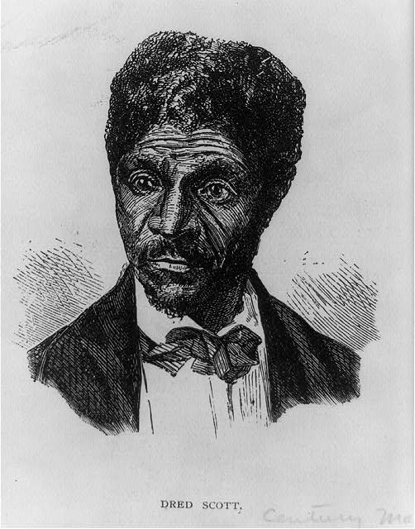
Dred Scott Decision
Dred Scott, a slave from Missouri, went to court and sued for his freedom on the grounds that when his master took him to free territories he was no longer a slave.
The U.S. Supreme Court had to decide…
Was he a Person or Property?
Hint: 4 Northern judges, 5 Southern judges

Slide 12
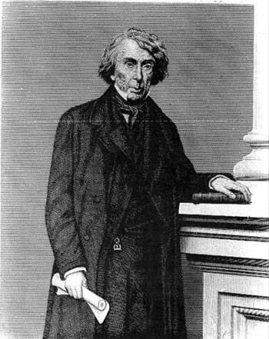
Chief Justice Roger Taney
Slaves were not citizens, so they could not sue in court
Slaves were property, so Congress did not have the power to ban slavery in any territory
Therefore, the Missouri Compromise was “unconstitutional”
Dred Scott remained a slave

Slide 13
Lincoln-Douglas Debates
The Kansas-Nebraska Act and the divisive nature of the slavery issue paved the way for the outbreak of the Civil War.
Stephen Douglas and Abraham Lincoln were running for a hotly contested Senate seat.
Lincoln and Douglas engaged in a series of debates that focused largely on slavery.
Although he lost the election, these debates launched Lincoln into national prominence which eventually led to his election as President of the United States.
Lincoln: “House divided upon itself cannot stand”

Slide 14
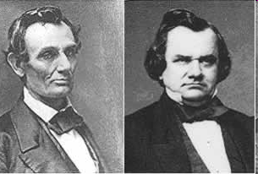
Lincoln-Douglas Debates
Before becoming president, Abraham Lincoln ran against Stephen Douglas for an Illinois Senate seat.
LINCOLN said…
A house divided against itself cannot stand
I believe this government cannot endure, permanently half slave and half free.
It will become all one thing or all the other.
Slavery is a MORAL ISSUE It is either right… or it is wrong.
DOUGLAS said…
In the Dred Scott Decision, the Supreme Court had decided the issue of slavery forever
Slavery was legal, if and when citizens voted to support it.

Slide 15
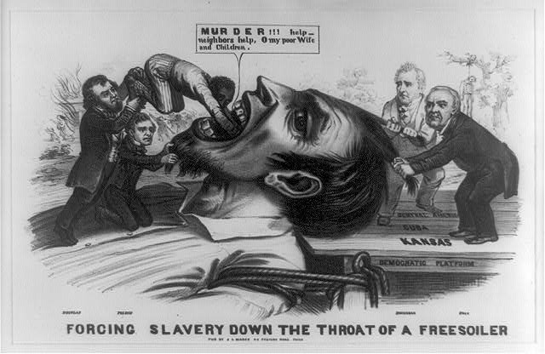

Slide 16
