Slide 1
RECONSTRUCTION
Mr. Winchell
APUSH
Period 5

Slide 2
QUIZ!
Just kidding…
Reconstruction Video

Slide 3
Key Questions
Who would direct the process of Reconstruction? The South itself, Congress, or the President?
Should the Confederate leaders be tried for treason?
How would the south, both physically and economically devastated, be rebuilt? And at whose expense?
How would the South be readmitted and reintegrated into the Union?
What should be done with over four million freed slaves? Were they to be given land, social equality, education, and voting rights?

Slide 4
The “New” Southern Economy
Former slaves were promised that they would receive land for themselves – 40 acres and a mule!
Land usually returned to the original plantation owners – former slaves rarely got land.
Owners wanted to return to a cash crop system similar to that used prior to the Civil War.
Northern merchants/textile mills encouraged this too.
Many former slaves returned to work on plantations as day laborers.
Many refused - worked in mills, factories, on railroads, etc.

Slide 5
3 Phases of Reconstruction
Presidential Reconstruction (1863-1866)
Congressional (or Radical) Reconstruction (1867-1877)
Redemption (1877-1900)

Slide 6
President Lincoln’s Plan
Ten Percent Plan
Proclamation of Amnesty and Reconstruction (1863)
Full presidential pardons to southerners who:
Took an oath of allegiance to the Union and the Constitution
Accepted the emancipation of slaves
State governments could be reestablished as soon as 10% of the population took the oath

Slide 7
Wade-Davis Bill
Required 50% of the number of 1860 voters to take an “iron clad” oath of allegiance
Required a state constitutional convention before the election of state officials
Enacted specific safeguards of freedmen’s liberties
Based on two ideas:
“State Suicide” Theory [MA Senator Charles Sumner]
“Conquered Provinces” Position [PA Congressman Thaddeus Stevens]

Slide 8
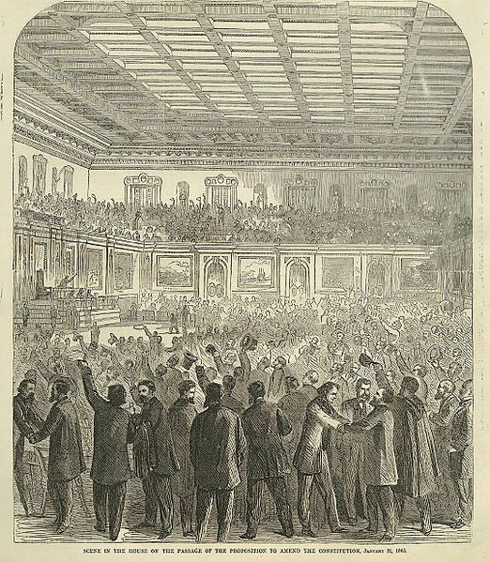
Thirteenth Amendment
Ratified in December, 1865
Neither slavery nor involuntary servitude, except as punishment for crime whereof the party shall have been duly convicted, shall exist within the United States or any place subject to their jurisdiction.

Slide 9
Freedmen’s Bureau
Provided food, shelter, medical aid for the destitute
Benefited both blacks (mostly freed slaves) and homeless whites
Had the authority to resettle freed blacks on confiscated farmland
Greatest success in education
Established almost 3,000 schools for freed blacks as well as several colleges

Slide 10
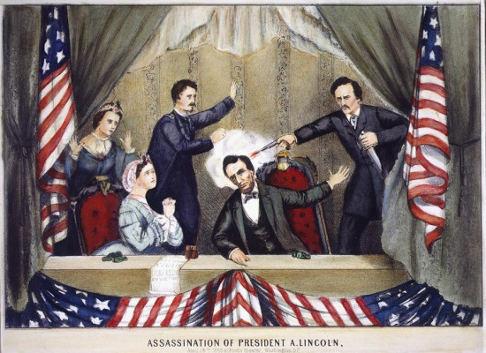
Lincoln Assassination

Slide 11
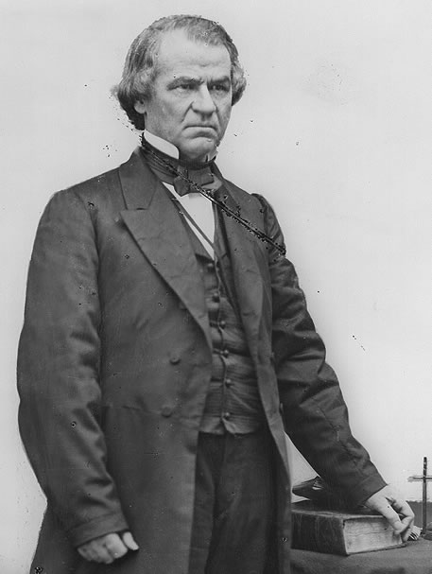
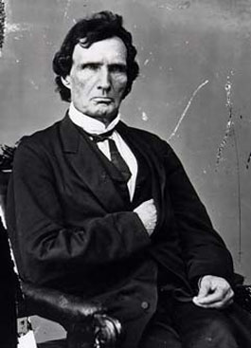
Conflicting Ideas on Reconstruction
Political Changes - Lincoln is dead and Andrew Johnson is now president. How will the South be brought back into the Union and the Nation “reconstructed?”
Lincoln’s 10% Plan – 10% of voters gave a loyalty oath, then they could form a new state government and re-enter the union (very lenient plan, presidential reconstruction).
Radical Republicans (led by Thaddeus Stevens) – wanted much harsher punishments for the South (esp. plantation owners) and wanted to free the slaves (congressional reconstruction).
Wade-Davis Bill – wanted congress to control reconstruction and require a majority loyalty oath – was pocket vetoed by Lincoln (congress vs. president showdown!).
Johnson’s Plan – similar to Lincoln’s plan – calls for the 13th amendment ratification and doesn’t address rights for slaves, pardons high-ranking officials (South is relieved, Rad Reps are mad!) .

Slide 12
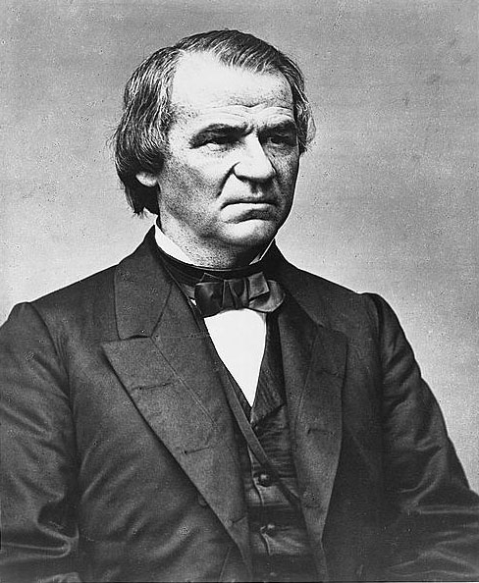
President Andrew Johnson
Chosen as running mate in 1864 to encourage pro-Union democrats to vote for the Union (Republican) party
Was the only senator from a Confederate state who stayed loyal to the Union
Anti-Aristocrat
White Supremacist
Agreed with Lincoln that states had never legally left the Union

Slide 13
Presidential
Reconstruction

Slide 14
President Johnson’s Plan
Plan is similar to Lincoln’s 10% Plan
Provided for disfranchisement of certain groups
All former leaders and officeholders of the Confederacy
Confederates with more than $20,000 in taxable property
Retains power to pardon “disloyal” southerners
Frequently pardoned wealthy planters
Many former Confederates in power by Fall 1865

Slide 15
Southern Governments – 1865
8 months after Johnson takes office, all 11 of the ex-Confederate states qualified to rejoin the Union
They repudiated secession and ratified the 13th Amendment.
But they didn’t give blacks voting rights and ex-Confederates elected to congress
Alexander Stephens, VP of the CSA, elected senator from Georgia

Slide 16
Black Codes
Prohibited blacks from renting land or borrowing money to buy land
Placed freedmen into a form of servitude by forcing them as “vagrants” and “apprentices” to sign work contracts
Worked in cotton fields under white supervision for deferred wages
Prohibited blacks from testifying against whites in court

Slide 17
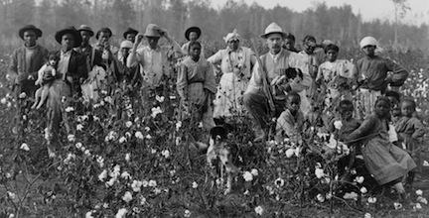
The Southern Response
Some plantations wanted to re-open but needed labor – two options:
Sharecropping – land owners would divide up land and give it to former slaves on credit (with tools and seed), half of the harvest was given to the owner, and the rest for the farmer to sell/eat.
In practice, a legal form of slavery – freed blacks are still tied to the land.
Tenant Farming – those slaves with money earned could lease the land and keep all their harvest (not a frequently seen).

Slide 18
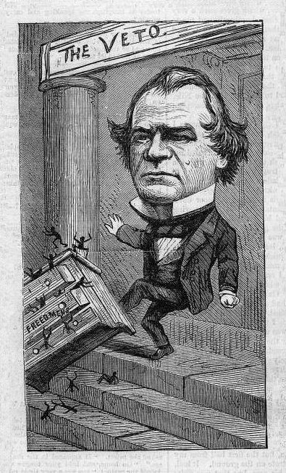
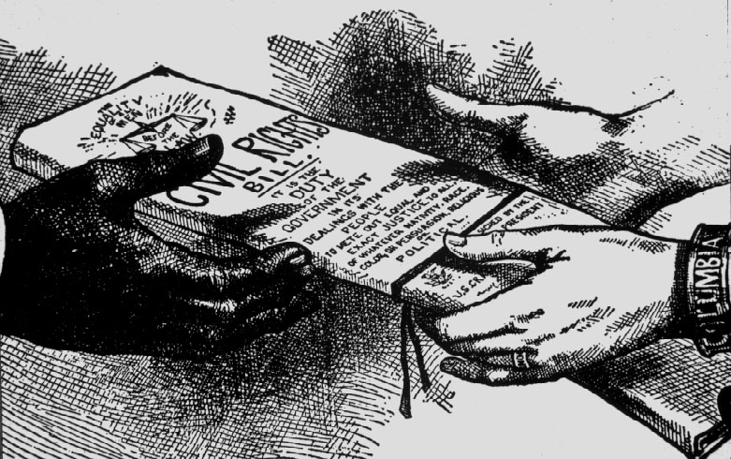
Clashes over Reconstruction
Congressional activity – Radical Republicans got a lot done without southern representative push back (remember all those acts in the Civil war…)
Radical Republicans stance - Johnson was being much too lenient towards the South.
Worried that Southern politicians would try to reinstate pre-civil war practices (aka slavery).
EX: Johnson vetoed extension of Freedman’s Bureau
Response…Passed Civil Rights Act of 1866 – gave citizenship to former slaves and prohibited black codes (restrictions on former slaves lives).
Johnson tried to veto it.
Congress overrode Johnson’s vetoes - drafted the 14th Amendment.
14th – Defines citizenship (“all persons born or naturalized”).

Slide 19
Presidential Reconstruction
Issues:
Pardons (Over 13,500)
Former Confederates elected to state positions and Congress
Black Codes
Race Riots (Memphis and New Orleans, others)
14th Amendment
Public Reaction in the North:
Election of 1866: Republicans 3-1 majorities in both houses and control over every northern state
Backlash against Johnson & new southern state gov’ts

Slide 20
Congress Breaks with the President
Congress bars Southern Congressional delegates.
Joint Committee on Reconstruction created.
February, 1866 → President vetoed the Freedmen’s Bureau bill.
March, 1866 → Johnson vetoed the 1866 Civil Rights Act.
Congress passed both bills over Johnson’s vetoes → 1st in U. S. history!!

Slide 21
Radical
(Congressional)
Reconstruction

Slide 22
14th Amendment
Ratified in July, 1868.
Provide a constitutional guarantee of the rights and security of freed people.
Insure against neo-Confederate political power.
Enshrine the national debt while repudiating that of the Confederacy.
Southern states would be punished for denying the right to vote to black citizens!

Slide 23
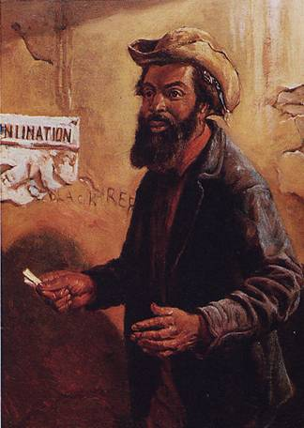
The Balance of Power in Congress
State | White Citizens | Freedmen
SC | 291,000 | 411,000
MS | 353,000 | 436,000
LA | 357,000 | 350,000
GA | 591,000 | 465,000
AL | 596,000 | 437,000
VA | 719,000 | 533,000
NC | 631,000 | 331,000

Slide 24
Radical Plan for Readmission
Civil authorities in the territories were subject to military supervision.
Required new state constitutions, including black suffrage and ratification of the 13th and 14th Amendments.
In March, 1867, Congress passed an act that authorized the military to enroll eligible black voters and begin the process of constitution making.

Slide 25
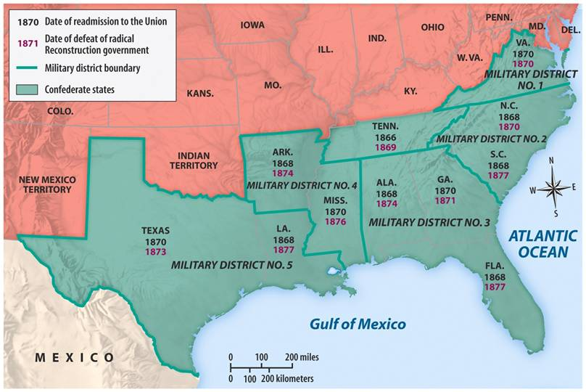
Reconstruction Acts of 1867
Military Reconstruction Act
Restart Reconstruction in the 10 Southern states that refused to ratify the 14th Amendment.
Divide the 10 “unreconstructed states” into 5 military districts.

Slide 26
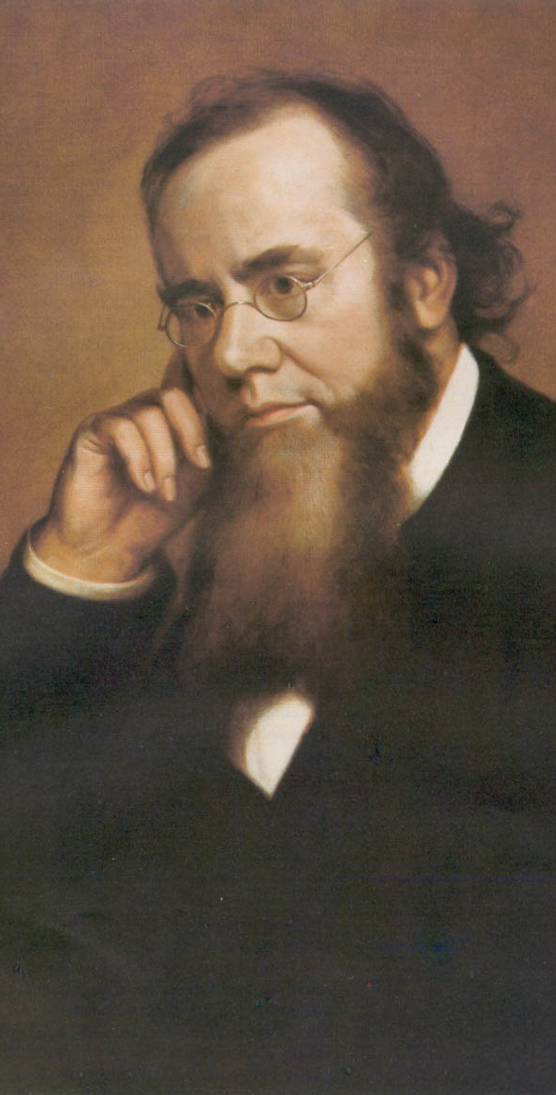
Reconstruction Acts of 1867
Command of the Army Act
The President must issue all Reconstruction orders through the commander of the military.
Tenure of Office Act
The President could not remove any officials [esp. Cabinet members] without the Senate’s consent, if the position originally required Senate approval.
Designed to protect radical members of Lincoln’s government.
A question of the constitutionality of this law.
Edwin Stanton

Slide 27
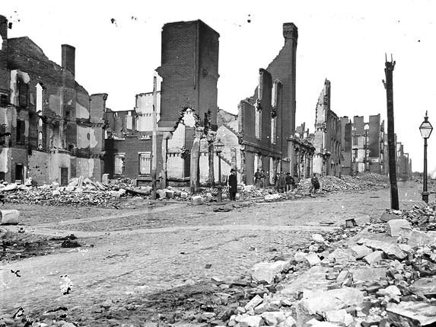
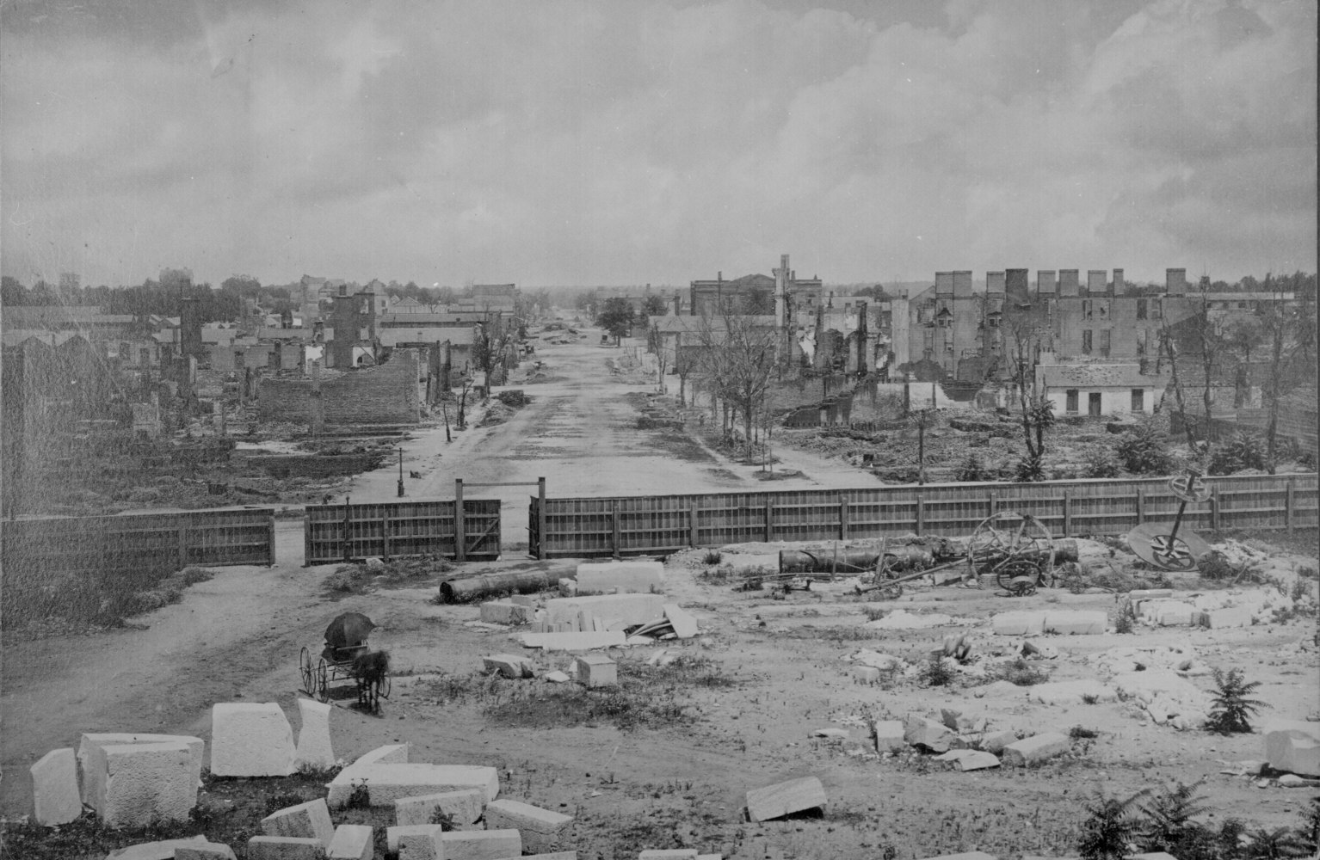
The South under Military Reconstruction
Southern states re-entered the Union - elected Republican dominated state governments.
A result of new African American voters (voted Repub.) and the disenfranchisement of former Confederates .
The Conditions of the South are BAD:
Farms destroyed/Slaves gone.
Factories/homes destroyed.
1/5th of white men dead/most others injured.
Confederate money and bonds were now worthless – no way to make money.
To create public work projects (for jobs), they had to raise taxes – this only makes things worse for the majority of southerners.

Slide 28
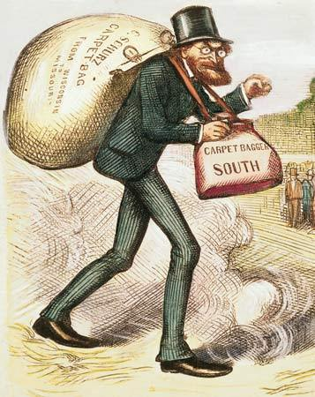
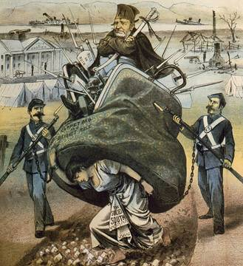
The South under Reconstruction
Southern perception - Republicans and northerners were attempting to take advantage of the South.
Scalawags - Southerners who joined with the Republican party (treated poorly and persecuted).
Carpetbaggers - Northerners who moved to the south to make money (some were dishonest).
Increased prices and took advantage of the southerners in need.

Slide 29
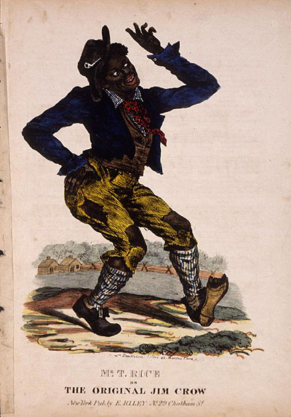
The Impact of Reconstruction
Southern opposition to changes made during Reconstruction – created backlash towards freed black populations.
Ku Klux Klan – wanted to restore white supremacy – tried to stop former slaves from exercising their rights, killed many, and burned schools and churches.
Congress passed Force Acts (use military force against KKK) in response to this activity.
Black codes will eventually turn into Jim Crow Laws (legalize unfair treatment of Southern Blacks).
Ex: Poll taxes and Grandfather clause (“if your Grandfather could vote then you can” to restrict voting.

Slide 30
President Johnson’s Impeachment
Johnson removed Stanton in February, 1868.
Johnson replaced generals in the field who were more sympathetic to Radical Reconstruction.
The House impeached him on February 24 before even drawing up the charges by a vote of 126 – 47!

Slide 31
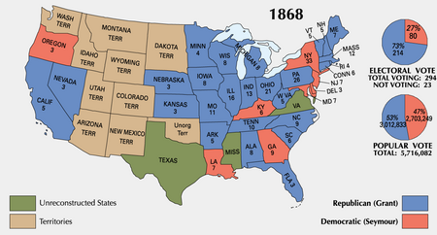
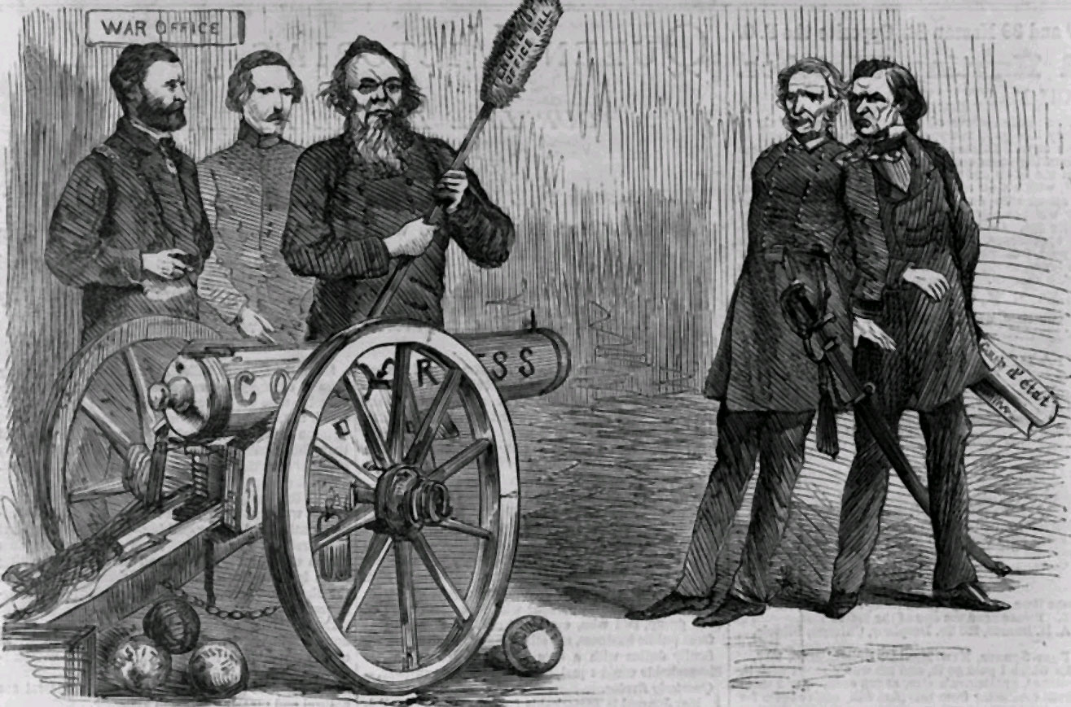
Johnson’ Impeachment
Radical Rep’s hate Johnson for his constant vetoing of bills – try to impeach him (charge him of breaking a law while in office).
Congress passed the Office of Tenure Act (you can’t fire a member of the cabinet without senate approval) – unconstitutional but Johnson fired his Sec. of War w/out approval and was charged.
Was one vote short of impeachment – first president to go through the impeachment process.
1868 – Republican and former war hero Ulysses S. Grant was elected – however would be a very ineffective president.

Slide 32
Johnson – 1st president to go through Impeachment Process!

Slide 33
Tenancy & the Crop Lien System
Furnishing Merchant | Tenant Farmer | Landowner
Loan tools and seed up to 60% interest to tenant farmer to plant spring crop. Farmer also secures food, clothing, and other necessities on credit from merchant until the harvest. Merchant holds “lien” {mortgage} on part of tenant’s future crops as repayment of debt. | Plants crop, harvests in autumn. Turns over up to ½ of crop to land owner as payment of rent. Tenant gives remainder of crop to merchant in payment of debt. | Rents land to tenant in exchange for ¼ to ½ of tenant farmer’s future crop.

Slide 34
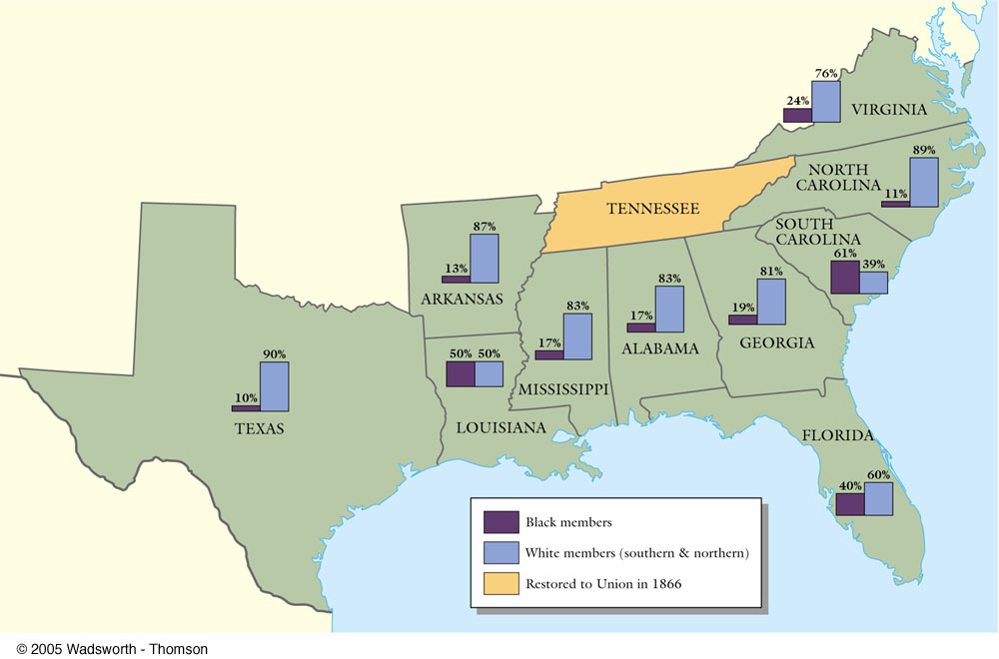
Black & White Political Participation

Slide 35
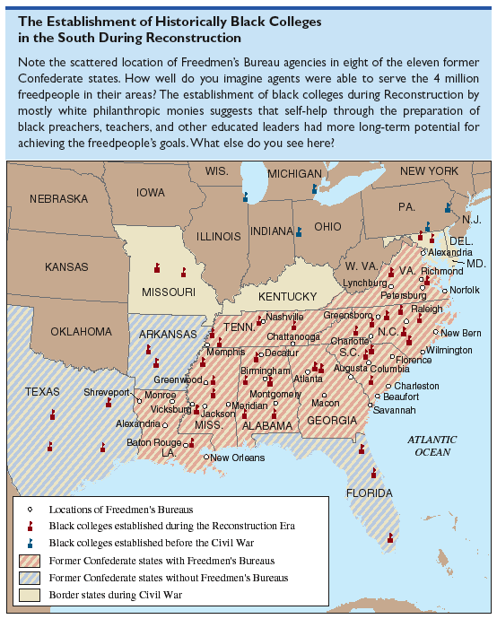
Establishment of Historically Black Colleges in the South

Slide 36
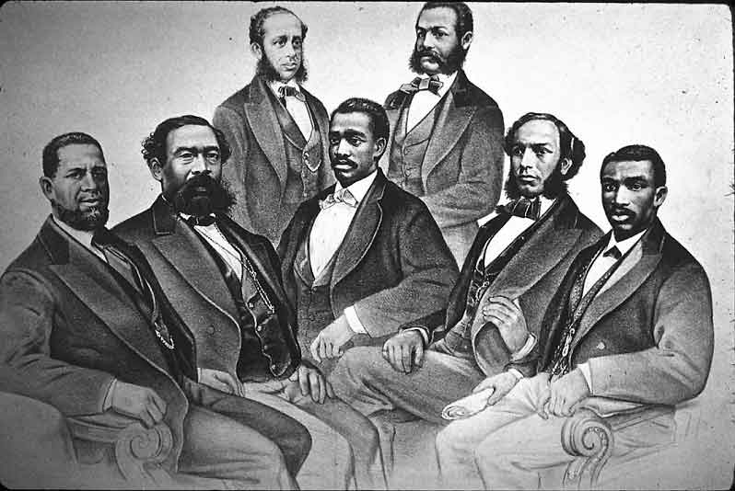
Black Senate & House Delegates

Slide 37
15th Amendment
Ratified in 1870.
The right of citizens of the United States to vote shall not be denied or abridged by the United States or by any state on account of race, color, or previous condition of servitude.
The Congress shall have power to enforce this article by appropriate legislation.
Women’s rights groups were furious that they were not granted the vote!

Slide 38
https://drive.google.com/file/d/0BzSBd4UNzvM-M0FKVlZsQTBkalU/view

