Slide 1
Reconstruction Falls Apart-Redemption and the Compromise of 1877
Mr. Winchell
APUSH Period 5

Slide 2
Four Reasons For End of Reconstruction
Legal challenges to Reconstruction
Grant’s Presidency (he sucks)
Panic of 1873
Recall of troops in 1877/Compromise of 1877

Slide 3
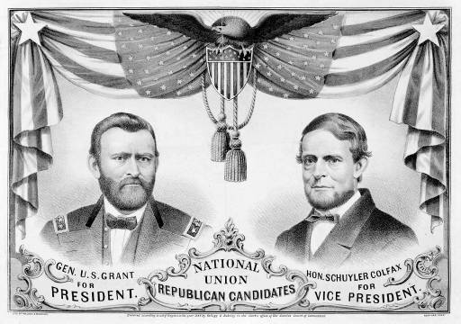
The 1868 Republican Ticket

Slide 4
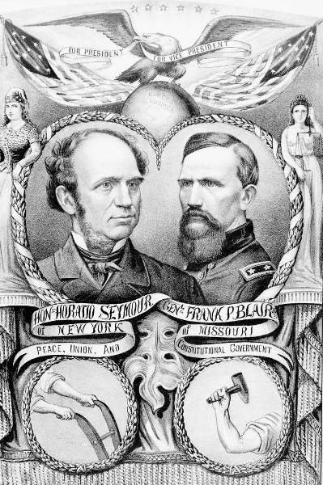
The 1868 Democratic Ticket

Slide 5
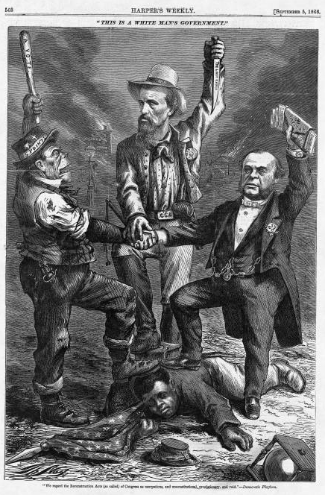
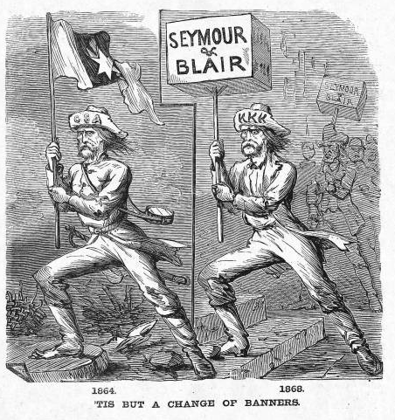
Waving the Bloody Shirt!
Republican “Southern Strategy”

Slide 6
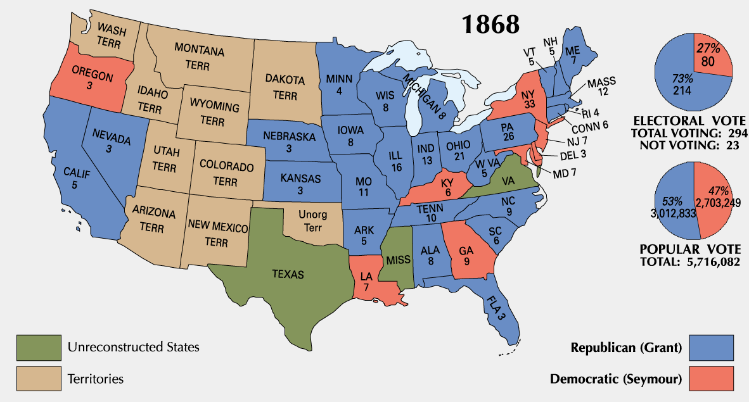
1868 Presidential Election

Slide 7
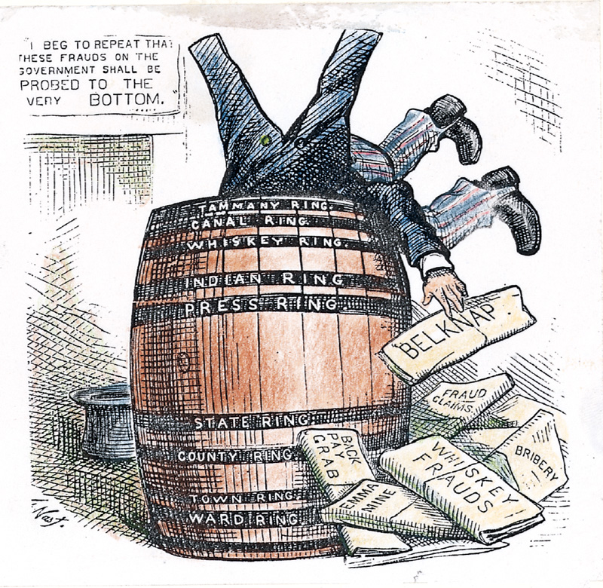
Grant Administration Scandals
Grant presided over an era of unprecedented growth and corruption.
Credit Mobilier Scandal.
Whiskey Ring.
The “Indian Ring.”

Slide 8
Ulysses S. Grant’s Presidency
President Grant’s (a Republican) cabinet is corrupt and scandals break out
People move away from Republican party as a result
Grant thought of as one of worst Presidents

Slide 9
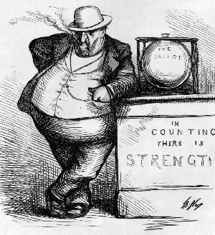
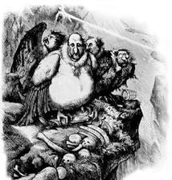
The Tweed Ring in NYC
William Marcy Tweed (notorious head of Tammany Hall’s political machine)
[Thomas Nast → crusading cartoonist/reporter]

Slide 10
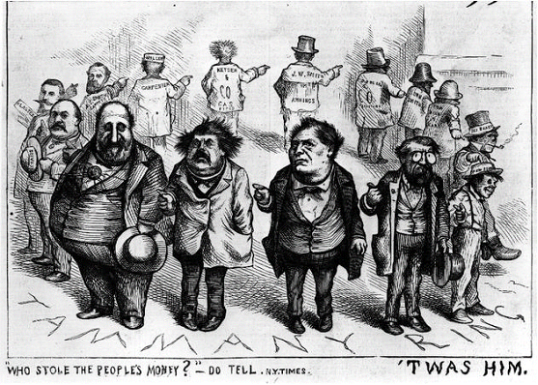
Who Stole the People’s Money?

Slide 11
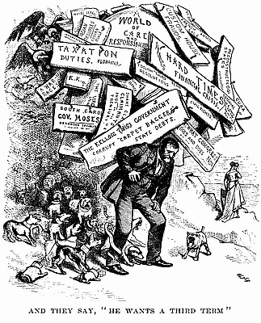
And They Say He Wants a Third Term

Slide 12
General Amnesty Act of 1872
South claims US isn’t a democracy because they cannot elect some Democrats - Valid Point
Congress allows former CSA officials to hold public office
Southern Democrats take hold of state positions

Slide 13
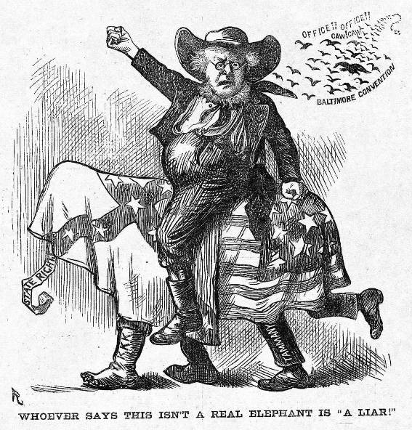
The Election of 1872
Rumors of corruption during Grant’s first term discredit Republicans.
Horace Greeley runs as a Democrat/Liberal Republican candidate.
Greeley attacked as a fool and a crank.
Greeley died on November 29, 1872!

Slide 14
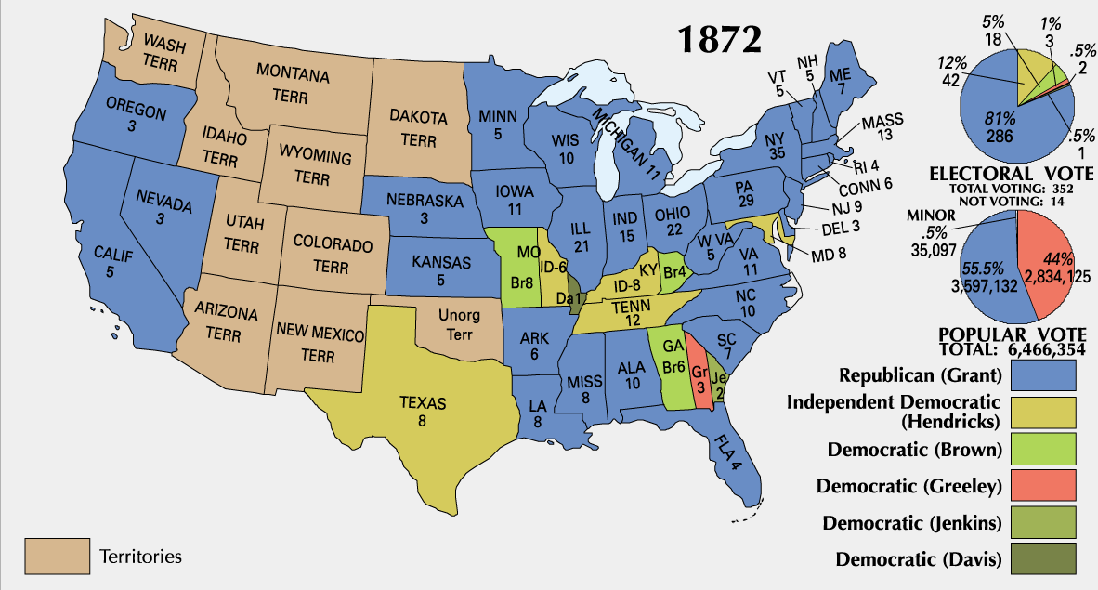
1872 Presidential Election

Slide 15
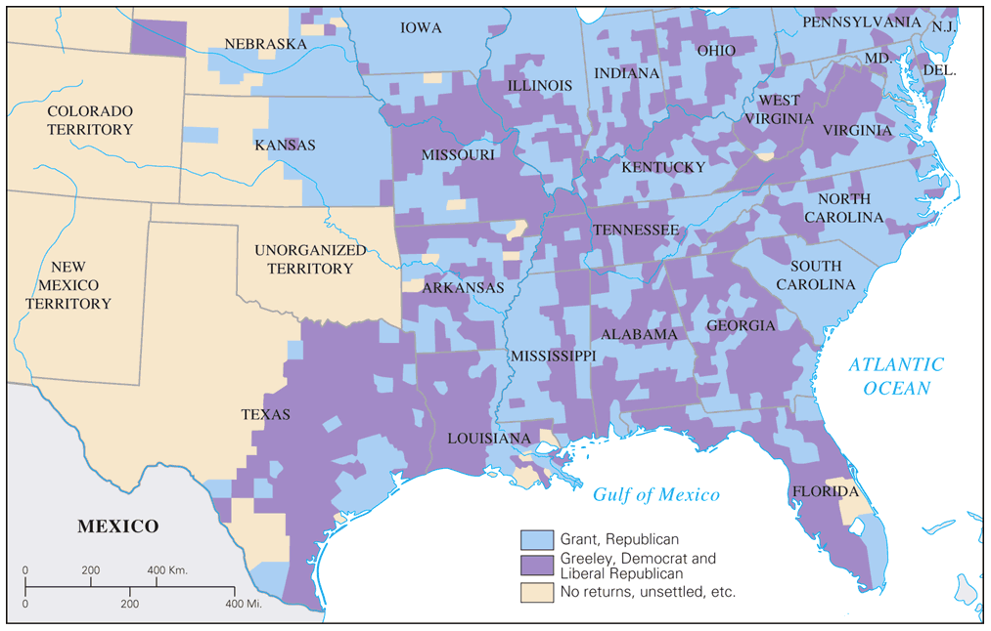
Popular Vote for President: 1872

Slide 16
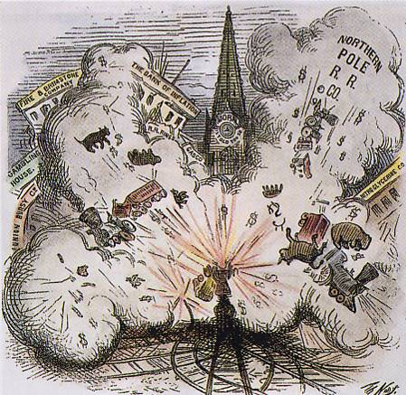
The Panic of 1873
It raises “the money question.”
debtors seek inflationary monetary policy by continuing circulation of greenbacks.
creditors, intellectuals support hard money.
1875 → Specie Redemption Act.
1876 → Greenback Party formed & makes gains in congressional races → The “Crime of ’73’!

Slide 17
Panic of 1873
US economy goes into a severe recession (2 million unemployed of 36 million)
People increasingly choose Democrats to try to fix the problems

Slide 18
The Civil Rights Act of 1875
Crime for any individual to deny full & equal use of public conveyances and public places.
Prohibited discrimination in jury selection.
Shortcoming → lacked a strong enforcement mechanism.
No new civil rights act was attempted for 90 years!

Slide 19
Legal Challenges to the 14th & 15th Amendments
The Slaughterhouse Cases (1873)
The court offered a narrow definition of the 14th Amendment.
It distinguished between national and state citizenship.
It gave the states primary authority over citizens’ rights.
Therefore, the courts weakened civil rights enforcement!

Slide 20
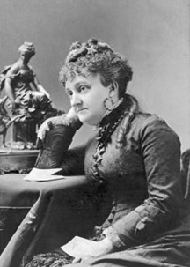
Legal Challenges to the 14th & 15th Amendments
Bradwell vs. Illinois (1873)
Myra Bradwell, a female attorney, had been denied the right to practice law in Illinois.
She argued that in the 14th Amendment, it said that the state had unconstitutionally abridged her “privileges and immunities” as a citizen.
The Supreme Court rejected her claim, alluding to women’s traditional role in the home.
Therefore, she should NOT be practicing law!

Slide 21
Legal Challenges to the 14th & 15th Amendments
U. S. vs. Cruickshank (1876)
LA white supremacists accused of attacking a meeting of Blacks & were convicted under the 1870 Enforcement Acts.
The Court held that the 14th Amendment extended the federal power to protect civil rights ONLY in cases involving discrimination by STATES.
Therefore, discrimination by individuals or groups were NOT covered.

Slide 22
Legal Challenges to the 14th & 15th Amendments
Civil Rights Cases (1883)
The Court declared the 1875 Civil Rights Act unconstitutional.
The Court held that the 14th Amendment gave Congress the power to outlaw discriminations by the states, but NOT by private individuals.
Black people must no longer “be the special favorites of the laws.”
Therefore, this marked the end of federal attempts to protect African American rights until well into the 20^{c}!

Slide 23
Legal Challenges to the 14th & 15th Amendments
U. S. vs. Reese, et. al. (1876)
The Court restricted congressional power to enforce the KKK Act.
The court ruled that the STATE alone could confer voting rights on individuals.
The 15th Amendment did NOT guarantee a citizen’s right to vote, but just listed certain impermissible grounds to deny suffrage.
Therefore, a path lay open for Southern states to disenfranchise blacks for supposedly non-racial reasons [like lack of education, lack of property, etc.]

Slide 24
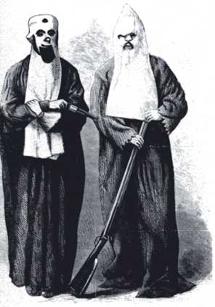
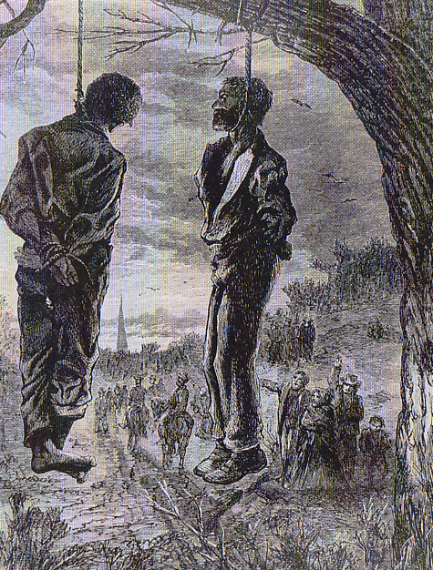
The “Invisible Empire of the South”

Slide 25
The
Abandonment
of Reconstruction

Slide 26
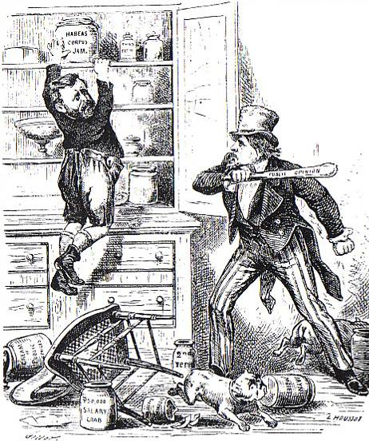
Northern Support Wanes
“Grantism” & corruption.
Panic of 1873 [6-year depression].
Concern over westward expansion and Indian wars.
Key monetary issues:
should the government retire $432m worth of “greenbacks” issued during the Civil War.
should war bonds be paid back in specie or greenbacks.

Slide 27
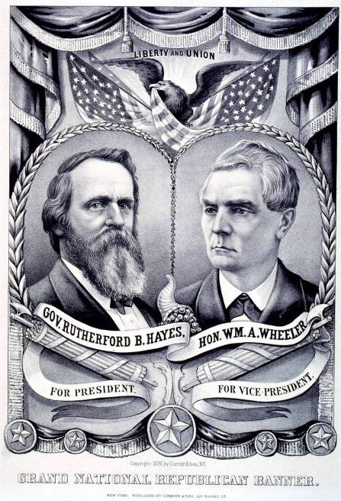
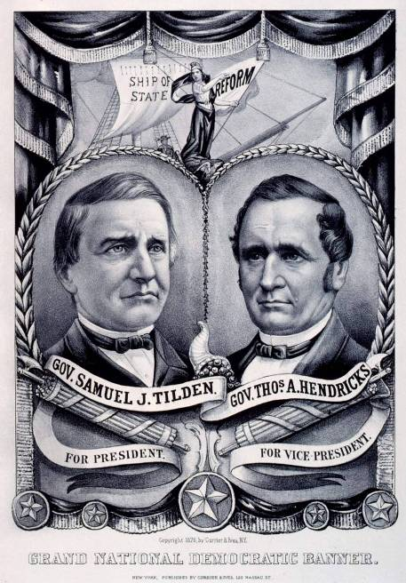
1876 Presidential Tickets

Slide 28
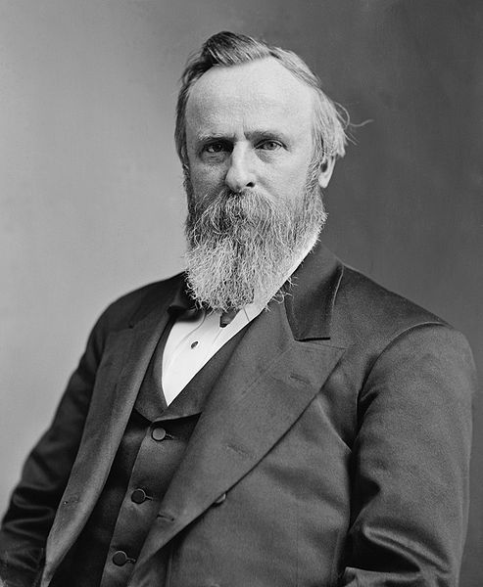
The Election of 1876
Republicans nominate Rutherford B. Hayes
Democrats nominate Samuel J. Tilden
Votes contested in LA, FL, SC
Special electoral commission created to decide who gets disputed votes
Votes 8-7 to give all electoral votes to Hayes
Democrats threaten to filibuster the results, send election to the House

Slide 29
U.S. Troops Recalled
Hayes wins support of the House in exchange for removing federal troops from South
Army that Congress sent to South to supervise Reconstruction were called back in 1877 by President Rutherford B. Hayes
Effectively ends supervision in the South
Southern Democrats (segregationists) are now in control

Slide 30
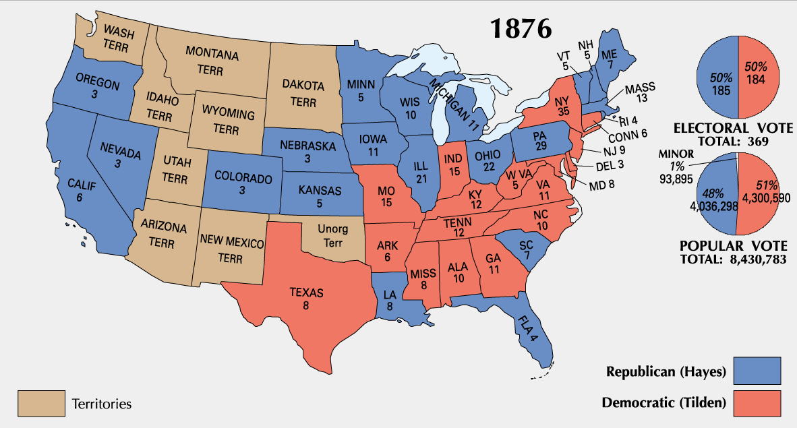
1876 Presidential Election

Slide 31
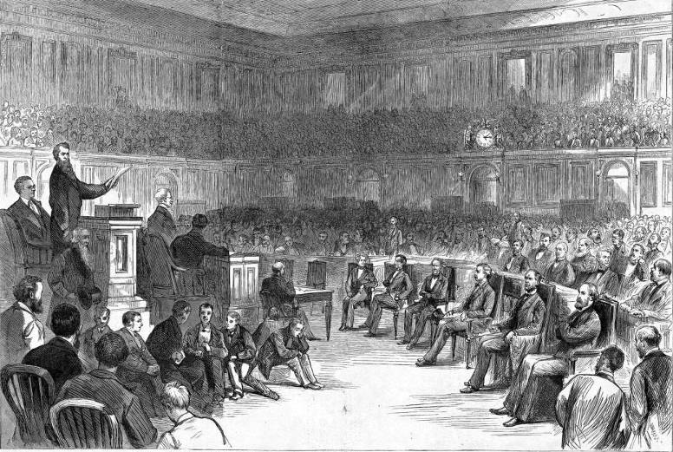
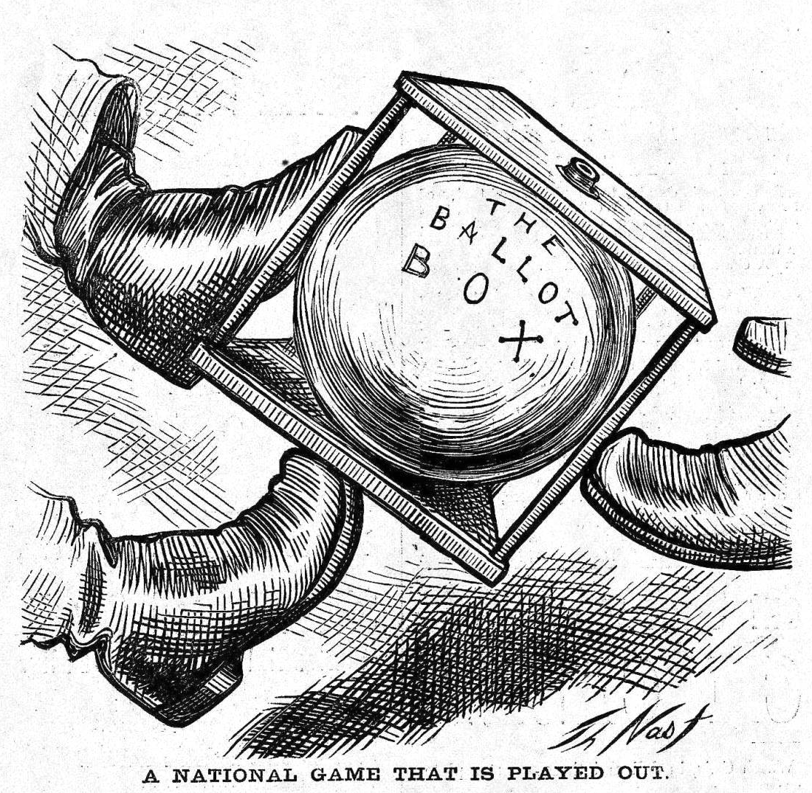
The Political Crisis of 1877
“Corrupt Bargain” Part II?

Slide 32
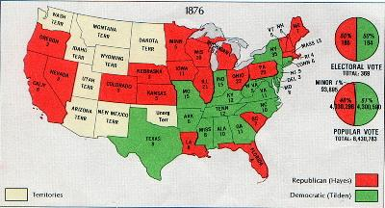
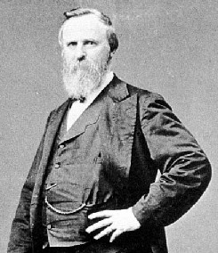
The End of Reconstruction
By the mid 1870’s:
Radicalism was dissolving.
Republicans - less interested in the South.
Democrats - gaining control of southern governments (they viewed this as “redemption”).
Election of 1876 – Rutherford B. Hayes (Rep) vs. Samuel Tilden (Dem) – really close race where Tilden on popular vote and 20 electoral votes were disputed.
Commission picked Hayes to win
To satisfy the southern Democrats, they came up with the Compromise of 1877:
Take federal troops out of the south.
Money for transportation improvements.
Southern Democrat in the cabinet.
* The Compromise of 1877 officially ended Reconstruction!

Slide 33
The Compromise of 1877 ends Reconstruction…but it is corrupt!

Slide 34
Problems with Reconstruction
Terrorist Groups
Reconstruction brought violent opposition throughout the South.
The KKK and similar organizations wanted to restore the old political order.
Their methods included threats, house burnings, and killings against not only blacks but whites as well.
State governments were unable to control violence.
Enforcement Acts
Three Enforcement Acts were passed, setting heavy penalties for anyone attempting to prevent a qualified person from voting.
They gave the army and federal courts power to capture and punish KKK members.
While the KKK was soon brought under control, other groups continued to operate.

Slide 35
Problems with Reconstruction
Support declines
White southerners felt the Acts threatened individual freedoms.
Northerners were dismayed that the army was still needed to keep the peace in the South.
State governments were seen as ineffective.
There was widespread poverty and lack of land reform for African Americans.
Lost faith
Costly building programs raised taxes and put state governments in debt.
Liberal Republicans helped the Democrats regain control of the House of Representatives.
Economic factors came into play, with the depression that began in 1873 taking more attention.

Slide 36
Success and Failures of Reconstruction
Successes
Union restored and South rebuilt
14th and 15th amendments guaranteed African Americans equal protection under the law
Freedman’s Bureau helped many black families get housing, jobs, and schooling
South adopted mandatory tax-supported education for blacks
Failures
Blacks remained in cycle of poverty
KKK kept blacks from voting
Racist attitudes remained
Long lasting bitterness in South towards Republicans and the North
South economy continued to emphasize agriculture
Did not address concerns of other groups such as women

Slide 37
The End of Reconstruction
Three Supreme Court decisions seriously weakened the goals and operations of Reconstruction. The Slaughterhouse Cases, United States v. Cruikshank, and United States v. Reese served to limit the impact of the 14th and 15th Amendments.
Supreme Court decisions
Violence increased, and southern Democrats grew stronger and bolder. Grant refused assistance since the northern public was “tired out” by South’s continuing problems. By 1876 Redeemers had won back almost all of the states.
Redeeming the South
The presidential election was disputed with charges of massive voting fraud. With the Compromise of 1877 Republicans agreed to withdraw federal troops in the South, and in return, Rutherford B. Hayes became president.
The election of 1876

