Slide 1
The Early Civil War-Politics of Warfare and Turning the Tide
Mr. Winchell
APUSH
Period 5

Slide 2
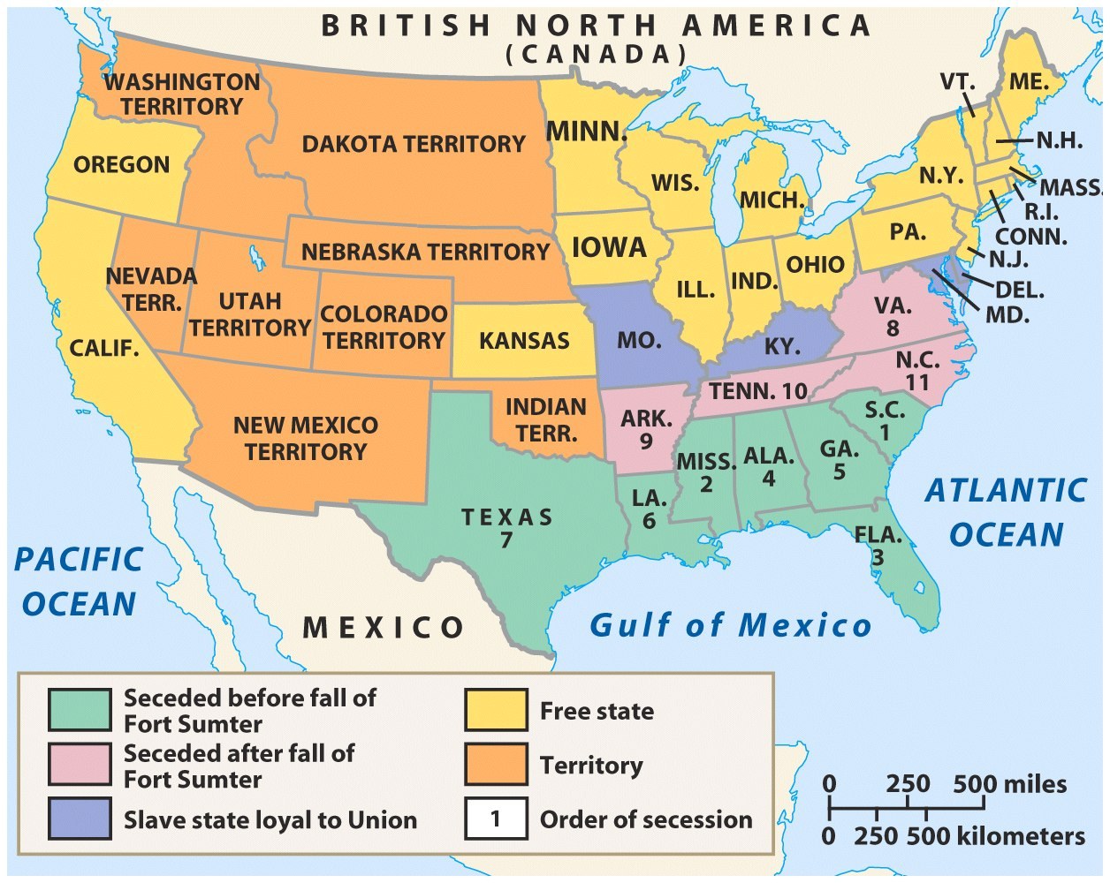
The Upper South did not view Lincoln’s election as a death sentence & did not secede immediately
Some Northerners thought the U.S. would be better off if the South was allowed to peacefully secede
SC seceded on Dec 20,1860
The entire Deep South seceded by Feb 1861
“Lame duck” Buchanan took no action to stop the South from seceding

Slide 3
Lincoln’s First Inaugural Address The Public Reacts
“Col. ORR calls Mr. K.'s attention to the results of the teachings of Black Repudblicanism, as developed in resistance to the Fugitive Slave Law, the inveigling of slaves, the raid of JOHN BROWN, and the recent insurrectionary movements in Texas, and asks -- can it be prudent, safe or manly, to submit to the domination of a party whose declared purpose is to destroy us and subvert our whole social and industrial policy?”
F.D.Richardson, Esq. of South Carolina

Slide 4
What is the “United States”?
The Southern decision to secede was based on old arguments:
The USA was a “compact between states,” not a national gov’t “above the states”
Therefore, states could leave the Union freely & peacefully
States’ rights must be protected as a guarantee of liberty
Individuals have the right to own property (slaves) & have the right to have their property returned (Fugitive Slave Law)
Southerners had threatened secession during a Congressional debate over slavery in 1790, the Missouri Crisis of 1820, the Nullification Crisis of 1832, & the crisis over California in 1850
Notes:
Threats of secession were nothing new. Some Southerners had threatened to leave the Union during a Congressional debate over slavery in 1790, the Missouri Crisis of 1819 and 1820, the Nullification Crisis of 1831 and 1832, and the crisis over California statehood in 1850. In each case, the crisis was resolved by compromise. Many expected the same pattern to prevail in 1861.
Drawing on arguments developed by John C. Calhoun, the convention held that the states were sovereign entities that could leave the Union as freely as they joined. Among the many indictments of the northern states and people, nothing seems more central than the issue of trust with respect to the capture and return of fugitive slaves

Slide 5
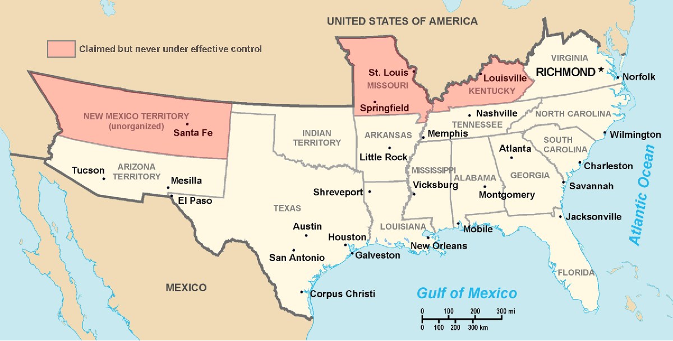
Secession & the Formation of the Confederate States of America
The CSA constitution resembled the U.S., but with 4 key changes: (1) it protected states’ rights, (2) guaranteed slavery, (3) referenced God, & (4) prohibited protective tariffs
On Feb 4, 1861, the Confederate States of America were formed
Mississippi Senator Jefferson Davis was elected CSA president
Notes:
Some wished to “let the South depart in peace”

Slide 6
The War Begins
Lincoln’s decision to resupply Ft. Sumter was stroke of genius
Fulfilled Inaugural Address pledge to hold federal property in rebel states
Forced rebels to make decision to start war
Davis decided to take fort before resupply ships arrived
Beauregard shelled fort April 12-13, 1861
Anderson surrendered April 13
Lincoln called for 75,000 volunteers to put down rebellion on April 15
Va., N.C., Tenn. & Ark. Seceded & joined CSA

Slide 7
Secession

Slide 8
“Our popular government has often been called an experiment. Two points in it our people have already settled – the successful establishing and the successful administering. One still remains: its successful maintenance against a formidable internal attempt to overthrow it.” Abraham Lincoln

Slide 9
Northern Advantages
At the outbreak of the Civil War, the North had lots of advantages:
Larger population for troops
Greater industrial capacity
Huge edge in RR transportation
Problem for the North:
Had to invade the South to win
Difficult to maintain enthusiasm & support for war over time

Slide 10
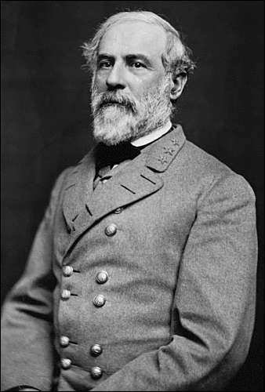
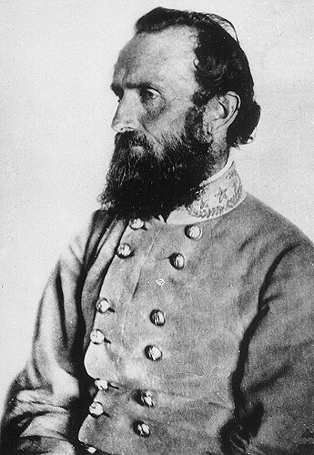
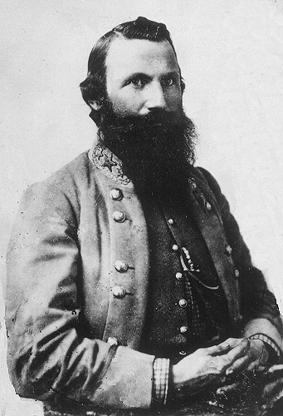
Southern Advantages
Although outnumbered & less industrial, South had advantages:
President Davis knew that they did not have to “win” the war; the South only had to drag out the fight & make the North quit
Had the best military leaders
England & France appeared more willing to support the South
“King Cotton” diplomacy
Robert E “Stonewall” J.E.B.
Lee Jackson Stuart

Slide 11
Advantages, Disadvantages, Strategy
 | Union | Confederacy
Advantages | - Lots of supplies and men - Transportation system (RR’s) - Factories and food production - Lincoln is a good Pres. | - Lots of money from cotton - Strong military schools and leaders - On the defense/know the territory - Strong desire to win - The south is BIG!
Disadvantages | - Bad generals/weak military in the beginning - On the offense | - Poor supply lines - Poor Transportation Less men for fighting Slavery
Strategies | - Anaconda Plan: 1. Take Richmond 2. Split south in ½ - take Miss R. 3. Blockade S. ports | - Survival as a nation - Defensive – sit and wait - If you can, attack the North
Generals | - George McClellan - George Meade - Joseph Hooker - Ambrose Burnside - Ulysses S. Grant - William Sherman | - Robert E. Lee - Stonewall Jackson - Joe Johnston - James Longstreet

Slide 12
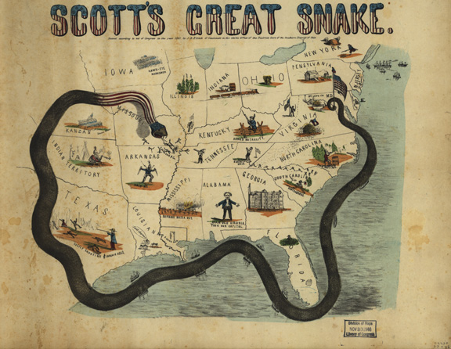
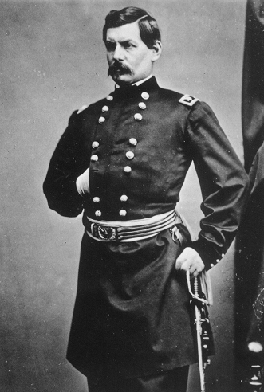
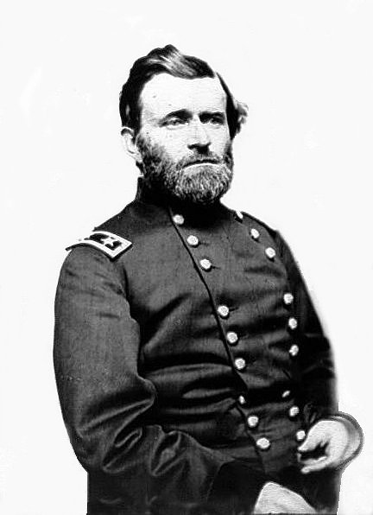
Winfield Scott’s Anaconda Plan
Southern strategy was an “offensive defense”: drag out the war & strategically attack the North to destroy Northern morale
Take the CSA capital at Richmond
Take control of the Mississippi River
George McClellan was in charge of Army of the Potomac
Ulysses Grant in the West
Divide the West from South
Blockade the Southern coast
Notes:
This plan maximized the North’s industrial advantages but required better leadership than North had

Slide 13
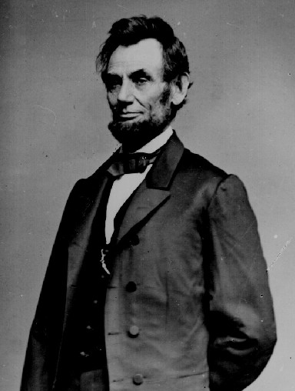
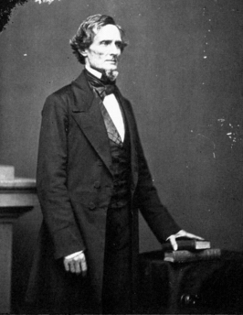
Political Leadership During the Civil War
Lincoln expanded his powers:
declared martial law
imprisoned “subversives”
briefly closed down a few newspapers
Davis was less effective:
concerned mainly with military duties
neglected the economy
obstructed by state governors who resisted conscription

Slide 14
LINCOLN'S "NECESSARY" ACTIONS
Suspended “civil liberties” or parts of the Constitution
writ of habeas corpus: Protects from unfair arrest and trial by jury.
Occupation of Baltimore: Controlled by military---- “martial law”
Arrested over 15,000 civilians: Without “probable cause”---suspicious “Rebel” sympathizers.
Closed “rebel” newspapers: Violated 1st amendment rights of “free speech and press”.
First Income Tax
Conscription
Greenbacks
1st paper money

Slide 15
The Diplomatic Struggle
From 1861 to 1862, the South used “cotton diplomacy” to get England & France to aid them:
Napoleon III favored the South but wanted England to do so 1st
England offered “belligerent” status to the CSA; but otherwise chose a hands-off policy
By 1863, “King Cotton” diplomacy failed because Egyptian & Indian cotton filled the European demand

Slide 16
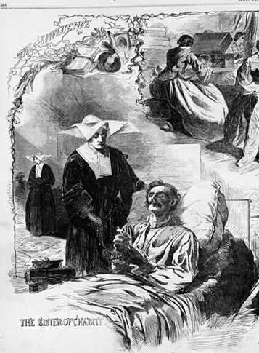
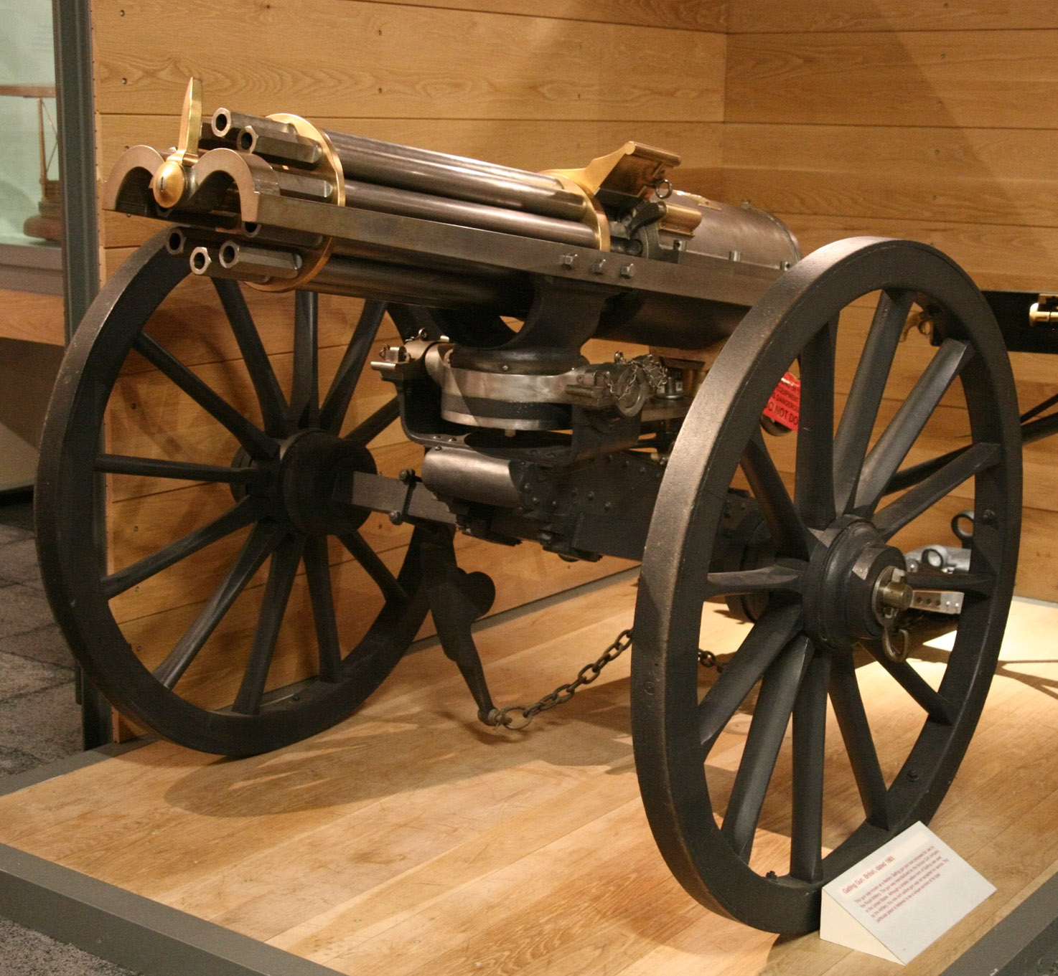
Fighting “Total War”
Women took gov’t jobs as bookkeepers, clerks & secretaries; A number of women also served as spies (Rose Greenhow, CSA)
Cone-shaped bullets & grooved barrel rifles
The Civil War was the world’s 1st “total war” in which the entire economy was devoted to winning:
North & South drafted soldiers
North & South employed female workers to meet supply demands
New weapons, old tactics, & sheer numbers of troops in battle led to massive casualties
Massive frontal assaults and massed formations with as many as 100,000 soldiers
Repeating rifles & the Gatling gun
Shrapnel, booby traps, & land mines
Women’s most prominent role were as nurses on the battlefield: distributing medical supplies, organizing hospitals, & offering comfort to wounded or dying soldiers
Notes:
One reason why the Civil War was so lethal was the introduction of improved weaponry. Cone-shaped bullets replaced musket balls, and beginning in 1862, smooth-bore muskets were replaced with rifles with grooved barrels, which imparted spin on a bullet and allowed a soldier to hit a target a quarter of a mile away. The new weapons had appeared so suddenly that commanders did not immediately realize that they needed to compensate for the increased range and accuracy of rifles. The Civil War was the first war in which soldiers used repeating rifles (which could fire several shots without reloading), breechloading arms (which were loaded from behind the barrel instead of through the muzzle), and automated weapons like the Gatling gun. The Civil War also marked the first use by Americans of shrapnel, booby traps, and land mines.
Outdated strategy also contributed to the high number of casualties. Massive frontal assaults and massed formations resulted in large numbers of deaths. In addition, far larger numbers of soldiers were involved in battles than in the past. In the Mexican War, no more than 15,000 soldiers opposed each other in a single battle, but some Civil War battles involved as many as 100,000 soldiers.
The Civil War separated families in unprecedented numbers and freed women to assume many new roles. With the departure of many men into the military, women entered many occupations previously reserved for men only: in factories, shops, and especially, the expanding civil service, where women took jobs as clerks, bookkeepers, and secretaries. A number of women also served as spies (like Rose O'Neal Greenhow (1814-1864), a Confederate spy in Washington) and even as soldiers (like Albert Cashier, whose real name was Jennie Hodgers).
But it was as nurses that women achieved particular prominence. Louisa May Alcott and Clara Barton were among thousands of women, North and South, who carried supplies to soldiers and nursed wounded men on the battlefield and in hospitals. Through organizations like the Christian Commission (formed by the North's YMCAs) and the U.S. Sanitary Commission (one of whose founders was Elizabeth Blackwell, the first American woman to earn a medical degree), women agents distributed medical supplies, organized hospitals, passed out Bibles and religious tracts, and offered comfort to wounded or dying soldiers.
Initially, Lincoln and his generals anticipated a conventional war in which Union soldiers would respect civilians' property. Convinced that there was residual unionist support in the South, they expected to preserve the South's economic base, including its factories and rail lines. But as the war dragged on, the Civil War became history's first total war, a war in which the Union sought the Confederacy's total defeat and unconditional surrender. To achieve success, Union officers such as Ulysses S. Grant and William Tecumseh Sherman believed that it was necessary to break the South's will to fight. Sherman summed up the idea of total war in blunt terms: "We are not only fighting hostile armies," he declared in 1864, "but a hostile people, and must make old and young, rich and poor, feel the hard hand of war.“ A year earlier, a general order was issued that declared that military necessity "allows of all destruction of property" and "appropriation of whatever an enemy's country affords necessary for the subsistence and safety of the Army." This order allowed soldiers to destroy anything that might be of use to the Confederacy.

Slide 17
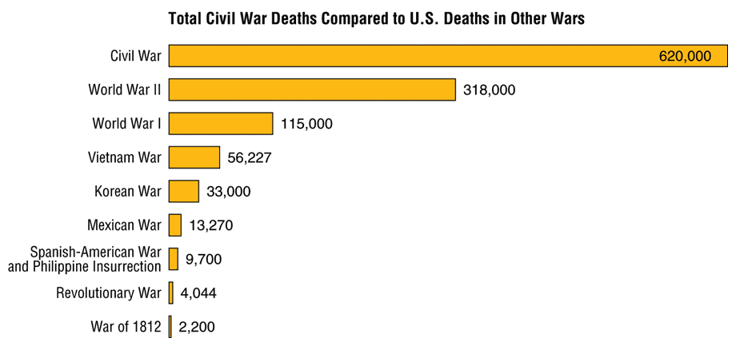
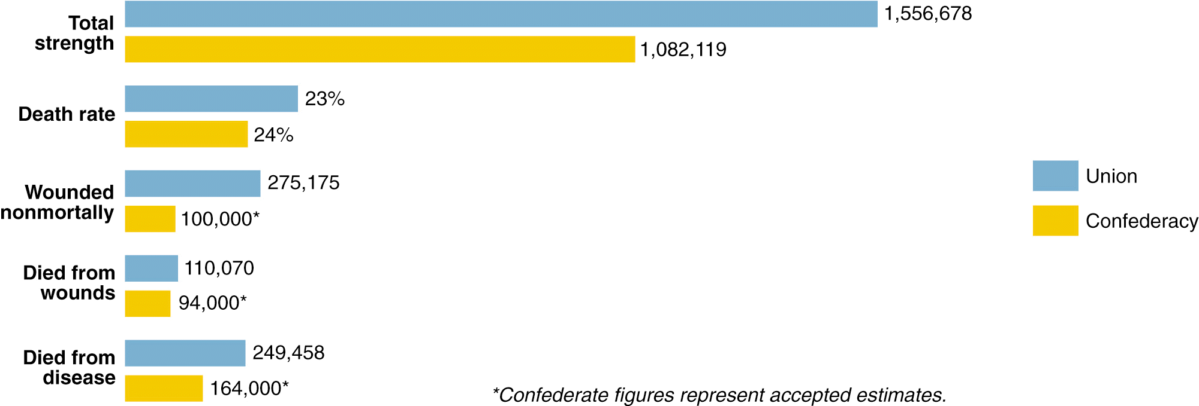
Casualties of the Civil War

Slide 18
The Civil War
From 1861-1863, the South consistently beat the North due to poor Union leadership & the Southern defensive strategy
1st battle was Bull Run (Manassas, VA) on July 21, 1861; “On to Richmond” campaign was repulsed by “Stonewall” Jackson
The U.S. & CSA forces fought to a draw at Antietam in Sept 1862—the single bloodiest day of the Civil War

Slide 19
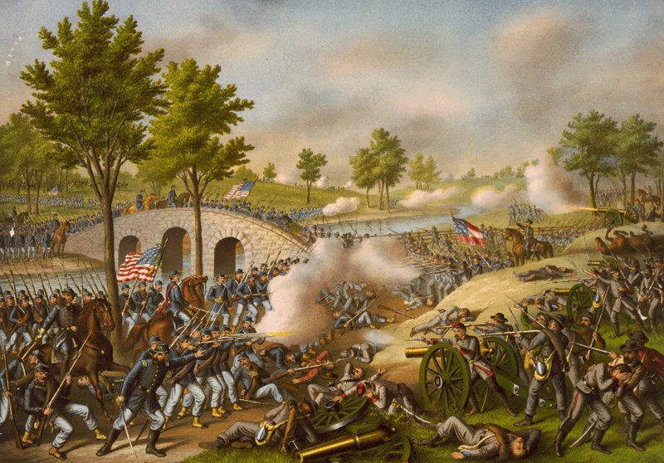
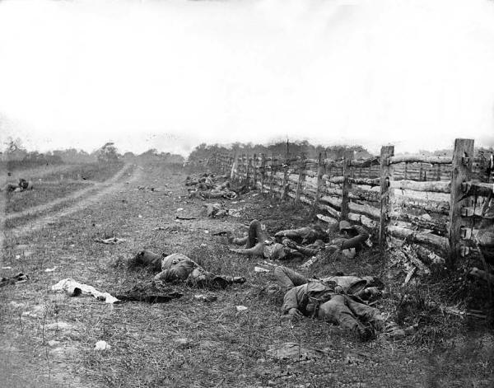
Early Activity (1861-2) – The South is Winning!
South is pushing North to DC and Maryland – Met at a series of battles in VA and MD.
Union commanders early in the war - overly cautious (esp. Union General McClellan).
Robert E. Lee (CSA General) - able to stay even against vastly larger Northern armies (until the last years).
McClellan – started Peninsula Campaign (attempted to take Richmond from the coast) – a failure!
Jackson and Lee separated and attacked at Antietam – fighting ensued!
A draw – the bloodiest day in US history (26k casualties).
Southern forces retreated…McClellan didn’t follow Lee – Lincoln fired him.

Slide 20
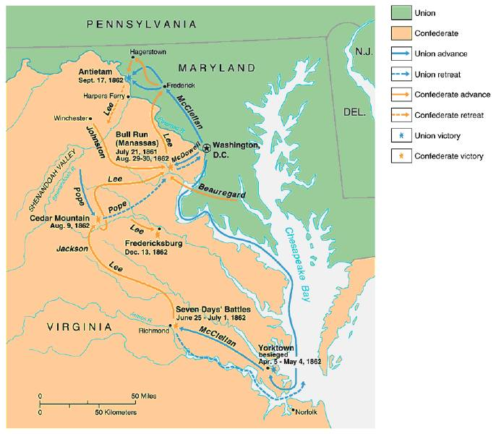

Slide 21
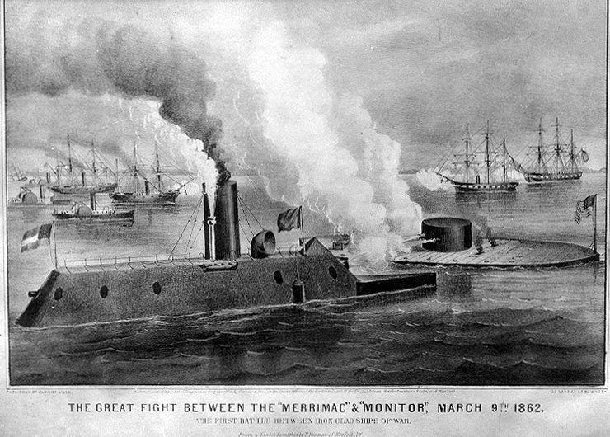
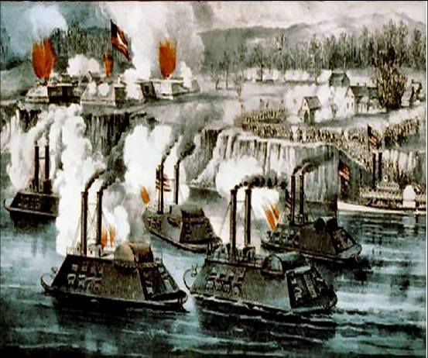
Early Activity (1861-2) – The South is Winning!
The war at Sea
North blockaded the southern ports (made it harder to get supplies internationally to support their war effort).
Southern response:
Illegal blockade running – hunted by Union ships.
Updated new ships wooden ships called “Ironclads” – took RR metal and covered ships to prepare for battle.
Two most famous in battle: Southern Merrimack vs. Northern Monitor.

Slide 22
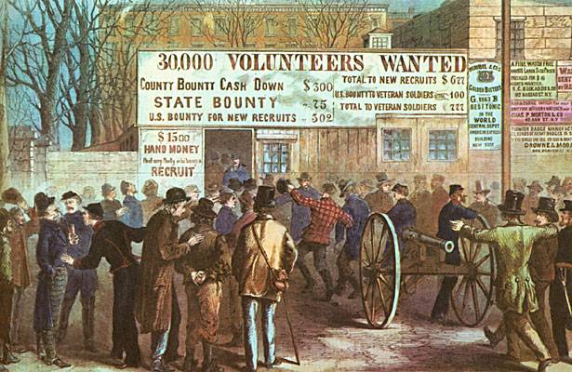
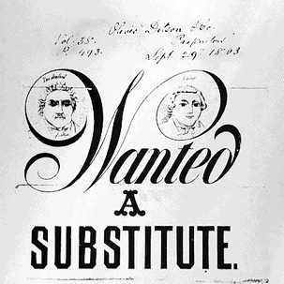
Early Mobilization - Conscription
At 1st – both sides called for volunteers only, but…
Eventually drafts (conscription) were installed:
North - you could pay someone else to take your spot or pay a fee to the government to not draft you, can be exempt due to medical reasons or a office holder.
South - those who owned large numbers of slaves were exempt.
A rich man’s war – A poor man’s fight!
Caused wide opposition (esp. in the North) - large-scale draft riots in northern cities (ex: Gangs of New York).
Most opposition came from laborers, immigrants, and Democrats.

Slide 23
Mobilizing the Home Fronts
The draft was unpopular among Southern governors & Northern, antiwar “Copperheads”
Both the North & South faced problems supporting the war:
Both sides began running out of troops; in 1862, the North & South began conscription (draft)
Funding the war was difficult; both sides printed paper money (greenbacks) to accommodate spending needs; led to runaway inflation (9,000% in the South)
Notes:
1 confederate dollar worth 8 cents in 1863

Slide 24
Riots Over the Draft

Slide 25
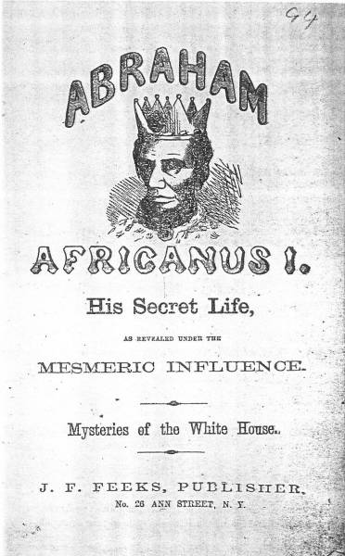
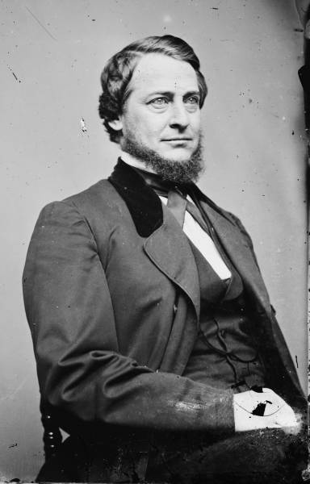
The Politics of the War
Divided loyalties in both North and South (mostly in North) – lots in the north did NOT support the war.
“Copperheads” - Northern Democrats who advocated peace/protested the war.
Lincoln suspended the writ of habeas corpus (have to tell someone why they are jailed and for how long) and seized telegraph offices.
Chief Justice Roger Taney said he had exceeded his constitutional powers - Lincoln ignored the ruling.
Dramatically expanded the powers of the presidency.
Border states - slave states that stayed in the Union (Ky, Mo, Md, De) and creation WV???
Copperhead Clement Vallandigham

Slide 26
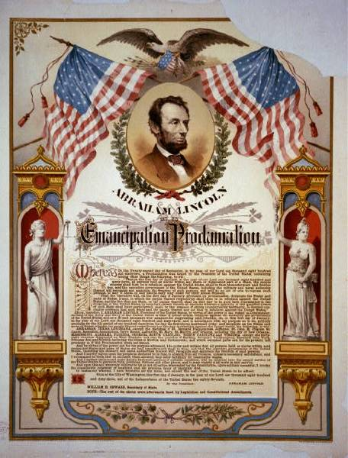
The Politics of the War Cont.
The South hoped for foreign intervention! - Possible, but it never happened.
Trent Affair - North seized a British ship and arrested two Confederate diplomats heading to Britain and France.
Britain backed down after Lincoln released the diplomats – stay neutral due to practice of slavery!
“King Cotton” - less important as new sources of cotton around the world emerged (Egypt).
Lincoln did not view the Civil War as a war to free the slaves until it became a political asset.
Lincoln writes the Emancipation Proclamation – gives the order for the Emancipation of slaves inside the Confederacy (could join the Union army)
Not a moral decision, but a military one – had no real power but was symbolic.
Didn’t free slaves in Border states.

Slide 27
The Politics of the War - Extensive Legislation Passed Without the South in Congress
1861 – Morrill Tariff Act – new tariff to create needed income to support the war effort
1862 – Homestead Act and Morrill Land Grant Act – provided free land to areas like Oklahoma and the great plains.
1862 – Emancipation Proclamation – freed slaves in the seceded states only!
1863 – Pacific Railway Act – promoted the building of the transcontinental RR – also helped the war effort (moved supplies to the western campaign).
1863 – National Bank Act – re-established a national banking system and supported the “greenback” and bonds creation for the war effort.

Slide 28
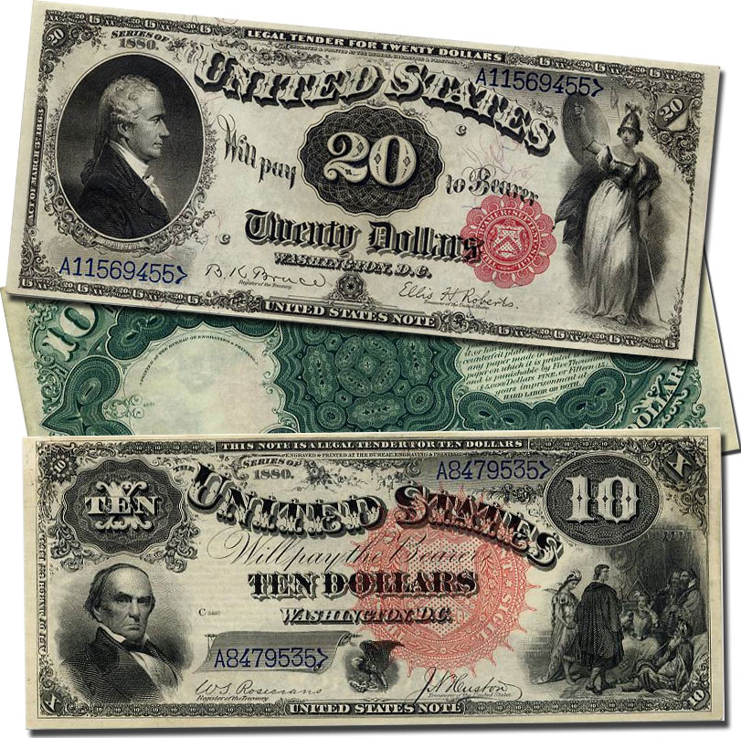
The Economics of the War
In the South: Severe food shortages, inflation, and economic collapse.
Blockade of Southern ports prevented most foreign trade.
Union occupation of food-producing areas led to food shortages.
In the North: The economy boomed!
Most industry grew - demand for military supplies kept industry going.
Wages declined/inflation high - much better in the North than the South.
Some Northern businesses made large profits - war profiteering (gaining extreme profit from war) by charging extreme prices.

Slide 29
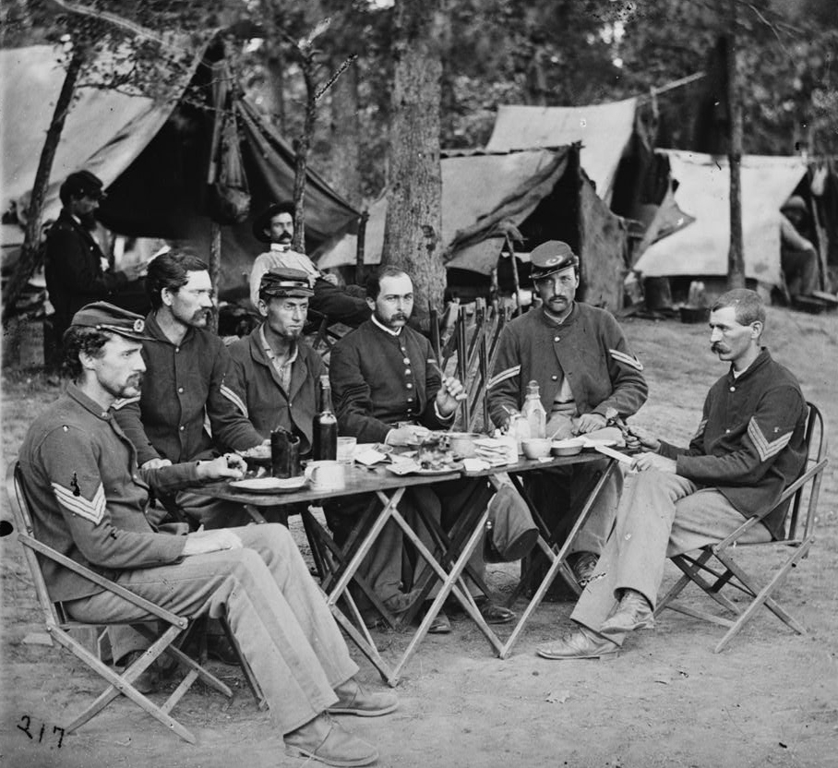
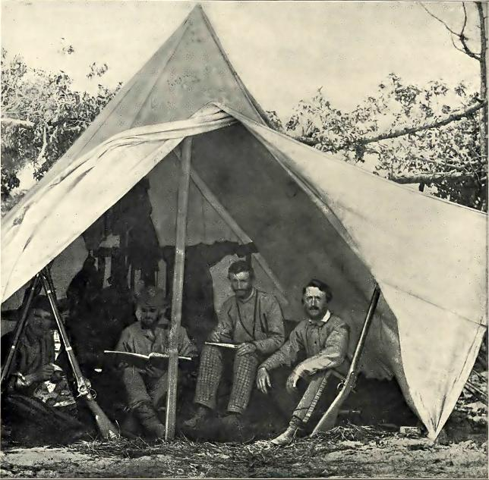
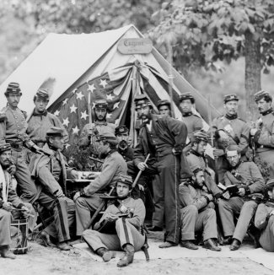
Life as a Soldier
Soldiers experienced poor living conditions, lack of food, and poor medical care.
Garbage and human waste typically were not well removed.
Bathing typically didn’t happen, and disease spread.
Southern soldiers’ experience - much MUCH worse!

Slide 30
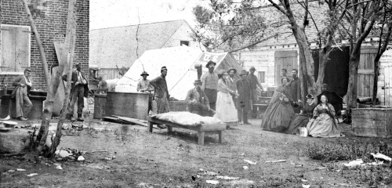
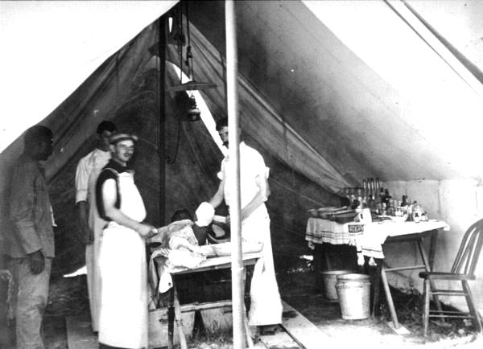
Life as a Soldier
S Supplies – food shortages and high prices, supplies created by women at home.
N Supplies – economy is booming – lots of immigrants to help make war goods and grow food (but was really poor quality – “shoddy”).
N Medicine – US Sanitary Commission (educate to sanitation), Woman Nurses (headed by Dorthea Dix), Clara Barton (Angel of the Battlefield), still lots of disease and death.
S Medicine – all done by volunteer women, lots of death from injuries and disease.

Slide 31
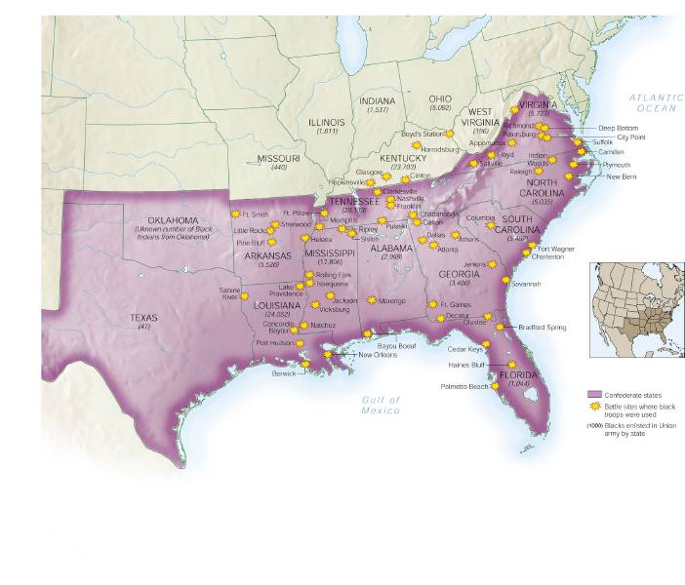
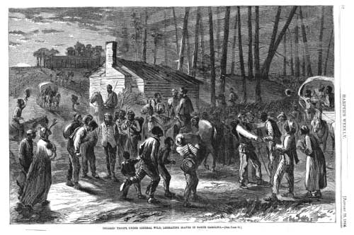
Life as a Soldier – African Americans
S Slaves - sabotage from slaves due to smaller numbers of whites on plantations.
N Blacks - could fight for the north – paid less, mostly given labor and holding assignments instead of fighting.
Liberated or runaway slaves were considered “contraband” by the North, and often served in various capacities in the army.
Ex: 54th Massachusetts!
Prison camps (both sides) – terrible! - Disease and death were common.
Andersonville GA camp – one of the worst!

Slide 32
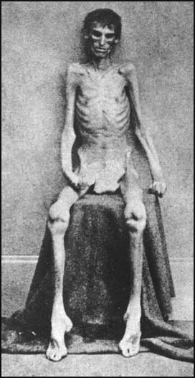
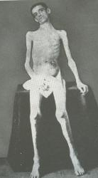
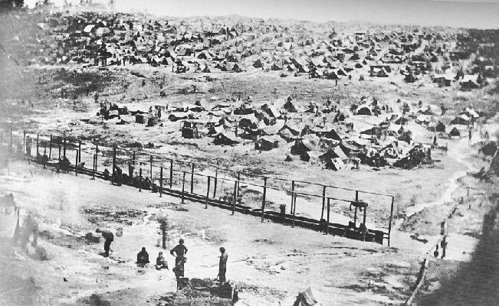
Confederate Prison Camp in Andersonville, GA
Union Prison Camp at Andersonville, GA
Built to hold 10,000 prisoners;
but held more than 32,000 Union POWs

Slide 33
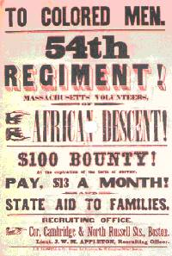
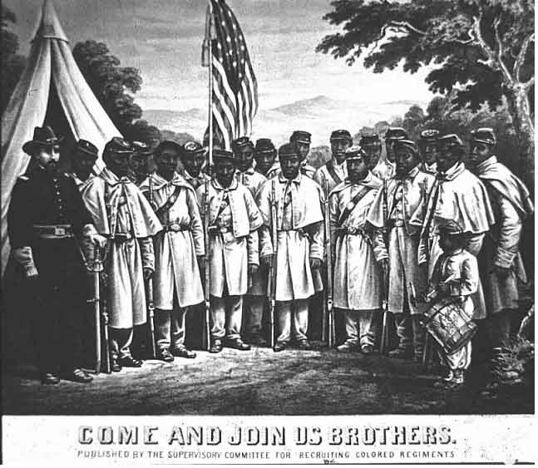
African-Americans in Civil War Battles

Slide 34
The Coming of Emancipation
At the beginning of the war, the North was fighting to preserve the Union, not to abolish slavery
By mid-1862, many Northerners called for immediate emancipation
Congress refused a gradual plan
Many thought immediate freedom for slaves would lure England & France into alliance
Southern victories pressured the North to “strike back”

Slide 35
"My paramount object in this struggle is to save the Union, and is not either to save or to destroy slavery. If I could save the Union without freeing any slave I would do it, and if I could save it by freeing all the slaves I would do it; and if I could save it by freeing some and leaving others alone I would also do that." —Abraham Lincoln, 1862

Slide 36
1862: Antietam and Emancipation

Slide 37
The War So Far
Notes:
The war had not been going well for the Union armies around Washington, D.C. The Union had lost every major battle in which it had fought in 1861 and 1862.

Slide 38
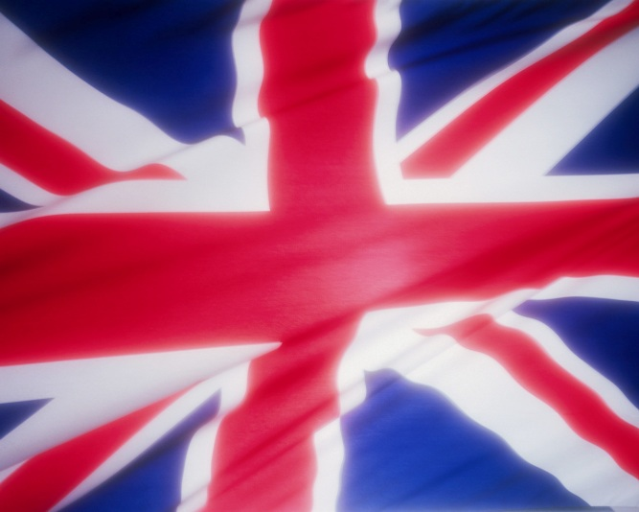
The War So Far
The Confederacy was hoping that Great Britain and France might help them in the war, giving the Confederacy an advantage.

Slide 39
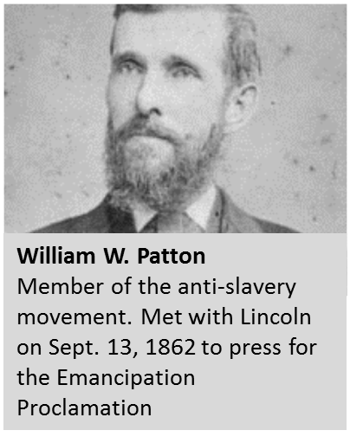
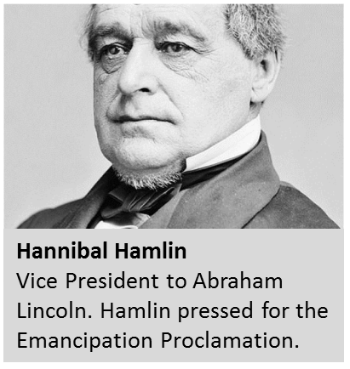
The War So Far
What is the war about?
Preserving the Union or Freeing the Slaves?
Notes:
The stated purpose of the war by the United States was to save the Union. However, abolitionists and Republicans were pressuring Lincoln to making freeing the slaves a goal of the war.

Slide 40
The War So Far
Reasons a Victory was Needed:
Lincoln wanted to show that his government was strong and could support or “back up” the proclamation.
Lincoln didn’t want it to appear that his government was weak, and that he was asking the slaves to rebel against their masters.
Notes:
Before freeing the slaves could be added to the war aims Lincoln felt strongly that the Union needed a victory.

Slide 41
Antietam September 17, 1862

Slide 42
The Emancipation Proclamation
Union “success” at Antietam led Lincoln to issue the Emancipation Proclamation on January 1, 1863:
Lincoln freed all slaves in Confederate territories
This did not free a single slave but it gave the North a new reason fight the Civil War
Inspired slaves to flee North
Pushed for the 13th Amendment
Passed after the Civil War ended on Jan 31, 1865

Slide 43
Emancipation Proclamation
“…all persons held as slaves within any State or designated part of a State, the people whereof shall then be in rebellion against the United States, shall be then, thenceforward, and forever free; and the Executive Government of the United States, including the military and naval authority thereof, will recognize and maintain the freedom of such persons, and will do no act or acts to repress such persons, or any of them, in any efforts they may make for their actual freedom.”
Who was actually freed?
And I hereby enjoin upon the people so declared to be free to abstain from all violence, unless in necessary self-defence; and I recommend to them that, in all cases when allowed, they labor faithfully for reasonable wages.
What was Lincoln’s advice?
And I further declare and make known, that such persons of suitable condition, will be received into the armed service of the United States to garrison forts, positions, stations, and other places, and to man vessels of all sorts in said service.
What roles were former slaves allowed to fill in the military?
And upon this act, sincerely believed to be an act of justice, warranted by the Constitution, upon military necessity, I invoke the considerate judgment of mankind, and the gracious favor of Almighty God.
Why does Lincoln have the right to issue this proclamation?

Slide 44
The Reality of the Emancipation Proclamation

Slide 45
Emancipation
Notes:
Abraham Lincoln now had a victory to issue the Emancipation Proclamation.

Slide 46
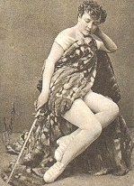
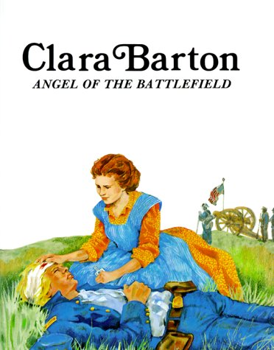
Women’s Role in the War
Nurses
Dorothea Dix – headed the US Sanitation Commission.
Clara Barton – Angel of the Battlefield).
“Camp Followers”
Mended clothes, cooked food, etc.
Spread of STDs.
Spies
“Hooker’s Girls”.
Home front
For the south: the backbone of the war effort – made everything in the home!
For the north: worked in the factories to support war material production.
Fought in combat!

Slide 47
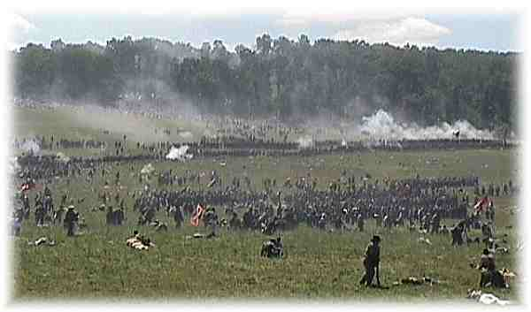
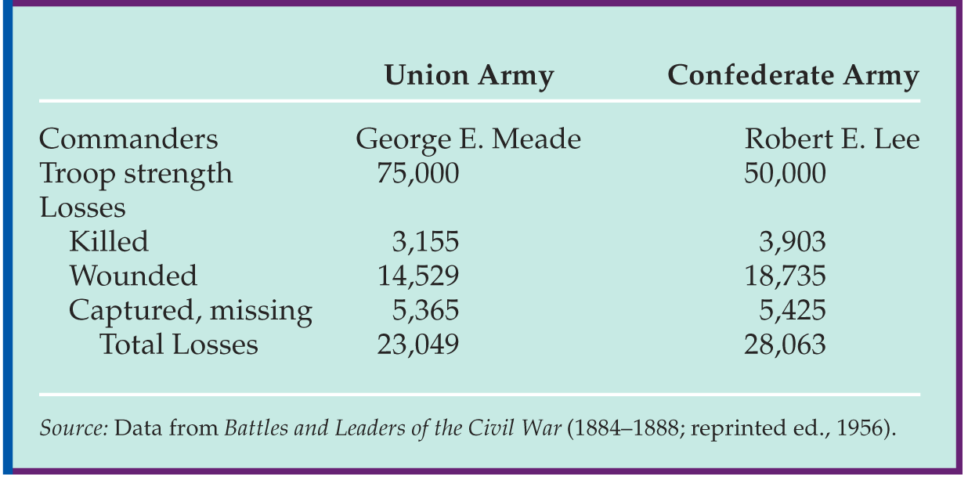
The War Progresses – 1863
Chancellorsville (May 1863) – Expensive Southern victory!
Confederates mistakenly fire upon Stonewall Jackson - He died 8 days later of pneumonia.
Turning point in the War – Gettysburg!
Lee (without Jackson) had pushed into Pennsylvania…
Not meant to be a fight – South was looking for supplies and North set up on Cemetery Ridge (high ground).
North held the South from taking the Ridge over three days - Huge casualties!
North never again gets attacked - South starts to lose battles!

Slide 48
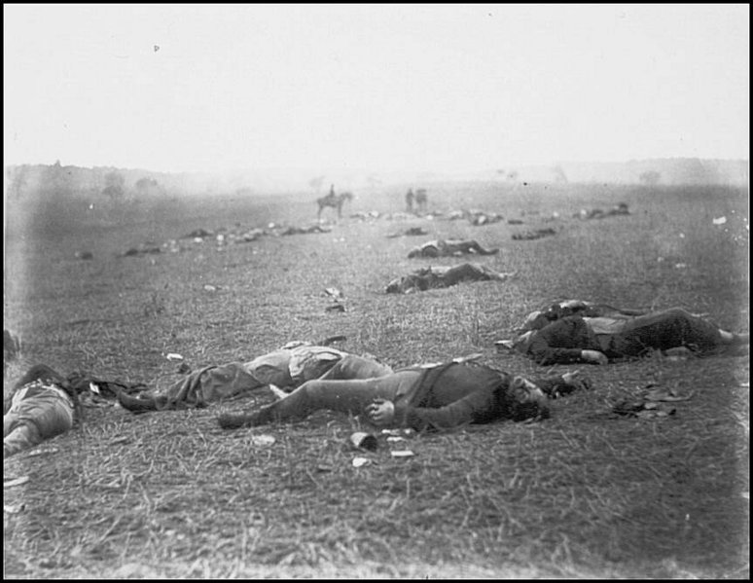

Slide 49
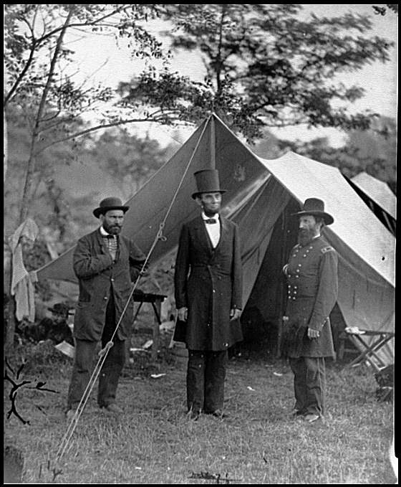
The War Progresses – 1863
Vicksburg (July 1863 - Same time as Gettysburg) - last major Southern city on the Mississippi River.
Sieged city – North eventually won (giving control of the river to the North and splitting the Confederacy in half).
Gettysburg Address – Lincoln speaks at the battle site – very inspiring and gives hope for Union repair and salvation.
Confederacy starts to wear down – few men, no supplies, moral is down (lots of desertion).
Grant takes General position and Sherman under him – believed they had to kill their spirit and supplies – both coming from home support (women).

